Slide 1
Secondary 3 Pure Geography
Chapter 3 – Variable Weather and Changing Climate
Gateway 3 – Is the weather becoming more extreme?

Slide 2
Gateway 3 – Is the weather becoming more extreme?
What are the characteristics of tropical cyclones?
Where are tropical cyclones found?
What are the hazards associated with tropical cyclones?
What are the impacts of tropical cyclones?
How do people respond to tropical cyclones?

Slide 3
What are the characteristics of tropical cyclones?
Tropical cyclones are weather systems that develop over the warm oceans in the tropics. Tropical cyclones range in diameter from 150km to more than 1500km.
Strong Winds
Low Central Pressure

Slide 4
Characteristics of Tropical Cyclones
Strong Winds
Tropical cyclones have sustained strong winds due to strong pressure gradient. The strong winds spiral inwards and upwards at high speed. The huge difference in pressures creates strong winds.

Slide 5
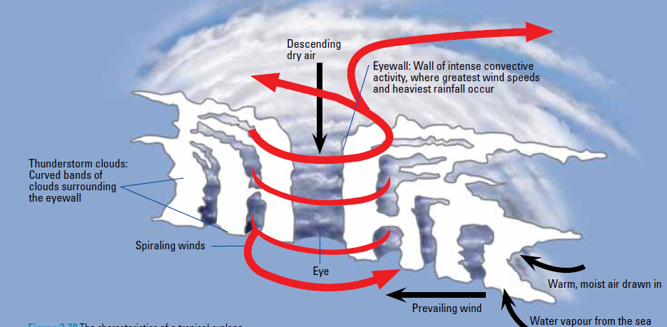
Characteristics of Tropical Cyclones
Low Central Pressure
An area of low central pressure is formed in the middle of the tropical cyclone, known as the eye. The eye is characterised by calm conditions and the absence of clouds.

Slide 6
Characteristics of Tropical Cyclones
Low Central Pressure
As warm moist air from the ocean rises, an area of low pressure is formed. Condensation occurs and releases latent heat when water vapour condenses to form water droplets.
Continuous large-scale latent heat released makes the air warmer and lowers the pressure so that more moist air from the ocean is drawn and spiral into this low pressure system to form dense cumulonimbus clouds which produce torrential rain.
As warm air rises, it cools and sinks. The calm dry descending air at the centre of the tropical cyclone creates the lowest pressure known as the eye. The tropical cyclone starts to fade away when it reaches land because the supply of warm moist air is cut off.

Slide 7
Gateway 3 – Is the weather becoming more extreme?
What are the characteristics of tropical cyclones?
Where are tropical cyclones found?
What are the hazards associated with tropical cyclones?
What are the impacts of tropical cyclones?
How do people respond to tropical cyclones?

Slide 8
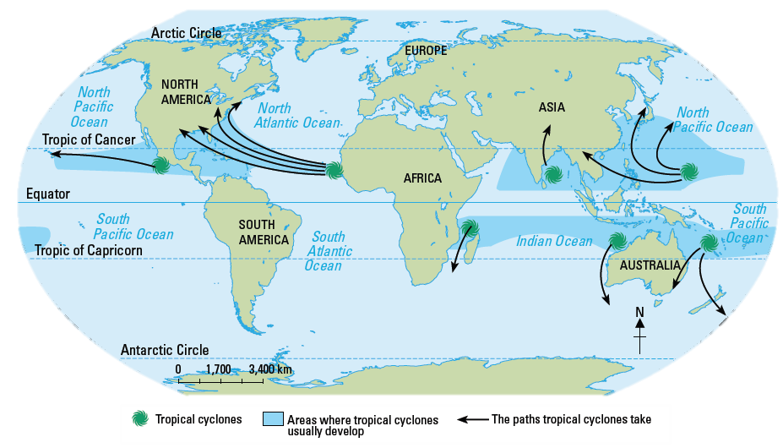
Where are tropical cyclones found?
Tropical cyclones are located at a latitude of 8° to 15° north and south of the Equator.
Tropical cyclones are also known as hurricanes and typhoons.
The conditions required for the formation of a tropical cyclone are:
High ocean surface temperatures of above 26.5°C.
Coriolis effect (deflection of winds, creating a spiraling motion)

Slide 9
Differences between Hurricane and Tornado
Hurricane | Tornado
Hurricanes form over the warm ocean. | Tornado forms over land and is a fierce spiral funnel-shaped storm.
Hurricane occurs from June to November in the Northern Hemisphere. | Tornado occurs from April to June in the Northern Hemisphere.
Hurricane gets its energy from the evaporated seawater. | Instability of air when the cold air tries to lift the warm air.
Hurricane lasts for 2 to 4 weeks. | Tornado lasts for a few minutes.

Slide 10
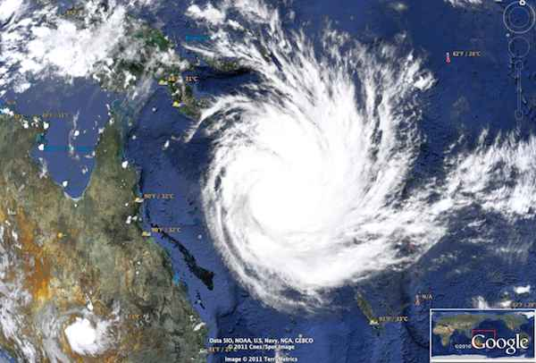
Tropical Cyclones
Places which do not experience them
Cyclones are not found between 0° to 7° and above 15° North and South of the Equator. This is due to the weak Coriolis effect found at these regions.
Tropical Cyclone Yasi, a powerful and destructive tropical cyclone which struck Northern Australia in 2011, causing major damage to the affected areas. Its highest wind speed was 250km/h.

Slide 11
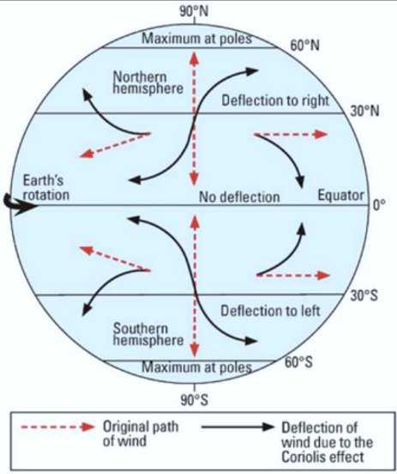
Distribution of Tropical Cyclones
The Coriolis Effect
The Coriolis effect is a force produced by the Earth’s rotation that causes the deflection of winds.
In the northern hemisphere, winds are deflected to the right and cause tropical cyclones to rotate in an anticlockwise direction.
In the southern hemisphere, winds are deflected to the left and cause tropical cyclones to rotate in a clockwise direction.

Slide 12
Gateway 3 – Is the weather becoming more extreme?
What are the characteristics of tropical cyclones?
Where are tropical cyclones found?
What are the hazards associated with tropical cyclones?
What are the impacts of tropical cyclones?
How do people respond to tropical cyclones?

Slide 13
What are the hazards associated with tropical cyclones?
Hazards associated with tropical cyclones include storm surges, strong winds and heavy rainfall. These hazards are powerful and may destroy buildings and infrastructure, as well as cause high death tolls.

Slide 14
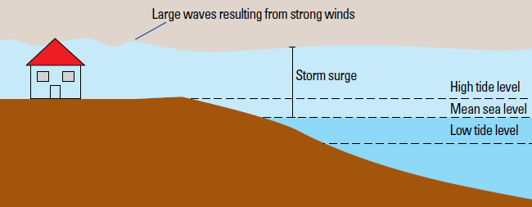
Hazards associated with Tropical Cyclones
Storm Surges
A storm surge is a sudden rise of sea level in which water is piled up against a coastline beyond normal conditions at high tides. Strong winds push water towards the coast and create huge waves.
Storm surges cause the greatest destruction to coastal areas where there is a loss in property and lives. Vessels are swept and stranded inland.
The levels of tides during a storm surge.

Slide 15
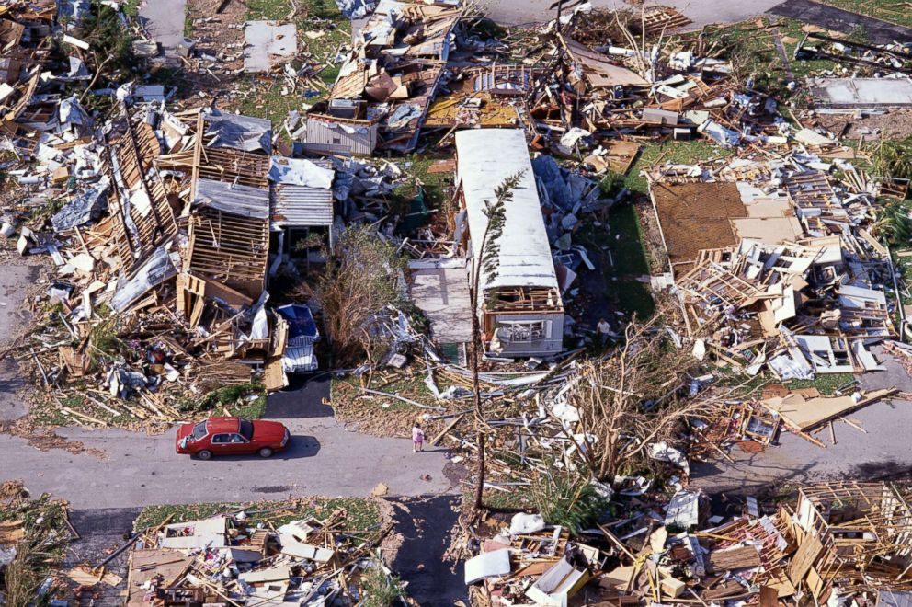
Hazards associated with Tropical Cyclones
Strong Winds
The strong force of winds destroys infrastructure and buildings. Loose debris fly and hit people and buildings.
Impact of Hurricane Andrew, which caused widespread damage to various parts of the United States of America. The hurricane attained strong wind speeds up to 180km/h.

Slide 16
Hazards associated with Tropical Cyclones
Torrential Rain
Large amount of rainfall causes inland flooding and rivers to overflow. Excess rainwater in soil will destabilise slopes and cause landslides. Landslides can remove or crush buildings.

Slide 17
Gateway 3 – Is the weather becoming more extreme?
What are the characteristics of tropical cyclones?
Where are tropical cyclones found?
What are the hazards associated with tropical cyclones?
What are the impacts of tropical cyclones?
How do people respond to tropical cyclones?

Slide 18
What are the impacts of tropical cyclones?
The hazards associated with tropical cyclones impact people and the environment in many different ways. Let us consider the physical, economic and social impacts of tropical cyclones.
Physical Impacts
Damage to houses and infrastructure (Typhoon Ketsuna)
Economic Impacts
Costs of repairs of damaged property and infrastructure (Hurricane Katrina) Loss of income due to damaged crops (Tropical Cyclone Yasi) Food Shortage (Cyclone Nargis)
Social Impacts
Disruption to water supply, sanitation and hygiene facilities (Cyclone Aila) People in affected areas are unable to get freshwater (Cyclone Aila) Spread of insect-borne diseases (Hurricane Mitch) Homelessness (Hurricane Katrina)

Slide 19
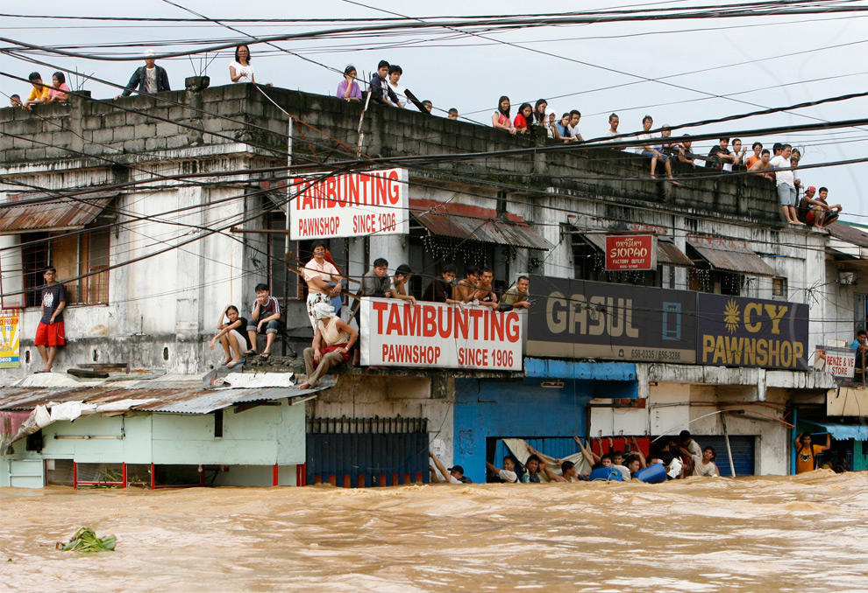
Physical Impacts
Damage to Houses and Infrastructure
Tropical cyclones cause damage to houses and infrastructure. Bridges and roads are destroyed, making it difficult to transport clean water, food and medicine to the affected areas.
Tropical cyclones are accompanied by torrential rain, leading to flooding. Thus, it will be difficult to distribute necessities such as food to the victims. Such an example was during the 2009 Typhoon Ketsuna in Manila.

Slide 20
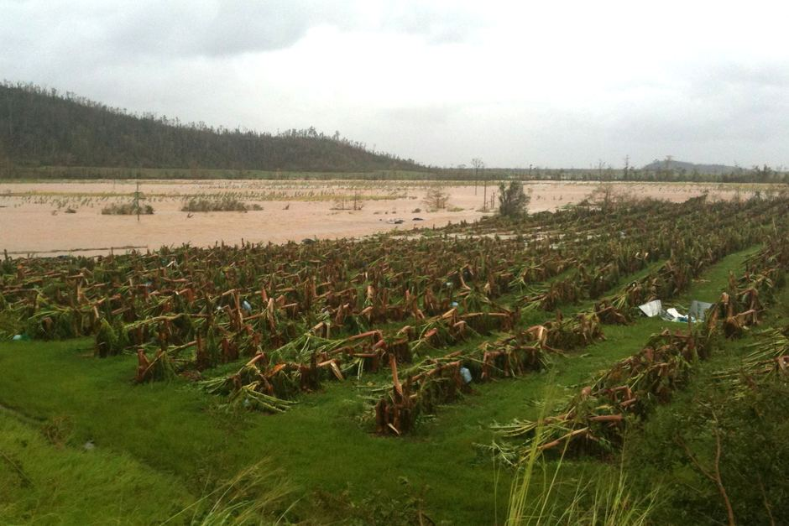
Economic Impacts
Loss of Income due to Damaged Crops
A huge amount of money is needed to repair the damaged houses and infrastructure. Income is also lost due to damaged crops.
For example, in 2011, Tropical Cyclone Yasi hit Queensland in Australia and about 75% of the total banana crops amounting to US$350 million was lost.
Tropical Cyclone Yasi devastated plantations in north Queensland, which produces 90% of Australia’s banana supply.

Slide 21
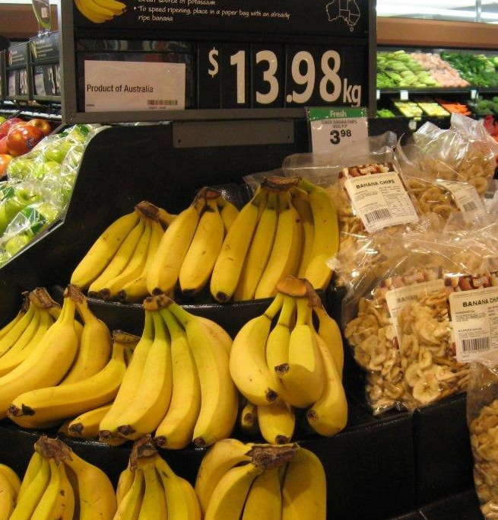
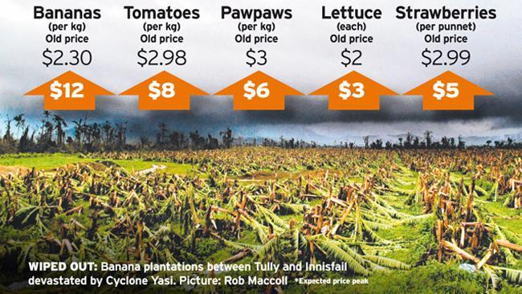
Economic Impacts
Loss of Income due to Damaged Crops
The following figures depict the economic impact of Tropical Cyclone Yasi when it struck Australia in 2011.
UP: Prices of crops soared, with the bananas being the most extreme at an increase of 420%.
LEFT: A supermarket in Melbourne showing the prices of bananas at $13.98/kg due to the huge loss in the number of crops when Tropical Cyclone Yasi struck Queensland.

Slide 22
Economic Impacts
Food Shortage
Food shortage can occur due to damaged farmlands. Flooded roads make it difficult for people living in the affected areas to have access to the food provided by the government.
For example, a total of US$4 billion was required to repair the damaged infrastructure and to provide humanitarian aid when Cyclone Nargis hit Myanmar in 2008.

Slide 23
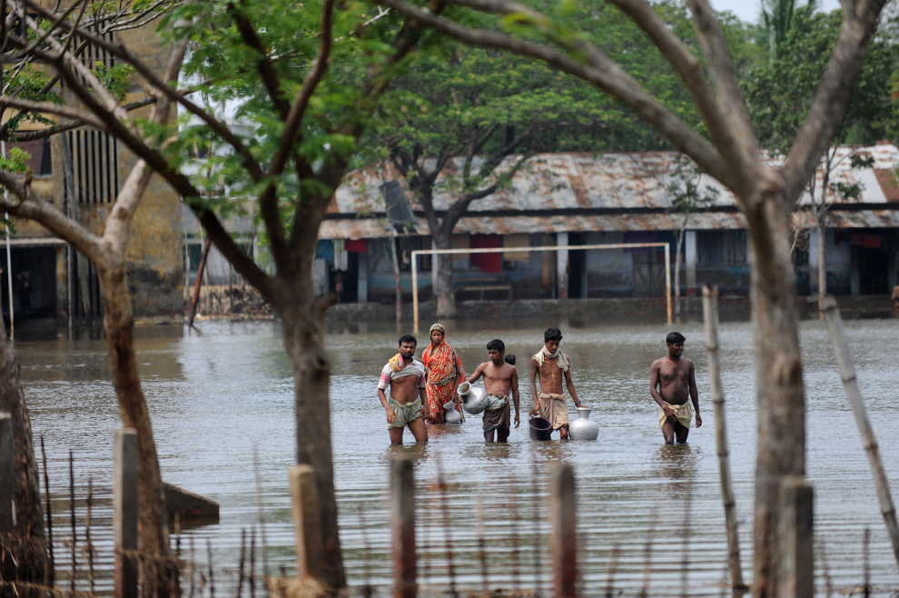
Social Impacts
Disruption to Water Supply, Sanitation and Hygiene Facilities
Flooding caused by a tropical cyclone may burst water and sewage pipes. Water may be contaminated and the spread of water-borne diseases may increase.
For example, in 2009, Cyclone Aila hit India and caused a cholera outbreak, affecting 1000 people. The cause of the outbreak was due to people drinking contaminated water.
Bangladeshi villagers wade through floodwater as they go to collect drinking water on the outskirts of Khulna on June 1, 2009

Slide 24
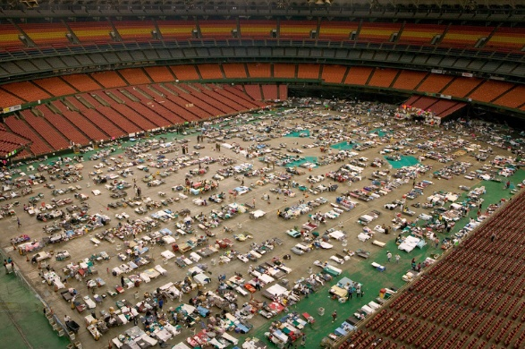
Social Impacts
Homelessness
People are forced to leave their damaged houses.
For example, in 2005, after Hurricane Katrina struck New Orleans in the United States of America, hundreds of thousands of people lost their homes and had to live in temporary shelters.
Aftermath of Hurricane Katrina. People camping for shelter in the Houston dome, Texas.

Slide 25
Gateway 3 – Is the weather becoming more extreme?
What are the characteristics of tropical cyclones?
Where are tropical cyclones found?
What are the hazards associated with tropical cyclones?
What are the impacts of tropical cyclones?
How do people respond to tropical cyclones?

Slide 26
How do people respond to tropical cyclones?
Tropical cyclones can cause great physical damage and lead to high economic costs and social losses. We can respond to these events in two ways.
Firstly, emergency action can be taken when tropical cyclones occur. Secondly, mitigation measures can be implemented to reduce or avoid the impact of tropical cyclones.
Emergency Action
Mitigation Measures
Prediction and Warning Land Use Control Coastal Plain Management Floodplain Management Reducing Vulnerability of Infrastructure

Slide 27
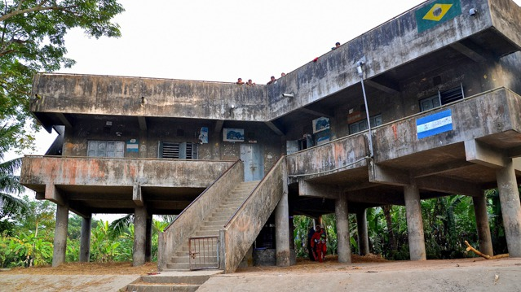
Emergency Action
Emergency action involves taking prompt action to respond to situations that put residents at risk to minimise injuries and deaths.
EFFECTIVENESS: The number of casualties can be greatly reduced. For example, cyclone-resistant raised concrete shelters built in high-risk areas of Bangladesh have acted as shields and saved many lives.
LIMITATIONS: However, cyclone shelters are very expensive to build and require regular maintenance. LDCs such as Bangladesh lack the finances to build and maintain them.
Flat roofs act as stability against strong winds
Pillars keep floodwaters away from people
A cyclone shelter in Bangladesh

Slide 28
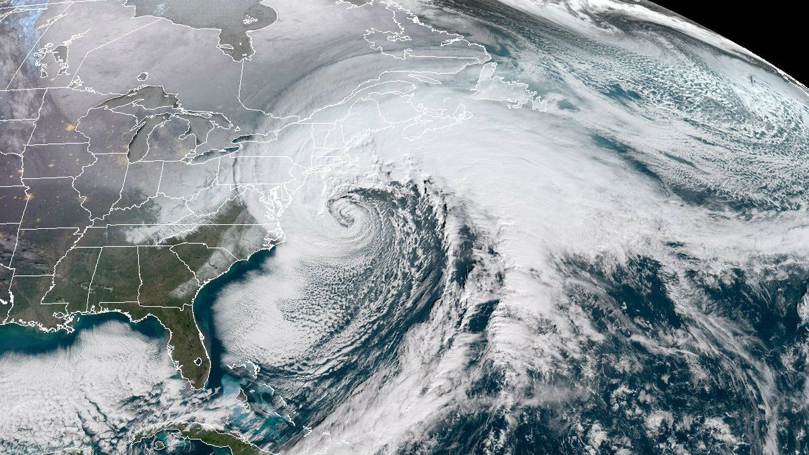
Mitigation Measures
Prediction and Warning
This involves predicting the arrival of cyclones by analysing satellite data, studying climatological records and exploring computer models of cyclone activity and their paths.
Satellite imagine of a tropical cyclone

Slide 29
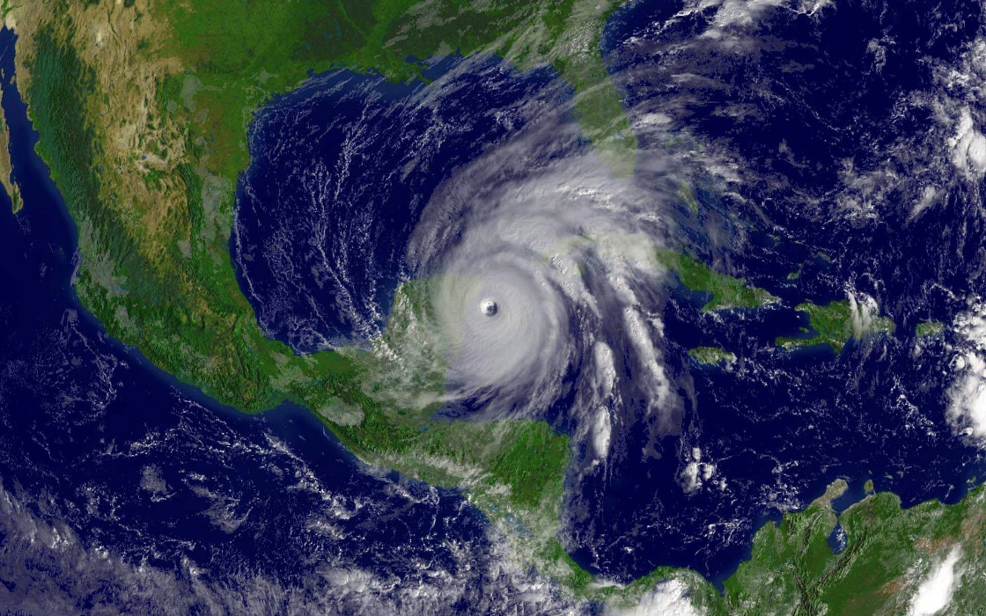
Mitigation Measures
Prediction and Warning
EFFECTIVENESS: This measure establishes pattern of occurrences and seriousness of damage caused by past cyclones and makes it possible to predict when a violent cyclone could occur. For example, meteorologists who studied records of the 2005 Hurricane Katrina gave warnings to residents to evacuate regarding the 2008 Hurricane Ike.
LIMITATIONS: However, the severity and time of occurrence of future cyclones cannot be accurately predicted.
Satellite image of Hurricane Wilma striking Florida in 2005

Slide 30
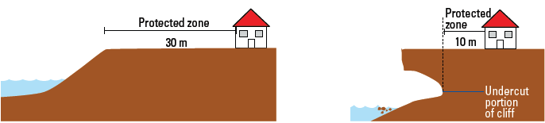
Mitigation Measures
Land Use Control (Coastal Plain Management)
Regulates the use of land by placing restrictions on how the land can be used.
EFFECTIVENESS: Successful to some extent because minimising development in high-risk areas limits exposure to hazards and reduces collapse of properties and loss of lives. This has been practised in the coastal parts of Taiwan and Japan.
LIMITATIONS: They can only be successful if authorities exert strict enforcement which requires time and manpower.
Protected areas ensure that no developments are affected if the area becomes flooded or if a cliff collapses

Slide 31
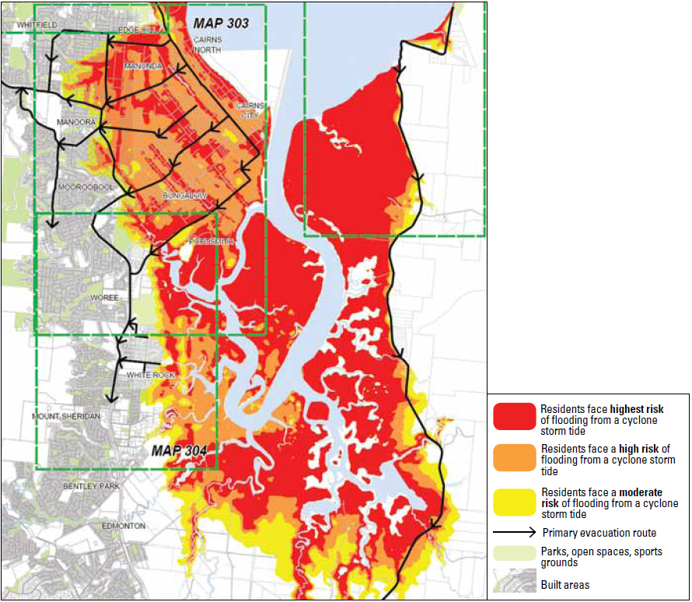
Mitigation Measures
Land Use Control (Floodplain Management)
This measure involves the drawing up of a master plan to protect critical assets from flooding.
EFFECTIVENESS: Farmers’ crops suffer less damage during wet monsoon seasons and income generation has boosted.
LIMITATIONS: Floodplain management has resulted in conflicting demands for water use. With climate change, vulnerability of floodplain communities to severe weather shocks and stresses will increase.
Floodplain management plan for Cairns, Australia based on models of storm surge floods.

Slide 32
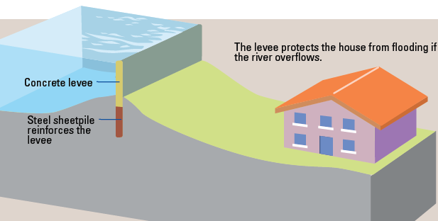
Mitigation Measures
Reducing Vulnerability of Infrastructure
To lessen the impacts of tropical cyclones, infrastructure needs to be reinforced to withstand their impacts. Reinforced structures include water and wind-resistant buildings and protective barriers such as coastal embankments and coastal dikes.
These protective barriers prevent water from overflowing river banks and also prevent surging waves from moving inland.

Slide 33
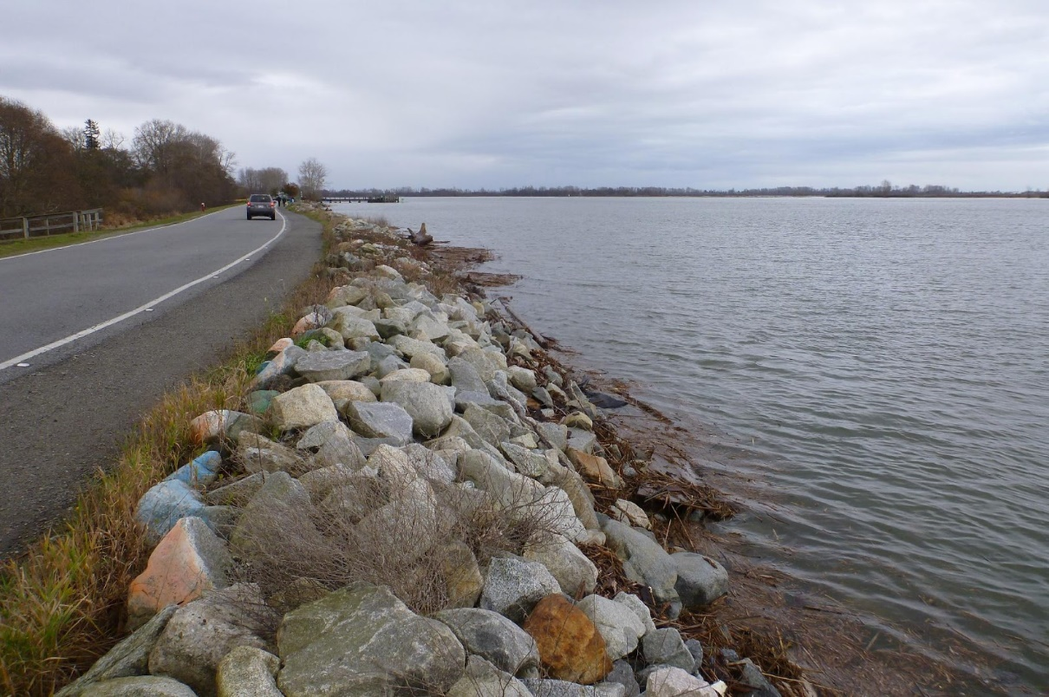
Mitigation Measures
Reducing Vulnerability of Infrastructure
EFFECTIVENESS: For example, houses in Florida, USA, have wind and water-resistant buildings. Effectiveness is seen when houses suffered little damage from Hurricane Wilma in 2005.
LIMITATIONS: However, regular inspection and expensive maintenance are needed for these measures to be effective.
Coastal dikes can last up to 30-50 years if properly maintained.

