Slide 1
Secondary 3 Pure Geography
Chapter 3 – Variable Weather and Changing Climate
Gateway 2 – What is happening to the Earth’s climate?

Slide 2
Gateway 2 – What is happening to the Earth’s climate?
How has global climate changed?
What are some natural causes of recent climate change?
What is the greenhouse effect and how does it work?
What is the enhanced greenhouse effect?
How do human activities lead to enhanced greenhouse effect?
How does climate change affect people?
What are the responses to climate change?

Slide 3
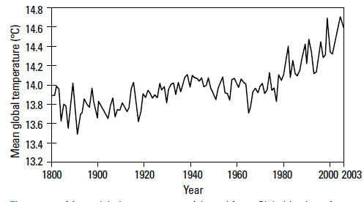
How has global climate changed?
Since 1880, global temperature shows a significant but irregular upward trend with fluctuations of 0.3°C to 0.6°C.
The temperature has increased by an average of 0.74°C.
This phenomenon is known as global warming, which is the increase in global temperatures over a long period of time.
Mean global temperatures from 1800 to 2003

Slide 4
Gateway 2 – What is happening to the Earth’s climate?
How has global climate changed?
What are some natural causes of recent climate change?
What is the greenhouse effect and how does it work?
What is the enhanced greenhouse effect?
How do human activities lead to enhanced greenhouse effect?
How does climate change affect people?
What are the responses to climate change?

Slide 5
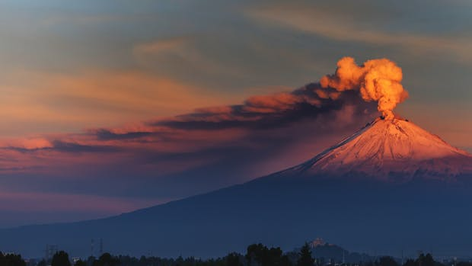
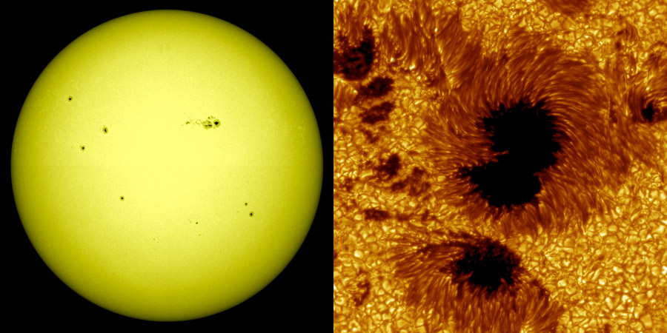
What are some natural causes of climate change?
There are two natural causes of climate change, namely volcanic eruptions and variations in solar output.
Volcanic Eruptions
Variations in Solar Output

Slide 6
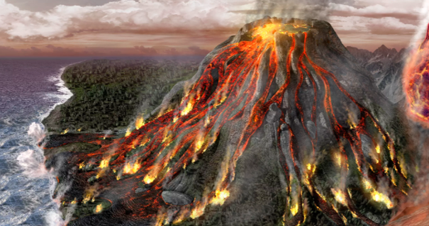
Natural Causes of Climate Change
Volcanic Eruptions
When a volcano erupts, large volumes of carbon dioxide, sulfur dioxide, water vapour, dust and ash are released into the atmosphere.
Sulfur dioxide reacts with water to form sulfur-based particles.
Together with dust and ash, these particles reflect solar energy back into space. This results in a cooling influence on global temperature.
Large volumes of carbon dioxide, sulfur dioxide, water vapour, dust and ash
Sulfur dioxide reacts with water to form sulfur-based particles

Slide 7
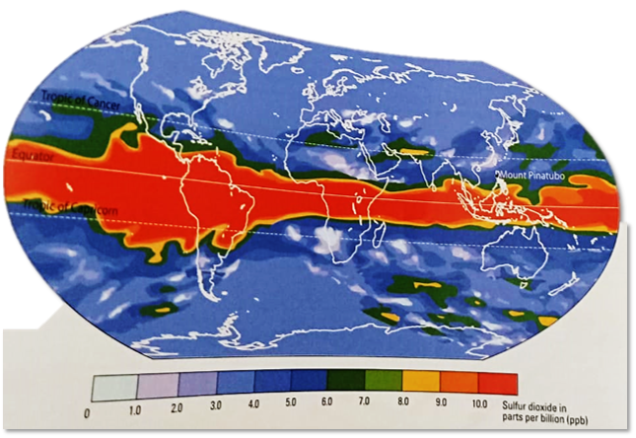
Natural Causes of Climate Change
Volcanic Eruptions
For example, the eruption of Mount Pinatubo in the Philippines in 1991 released 17 million tonnes of sulfur dioxide into the atmosphere, forming sulfur-based particles that spread around the Earth in two weeks. Temperatures in the northern hemisphere lowered as much as by 0.6°C.
Amount and distribution of sulfur dioxide that was released into the atmosphere after Mount Pinatubo’s eruption

Slide 8
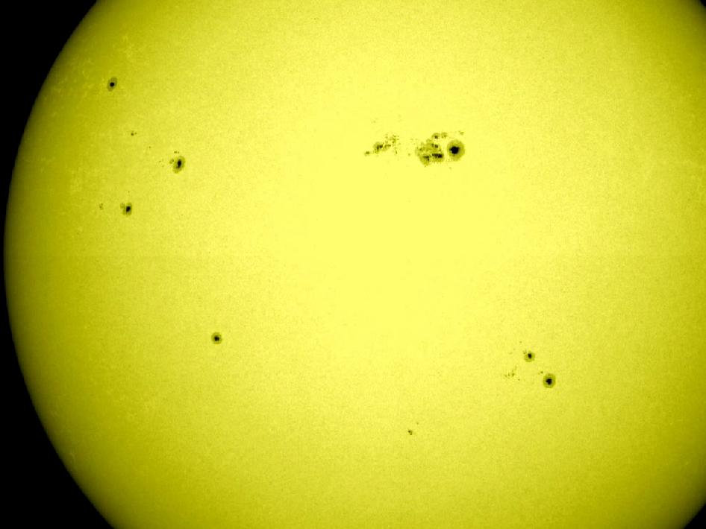
Natural Causes of Climate Change
Variations in Solar Output
Sunspots refer to dark spots on the Sun’s surface that indicate cooler regions. The number of sunspots rises and falls due to changes in the Sun’s magnetic field.
To compensate for the cool sunspots, the Sun radiates more solar energy. When there are a lot of sunspots, global temperature increases.
Number of Sunspots | Global Temperature
Increases | Increases
Thus, the number of sunspots is directly proportional to the global temperature.
Sunspots represented by the dark spots on surface of the sun.

Slide 9
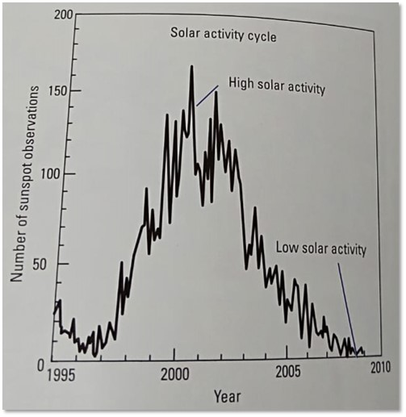
Natural Causes of Climate Change
Variations in Solar Output
The changes in the number of sunspots from 1995 to 2009 are as shown.
It is evident that the solar activity increases as the number of sunspot observations increases, accounting for the increase in global temperature.
Number of Sunspots | Solar Activity
Increases | Increases
Thus, the number of sunspots is directly proportional to the solar activity.

Slide 10
Gateway 2 – What is happening to the Earth’s climate?
How has global climate changed?
What are some natural causes of recent climate change?
What is the greenhouse effect and how does it work?
What is the enhanced greenhouse effect?
How do human activities lead to enhanced greenhouse effect?
How does climate change affect people?
What are the responses to climate change?

Slide 11
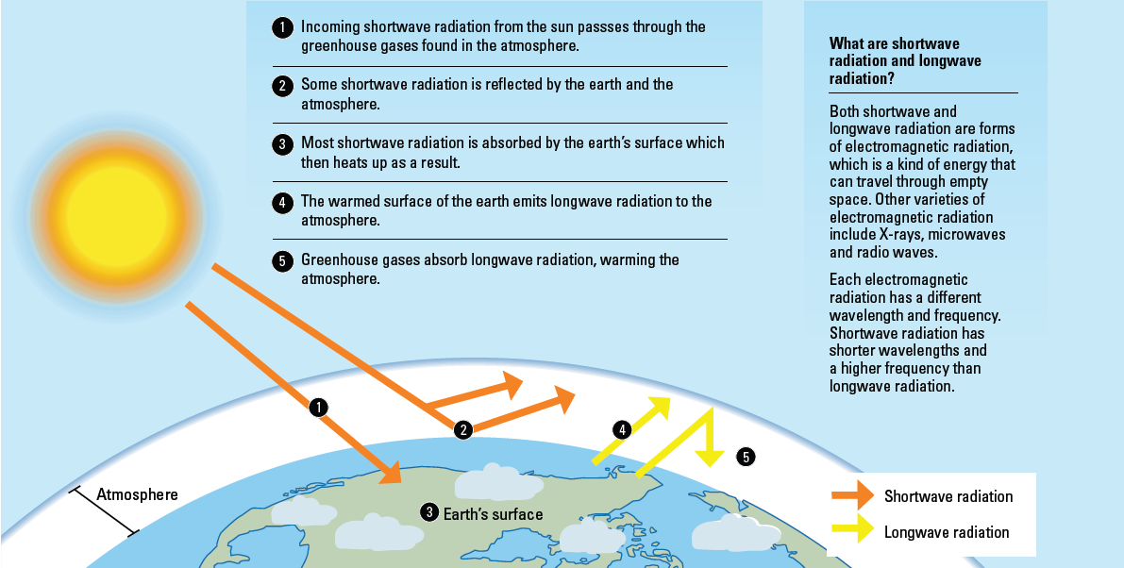
What is the greenhouse effect and how does it work?

Slide 12
The Greenhouse Effect
The greenhouse effect is a phenomenon in which the Earth is kept warm because the greenhouse gases prevent the long-wave radiation from completely escaping back to space is called the greenhouse effect. The greenhouse effect supports life on the Earth.

Slide 13
The Greenhouse Effect
The incoming shortwave radiation from the Sun passes through the greenhouse gases found in the atmosphere.
Some shortwave radiation is reflected by the Earth and the atmosphere. Most shortwave radiation is absorbed by the Earth’s surface which then heats up as a result.
The warmed surface of the Earth emits longwave radiation to the atmosphere. Greenhouse gases absorb longwave radiation, warming the atmosphere.

Slide 14
Gateway 2 – What is happening to the Earth’s climate?
How has global climate changed?
What are some natural causes of recent climate change?
What is the greenhouse effect and how does it work?
What is the enhanced greenhouse effect?
How do human activities lead to enhanced greenhouse effect?
How does climate change affect people?
What are the responses to climate change?

Slide 15
What is the enhanced greenhouse effect?
The enhanced greenhouse effect refers to an increase in the concentration of greenhouse gases in the atmosphere, leading to a rise in global temperature, which results in global warming.
Greenhouse Gases
Water Vapour Carbon Dioxide Methane Nitrous Oxide Ozone Chlorofluorocarbons (CFC)

Slide 16
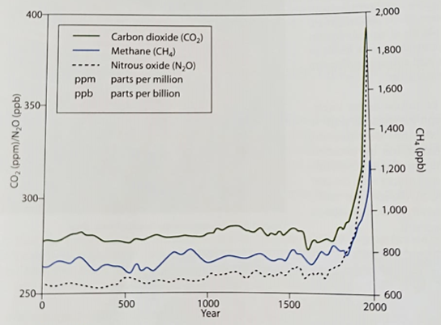
Enhanced Greenhouse Effect
Concentrations of greenhouse gases such as nitrous oxide and methane have increased in the Earth’s atmosphere since the Industrial Revolution in the mid-18th century. Among these gases, the most significant increase is in the amount of carbon dioxide.
Graph representing the changes in the atmospheric concentrations of carbon dioxide, methane and nitrous oxide

Slide 17
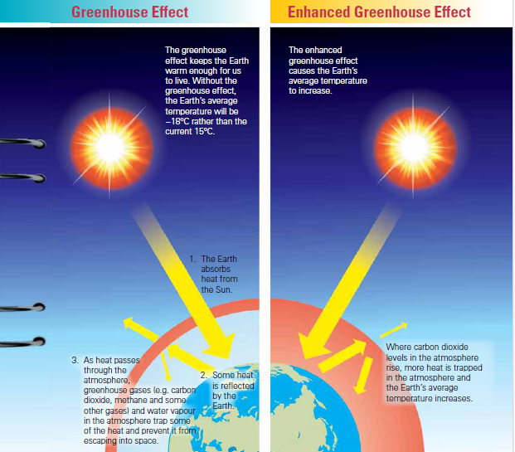
Enhanced greenhouse effect
Comparison with greenhouse effect

Slide 18
Gateway 2 – What is happening to the Earth’s climate?
How has global climate changed?
What are some natural causes of recent climate change?
What is the greenhouse effect and how does it work?
What is the enhanced greenhouse effect?
How do human activities lead to enhanced greenhouse effect?
How does climate change affect people?
What are the responses to climate change?

Slide 19
How do human activities lead to enhanced greenhouse effect?
The concentration of greenhouse gases in the atmosphere has increased mainly due to anthropogenic factors. Anthropogenic factors are factors caused by human activities such as deforestation and changing land use.
Deforestation and associated increase in atmospheric carbon dioxide | Changing land use and associated increase in greenhouse gases
Deforestation and Carbon Oxidation | Agriculture Industrialisation Urbanisation

Slide 20
Deforestation and associated increase in atmospheric carbon dioxide
Deforestation and Carbon Oxidation
The process of the removal of trees clears the area for mining activities, agriculture, construction of infrastructure and also meets the increasing demand for products such as paper and furniture.
There will also be fewer trees to photosynthesise and thus leading to an increase in carbon dioxide that traps more heat.

Slide 21
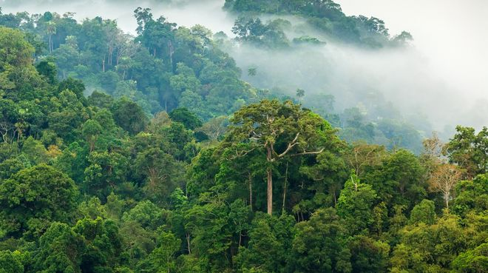
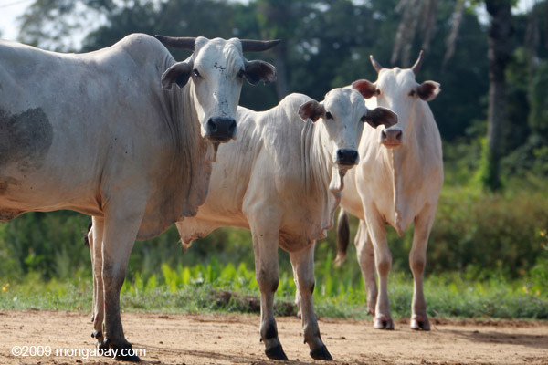
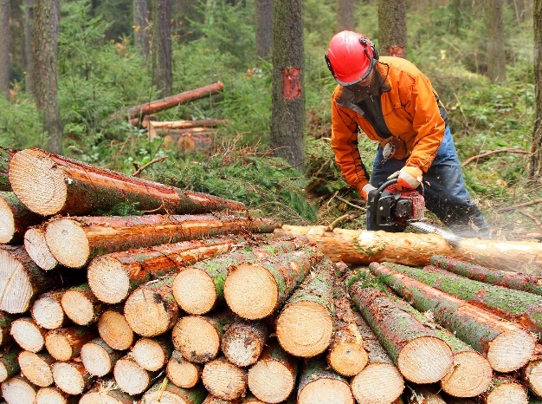
Deforestation and associated increase in atmospheric carbon dioxide
For example, the Amazon rainforest in South America has the highest rate of deforestation due to the need for development activities such as cattle ranching and commercial logging.
Cattle ranching in the Amazon Rainforest, the practice of grazing an example of a livestock
Logging process
The Amazon rainforest in the morning mist

Slide 22
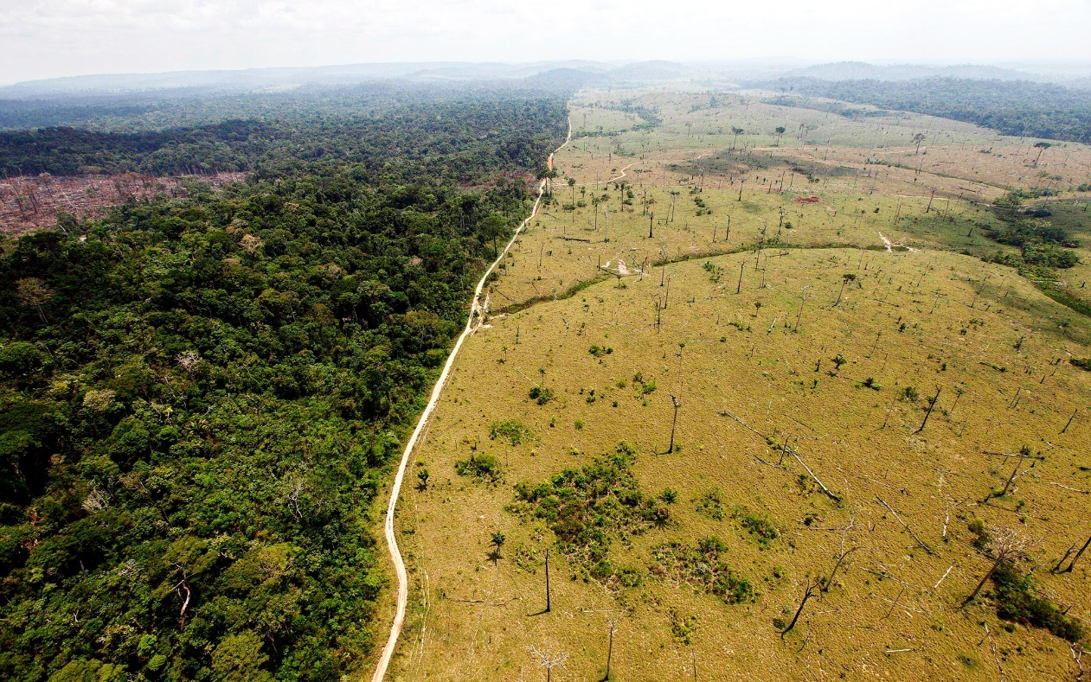
Deforestation and associated increase in atmospheric carbon dioxide
Deforestation exposes the soil to sunlight and increases the soil temperature, leading to a faster rate of carbon oxidation that contributes to more carbon dioxide in the atmosphere.
Carbon oxidation refers to accumulated carbon from the decay of dead leaves and animals reacting with oxygen to produce carbon dioxide.
Deforestation exposes soil to sunlight. This increases the temperature of the soil and the rate of carbon oxidation in the soil.
Deforestation | Rate of carbon oxidation
Increases | Increases

Slide 23
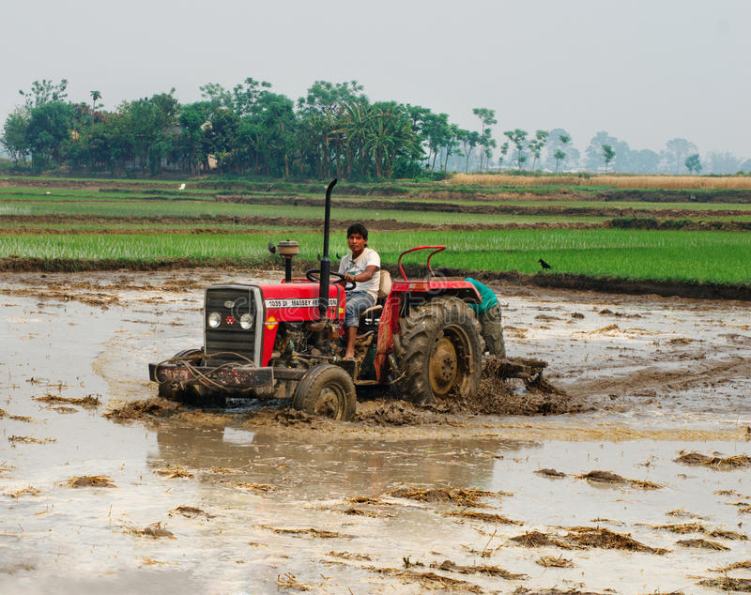
Changing land use and associated increase in greenhouse gases
Agriculture (3rd largest contributor of greenhouse gas)
Decomposition of dead leaves and animals in the rising number of rice fields releases more methane that traps more heat.
Rearing more cattle increases methane that was released as a waste gas.
The use of nitrogen-based fertilisers to improve yields increases nitrous oxide. Nitrous oxide is released when rain flows through the soil.
Tractors run on fossil fuels which release carbon dioxide.
Organic matter such as dead leaves releases methane during decomposition. Decomposition is very rapid in rice fields due to the high moisture level in the soil.
The use of inorganic fertilisers increases the amount of nitrous oxide in the soil.

Slide 24
Changing land use and associated increase in greenhouse gases
Agriculture (3rd largest contributor of greenhouse gas)
For example, in Argentina, methane from cows accounts for more than 30% of the country’s total greenhouse emissions.

Slide 25
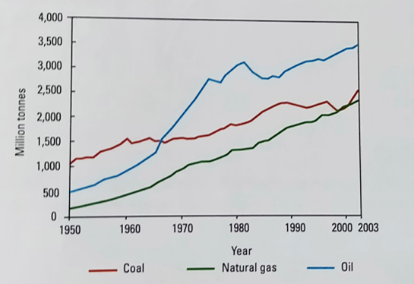
Changing land use and associated increase in greenhouse gases
Industrialisation (Largest contributor of greenhouse gas)
Increased urbanisation leads to an increase in industrial activities to produce goods and services for the people.
More fossil fuels are burnt to supply energy for the manufacturing of goods and this leads to an increase in carbon dioxide.
With the increase in the usage of fossil fuels, the global mean annual temperatures also showed an increase, indicating a strong correlation.

Slide 26
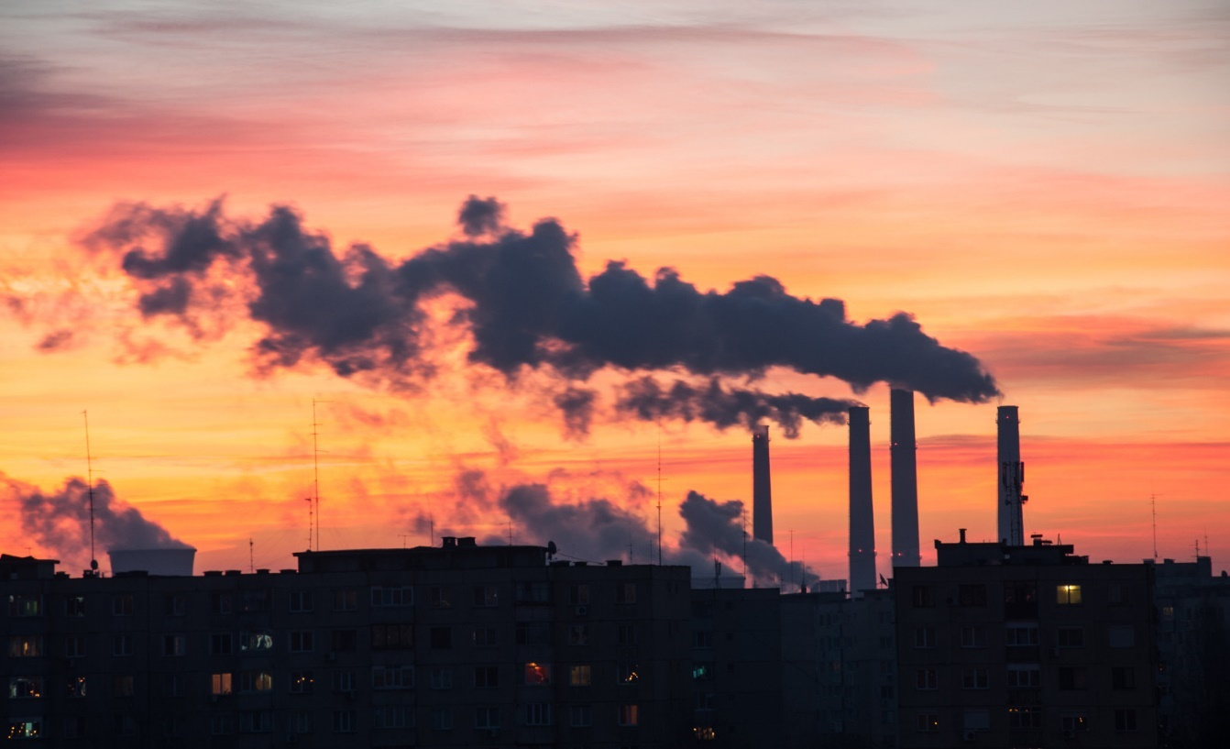
Changing land use and associated increase in greenhouse gases
Industrialisation (Largest contributor of greenhouse gas)
For example, China and India are contributing a lot to global carbon dioxide emissions due to their high level of industrial processes, using fossil fuels as their main energy source.
In heavy industries such as power stations, coal and oil are burned in order to produce energy

Slide 27
Changing land use and associated increase in greenhouse gases
Urbanisation (2nd largest contributor of greenhouse gas)
An increasing number of people living in urban areas will indirectly lead to burning of more fossil fuels to produce energy for domestic, industries, transport and commercial activities.
This increases carbon dioxide that is produced when fossil fuels are burnt.
For example, the world’s fastest urbanisation is in India and it is also one of the top contributors of global carbon dioxide due to the burning of fossil fuels.

Slide 28
Gateway 2 – What is happening to the Earth’s climate?
How has global climate changed?
What are some natural causes of recent climate change?
What is the greenhouse effect and how does it work?
What is the enhanced greenhouse effect?
How do human activities lead to enhanced greenhouse effect?
How does climate change affect people?
What are the responses to climate change?

Slide 29
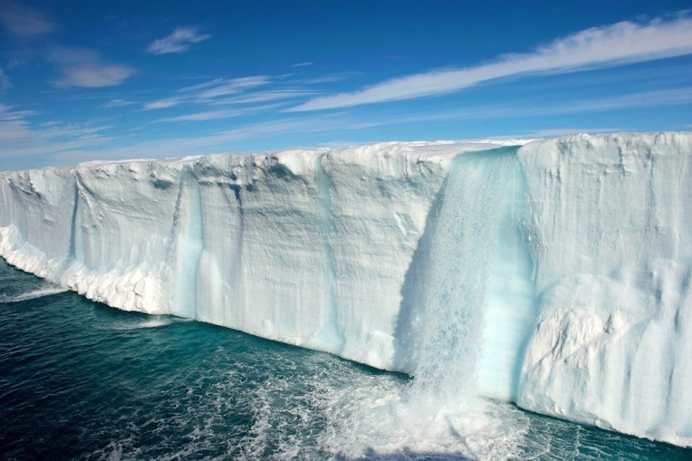
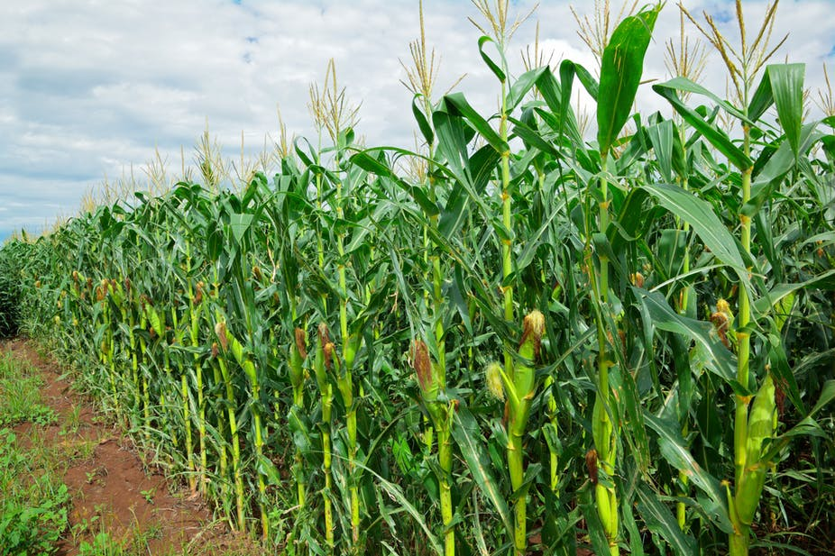
How does climate change affect people?
Changes in the global climate have an impact on humans. Small changes in the climate could lead to increased sea levels and put coastal areas in danger of being flooded.
Besides rising sea levels, other impacts of climate change include more frequent extreme weather events, the spread of some infectious insect-borne diseases and the lengthening of the growing season in certain regions.
Sea Level Rise
More Frequent Extreme Weather Events
Spread of some Infectious Insect-Borne Diseases
Lengthen the Growing Season in Certain Regions
Main causes of sea level rise
The growing season of crops in certain regions might be lengthened

Slide 30
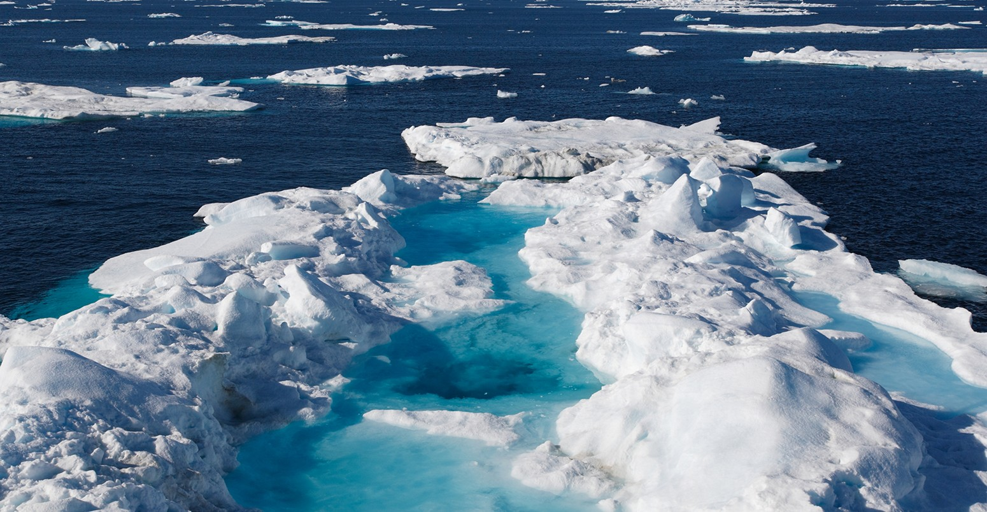
Impacts of Climate Change
Sea Level Rise
Coastal areas and low-lying areas will be flooded as a result of a rise in sea level. Animals that need year-round ice caps such as polar bears and seals will face extinction.
Higher temperatures cause the melting of glaciers in Greenland and Antarctica. The resultant meltwater causes a rise in the sea level.
Higher temperatures in the atmosphere cause water in seas and oceans to expand. This increases the sea level.
Main causes of sea level rise

Slide 31
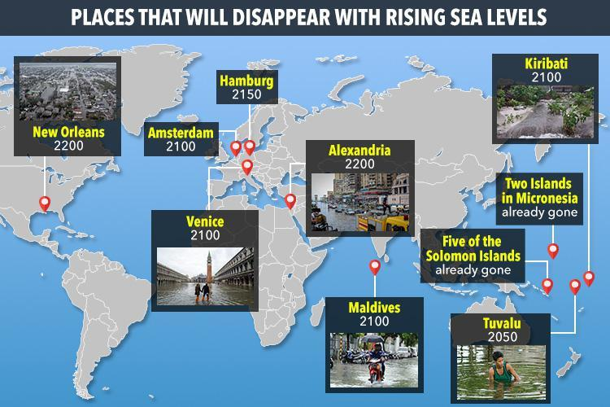
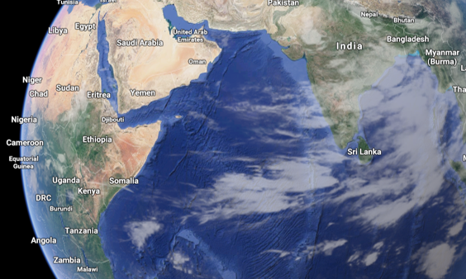
Impacts of Climate Change
Sea Level Rise
For example, Maldives, which has the lowest elevation in the world and a population of 430,000 may be completely swallowed up by the ocean by 2100.
Maldives

Slide 32
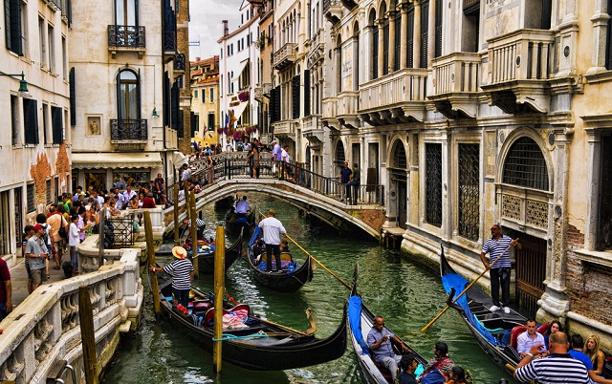
Impacts of Climate Change
Sea Level Rise
Another example involves the study of Venice, a low-lying land with a population of 260,000. Scientists estimate that this region would be disappear in 2100 with the rising sea levels.
Venice, Italy

Slide 33
Impacts of Climate Change
More Frequent Extreme Weather Events
Floods and droughts can destroy farmlands and lead to a decrease in food production.
Heat waves can cause wildfires that worsen air pollution and increase breathing difficulty among the elderly and children.
Tropical cyclones can damage the infrastructure of a country, causing disruption to water supply and sanitation facilities.
Weather Event | Outcome | Impact
Floods and Droughts | Farmlands destroyed | Decrease in food production
Heat Waves | Air pollution worsens | Increase breathing difficulty among the elderly and children
Tropical Cyclones | Damaged infrastructure | Cause disruption to water supply and sanitation facilities

Slide 34
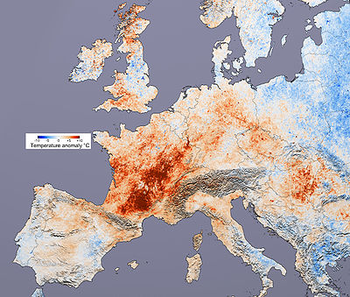
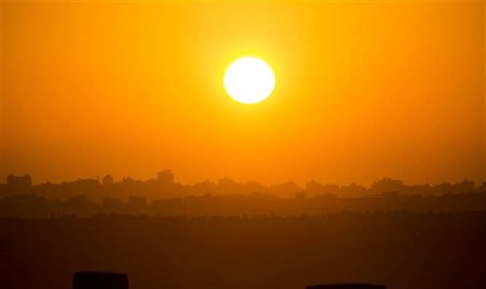
Impacts of Climate Change
More Frequent Extreme Weather Events
For example, the heat wave in Europe in August 2003 killed more than 70,000 people.
A heat wave is a period of excessively hot weather which is usually accompanied by high levels of relative humidity.
Average temperature of western Europe in 2003

Slide 35
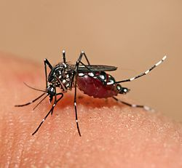
Impacts of Climate Change
Spread of some Infectious Insect-Borne Diseases
Higher temperature and heavy rainfall result in the thrive of insects and may lead to the spread of infectious insect-borne diseases such as malaria.
With the effect of climate change, it would result in the spread of insect-borne diseases such as dengue which is spread from the Aedes Mosquitoes.

Slide 36
Impacts of Climate Change
Spread of some Infectious Insect-Borne Diseases
For example, continents such as Europe and North America used to have moderate temperatures but are currently facing the problem of mosquitoes growing in large numbers. This results in the spread of diseases such as malaria and dengue fever.

Slide 37
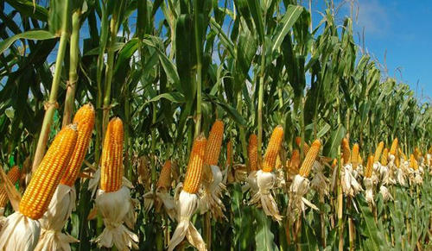
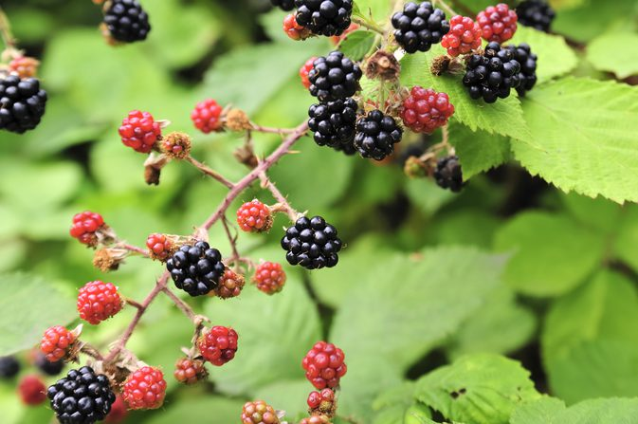
Impacts of Climate Change
Lengthen the Growing Season in Certain Regions (Advantage)
Higher temperature may lead to longer growing seasons in some regions. For example, new crops such as maize and blackberries can now be cultivated in the United Kingdom.
Advantage | Disadvantage
New crops such as maize and blackberries can now be cultivated in the United Kingdom. | Fruits such as apples has seen a decrease in production in China.
Maize and blackberries can be cultivated in the United Kingdom due to the lengthened growing season.

Slide 38
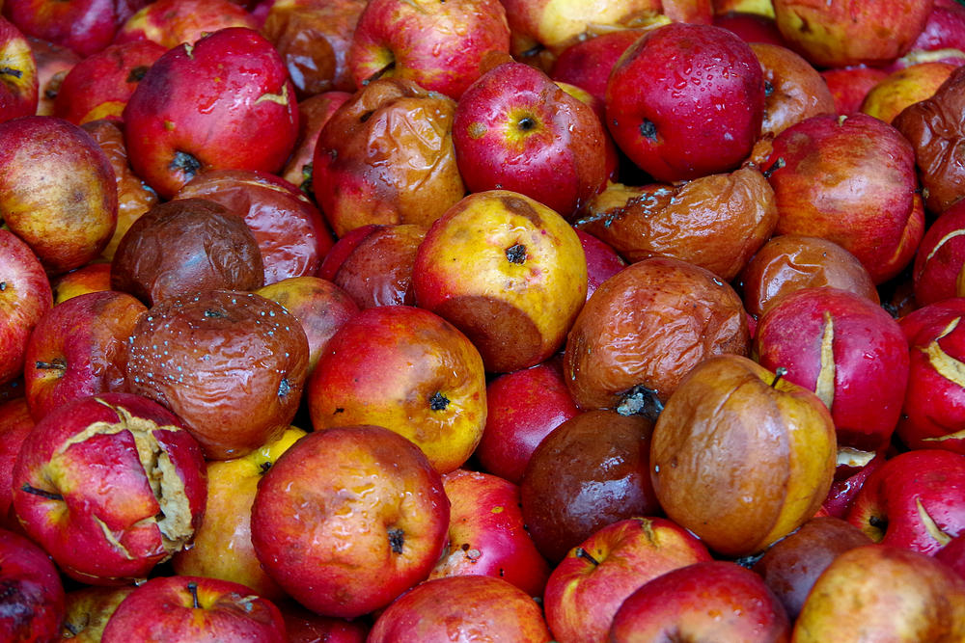
Impacts of Climate Change
Lengthen the Growing Season in Certain Regions (Disadvantage)
However, production of crops can be reduced in some countries as certain crops require cool weather conditions. For example, fruits such as apples have seen a decrease in production in China.
Advantage | Disadvantage
New crops such as maize and blackberries can now be cultivated in the United Kingdom. | Fruits such as apples has seen a decrease in production in China.
Apples may be rotten and experience a decline in production due to the lengthened growing season.

Slide 39
Gateway 2 – What is happening to the Earth’s climate?
How has global climate changed?
What are some natural causes of recent climate change?
What is the greenhouse effect and how does it work?
What is the enhanced greenhouse effect?
How do human activities lead to enhanced greenhouse effect?
How does climate change affect people?
What are the responses to climate change?

Slide 40
What are the responses to climate change?
The immense challenges posed by climate change require coordinated responses from countries. Policies on an international level have been implemented to address the problem of climate change.
Additionally, as different places face specific climate-related issues, policies on a national level are needed to address these issues more adequately.

Slide 41
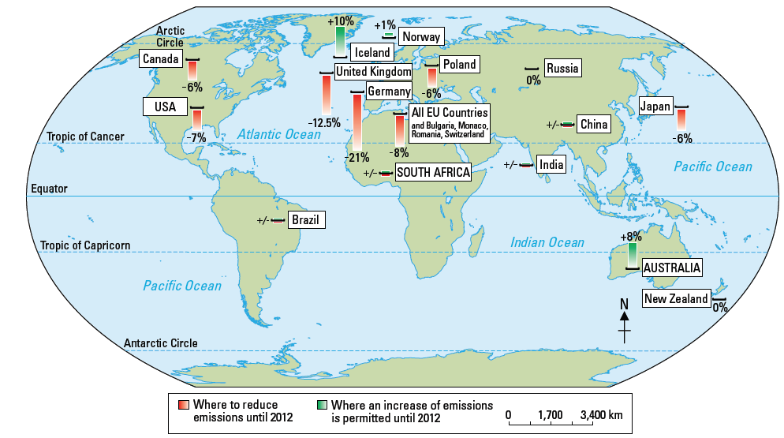
International Agreements
Kyoto Protocol
The Kyoto Protocol was an international agreement that was drawn up in 1997 and came into force in 2005 with the goal of reducing the levels of greenhouse gases in the atmosphere.
Many countries signed and participated in the measures to reduce greenhouse gases. Greater responsibility to reduce greenhouse gases was placed on 37 developed countries and the European countries.
Targets made by selected countries in the Kyoto Protocol to reduce greenhouse gas emissions

Slide 42
International Agreements
Kyoto Protocol
EFFECTIVENESS: For example, from 2008 to 2012, many countries such as Finland and Greece were successful in reducing their combined greenhouse gas emissions by at least 5% below their 1990 levels.
These countries also helped the less developed countries to reduce greenhouse gas emission by giving them funds.
LIMITATIONS: However, some countries such as Denmark, Austria and Spain who signed the Kyoto Agreement were unable to achieve their targets.
Also countries that did not sign the Kyoto Protocol such as China and the United States of America continued to contribute high emissions of greenhouse gases.
Effectiveness
Finland, Greece
Limitations
Denmark, Austria, Spain China, India, United States of America

Slide 43
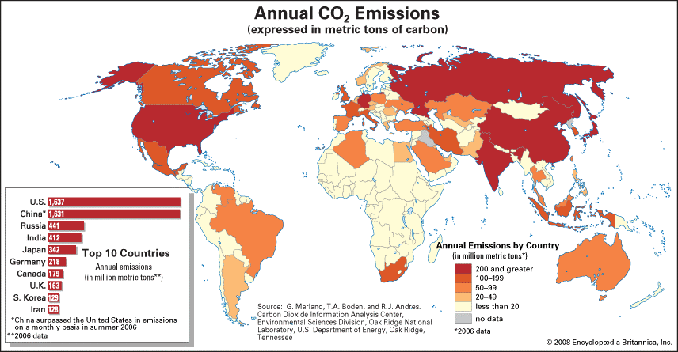
International Agreements
Kyoto Protocol
Annual carbon dioxide emissions

Slide 44
National Responses
At the national level, individual countries should implement policies to achieve the international goal of reducing greenhouse gas emissions. Responses are necessary at the national level because there are measures that are specific to countries.
Singapore has taken some measures to reduce greenhouse gas emissions such as
Singapore Green Plan 2012 (reducing the use of fossil fuels)
Green Mark Scheme (constructing green buildings)
Plant-A-Tree Programme (planting more trees and plants)

Slide 45
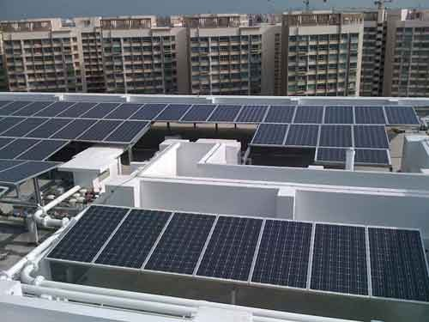
National Responses
Singapore Green Plan 2012
Reducing the use of fossil fuels refers to switching the main source of energy usage to cleaner sources instead of burning fossil fuels which releases high levels of greenhouse gases.
HDB rooftops in Punggol have solar panels installed to reduce fossil fuels

Slide 46
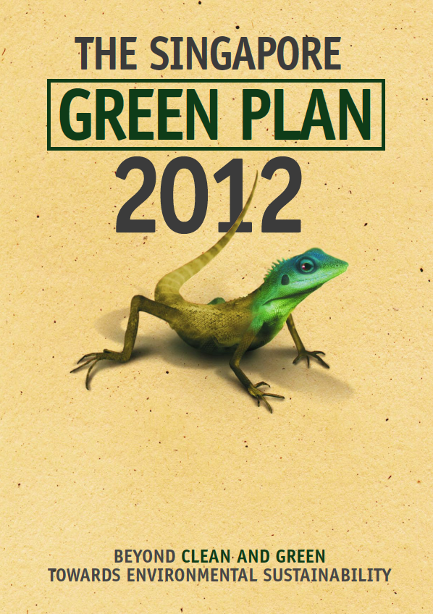
National Responses
Singapore Green Plan 2012
EFFECTIVENESS: For example, the Singapore Green Plan 2012 implemented in 2002 aims to generate 60% of Singapore’s energy by using natural gas, which is a cleaner form of energy.
LIMITATIONS: However, infrastructure to process and transport such cleaner forms of energy such as natural gas is expensive and Less Developed Countries may be unable to afford it.
A poster regarding the Singapore Green Plan 2012

Slide 47
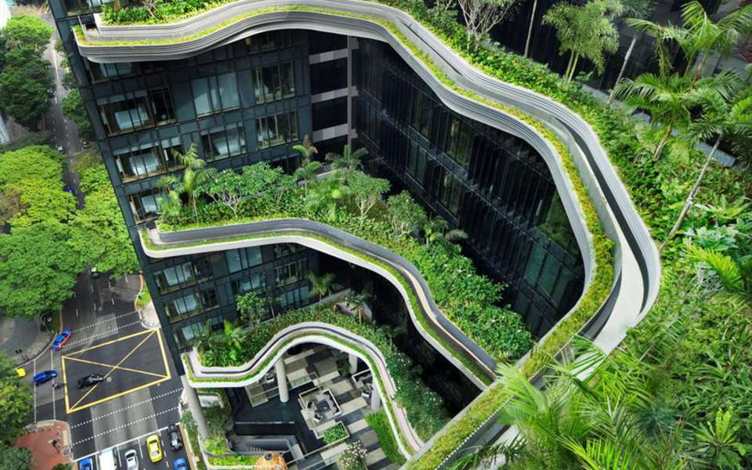
National Responses
Green Mark Scheme
Constructing green buildings refers to constructing buildings which are more energy-efficient, using less energy to provide the same service.
PARKROYAL in Chinatown

Slide 48
National Responses
Green Mark Scheme
EFFECTIVENESS: Using more energy-efficient sources such as solar energy to power up buildings is successful in reducing the use of fossil fuels to generate electricity.
For example, the Green Mark Scheme in Singapore evaluates and certifies buildings which are considered “green” and many buildings such as the National Library Building have reported a 15% to 35% energy saving.
LIMITATIONS: However, green buildings may cost more to build and developers who only look for immediate profits will not consider constructing such buildings even if they are more energy-efficient.

Slide 49
National Responses
Plant-A-Tree Programme
Planting more trees and plants refer to planting trees and plants in tree-planting events that take place monthly throughout Singapore.

Slide 50
National Responses
Plant-A-Tree Programme
EFFECTIVENESS: It is effective as trees are the green lungs of the environment as they remove carbon dioxide from the atmosphere.
For example, the Plant-A-Tree Programme in Singapore has contributed to an estimated 60,000 trees yearly throughout Singapore by the National Parks Board.
LIMITATIONS: However, trees take many years to mature, so the positive effects of tree planting will take time to materialise.

Slide 51
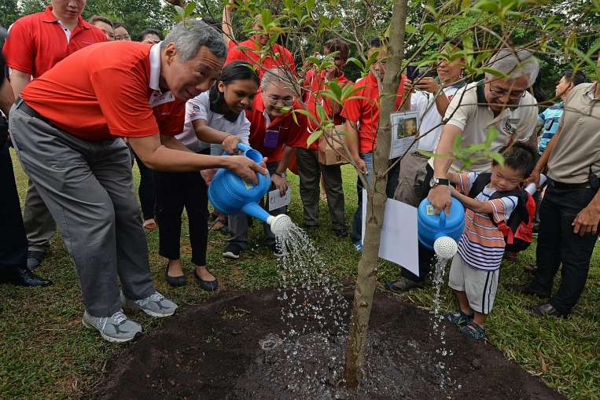
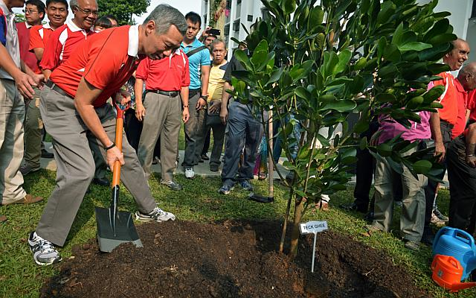
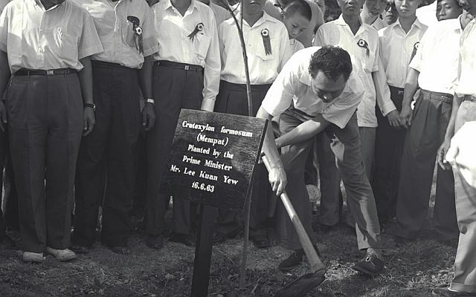
National Responses
Plant-A-Tree Programme
Right: Mr. Lee Kuan Yew initiating the Plant-A-Tree Programme, 1963
Up: Mr. Lee Hsien Loong continuing the Plant-A-Tree Programme, 2015

