Slide 1
Secondary 3 Pure Geography
Chapter 3 – Variable Weather and Changing Climate
Gateway 1 – Why do different places experience different weather and climate?

Slide 2
Gateway 1 – Why do different places experience different weather and climate?
What is the difference between weather and climate?
What are the elements of weather?
What are the climatic types and where are they experienced?

Slide 3
What is the difference between weather and climate?
Weather is defined as the condition of the atmosphere at a particular place and specific time.
Climate is the average condition of the atmosphere of a particular place over a long period of time, usually 30 years.
Weather | Climate
Short-term condition Unpredictable Changes all the time from hour to hour | Does not change Long-term atmospheric condition

Slide 4
Gateway 1 – Why do different places experience different weather and climate?
What is the difference between weather and climate?
What are the elements of weather?
What are the climatic types and where are they experienced?

Slide 5
What are the elements of weather?
The weather can be described in terms of 6 elements called the elements of weather. These 6 elements are temperature, relative humidity, clouds, rainfall, air pressure and wind.

Slide 6
Temperature
Temperature refers to the degree of hotness or coldness of a place. It is dependent on the Sun’s energy or solar energy.
Temperature is regularly measured and recorded around the world. It is measured in degrees Celsius (°C) using an analogue or digital thermometer. In the study of weather, high temperatures are defined as anything above 20°C and low temperatures as anything below 10°C.
High Temperatures | Low Temperatures
Temperature > 20°C | Temperature < 10°C

Slide 7
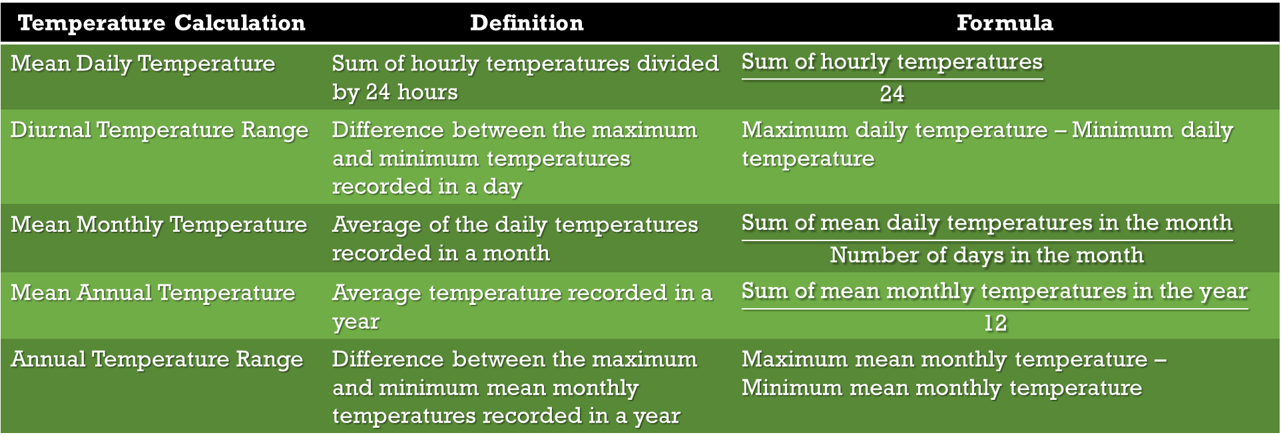
Temperature Calculation
Temperature Calculation | Definition | Formula
Mean Daily Temperature | Sum of hourly temperatures divided by 24 hours | $$\frac{\text{Sum} \text{of} \text{hourly} \text{temperatures}}{\text{24}}$$
Diurnal Temperature Range | Difference between the maximum and minimum temperatures recorded in a day | Maximum daily temperature – Minimum daily temperature
Mean Monthly Temperature | Average of the daily temperatures recorded in a month | $$\frac{\text{Sum} \text{of} \text{mean} \text{daily} \text{temperatures} \text{in} \text{the} \text{month}}{\text{Number} \text{of} \text{days} \text{in} \text{the} \text{month}}$$
Mean Annual Temperature | Average temperature recorded in a year | $$\frac{\text{Sum} \text{of} \text{mean} \text{monthly} \text{temperatures} \text{in} \text{the} \text{year}}{\text{12}}$$
Annual Temperature Range | Difference between the maximum and minimum mean monthly temperatures recorded in a year | Maximum mean monthly temperature – Minimum mean monthly temperature

Slide 8
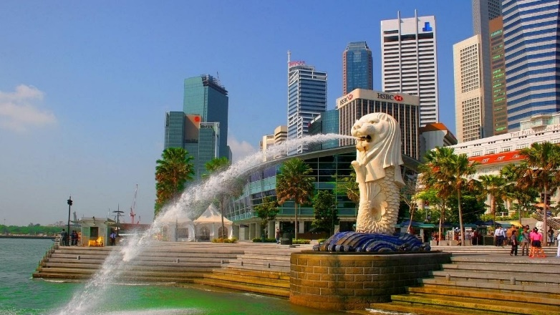
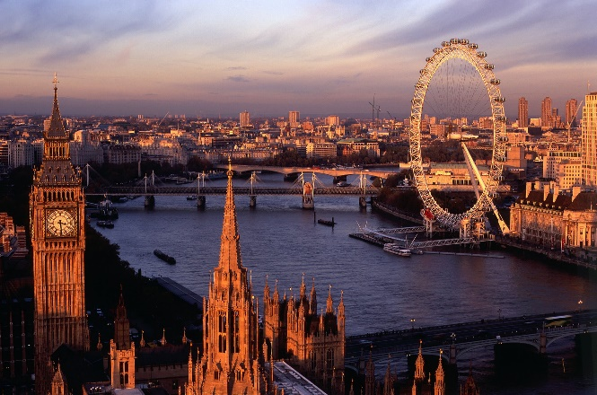
Factors influencing the Temperature of Locations
Temperature varies across the Earth. Some places are so cold that even the soil there freezes. Other places are so warm that their taps have no water settings. Factors that cause variations in the world temperatures include the following:
Latitude
Altitude
Distance from the sea
Cloud Cover
Singapore
London
Singapore has a higher mean annual temperature as compared to London. What is the main reason which led to this difference?

Slide 9
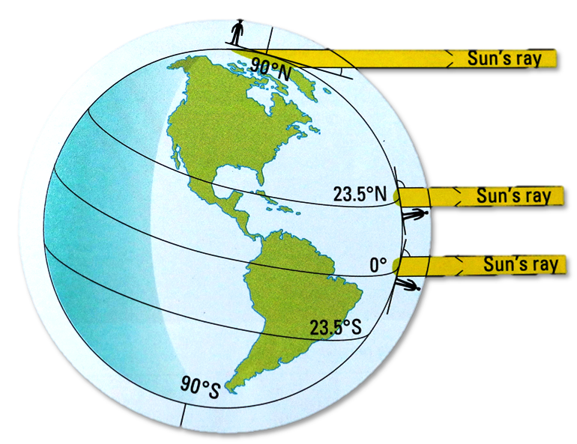
Factors influencing the Temperature of Locations
Latitude
Temperatures at lower latitudes are higher than at higher latitudes because the Sun’s rays strike at a higher angle of incidence.
Temperatures at higher latitudes are lower than at lower latitudes because the Sun’s rays strike at a lower angle of incidence.
At higher latitudes, the solar energy is spread over a wider area.
At lower latitudes, the solar energy is concentrated on a small area.

Slide 10
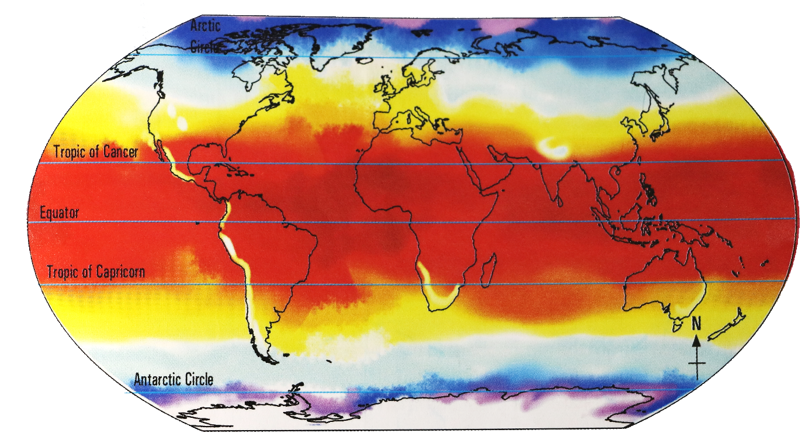
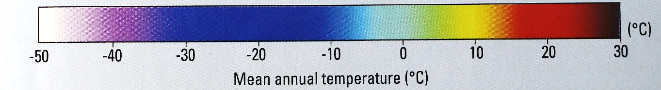
Factors influencing the Temperature of Locations
Latitude (Latitudinal Locations)
Areas located near the equator experience the highest mean annual temperature, whereas areas located near the Arctic Circle and Antarctic Circle experience the lowest mean annual temperature.
As the latitude increases, the mean annual temperature decreases since the angle of incidence formed by the rays of the Sun striking the surface of the Earth decreases. As a result, the area of concentration the solar energy strikes on decreases with respect to the increasing latitude.
Global Mean Annual Temperatures

Slide 11
Factors influencing the Temperature of Locations
Latitude
For example, Singapore is located at 1°N and her mean annual temperature is 27°C. Therefore, at lower latitudes, the temperature is higher.
For example, London is located at 50°N and her mean annual temperature is 12°C. Therefore, at higher latitudes, the temperature is lower.
Latitude | Temperature
Increases | Decreases
Thus, latitude and temperature have an inverse relationship.

Slide 12
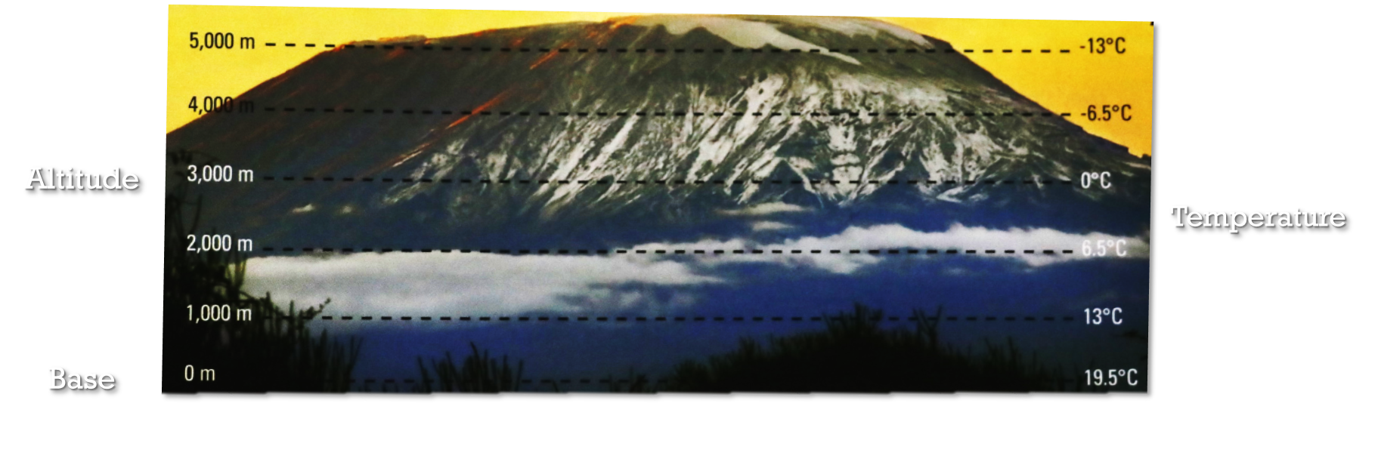
Factors influencing the Temperature of Locations
Altitude
Temperature decreases with altitude, which is the height of a place in relation to the sea level. Temperature generally decreases by 6.5°C with every 1000 metres increase in altitude.

Slide 13
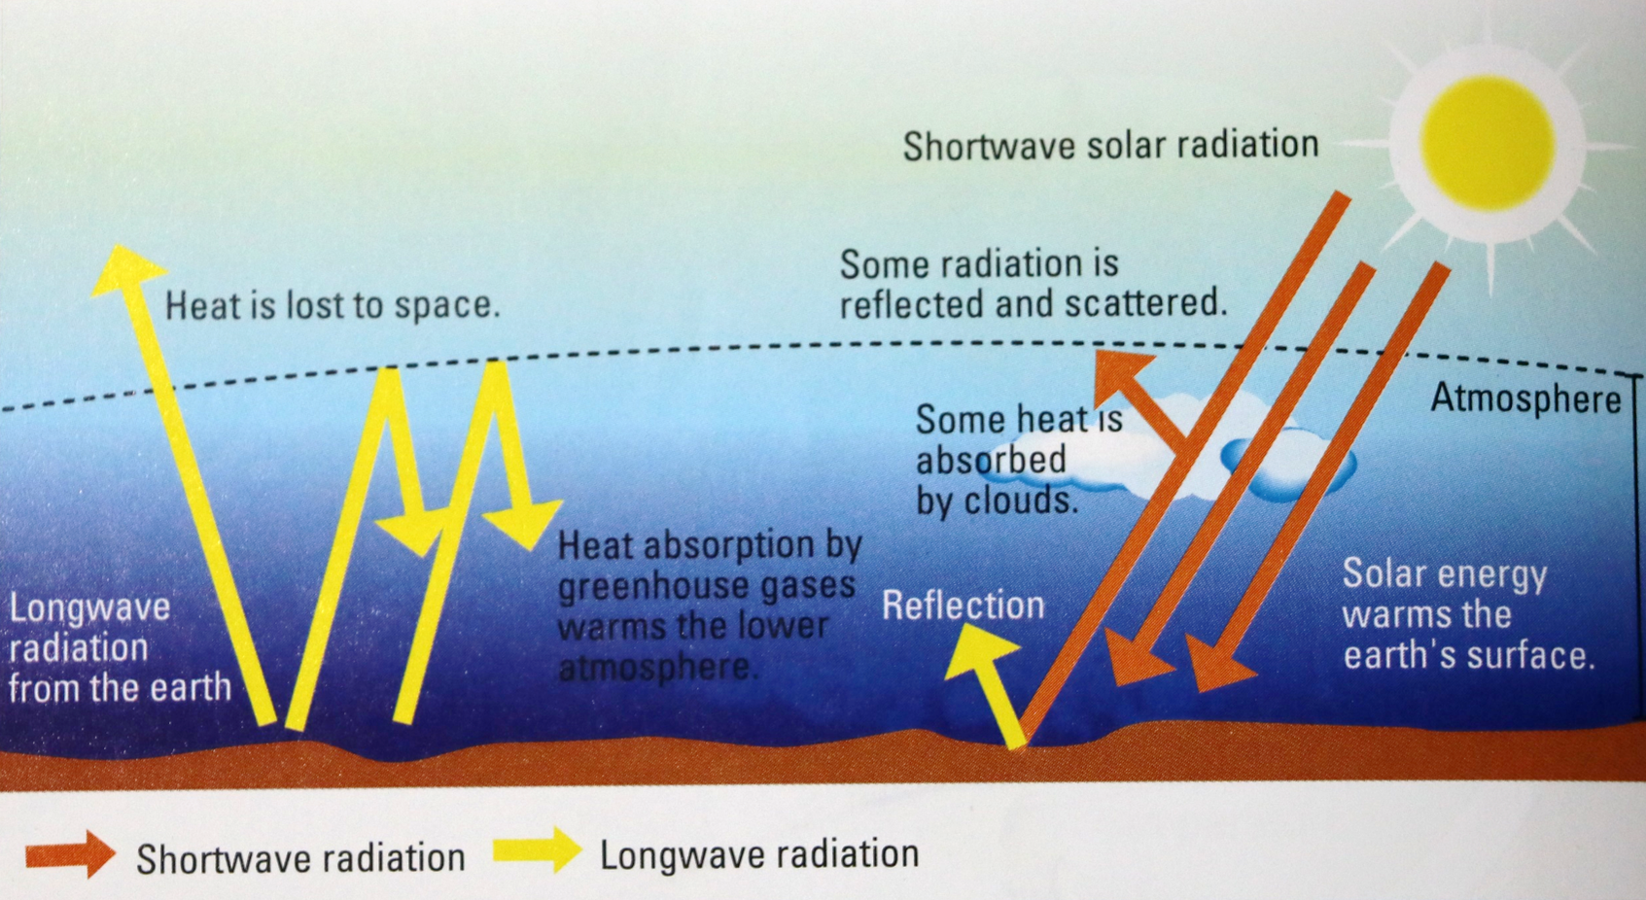
Factors influencing the Temperature of Locations
Altitude
Shortwave Radiation | Longwave Radiation
Absorbed by the Earth’s surface | Transmitted to the atmosphere

Slide 14
Factors influencing the Temperature of Locations
Altitude
The Earth’s surface is warmed up by the incoming shortwave radiation. At lower altitude, there are more atmospheric gases and particles such to trap the heat emitted from the warm ground.
Greenhouse gases absorb the outgoing longwave radiation, warming the atmosphere. Air that is further from the Earth’s surface absorbs less heat from the longwave radiation as air is less dense at higher altitudes.

Slide 15
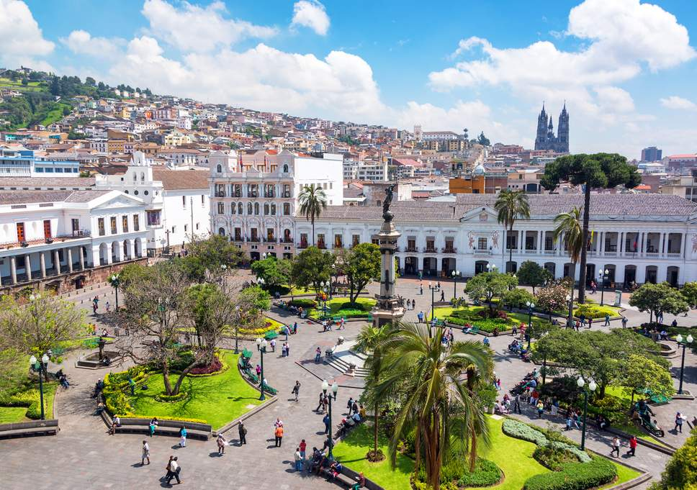
Factors influencing the Temperature of Locations
Altitude
Quito is located at a high altitude of 2800 metres above sea level but has a mean annual temperature of 13°C.
Singapore is located at a low altitude of 10 metres above sea level and has a mean annual temperature of 27°C.
Altitude | Temperature
Increases | Decreases
Thus, altitude and temperature have an inverse relationship.
Quito, Ecuador

Slide 16
Factors influencing the Temperature of Locations
Distance from the sea
The sea heats up and cools down more slowly than the land. The difference in the rate of heating and cooling of the sea and lands affects the temperature of coastal and inland areas.

Slide 17
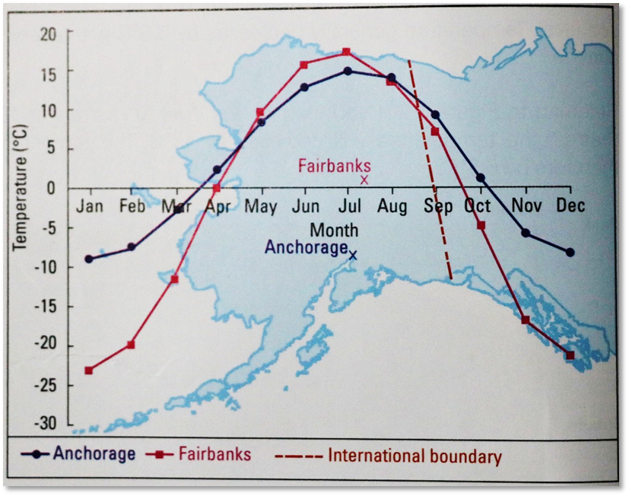
Factors influencing the Temperature of Locations
Distance from the sea
The diagram shows the U.S. State of Alaska. From the diagram, it is evident that Anchorage is closer to the sea as compared to Fairbanks.
Mean monthly temperatures of Fairbanks and Anchorage from 1971 to 2000

Slide 18
Factors influencing the Temperature of Locations
Distance from the sea (Maritime Effect)
During summer, the air over Anchorage heats up slower than in Fairbanks, therefore Anchorage is having a warm summer rather than a hot summer.
During winter, the air over Anchorage cools down slower than in Fairbanks, therefore Anchorage is having a mild winter rather than a cold winter.
Thus, Anchorage is experiencing maritime effect as it has a warm summer and mild winter.
Areas with Maritime Effect
Experiences a warm summer and mild winter

Slide 19
Factors influencing the Temperature of Locations
Distance from the sea (Continental Effect)
During summer, the air over Fairbanks heats up quicker than in Anchorage, therefore Fairbanks is having a hot summer rather than a warm summer.
During winter, the air over Fairbanks cools down quicker than in Anchorage, therefore Fairbanks is having a cold winter rather than a mild winter.
Thus, Fairbanks is experiencing continental effect as it has a hot summer and cold winter.
Areas with Continental Effect
Experiences a hot summer and cold winter

Slide 20
Factors influencing the Temperature of Locations
Cloud Cover
Cloud cover is the extent of the sky that is covered by clouds. The amount of cloud cover influences the temperatures on the Earth’s surface in the day and at night.
With Cloud Cover | Without Cloud Cover
Cooler day Warmer night Smaller diurnal temperature range | Warmer day Cooler night Higher diurnal temperature range

Slide 21
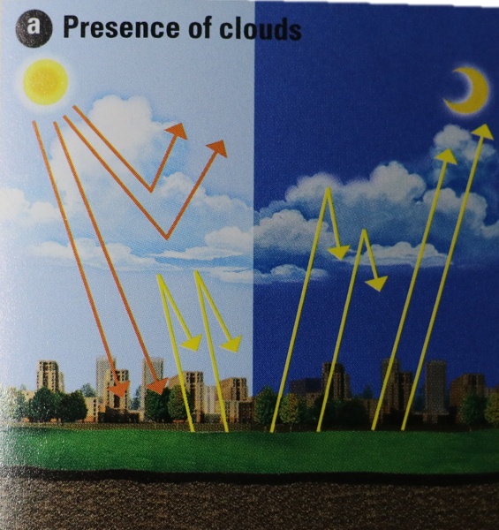
Factors influencing the Temperature of Locations
Cloud Cover (Presence of Clouds)
With the presence of clouds, during the day, it is cooler because the clouds reflect a large portion of solar radiation from the Sun into space, reducing the amount of shortwave radiation to Earth.
With the presence of clouds, at night, it is warmer because the clouds absorb the heat that is radiated from the Earth’s surface and prevents it from escaping into space.
Incoming shortwave solar radiation from the Sun
Clouds absorb the heat radiated from the Earth’s surface
Clouds reflect a large portion of solar radiation

Slide 22
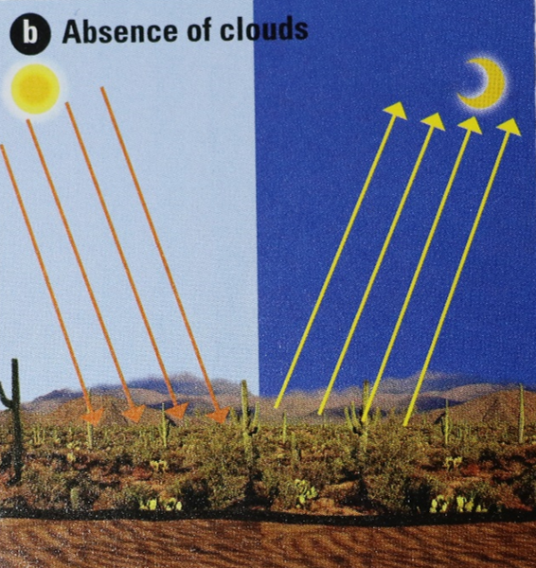
Factors influencing the Temperature of Locations
Cloud Cover (Absence of Clouds)
With the absence of clouds, during the day, it is warm because there are no clouds to reflect the solar radiation from the Sun into space, increasing the amount of shortwave radiation to Earth.
With the absence of clouds, at night, it is cooler because there are no clouds to absorb the heat that is radiated from the Earth’s surface and allows it to escape into space.
Incoming shortwave solar radiation from the Sun
Absence of clouds results in the heat from the Earth’s surface to easily escape into space
Absence of clouds results in more solar radiation transmitted to Earth

Slide 23

Factors influencing the Temperature of Locations
Cloud Cover
For example, Singapore, an area with cloud cover, experiences a smaller diurnal temperature range as compared to an area without cloud cover like the Sahara Desert.
The Sahara Desert has temperatures as high as 50°C during the day and as low as 0°C at night as it has the absence of clouds.
Sahara Desert, the 3rd largest desert in the world

Slide 24
Factors influencing the Temperature of Locations
Assertion of Factors
Overall, latitude is the most important factor in influencing the temperature of locations. In comparison with two areas which have different latitudes but with cloud cover, the temperature of both locations will still differ greatly. Latitude greatly affects the amount of incoming shortwave solar radiation from the Sun to the Earth, hence affecting the annual mean temperature whereas cloud cover affects the diurnal temperature range.
Factor | Latitude | Altitude | Distance from the sea | Cloud Cover
Examples | Singapore |  | Fairbanks | Singapore
 | London | Quito | Anchorage | Sahara Desert
Affection | Mean Annual Temperature |  | Annual Temperature Range | Diurnal Temperature Range
Relationship with Temperature | Inverse |  |  | Inverse

Slide 25
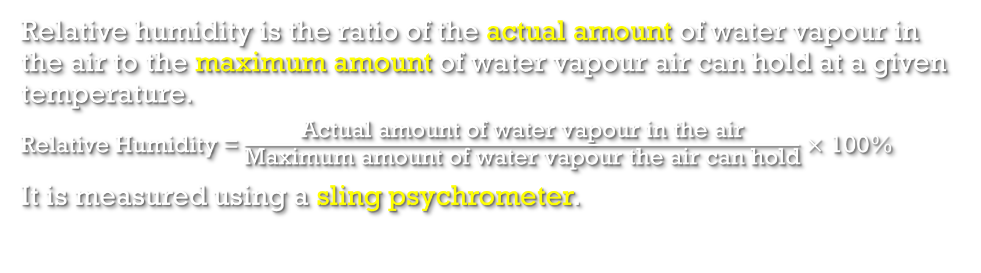
Relative Humidity
Relative humidity is the ratio of the actual amount of water vapour in the air to the maximum amount of water vapour air can hold at a given temperature.
Relative Humidity =$\frac{\text{Actual} \text{amount} \text{of} \text{water} \text{vapour} \text{in} \text{the} \text{air}}{\text{Maximum} \text{amount} \text{of} \text{water} \text{vapour} \text{the} \text{air} \text{can} \text{hold}}$ $\text{×}$ 100%
It is measured using a sling psychrometer.

Slide 26
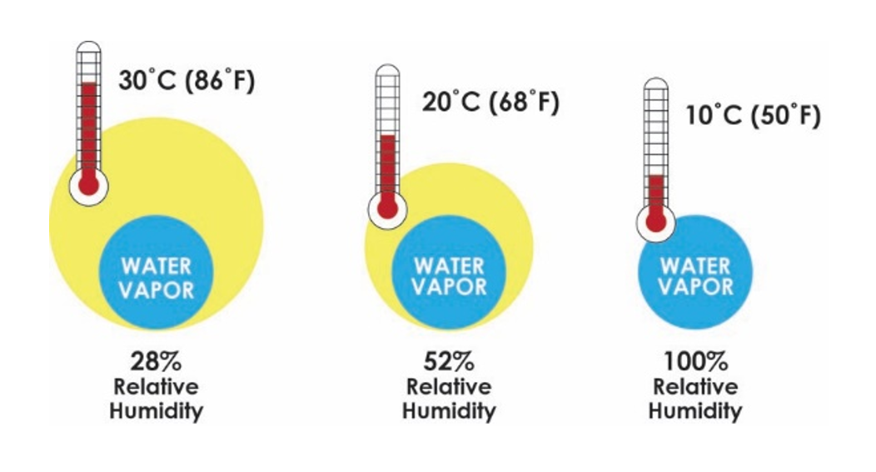
Relative Humidity
Effect of Temperature on Relative Humidity
Relative humidity varies with temperature. At higher temperatures, air will be able to hold more water vapour because the air molecules are more spread out, hence more water vapour can fill the spaces.
Assuming that the actual water vapour in the air is constant, the relative humidity is lower at higher temperatures and higher at lower temperatures.
As the relative humidity increases, the temperature decreases

Slide 27
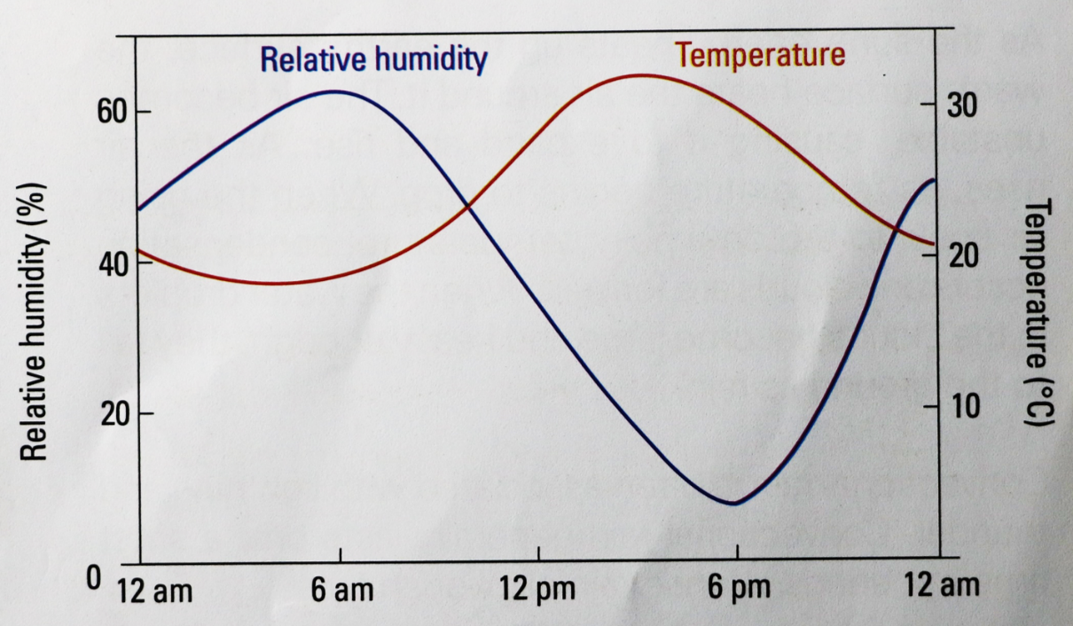
Relative Humidity
Effect of Temperature on Relative Humidity
The relative humidity tends to be higher from midnight to early in the morning and lower during the mid-afternoon from 3pm to 6pm.
Graph showing the relationship between relative humidity and temperature

Slide 28
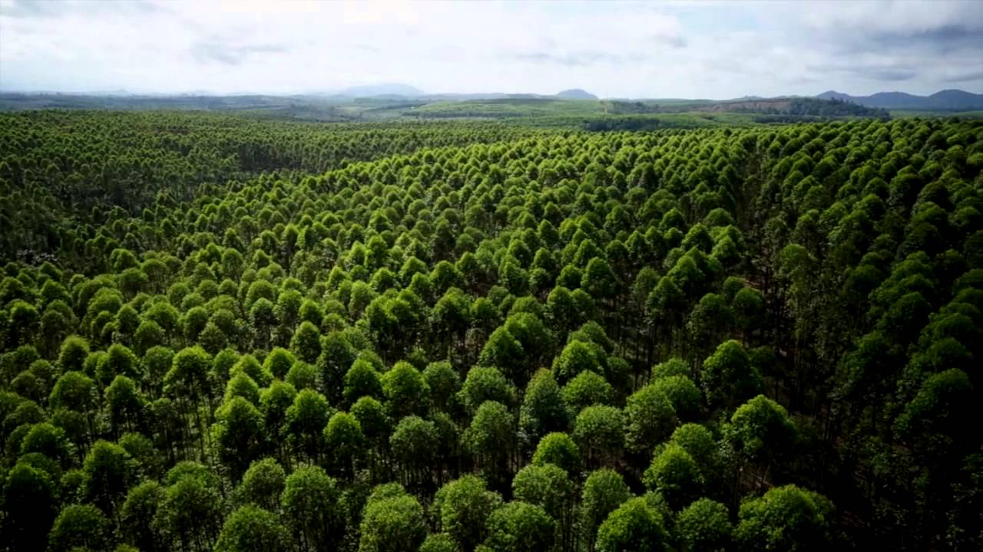

Relative Humidity
Effect of Temperature on Relative Humidity
Since warm air can hold more water vapour than cool air, the amount of rainfall that falls in tropical areas is usually higher than that in temperate areas.
Kalimantan Rainforest in Indonesia, a tropical area
Paris, the capital of France, a temperate area

Slide 29
Relative Humidity
Differences in Relative Humidity in Different Locations
Differences in relative humidity are dependent on temperature. Temperature varies from place to place due to unequal heating of the Earth’s surface via shortwave solar radiation.
Unequal heating depends on factors such as latitude, altitude, distance from the sea. For example, at a coastal area, sea breeze in the afternoon results in much humidity brought to the land, increasing the relative humidity.
Generally, coastal areas experience a higher relative humidity.

Slide 30
Relative Humidity
Saturation
When the relative humidity reaches 100%, saturation occurs. Saturation is also known as dew point temperature. At dew point temperature, condensation takes place.

Slide 31

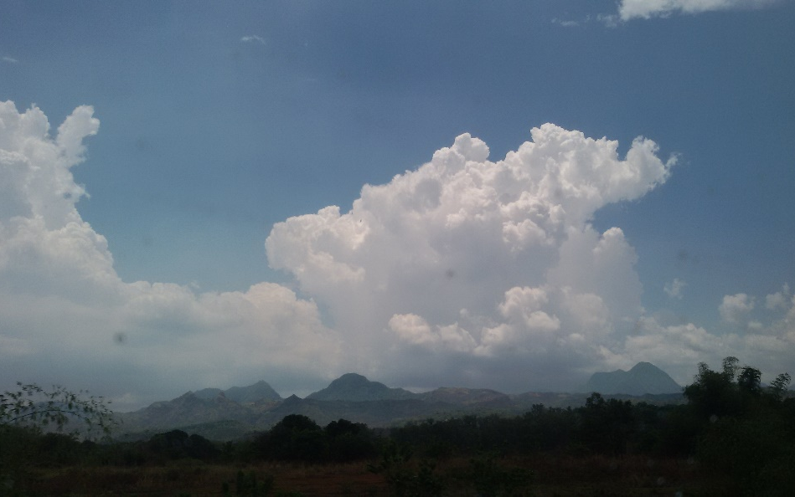

Clouds
Clouds are mass of water droplets or ice crystals suspended in the atmosphere. They form when water vapour cools at dew point temperature and changes into water droplets.
Altocumulus Clouds
Cumulonimbus Clouds
Cirrus Clouds

Slide 32
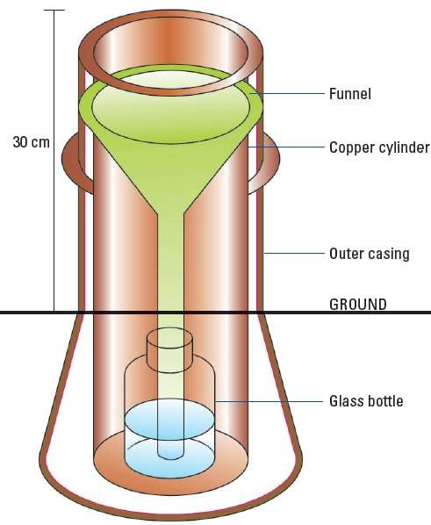
Rainfall
Precipitation refers to water in any form that falls from the atmosphere to the surface of the Earth. Rainfall is measured using a rain gauge.
There are two types of rainfall which are namely:
Convectional Rain
Relief Rain (Orographic Rain)
High Rainfall | Low Rainfall
> 1500mm | < 250mm
Rain Gauge

Slide 33
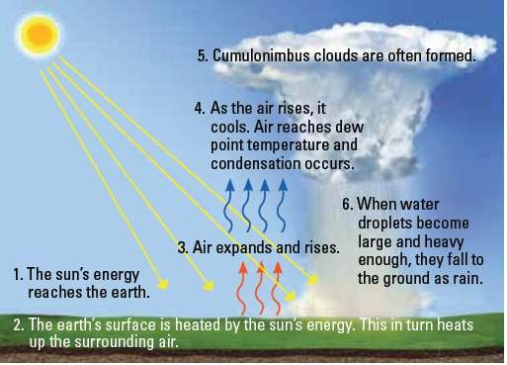
Rainfall
Formation of Convectional Rain

Slide 34
Rainfall
Formation of Convectional Rain
Incoming shortwave solar radiation from the Sun reaches the Earth.
The Earth’s surface is heated by the Sun’s energy, which in turns heats up the surrounding air.
The warm air expands and rises.
As the air rises, it cools. It eventually reaches dew point temperature, resulting in condensation to occur.
Cumulonimbus clouds are often formed.
When the water droplets become too heavy, they fall back to the Earth’s surface as convectional rain.

Slide 35
Rainfall
Characteristics of Convectional Rain
Convectional rain occurs when the Earth’s surface is heated intensely. Hence, this form of rain is common in the tropics which receive a great amount of sunlight.
Convectional rain is often associated with thunder and lightning and it generally lasts only a short time but brings intense rainfall over an area.

Slide 36
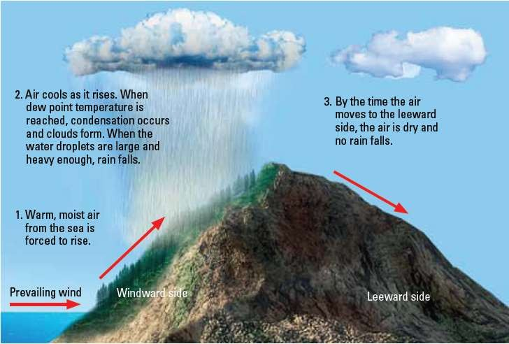
Rainfall
Formation of Relief Rain (Orographic Rain)

Slide 37
Rainfall
Formation of Relief Rain (Orographic Rain)
The warm, moist air from the sea comes into contact with the windward side of the mountain and it is forced to rise.
Air cools as it rises. When dew point temperature is reached, condensation occurs and clouds form. When the water droplets become too heavy, they fall back to the Earth’s surface as relief rain.
By the time the air moves to the leeward slope, it becomes too dry and no rain falls.
When air descends, it is compressed and warmed by the heat near the Earth’s surface. This increases its moisture holding capacity and hence reducing its relative humidity.

Slide 38
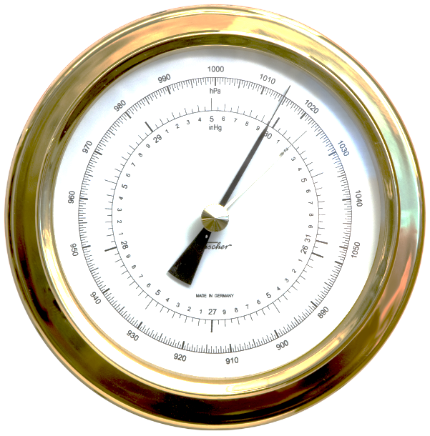
Pressure and Winds
Air Pressure
Air pressure is the force exerted on a unit area of the Earth’s surface by the weight of a column of air above it. It is measured in millibars (mb) using a barometer.
The average sea level pressure is 1013mb.
High Pressure | Low Pressure
> 1013mb | < 1013mb
Barometer

Slide 39
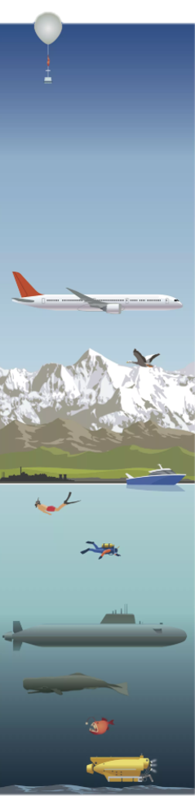
Pressure and Winds
Air Pressure (Relationship with Altitude)
Air pressure decreases as altitude increases because air at higher altitudes are less dense, hence less force is being exerted. Less dense air at higher altitudes is due to gravity pulling the air molecules towards the lower surface of the Earth. Hence, air pressure is higher at sea level and lower at higher altitudes.
Comparing the pressure levels on the peak of a mountain and deep within the ocean, the air pressure at the peak of the mountain is less and the air up there is much thinner.
Altitude | Air Pressure
Decreases | Increases
Hence, altitude and pressure have an inverse relationship.

Slide 40
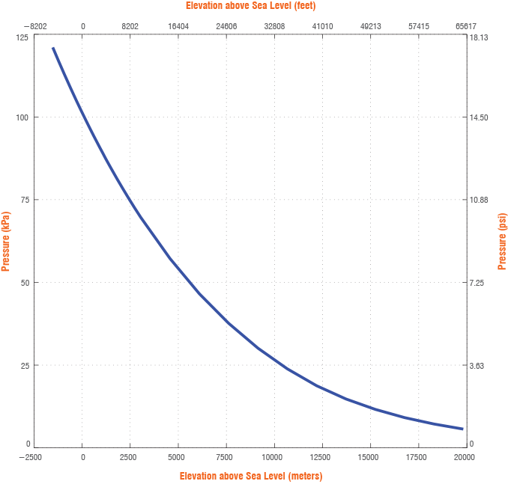
Pressure and Winds
Air Pressure (Relationship with Altitude)
It is evident that air pressure decreases as the altitude increases.

Slide 41
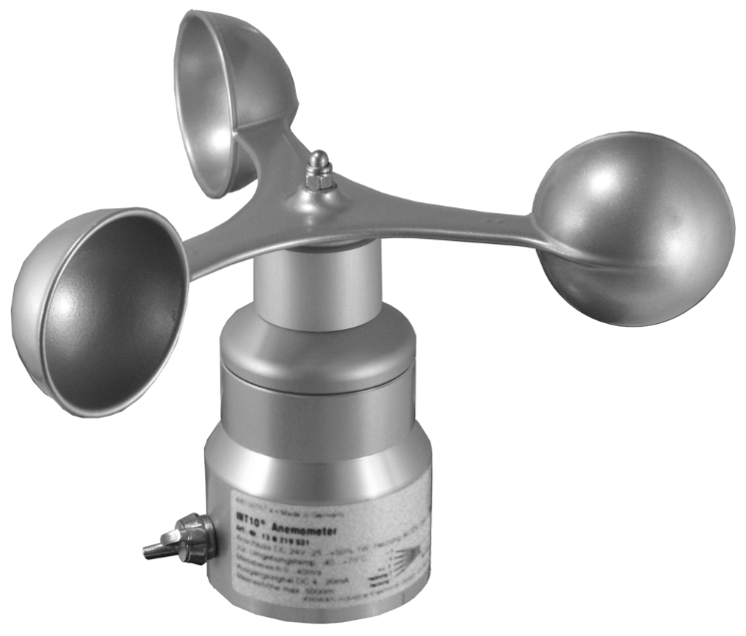
Pressure and Winds
Winds (Beaufort Scale)
Air moves from an area of high pressure to an area of low pressure. This movement of air is known as wind. Pressure gradient is the difference in air pressure between 2 locations. The steeper the surface air pressure gradient, the faster the wind speed.
Wind is described in terms of speed, direction and frequency. Wind speed is the rate at which air is moving and is measured in kilometres per hour (km/h) using an anemometer.
Winds blowing frequently from one direction are termed prevailing winds.
Gradient of Surface | Wind Speed
Increases (becomes steeper) | Increases
Thus, the gradient of a surface is directly proportional to the wind speed.
Anemometer

Slide 42
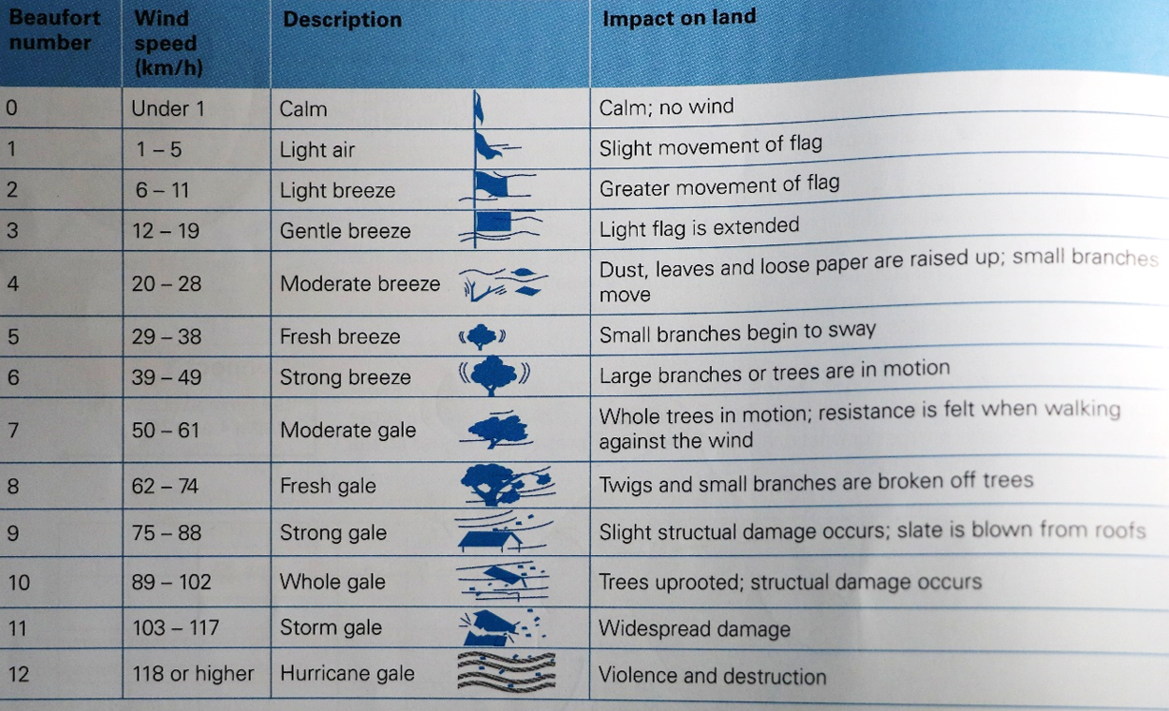
Pressure and Winds
Winds (Beaufort Scale)
The Beaufort Scale can also be used to measure wind speed based on visual impacts of wind on land.

Slide 43
Pressure and Winds
Wind Systems
Land and sea breezes are local winds that occur in coastal areas. These winds lower the temperature of coastal areas during the day and regulate the temperature during the night, leading to a smaller diurnal temperature range in these areas.

Slide 44
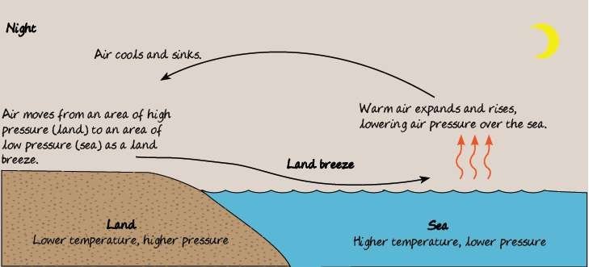
Pressure and Winds
Wind Systems (Land Breeze)
At night, the land cools down faster than the sea. Therefore, the land is cooler and creates an area of higher pressure. The sea cools down slower than the land. Therefore, the sea is warmer and creates an area of lower pressure.
Since air moves from an area of high pressure to an area of low pressure, it moves from the land to the sea as a land breeze.
Land | Sea
Cooler Higher pressure | Warmer Lower pressure
Air moves from land to sea (Land Breeze) Night, Land Breeze (Remember: National Library Board)

Slide 45
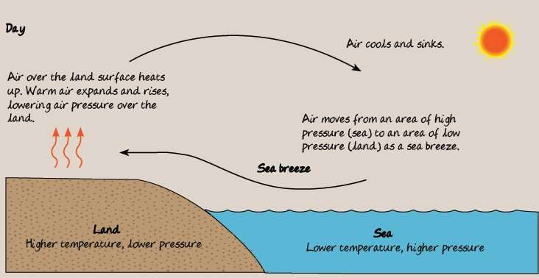
Pressure and Winds
Wind Systems (Sea Breeze)
In the day, the land heats up faster than the sea. Therefore, the land is warmer and creates an area of lower pressure. The sea heats up slower than the land. Therefore, the sea is cooler and creates an area of higher pressure.
Since air moves from an area of high pressure to an area of low pressure, it moves from the sea to the land as a sea breeze.
Land | Sea
Warmer Lower pressure | Cooler Higher pressure
Air moves from sea to land (Sea Breeze) Day, Sea Breeze (Remember: DBS Bank)

Slide 46
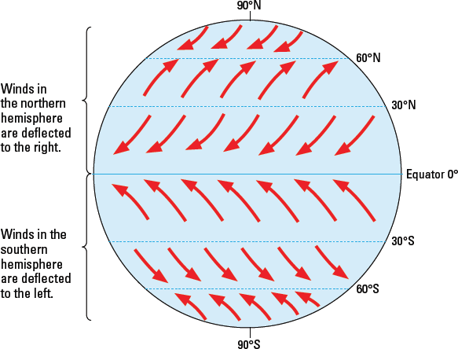
Pressure and Winds
Monsoon Winds
Monsoon winds are regional wind patterns that reverse direction seasonally. This brings seasonal changes in precipitation. The levels of precipitation can either increase or decrease with the occurrence of monsoons and lead to wet or dry seasons.
Monsoon winds and other winds are affected by the Coriolis effect, which is a force produced by the Earth’s rotation. As the Earth rotates, the Coriolis effect changes the course of moving objects on the Earth’s surface. The Coriolis effect causes the bending or deflection of winds.

Slide 47
Pressure and Winds
Monsoon Winds (Southwest Monsoon)
The southwest monsoon takes place between June and September, when it is summer in the northern hemisphere. The air over Central Asia heats up, expands and rises, forming a region of low pressure over the area.
During the same period, the southern hemisphere is experiencing winter. The low temperature causes the air to be cold and dense, exerting a greater force on the Earth’s surface. This results in an area of higher pressure over Australia.
Northern Hemisphere | Southern Hemisphere
Summer Lower pressure | Winter Higher pressure
Southwest Monsoon takes place from June to September (SW69)

Slide 48
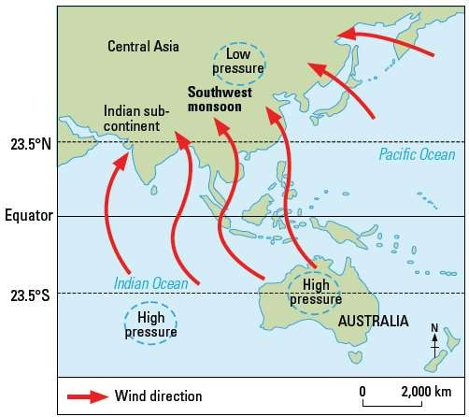
Pressure and Winds
Monsoon Winds (Southwest Monsoon)
Due to the difference in pressure between Central Asia and Australia, air from Australia moves to the Indian subcontinent and Central Asia as the southeast monsoon winds.
As the winds cross the Equator, the Coriolis effect deflects the winds to the right. These winds become the southwest monsoon winds and warm up as they head for Central Asia.
The warm air picks up moisture as it travels over the Indian Ocean and brings heavy rain to the Indian subcontinent.

Slide 49
Pressure and Winds
Monsoon Winds (Northeast Monsoon)
The northeast monsoon takes place between October and February, when it is summer in the southern hemisphere. The air over Australia heats up, expands and rises, forming a region of low pressure over the area.
During the same period, the northern hemisphere is experiencing winter. The low temperature causes the air to be cold and dense, exerting a greater force on the Earth’s surface. This results in an area of higher pressure over Central Asia and the Indian subcontinent.
Northern Hemisphere | Southern Hemisphere
Winter Higher pressure | Summer Lower pressure
Northeast Monsoon takes place from October to February (NE1002)

Slide 50
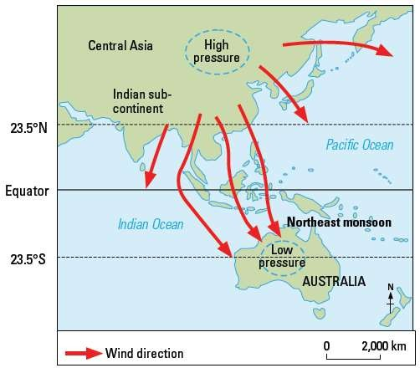
Pressure and Winds
Monsoon Winds (Northeast Monsoon)
Due to the difference in pressure between Central Asia and Australia, air from the Indian subcontinent and Central Asia move to Australia as the northeast monsoon winds.
As the winds cross the Equator, the Coriolis effect deflects the winds to the left. These winds become the northwest monsoon winds and warm up as they head for Australia.
The warm air picks up moisture as it travels over the Indian Ocean and brings heavy rain to Australia.

Slide 51
Gateway 1 – Why do different places experience different weather and climate?
What is the difference between weather and climate?
What are the elements of weather?
What are the climatic types and where are they experienced?

Slide 52
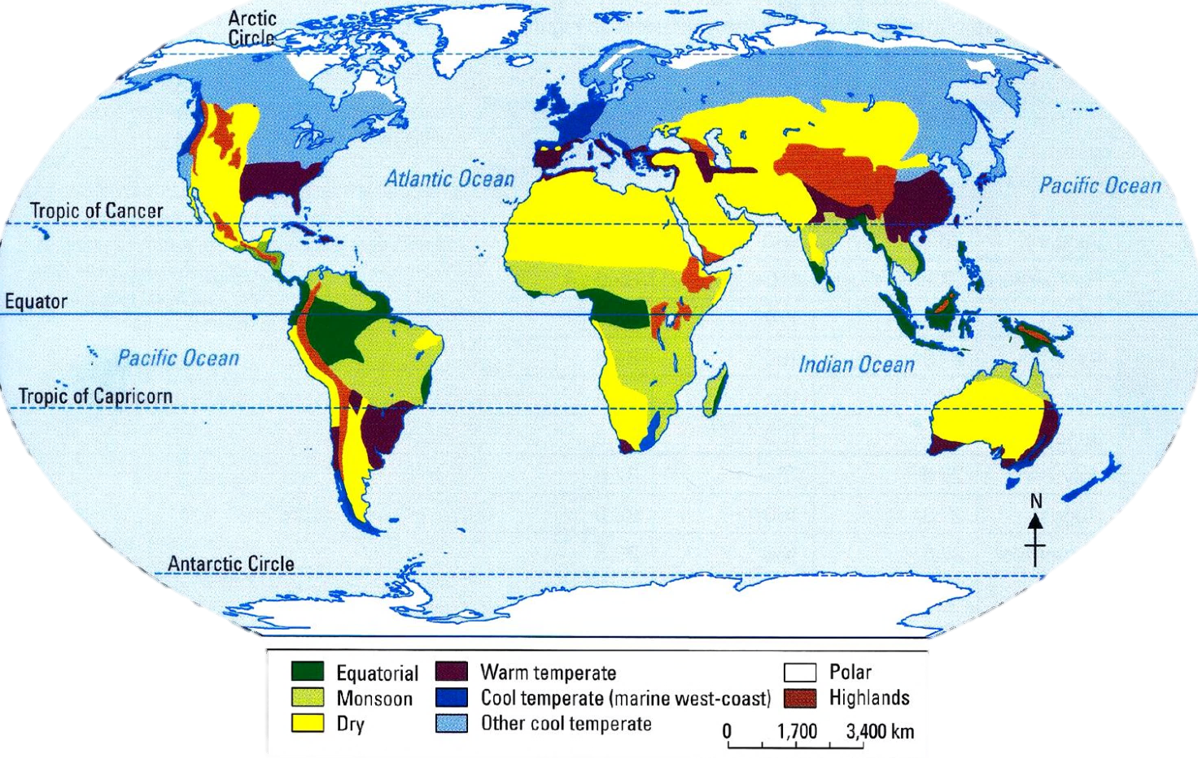
What are the climatic types and where are they experienced?
Distribution of different climatic types is dependent on their latitudinal location, average temperature and rainfall patterns. The three main climatic types are equatorial climate, monsoon climate and cool temperate (marine west-coast) climate.

Slide 53
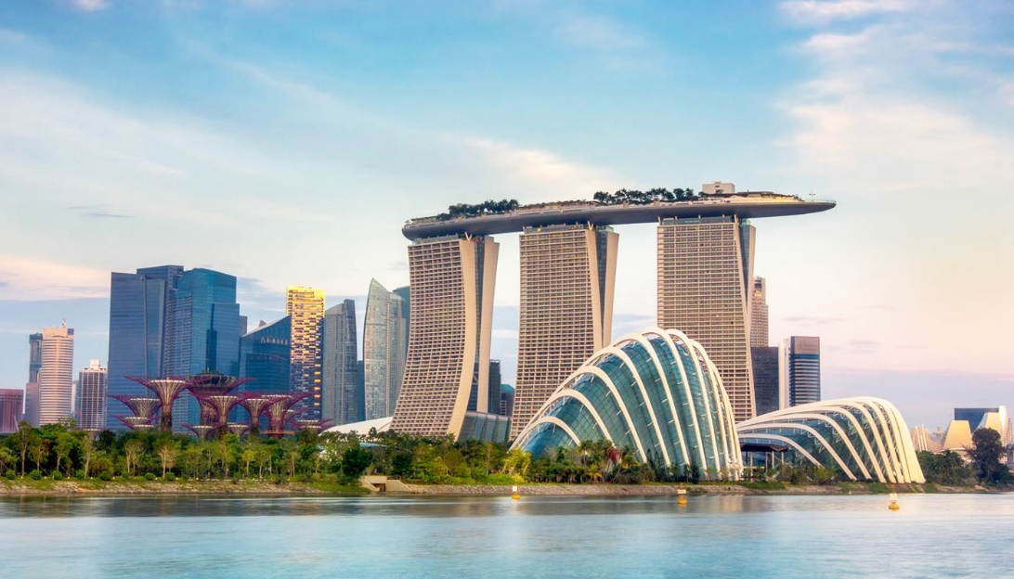
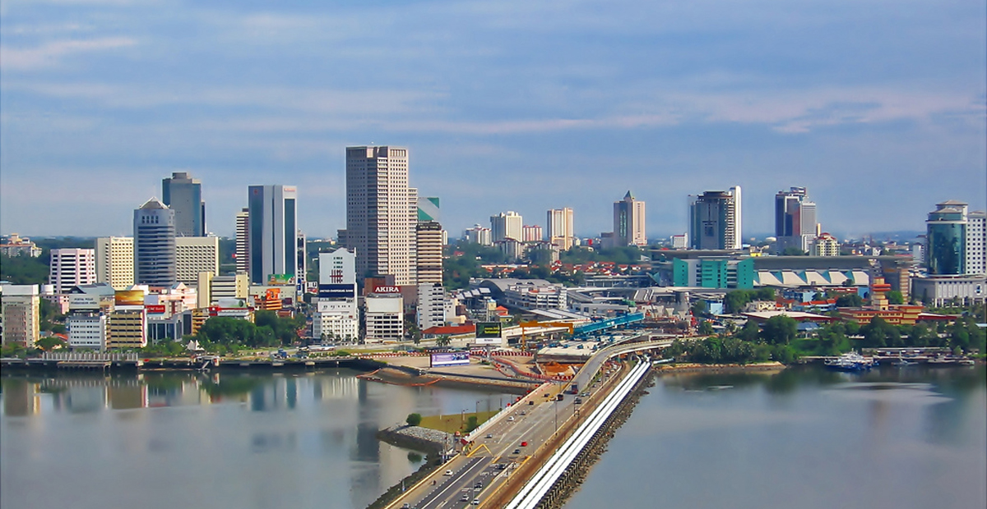
Equatorial Climate
Distribution
Places that experience the equatorial climate are usually located 10° North and South of the Equator.
Examples of cities experiencing this climate include Singapore and Johor Bahru in Malaysia.
Singapore
Johor Bahru, Malaysia

Slide 54
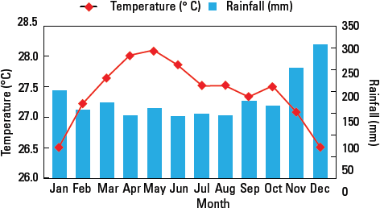
Equatorial Climate
Temperatures
The equatorial climate is characterised by high temperatures because of the high angle of incidence of the Sun’s rays that strike onto the Earth’s surface, resulting in the solar energy being concentrated on a small area.
These places experience a high mean annual temperature of about 27°C and small annual temperature range of about 2°C.
These areas also receive long hours of sunlight.
Climograph of Johor, Malaysia

Slide 55
Equatorial Climate
Rainfall
For places which experience the equatorial climate, they have high relative humidity usually above 80% throughout the year due to rapid evaporation rate caused by high temperatures.
Convectional rain is common and usually falls in the late afternoon. The annual rainfall is high of more than 2000mm and it is wet throughout the year. There is no distinct dry season.
Climograph of Johor, Malaysia

Slide 56
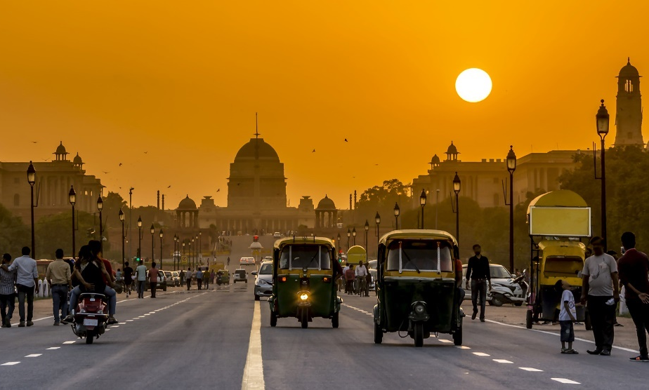
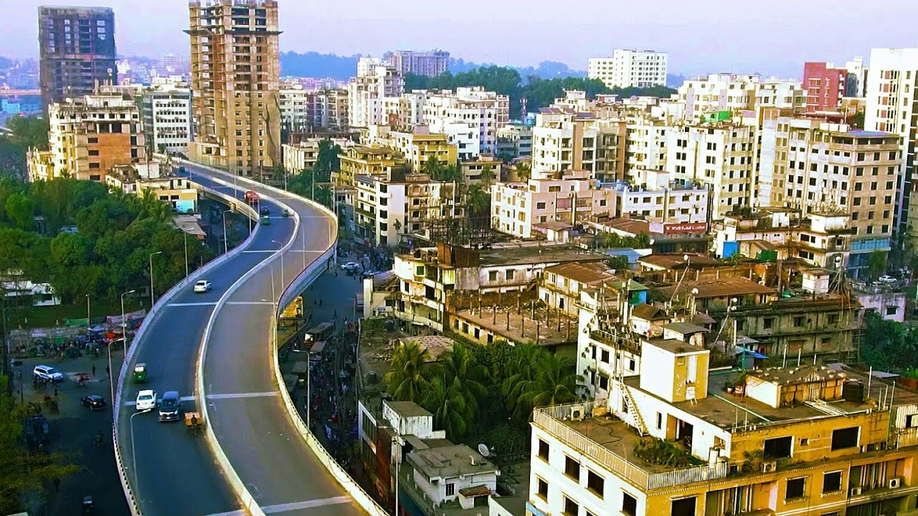

Monsoon Climate
Distribution
Places that experience the monsoon climate are usually located 5° to 25° North and South of the Equator.
Examples of cities experiencing this climate include India, Australia and Bangladesh.
New Delhi, India
Chittagong, Bangladesh
Sydney, Australia

Slide 57
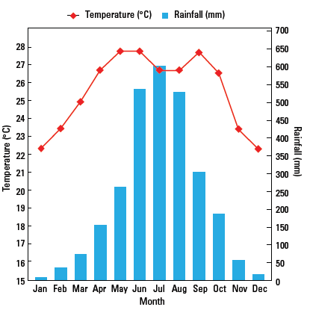
Monsoon Climate
Temperatures
The monsoon climate is characterised by high mean annual temperatures but lower than that of equatorial climatic regions due to their location being further away from the Equator.
The mean annual temperature averages 26°C and it can be as high as 30°C during the hot and dry season and around 20°C during the cold season.
The annual temperature range is small at about 4°C.
Climograph of Chittagong, Bangladesh

Slide 58
Monsoon Climate
Rainfall
For places which experience the monsoon climate, they generally have high annual rainfall of more than 1500mm. These areas also have distinct wet and dry seasons as these places are influenced by monsoon winds.
For example, Chittagong in Bangladesh receives an average of 2000mm of rainfall during the wet season between June and September. However, during the dry season from October to May, it receives about 750mm of rainfall.
Climograph of Chittagong, Bangladesh

Slide 59
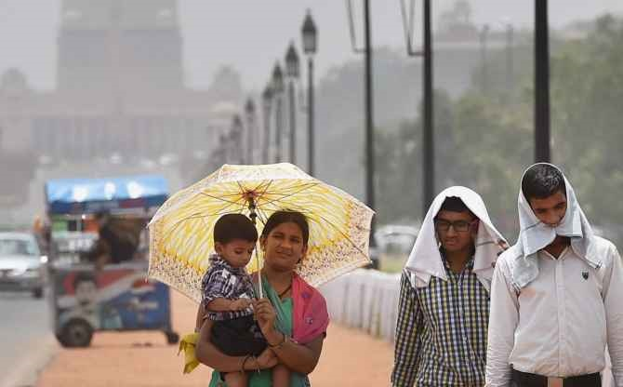
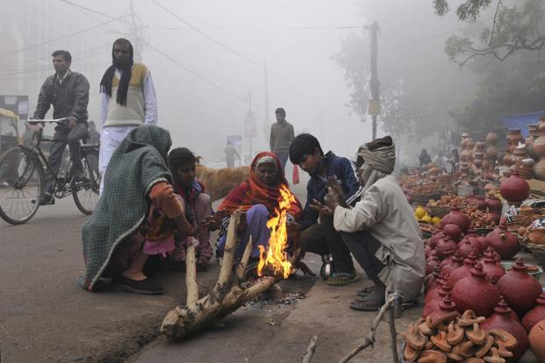
Monsoon Climate
Rainfall
For places which experience the monsoon climate, they generally have high annual rainfall of more than 1500mm. These areas also have distinct wet and dry seasons as these places are influenced by monsoon winds.
For example, Chittagong in Bangladesh receives an average of 2000mm of rainfall during the wet season between June and September. However, during the dry season from October to May, it receives about 750mm of rainfall.
Heat wave in New Delhi, India
Cold Season in Agra, North India

Slide 60
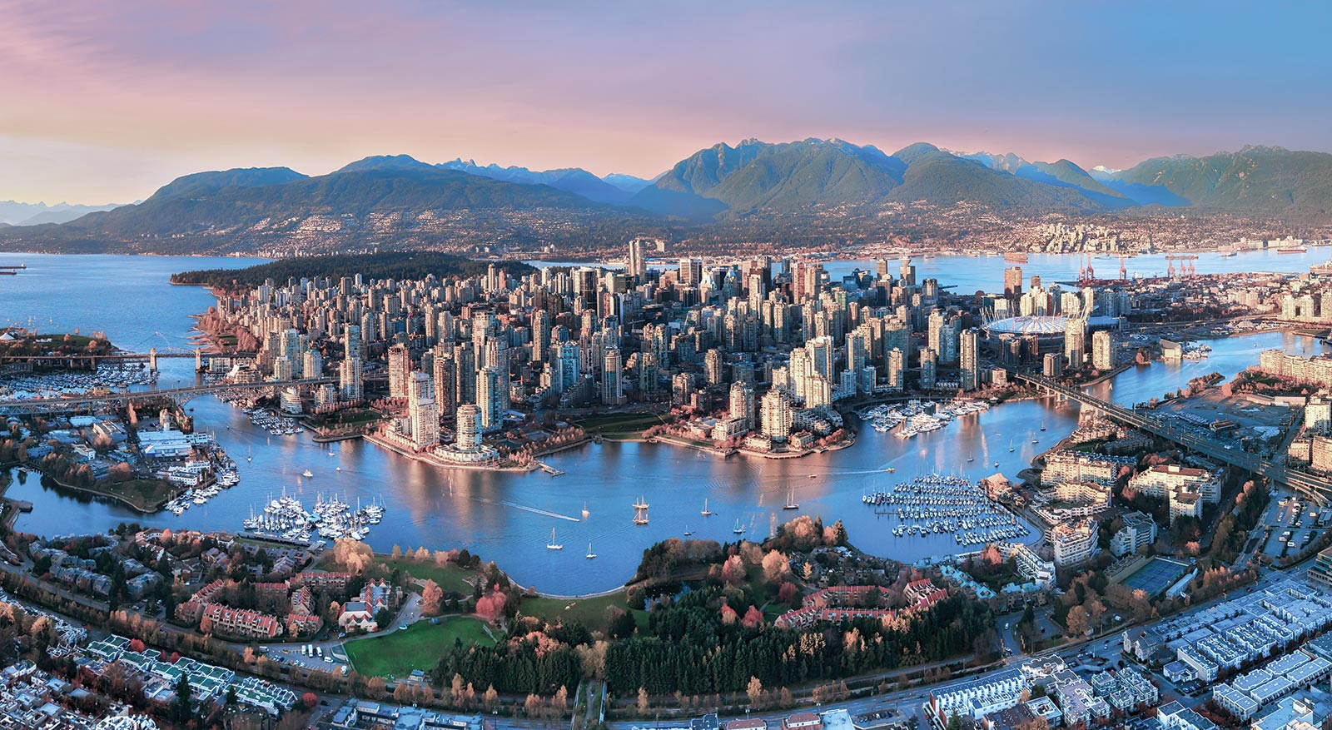
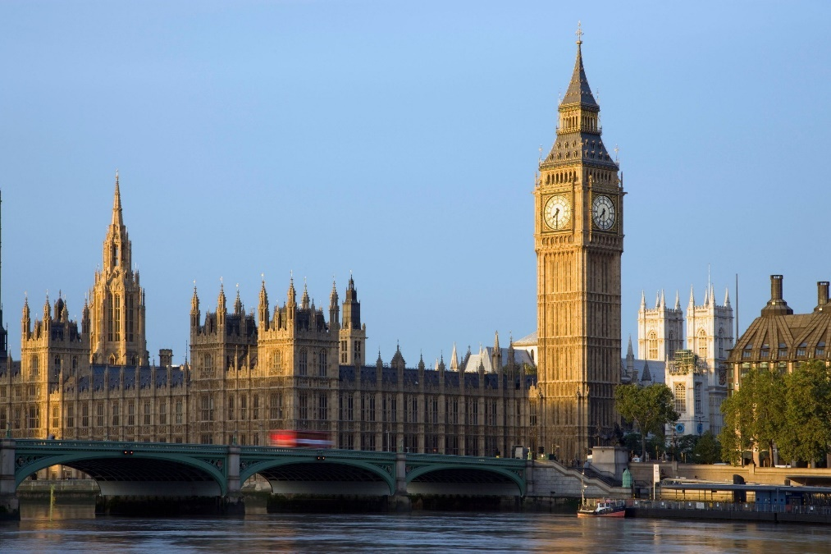
Cool Temperate Marine West-Coast Climate
Distribution
Places that experience the monsoon climate are usually located 45° to 60° North and South of the Equator.
Examples of cities experiencing this climate include Vancouver in Canada, London and Paris.
Vancouver, Canada
London, England

Slide 61
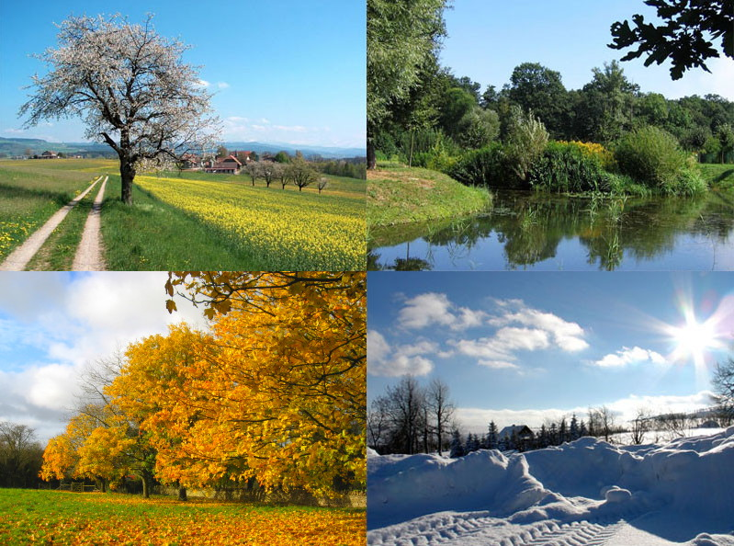
Cool Temperate Marine West-Coast Climate
Temperatures
The cool temperate marine west-coast climate is characterised by the four distinct seasons of spring, summer, autumn and winter due to the tilt of the Earth and its revolution around the Sun.

Slide 62
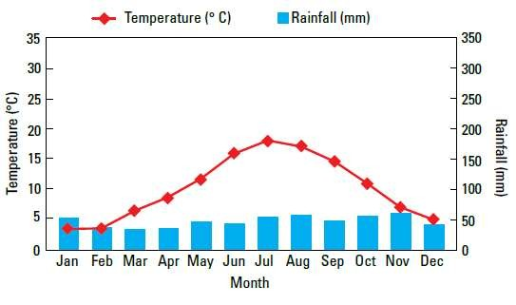
Cool Temperate Marine West-Coast Climate
Temperatures
Places experiencing this climate have temperatures ranging from -3°C to 22°C depending on the season. As a result, the annual temperature range for cool temperate marine west-coast climate is large.
Climograph of London, England

Slide 63
Cool Temperate Marine West-Coast Climate
Temperatures
Winters are mild, have shorter days and receive less energy from the Sun because the Sun’s rays strike at an oblique angle.
Summers are cool and warm and receive more solar energy due to the Sun’s rays striking at a larger angle.

Slide 64
Cool Temperate Marine West-Coast Climate
Rainfall
Rainfall is evenly distributed throughout the year. However, the amount of rain received is low, ranging from 300mm to 900mm. Rain falls throughout the year with no distinct wet or dry seasons.
Climograph of London, England

