Slide 1
Secondary 3 Pure Geography
Chapter 2 – Living with Tectonic Hazards
Gateway 3 – How do people prepare for and respond to earthquakes?

Slide 2
Gateway 3 – How do people prepare for and respond to earthquakes?
Why do people continue to live in areas prone to earthquakes?
How do people respond to natural hazards like earthquakes?

Slide 3
Why do people continue to live in areas prone to earthquakes?
People continue to live in earthquake-prone areas because they can respond in various ways which are namely
Fatalistic Approach
  Accept and resist evacuation. Typical for less developed countries who have limited access and knowledge.
Acceptance Approach
  Live with the risk due to the potential benefits offered in the area.
Adaptation Approach
  Well prepared for earthquakes.

Slide 4
Gateway 3 – How do people prepare for and respond to earthquakes?
Why do people continue to live in areas prone to earthquakes?
How do people respond to natural hazards like earthquakes?

Slide 5
How do people respond to Earthquakes?
Even though people are not able to prevent earthquakes, they are able to implement measures that would prepare them to cope with the impacts of earthquakes. Preparedness measures can reduce the extent of damage and allow populations to survive an earthquake.

Slide 6
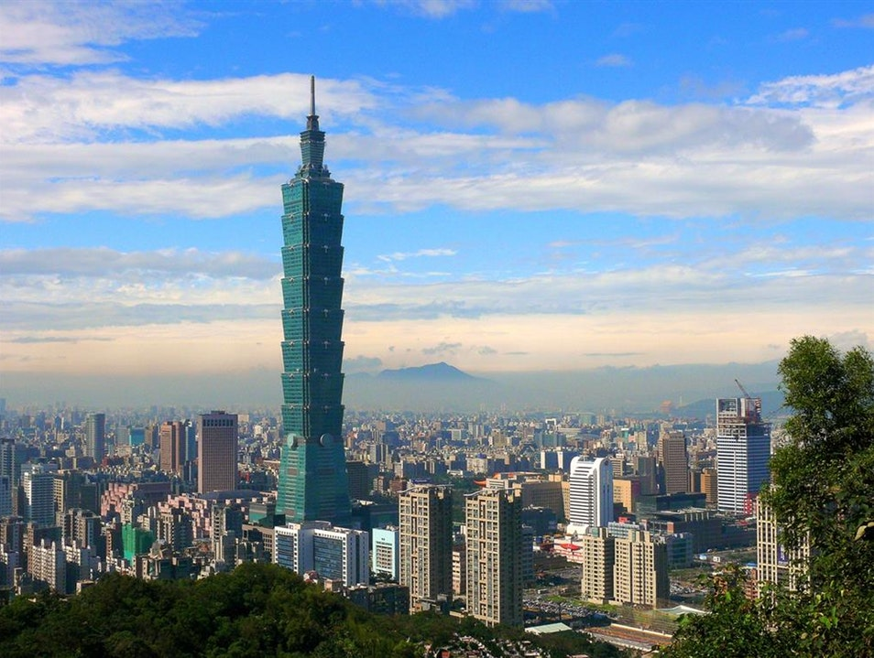
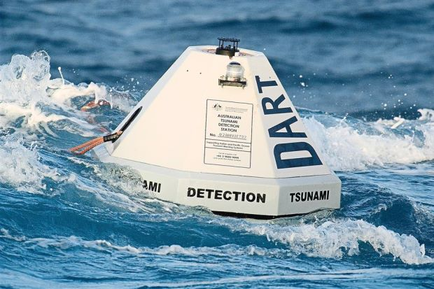
Preparedness Measures
The preparedness measures that people put in place to cope with earthquakes and its associated hazards include
Land Use Regulation
Infrastructure
Emergency Drills
Earthquake and Tsunami Monitoring and Warning Systems
Infrastructure, Effective Design
Tsunami Early Warning Systems

Slide 7
Preparedness Measures
Land Use Regulation
Land use regulations are a set of rules implemented to restrict developments in certain areas.
EFFECTIVENESS: This would reduce casualties and economic damages as buildings will not be built in places which are unsafe.
LIMITATION: However, this measure is costly as the government acquires unsafe land. Existing owners might also be reluctant to give up land.
For example, in California, United States of America, all new building developments are not built across fault lines or areas at risk of liquefaction.

Slide 8
Preparedness Measures
Infrastructure
Infrastructure needs to be developed with advanced engineering to withstand the vibration associated with an earthquake which includes the following.
Effective building design can reduce the collapse of buildings and minimise the damage caused by an earthquake.
Roads, bridges and dams can be built to resist the shaking of the ground so that they do not collapse, or can be easily repaired if they collapse.
Homes, office buildings and factories can be fitted with trip switches that ensure all electrical points are switched off in the event of an earthquake. This measure prevents fires from breaking out.
This measure helps to reduce collapses and minimises damage.

Slide 9
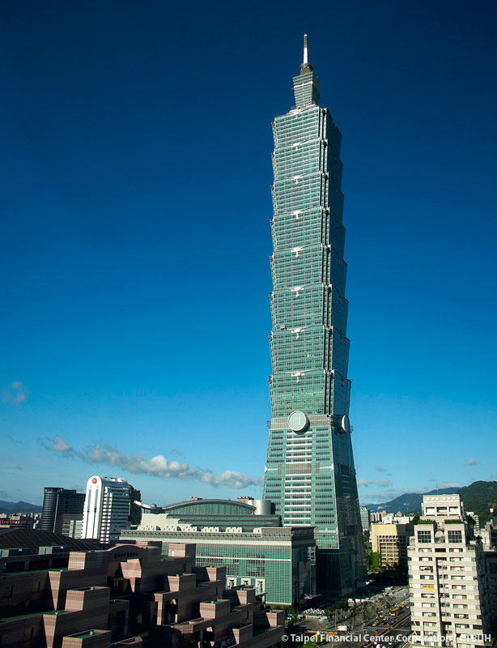
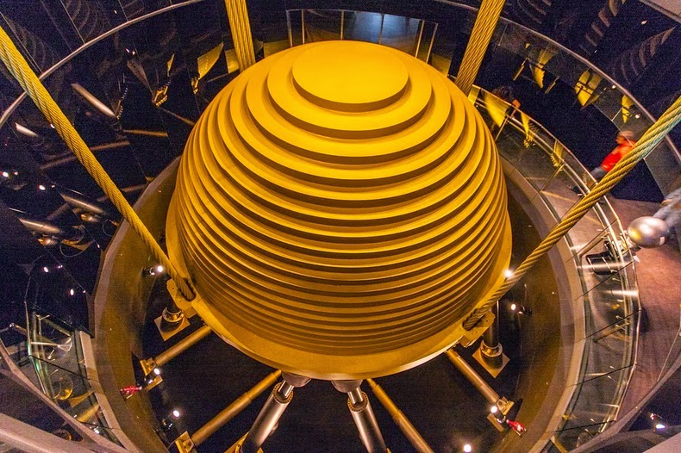
Preparedness Measures
Infrastructure
EFFECTIVENESS: This will lead to fewer lives being lost, faster rescue and evacuations and less money spent on recovery for the affected areas.
LIMITATION: However, this measure is expensive and it is not cost-effective to retrofit existing buildings.
Taipei 101 is made of steel and reinforced concrete which are able to withstand earthquakes better than more brittle materials. A damping device acts as a shock absorber for some of the seismic energy released during an earthquake, acting as counterweights which move in the direction opposite to the motion of an earthquake. This prevents the building from swaying too much and collapsing.
Damping Device in Taipei 101

Slide 10
Preparedness Measures
Emergency Drills
Emergency drills are a form of preparedness measure where people practice the steps to take when an earthquake occurs. This creates awareness and reduces panic and irrational behavior during an event.
EFFECTIVENESS: This would prevent widespread panic and hysteria in the event of an earthquake and the public would know how to act appropriately.
LIMITATION: However, this is based on the magnitude of past earthquakes and therefore, the emergency scenario might not be realistic and would sometimes turn out unprecedented.

Slide 11
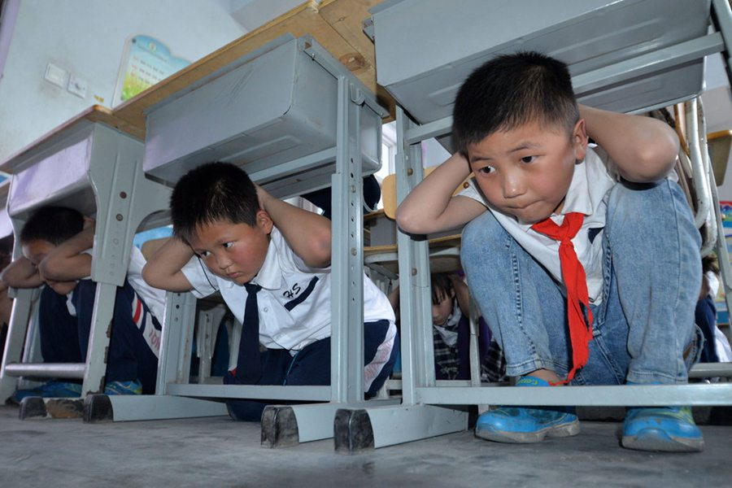
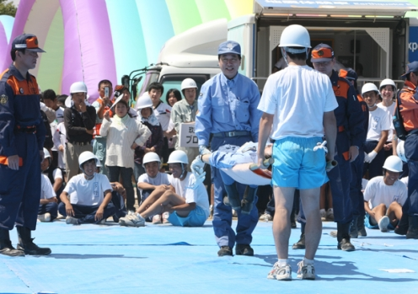
Preparedness Measures
Emergency Drills
For example, every year since 1960, Japan conducts emergency drills on September 1st to commemorate Disaster Prevention Day. People all over Japan are involved where a simulation of an earthquake of high magnitude is carried out. The intention is to prepare the people on how to mentally react to a disaster.
Disaster Prevention Day in Japan

Slide 12
Preparedness Measures
Earthquake Monitoring and Warning Systems
Seismic risk maps show the likelihood of locations at risk from earth movements or liquefaction. Earthquake sensors in earthquake-prone zones help monitor the frequency of vibrations and detect possible developments of an earthquake.
EFFECTIVENESS: Technology can be used to measure movements on the Earth’s surface and predict the occurrences of earthquakes.
LIMITATION: However, earthquake sensors are expensive to obtain, install and use. Furthermore, the warnings provided may not provide sufficient time for an evacuation. Noise, lightning or device failure may interfere with the seismograph and result in false warnings being given. It is also difficult to give accurate warnings when multiple earthquakes occur close to each other.

Slide 13
Preparedness Measures
Tsunami Monitoring and Warning Systems
Tsunami monitoring and warning systems are activated to warn people about the occurrence of a tsunami.
EFFECTIVENESS: Technology can be used to measure movements on the Earth’s surface and predict the occurrences of tsunamis, prompting people to evacuate and saving their lives.
LIMITATION: Tsunami detectors are prone to giving false alarms when waves are high and there is little time to evacuate once an approaching tsunami is detected.

Slide 14
Preparedness Measures
Tsunami Monitoring and Warning Systems
In the case of Japan, when the warning system for impending 2011 Tohoku earthquake alerted millions of people a minute before it struck, procedures of earthquake drills were followed and speedy evacuation helped save some lives.
In the case of Haiti, a lesser developed country, there was no warning prior to the 2010 Haiti earthquake. As a result, people were caught unawares and many lives were lost.

Slide 15
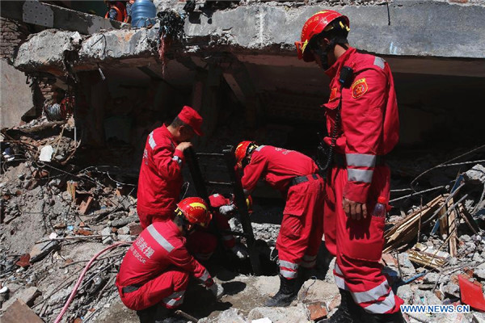
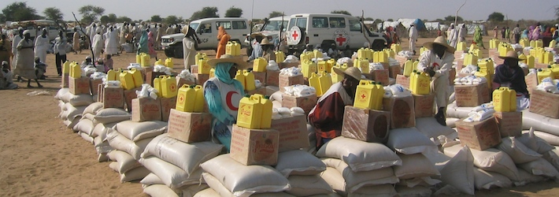
Short-Term Responses
How people prepare for and respond to an earthquake is also important in restoring a place and making it liveable again. This includes both short-term and long-term responses.
Short-term responses are those that occur immediately and last for weeks after the occurrence of an earthquake. Short-term responses include providing survivors with the basic necessities of food, water and shelter.
Humanitarian, emergency and disaster management
Rescuing victims of earthquake

Slide 16
Short-Term Responses
Search and Rescue
People trapped under collapsed buildings are quickly located and freed.
EFFECTIVENESS: Some survivors are found after being trapped for a couple of weeks without food.
For example, after the 2011 Tohoku Earthquake in Japan, sniffer dogs and heat sensors were deployed and successfully rescued many who were trapped.
LIMITATION: Rescue workers only have a limited time of 72 hours to find trapped survivors. Without food and water, the trapped victims are unlikely to survive after 3 days.

Slide 17
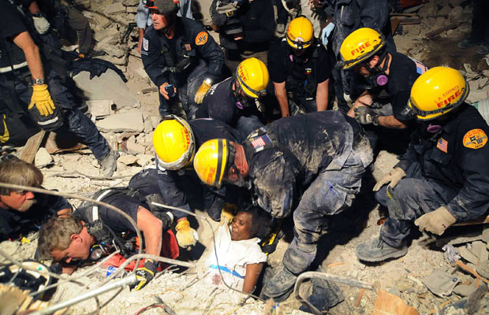
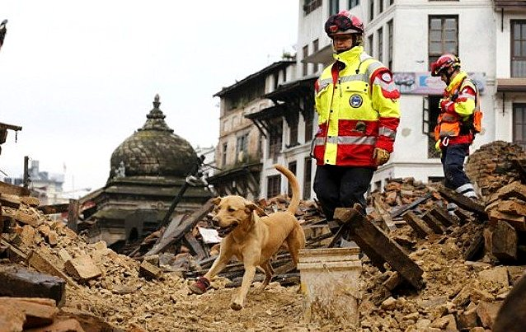
Short-Term Responses
Search and Rescue
Rescue workers pulling out a woman from the rubble of a collapsed building during the 2010 Haiti Earthquake
Sniffer dogs are deployed to aid in searching for trapped victims

Slide 18
Short-Term Responses
Emergency, food and medical supplies
The injured are treated and clean drinking water is provided to survivors in order to prevent dehydration and the spread of diseases.
EFFECTIVENESS: The provision of immediate aid helps survivors continue with their lives.
For example, after the Afyon Earthquake in Turkey in 2002, the Turkish Red Crescent Society immediately responded by delivering tents, blankets and heaters to the region.
LIMITATION: However, medical supplies, food and water may be insufficient which might lead to social unrest.

Slide 19
Long-Term Responses
Long-term responses to earthquakes can stretch over months and years and involve rebuilding an affected region. However, carrying out such measures and responses can be costly.
Rebuilding of infrastructure
Provision of health care

Slide 20
Long-Term Responses
Rebuilding of Infrastructure
Infrastructure and amenities are rebuilt and improved upon after a disaster.
EFFECTIVENESS: Authorities often develop stricter building codes to ensure infrastructure is restored at a higher safety level than before.
For example, after the Kobe Earthquake in Japan in 1995, the Japanese government spent billions of dollars developing technology to build more earthquake-resistant buildings.
LIMITATION: Reinforced buildings which are built to protect against earthquakes are not necessarily protected against tsunamis. Additional protection could be in the form of coastal structures such as breakwaters.

Slide 21
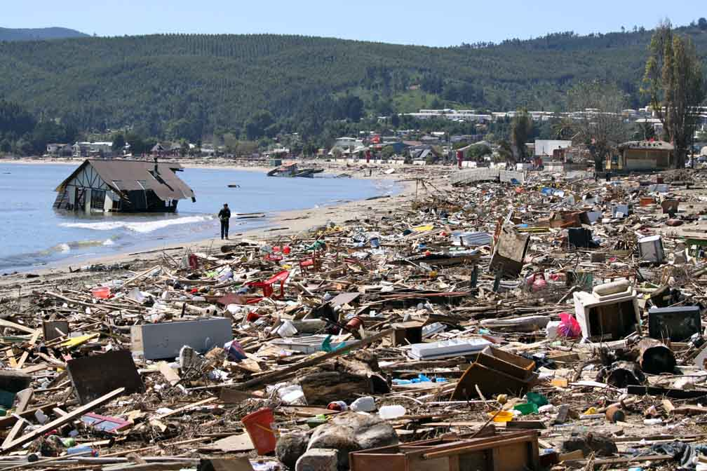
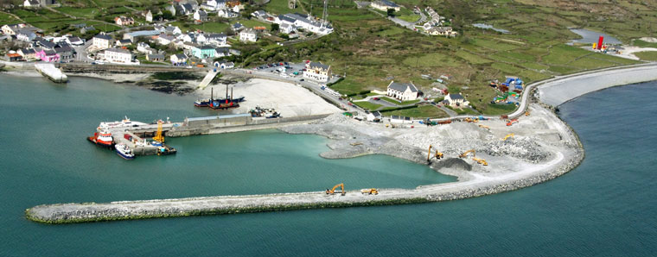
Long-Term Responses
Rebuilding of Infrastructure
Breakwaters are artificial offshore structures which intercept longshore currents and prevent beach erosion
Outcome of 2010 Chile Earthquake when a tsunami struck the coastal region

Slide 22
Long-Term Responses
Provision of Health Care
Health options such as long-term counselling are provided. The loss of loved ones, homes or jobs after earthquakes cause long-lasting trauma.
EFFECTIVENESS: Problems can be identified or addressed early.
For example, a year after the Christchurch Earthquake in New Zealand in 2011, significant problems of anxiety and depression were identified amongst all age groups of the affected population. This resulted in a greater number of health workers being deployed in the area.
LIMITATION: Improving health options such as restoring the resilience of people after an earthquake can be very challenging.

