Slide 1
Secondary 3 Pure Geography
Chapter 2 – Living with Tectonic Hazards
Gateway 2 – What landforms and associated phenomena are found at plate boundaries?

Slide 2
Gateway 2 – What landforms and associated phenomena are found at plate boundaries?
Why are different landforms found at different plate boundaries and how are they formed?
What phenomena are found at plate boundaries and how are they formed?

Slide 3
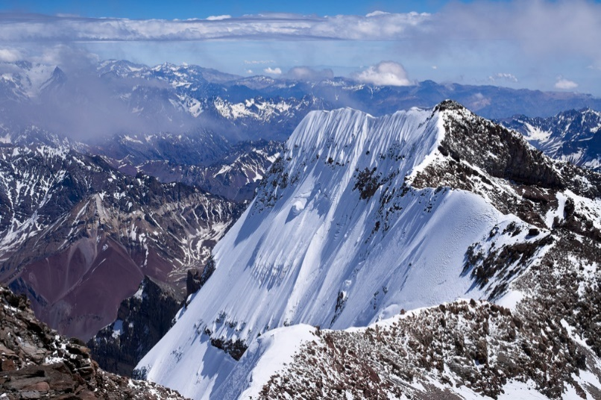
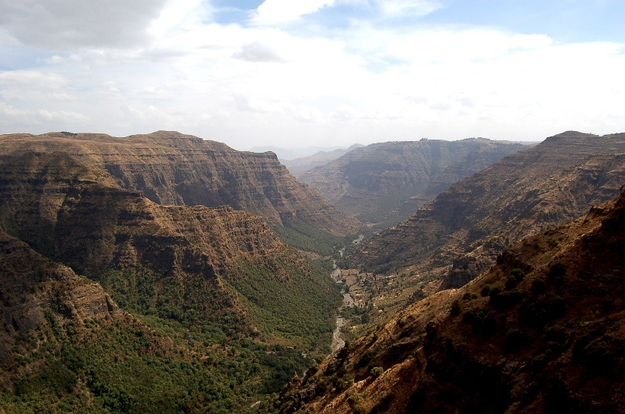
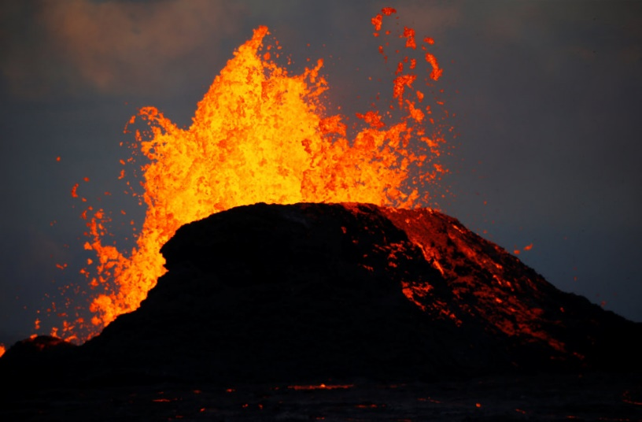
Why are different landforms found at different plate boundaries and how are they formed?
The movement of plates at different plate boundaries can result in various landforms such as fold mountains, rift valleys and block mountains as well as volcanoes.
Andes Fold Mountains
East African Rift Valley
Kilauea Volcano, Hawaii

Slide 4
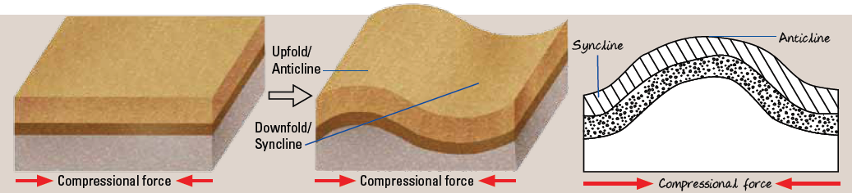

Fold Mountains
Fold mountains are formed along convergent plate boundaries where plates move toward each other and collide.
The compressional force causes the layers of rocks to buckle and fold. This process is known as folding.
In a folded rock layer, the upfold is called the anticline and the downfold is known as the syncline.

Slide 5
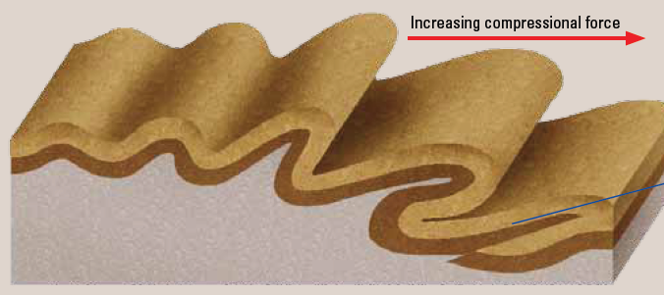
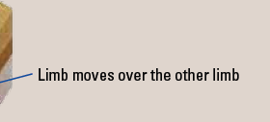
Fold Mountains
When there is increasing compressional force on one limb of a fold, the rocks may buckle until a fracture forms. The limb may then move forward to ride over the other limb.

Slide 6
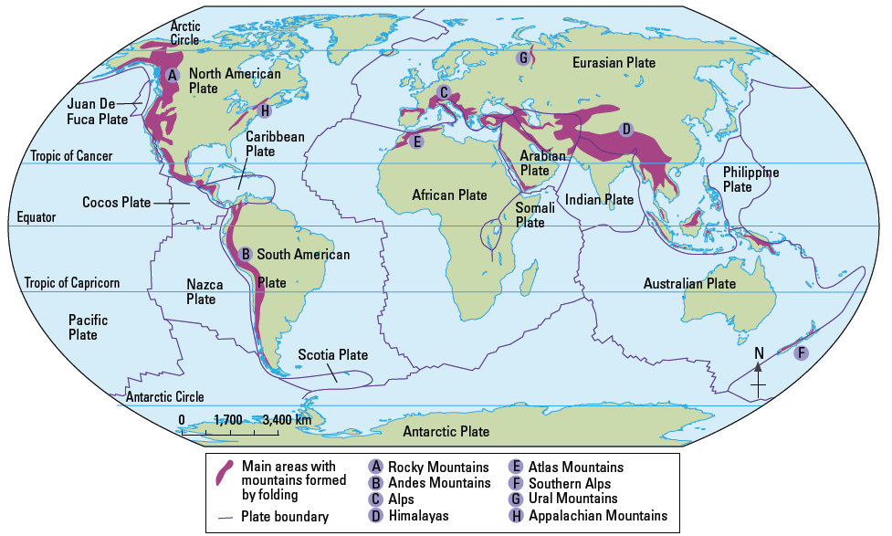
Fold Mountains
Locations of Fold Mountains
Fold mountains are found at convergent plate boundaries.

Slide 7
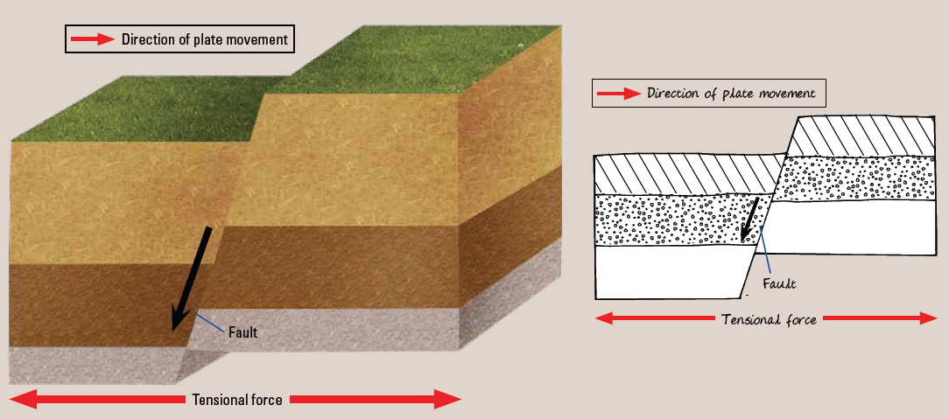
Rift Valleys and Block Mountains
Rift valleys and block mountains are formed at divergent plate boundaries where plates are pulled apart, giving rise to faults.
A fault is a fracture in the rocks along which the rocks are displaced. The tensional forces result in parts of the crust being fractured. This process is called faulting.

Slide 8
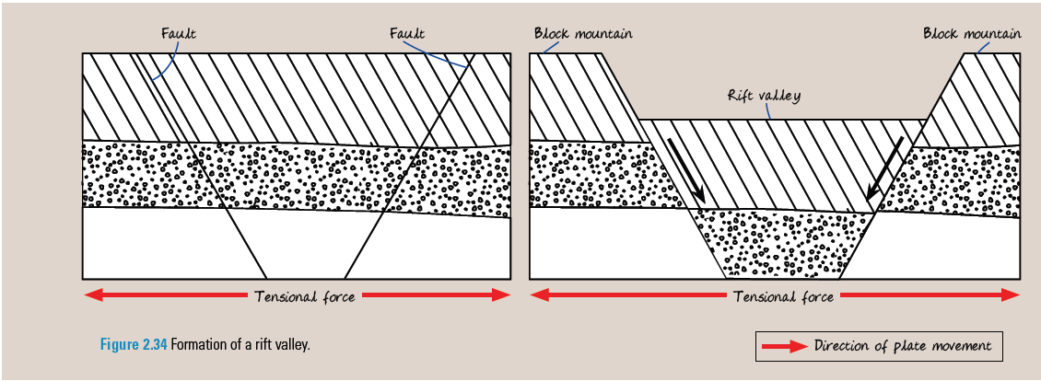
Rift Valleys and Block Mountains
A rift valley is a valley with steep sides formed along fault lines.
When sections of the crust extend along fault lines, tensional forces can cause a central block of land to subside between a pair of parallel faults, forming a rift valley.

Slide 9
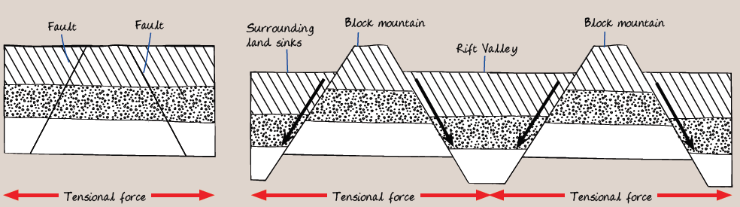
Rift Valleys and Block Mountains
A block mountain is a block of land with steep sides.
It is formed when sections of the crust extend along fault lines and rock masses surrounding a central block sink due to tensional forces.

Slide 10
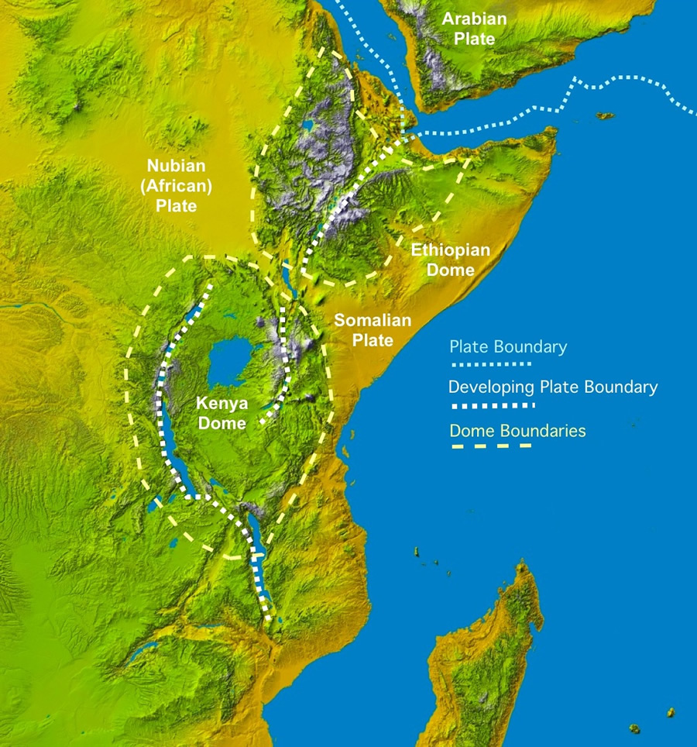
Rift Valleys and Block Mountains
Location of Rift Valleys and Block Mountains
Rift valleys and block mountains are found at divergent plate boundaries.
For example, the East African Rift Valley is formed due to the divergent movement of the Somalian boundary of the African Plate from the Nubian boundary of the African plate.

Slide 11
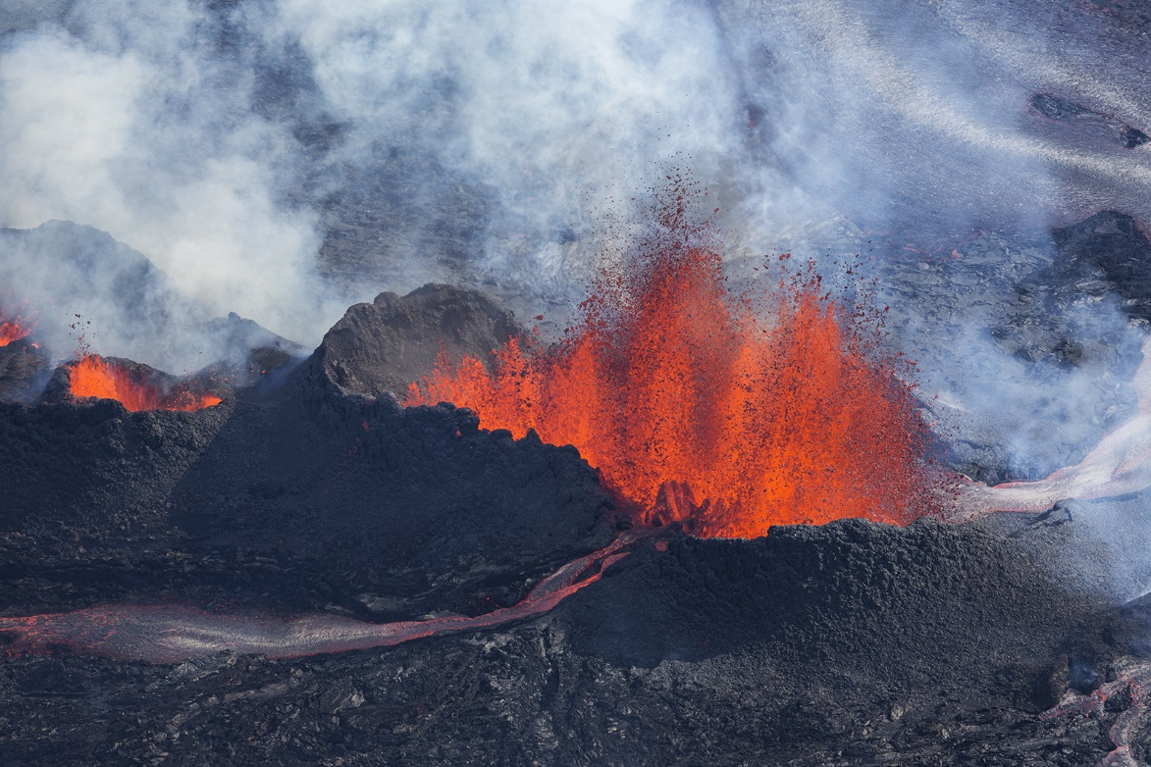
Volcanoes
A volcano is a landform formed by magma ejected from the mantle onto the earth’s surface.
Magma is molten rock found below the Earth’s surface and builds up within the crust to form a magma chamber. A magma chamber is a reservoir of molten rock beneath the Earth’s crust.
Holuhraun Volcanic Eruption, Iceland

Slide 12
Volcanoes
Volcanoes are formed by a process known as vulcanicity.
1. As magma seeps into the magma chamber, the amount of pressure in the chamber builds up, giving rise to a volcanic eruption.
2. When the pressure in the chamber is too great, magma moves via vents to the Earth’s surface, causing a volcanic eruption.
3. Volcanic materials are ejected during this process.
4. Much lava solidifies near the vent to form a small volcanic cone known as the crater.
5. Subsequent new layers of lava and volcanic materials build up the volcano.

Slide 13
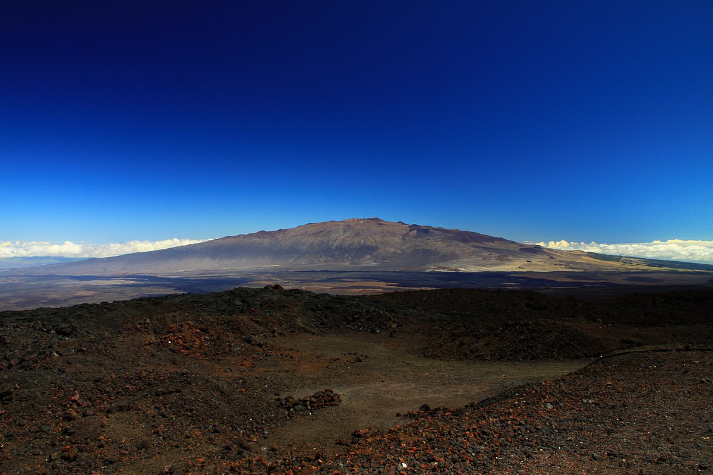
Volcanoes
Shield Volcanoes
Shield volcanoes have gentle sloping sides and a broad summit.
When low-silica lava is ejected, these volcanoes are formed. As low-silica lava flows easily due to it being less viscous, it spreads out over a large area before solidifying.
Since the lava does not trap much gas, eruptions are usually not explosive. With successive eruptions, the base of the volcano increases in size as the lava accumulates.
Shield volcanoes are common along divergent plate boundaries where magma can rise directly above the mantle.
Mauna Kea, a shield volcano in Hawaii, United States of America

Slide 14
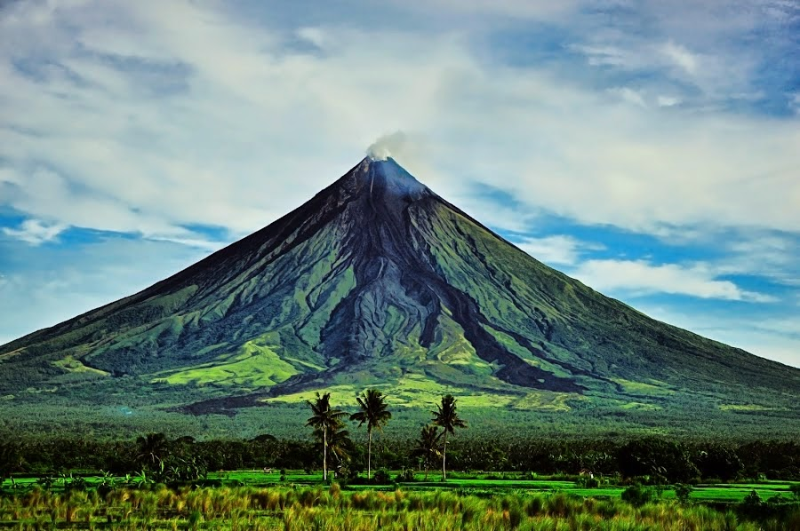
Volcanoes
Stratovolcanoes
Stratovolcanoes are also known as composite volcanoes and they develop from successive eruptions of lava and pyroclasts. Pyroclasts refer to ash and rock fragments which are ejected during a volcanic eruption.
After an initial eruption of pyroclasts, the subsequent eruption ejects lava which covers them and prevents them from being eroded.
Successive eruptions build a high volcano with a slightly concave shape. Hence, the volcano is steeper at the top and gentler at the base.
Secondary cones may develop as magma from the vents seeps into the sides of the cone and erupts.
Mount Mayon, a stratovolcano in the Philippines

Slide 15
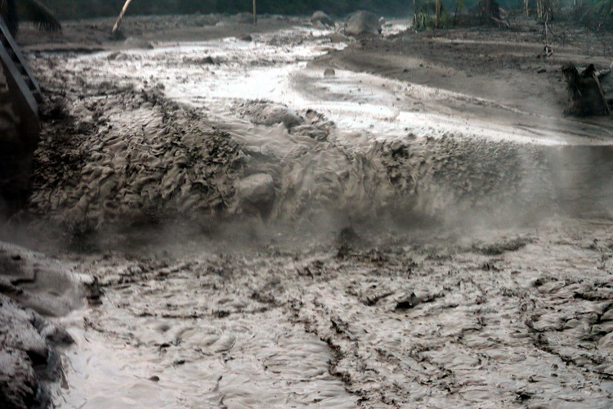
Volcanoes
Stratovolcanoes
Pyroclastic flow and lahars may result from volcanic eruptions. Lahars are formed when pyroclasts mix with water from melted ice or lakes and they are fast-flowing mudflows.
Lahar is a destructive mudflow on the slopes of a volcano

Slide 16
Volcanoes
Comparison between Shield Volcanoes and Stratovolcanoes
 | Shield Volcanoes | Stratovolcanoes
Structure | Gentle sloping sides, broad submit | Tall, slightly concave, steeper at the top with a gentler base
Type of lava | Low silica, non-viscous | High silica content, viscous
Type of eruption | Usually not explosive | Generally explosive (viscous lava traps gas)
Example | Mauna Kea, USA | Mount Mayon, the Philippines

Slide 17
Gateway 2 – What landforms and associated phenomena are found at plate boundaries?
Why are different landforms found at different plate boundaries and how are they formed?
What phenomena are found at plate boundaries and how are they formed?

Slide 18
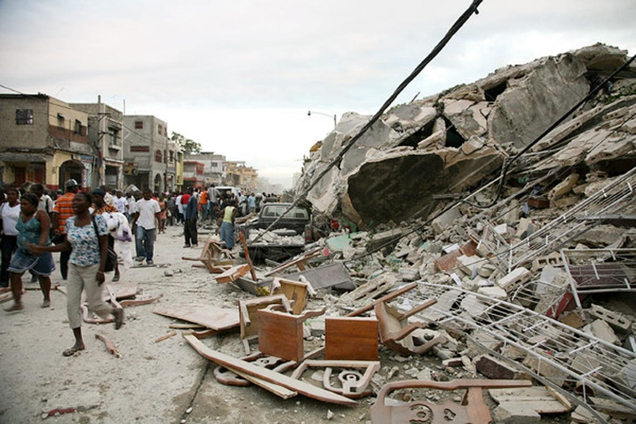
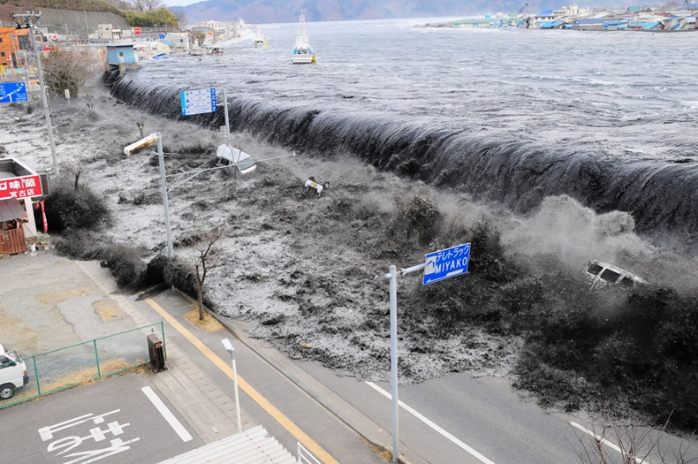
What phenomena are found at plate boundaries and how are they formed?
Phenomena which are associated with plate movements include earthquakes, tsunamis and volcanic eruptions.
Aftermath of 2010 Haiti Earthquake
Tsunami in Japan
Eruption of Kilauea in Hawaii

Slide 19
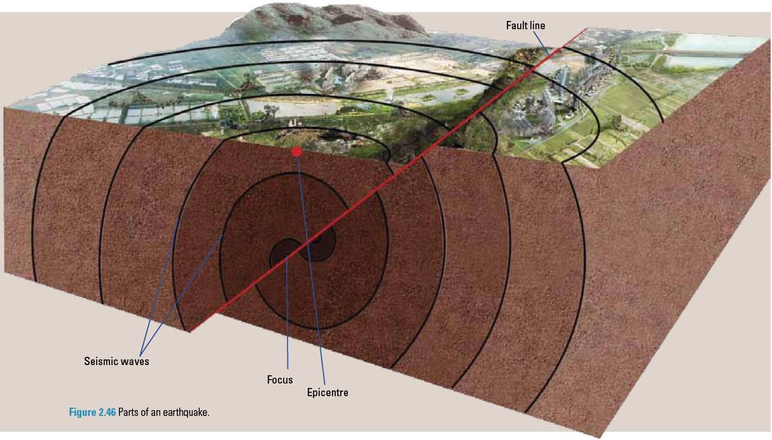
Earthquakes
An earthquake is a vibration in the Earth’s crust caused by the sudden release of stored energy in the rocks found along the fault lines. Earthquakes occur when there is movement along plate boundaries.
The plate movements cause the build-up of stress on the rocks on either side of the fault. When the rocks can no longer withstand the increasing stress, they can slip many metres, causing an earthquake.

Slide 20
Earthquakes
An earthquake releases energy in the form of seismic waves. These waves radiate out from a point of sudden energy release called the focus. The point on the Earth’s surface directly above the focus is known as the epicentre.

Slide 21
Earthquakes
Extent of Earthquakes
Earthquakes release different amounts of energy. The amount of energy released is described as the magnitude of the earthquake.
The Richter Scale is used to measure the magnitude of an earthquake.

Slide 22
Earthquakes
Extent of Earthquakes
Apart from its magnitude, the extent of damage caused by an earthquake may vary based on other factors:
Population density
Time of occurrence
Level of preparedness
Distance from the epicentre
Type of soil

Slide 23
Earthquakes
Extent of Earthquakes [Population Density]
The number of people living in the affected area is an important factor. Earthquakes in sparsely populated areas are likely to affect fewer people than in densely populated areas. Therefore, an earthquake in a city can cause more casualties and damage than an earthquake in the countryside.

Slide 24
Earthquakes
Extent of Earthquakes [Level of preparedness]
The amount of preparation taken by the authorities and citizens makes a significant difference to the impact of an earthquake. These preparations include having evacuation plans, trained rescue workers and a range of action plans. The damage caused by an earthquake is more manageable when people are better prepared for it.

Slide 25
Earthquakes
Extent of Earthquakes [Distance from the epicentre]
The damage caused by an earthquake is more severe when an area is closer to the epicentre of the earthquake. During the earthquake in Christchurch, New Zealand in 2011, the epicentre was in a town a few kilometres away from the city centre. The city suffered more damage than areas further away from the city.

Slide 26
Earthquakes
Extent of Earthquakes [Time of occurrence]
The time of the day during which an earthquake occurs determines where people are and what they are doing. This will affect their chances of survival in an earthquake. If the earthquake occurs when most people are sleeping, there is a higher chance that these people will be trapped in their houses and more deaths may occur. For example, more than 2400 people died when an earthquake occurred a couple of hours after midnight in the Sun Moon Lake region in Taiwan in 1999.

Slide 27
Earthquakes
Extent of Earthquakes [Type of soil]
In places where the sediments are loose and unconsolidated, the seismic waves are amplified and this results in greater damage when earthquakes occur. Structures built on saturated and unconsolidated sediments can be affected by liquefaction. Liquefaction is when the ground becomes unstable and saturated soil flows like a liquid. In Christchurch, many houses and buildings had to be abandoned because of liquefaction after an earthquake in 2011.

Slide 28
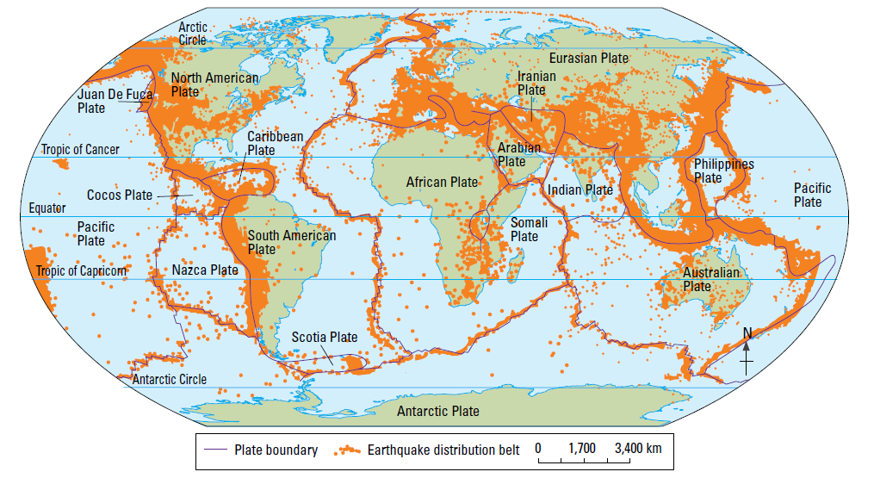
Earthquakes
Location and Distribution of Earthquakes
Earthquakes can occur at convergent, divergent and transform plate boundaries but occur most often at convergent plate boundaries. This is because stress builds up when a plate subducts beneath another.
Around 75% of the earthquakes which occur annually are found along the Pacific Ring of Fire.

Slide 29
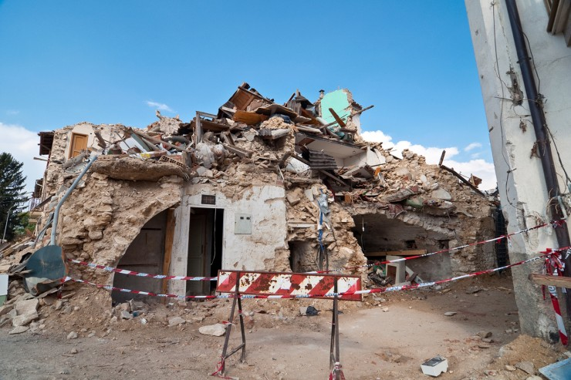
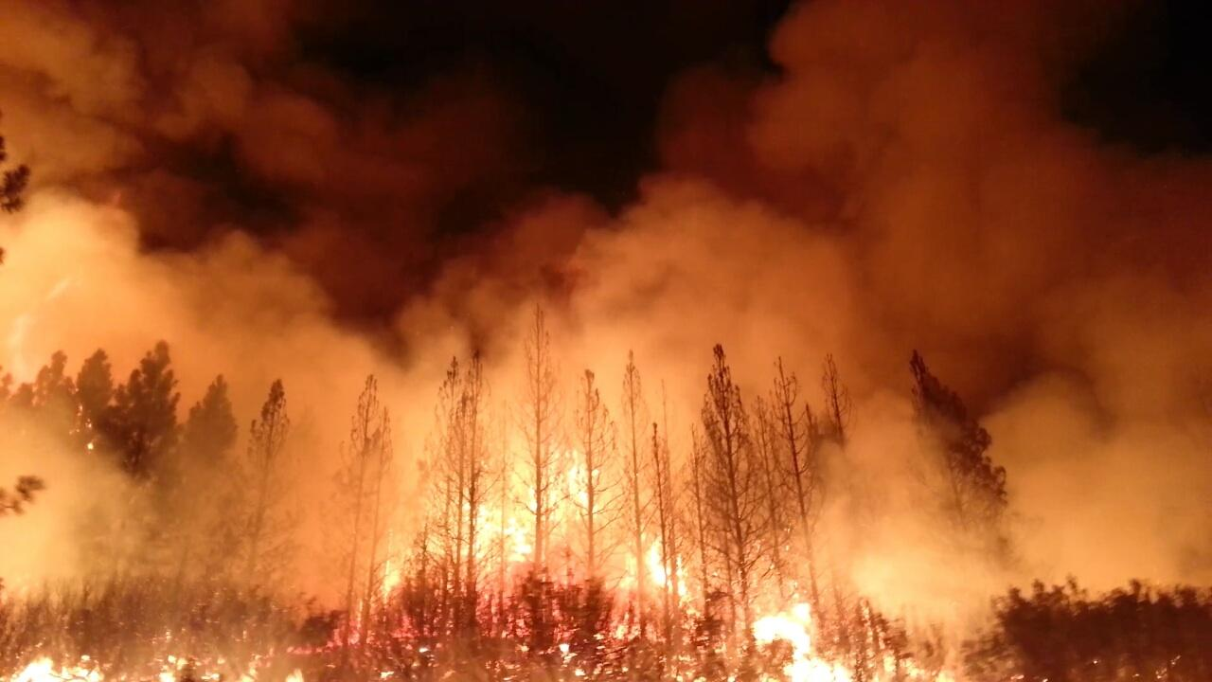
Earthquakes
Risks associated with living in Earthquake Zones
Some hazards associated with living in earthquake zones include the threat of tsunamis, disruption of services, fires, landslides, destruction of properties, destruction of infrastructure and loss of lives.
Tsunami in Japan
Destruction of Infrastructure
Wildfire

Slide 30
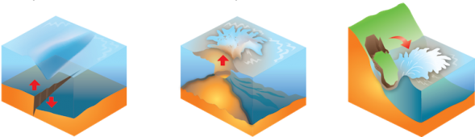
Risks associated with living in Earthquake Zones
Tsunamis
One of the most damaging hazards associated with an earthquake is a tsunami. Tsunami refers to an unusually large sea wave. They may be formed by:
The movement of the seafloor during a large earthquake at the subduction zones
An explosive underwater volcanic eruption
A landslide above sea level which causes materials to plunge into the water. Such landslides may be due to earthquakes or volcanic eruptions.
These 3 diagrams show the possible formations of a tsunami – illustrating an earthquake, volcanic eruption and a landslide respectively.

Slide 31
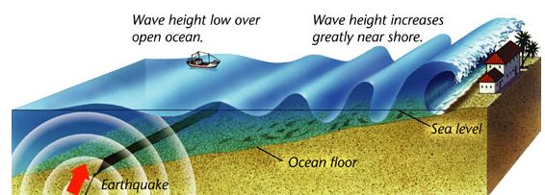
Risks associated with living in Earthquake Zones
Formation of Tsunamis
Tsunamis are formed when seismic energy from an offshore earthquake forces out a mass of sea water.
The subduction of the denser oceanic plate causes much pressure and tension to be built up.
As the threshold is reached, the oceanic plate snaps back to its original position, causing much energy to be released in the form of seismic waves.
This causes an offshore earthquake which displaces a huge mass of seawater. The wave created has a large wavelength but a low height.
On reaching shallower water, greater friction with the seabed slows down the waves and forces them to increase in height, resulting in a tsunami that breaks violently at the coast.

Slide 32
Risks associated with living in Earthquake Zones
Disruption of Services
An earthquake can disrupt services such as the supply of electricity, gas and water and potentially affect a large area. Vibrations on the ground can snap pipes and break cables which may cause the outbreak of fires. Communication services such as television broadcasts and telephone connections may also be affected.
The earthquake in Kobe, Japan, in 2004 damaged pipes and transmission lines. This disrupted electricity, gas and water supplies to about a million of Kobe city’s 1.4 million residents.

Slide 33
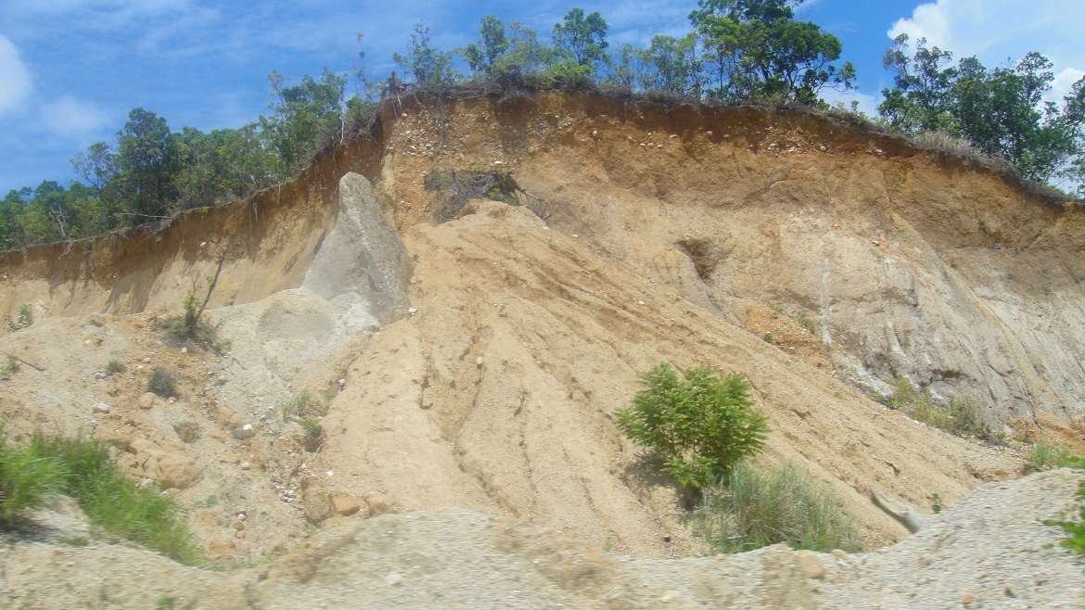
Risks associated with living in Earthquake Zones
Landslides
The shaking of the ground during earthquakes can weaken the slopes of hills and mountains. The unstable slopes may result in landslides. Landslides are rapid downslope movements of soil, rock and vegetation debris from a slope. They can range from several metres to several kilometres in both length and width.
Mudflows may also occur when there is heavy rainfall which saturates the soil, causing the mixed soil debris to flow down the slope. Mudflow is often experienced in Indonesia and the Philippines where heavy rainfall is common.
Landslide

Slide 34
Risks associated with living in Earthquake Zones
Destruction of Properties
Earthquakes can cause widespread destruction to many homes. People may be without homes after the disaster and reside at temporary shelters while their homes are being rebuilt.

Slide 35
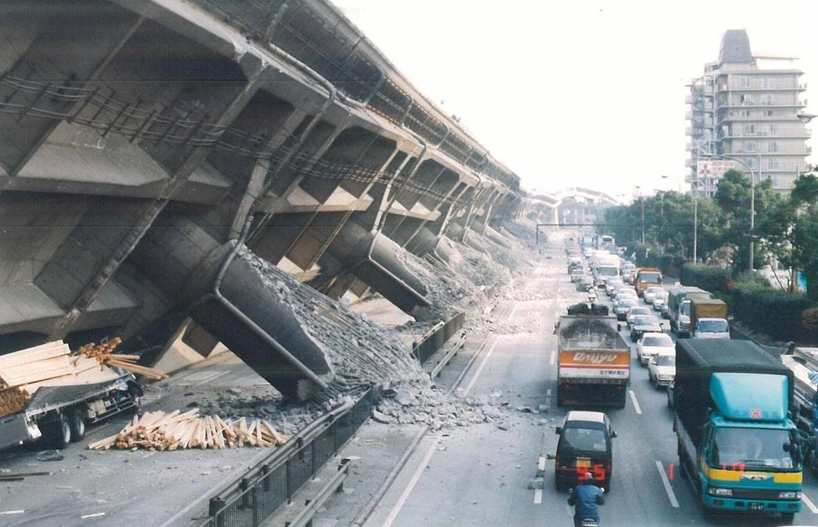
Risks associated with living in Earthquake Zones
Destruction of Infrastructure
Earthquakes may cause cracks to form in infrastructure such as roads and bridges. Transportation can be disrupted as it is unsafe to use the damaged roads. For example, after the earthquake in Kobe, Japan, in 1995, many places in the city became inaccessible or difficult to reach.
Aftermath of Kobe Earthquake in 1995

Slide 36
Risks associated with living in Earthquake Zones
Loss of Lives
Earthquakes and their associated hazards often threaten the lives of those living in earthquake zones.
The hazards associated with living in earthquake zones can cause great destruction when an earthquake occurs. Hence, it is important for people living in earthquake zones to be prepared for an earthquake and take necessary precautionary measures to minimise the damage.

Slide 37
Volcanic Eruptions
Volcanic eruptions result from tectonic activity. Volcanic eruptions can occur on land or on the seafloor.
There are 3 types of volcanoes – active, dormant and extinct volcanoes.
Active volcanoes refer to volcanoes which are currently erupting or are expected to erupt in the near future.
Dormant volcanoes are currently inactive but may erupt in the future.
Extinct volcanoes refer to volcanoes without current seismic activity and with no geological evidence of eruptions for the past thousands of years.

Slide 38
Risks of living near Volcanic Areas
There are risks associated with living near volcanic areas. For example, people who live near the subduction zones of the Pacific Ring of Fire face the risks from volcanic eruptions. These people include the populations of Indonesia, the Philippines, Taiwan and Japan.

Slide 39
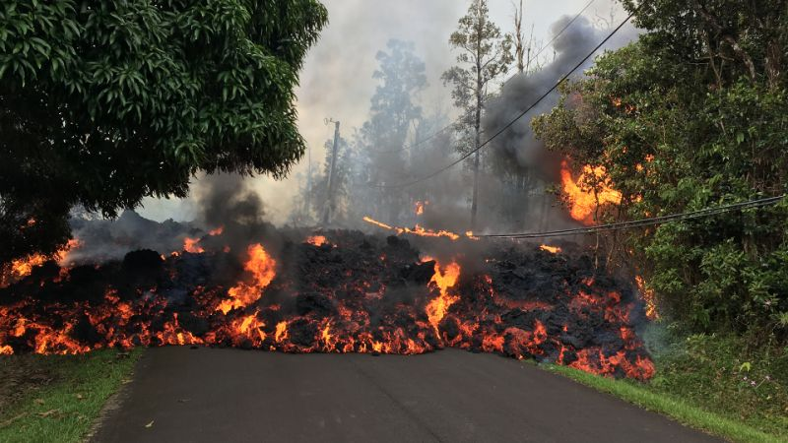
Risks of living near Volcanic Areas
Massive Destruction by Volcanic Materials
Volcanic materials produced by volcanic eruptions include lava and pyroclasts that consist of ash, rock fragments and volcanic bombs. These volcanic materials can lead to widespread damage of property.
Landslides can occur due to the structural collapse of a volcanic cone. They can obstruct the flow of rivers which causes floods, block roads, and bury villages and farmlands.
Ongoing eruption of Kilauea, Hawaii since 1983 has destroyed many homes and highways

Slide 40
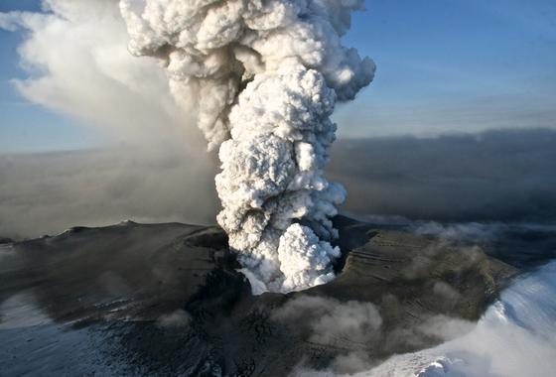
Risks of living near Volcanic Areas
Pollution
Ash particles may block sunlight, suffocate crops, and cause severe respiratory problems for people and animals.
Volcanic eruptions can also release gases such as carbon dioxide, sulfur dioxide and carbon monoxide which may be harmful to people.
The eruption of Eyjafjallajökull in Iceland in 2010 produced extensive volcanic ash clouds containing tiny particles of abrasive glass, sand and rock, posing a serious danger to aircraft engines and structures.

Slide 41
Benefits of living near Volcanic Areas
After investigating the nature and risks of volcanic eruptions, it may seem unlikely that anyone would live near volcanic areas. However, many people continue to live in regions near active volcanoes due to its numerous benefits which include having fertile soil, precious stones and minerals, tourism and a source of geothermal energy.

Slide 42
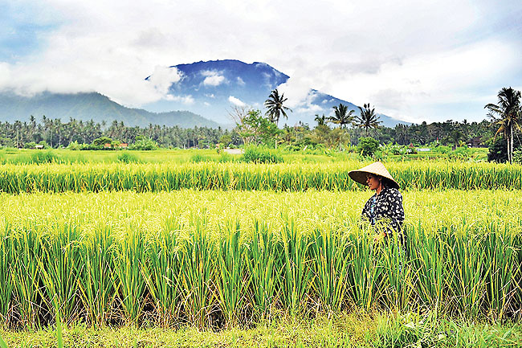
Benefits of living near Volcanic Areas
Fertile Soil
Lava and ash from the volcanic eruptions break down to form fertile volcanic soils and they are very favourable to agriculture.
The volcanic soils of Java and Bali in Indonesia support the cultivation of crops such as tea, coffee and rice. This is the main reason why these two islands have been able to support a large rural population over many decades.

Slide 43
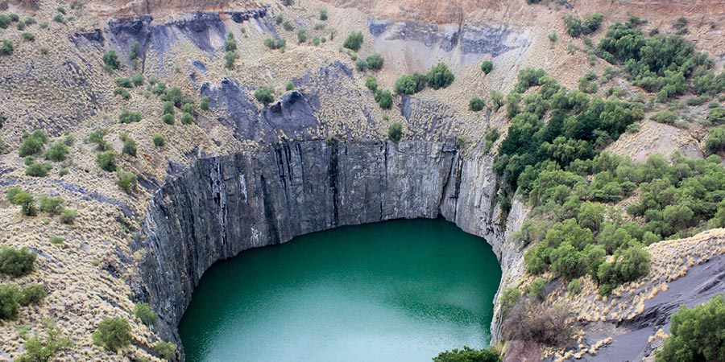
Benefits of living near Volcanic Areas
Precious Stones and Minerals
Volcanic rocks can be rich in precious stones and minerals. These resources can only be from a volcanic area after millions of years. An example is diamond.
The old volcanic rocks at Kimberley in South Africa are one of the world’s richest sources of diamond.

Slide 44
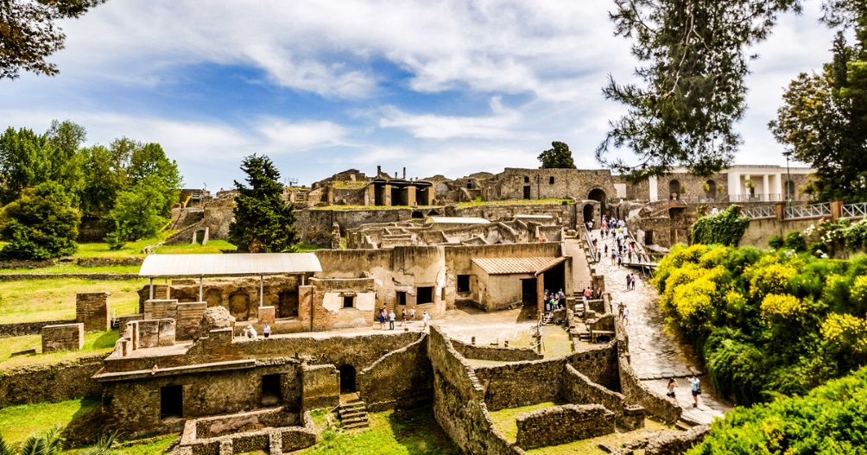
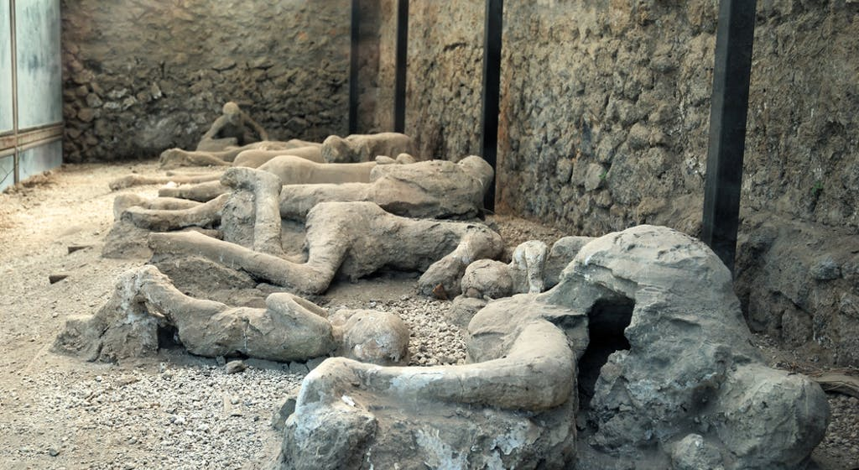
Benefits of living near Volcanic Areas
Tourism
Volcanic areas offer a variety of activities for tourists to engage in. Many people visit volcanoes to hike and camp in the area or simply to enjoy the scenery. Volcanic areas are rich in history and people can visit these areas to learn more about them.
The town of Pompeii, Italy was buried by layers of ash from the nearby Mount Vesuvius in 79 CE. The unearthed archaeological site has revealed buildings, pottery and mosaic left intact.

Slide 45
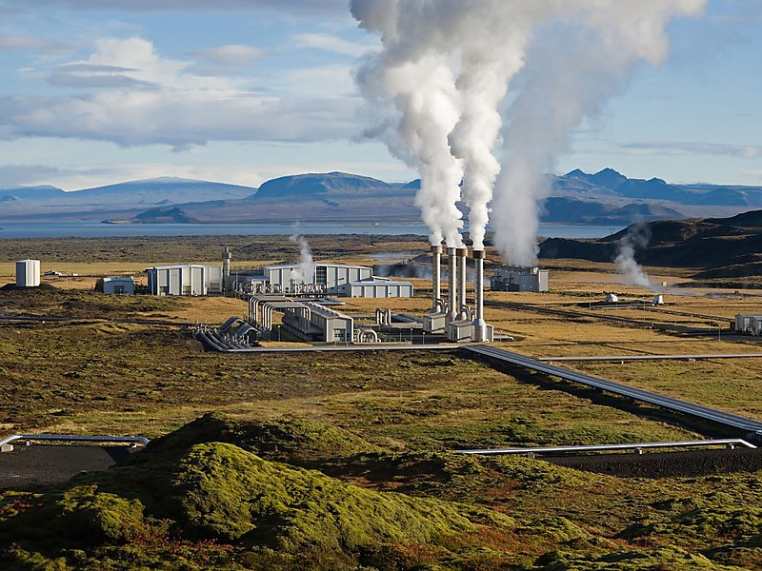
Benefits of living near Volcanic Areas
Geothermal Energy
Geothermal energy is derived from the heat in the Earth’s crust. When groundwater comes into contact with hot rocks beneath the surface, it heats up and erupts as hot water or steam. The hot water or steam can be harnessed to drive turbines and produce electricity.
Most of Iceland’s electricity is generated from geothermal power because of the large number of volcanoes in the country. Over 70% of homes in Iceland are heated by volcanic steam.

