Slide 1
Secondary 3 Pure Geography
Chapter 2 – Living with Tectonic Hazards
Gateway 1 – Why are some places more prone to tectonic hazards?

Slide 2
Gateway 1 – Why are some places more prone to tectonic hazards?
What is a natural hazard?
What is the internal structure of the Earth?
What is a tectonic plate?
Why do tectonic plates move?
What are the different types of plate boundaries?

Slide 3
What is a natural hazard?
Natural hazards are events that occur naturally and that threaten human lives and cause damage to property and the environment.
This is a result from the interaction of physical processes and varied ways man uses environment.

Slide 4
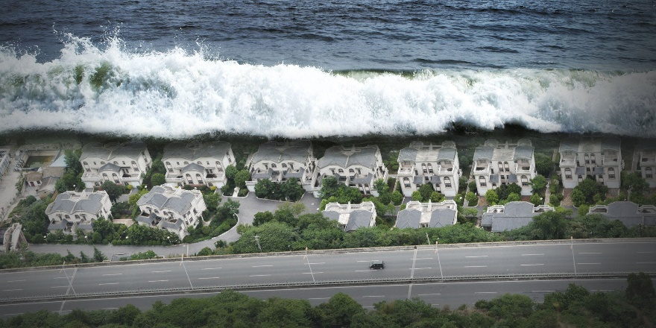
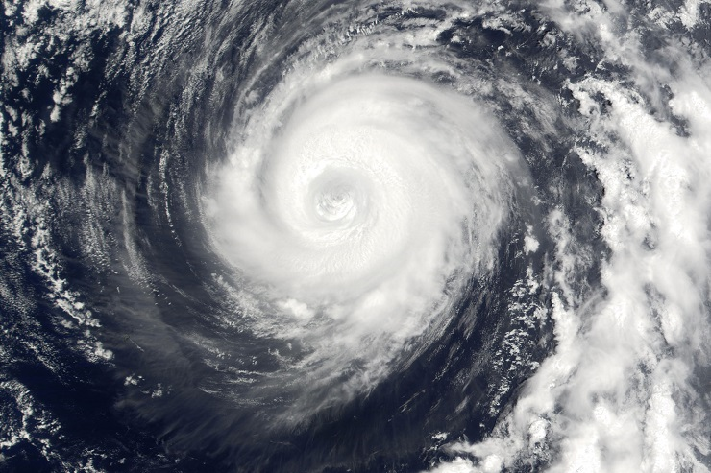
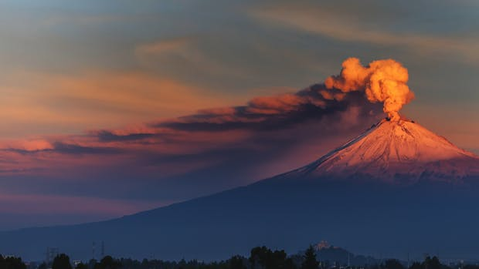
Natural Hazards
Types of Natural Hazards
Natural hazards can be classified into tectonic hazards and climatic hazards.
Tectonic Hazards (e.g. Volcanic Eruptions, Earthquakes)
Climatic Hazards (e.g. Floods, Tropical Storms)
Tsunami
Tropical Storm
Volcanic Eruption

Slide 5
Gateway 1 – Why are some places more prone to tectonic hazards?
What is a natural hazard?
What is the internal structure of the Earth?
What is a tectonic plate?
Why do tectonic plates move?
What are the different types of plate boundaries?

Slide 6
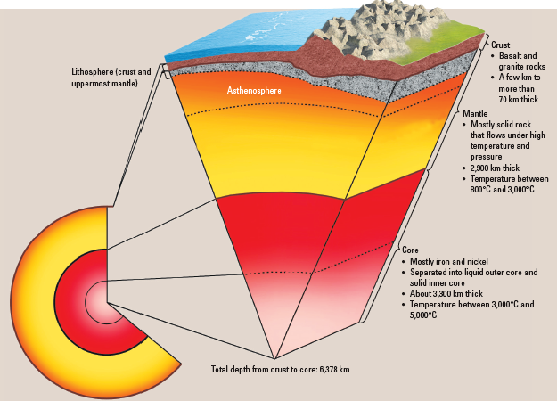
What is the Internal Structure of the Earth?
The internal structure of the Earth comprises different layers with different compositions and varied physical properties. It contains the core, mantle and the crust.

Slide 7
Internal Structure of the Earth
Core
The core is rich in iron and nickel. It is divided into the outer core and the inner core.
The outer core consists of liquid whereas the inner core is solid. The reason for the solid appearance for the inner core is due to pressure exerted by the surrounding layers.
The temperature of the core varies between 3000°C and 5000°C.

Slide 8
Internal Structure of the Earth
Mantle and Asthenosphere
The mantle consists of mainly solid rock which flows under high temperature and pressure. The uppermost mantle is beneath the crust and it is dense and rigid.
The asthenosphere lies beneath the uppermost mantle and it consists of viscous rocks, hence this layer is highly viscous and partially rigid.
The temperature of the mantle varies between 800°C and 3000°C.

Slide 9
Internal Structure of the Earth
Crust
The crust consists of solid rocks like basalt and granite. There are two types of crust – oceanic and continental.
The oceanic crust is found beneath the oceans whereas the continental crust is found beneath the continents.

Slide 10
Gateway 1 – Why are some places more prone to tectonic hazards?
What is a natural hazard?
What is the internal structure of the Earth?
What is a tectonic plate?
Why do tectonic plates move?
What are the different types of plate boundaries?

Slide 11
What is a Tectonic Plate?
A tectonic plate is made up of either oceanic crust, continental crust or a combination of both. The Earth’s crust is broken into different pieces that move in relation to one another.
Oceanic Crust | Continental Crust
Found beneath oceans Very thin Dense Consists of basalt (fine-grained rocks) | Found beneath the continents Very thick Less dense Consists of granite (coarse-grained rocks)

Slide 12
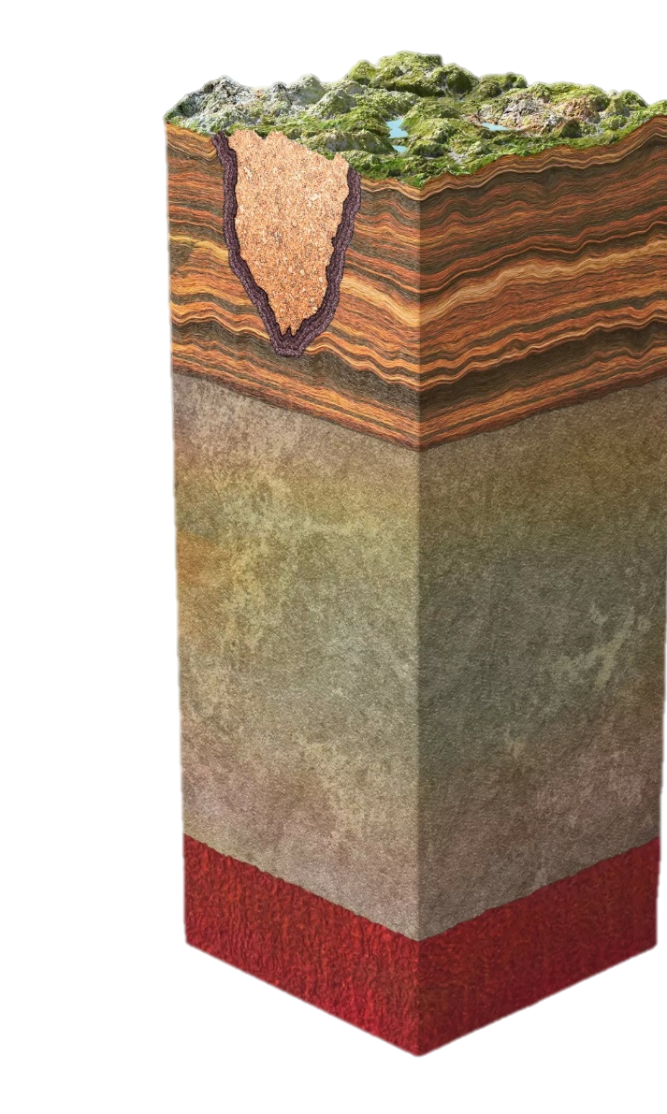
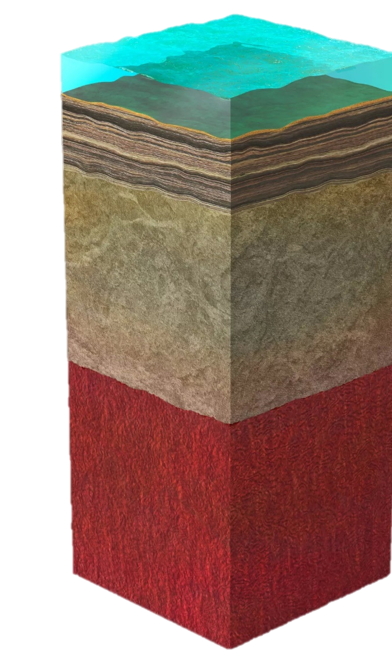
Tectonic Plates
Comparing Oceanic and Continental Crusts
This is a visual representation to show the different layers beneath the Earth’s crust.
Land
Oceans
Oceanic Crust
Continental Crust
Lithosphere
Lithosphere
Asthenosphere
Asthenosphere

Slide 13
Gateway 1 – Why are some places more prone to tectonic hazards?
What is a natural hazard?
What is the internal structure of the Earth?
What is a tectonic plate?
Why do tectonic plates move?
What are the different types of plate boundaries?

Slide 14
Why do Tectonic Plates move?
Tectonic plates move due to two reasons which are namely convection currents and slab-pull force.

Slide 15
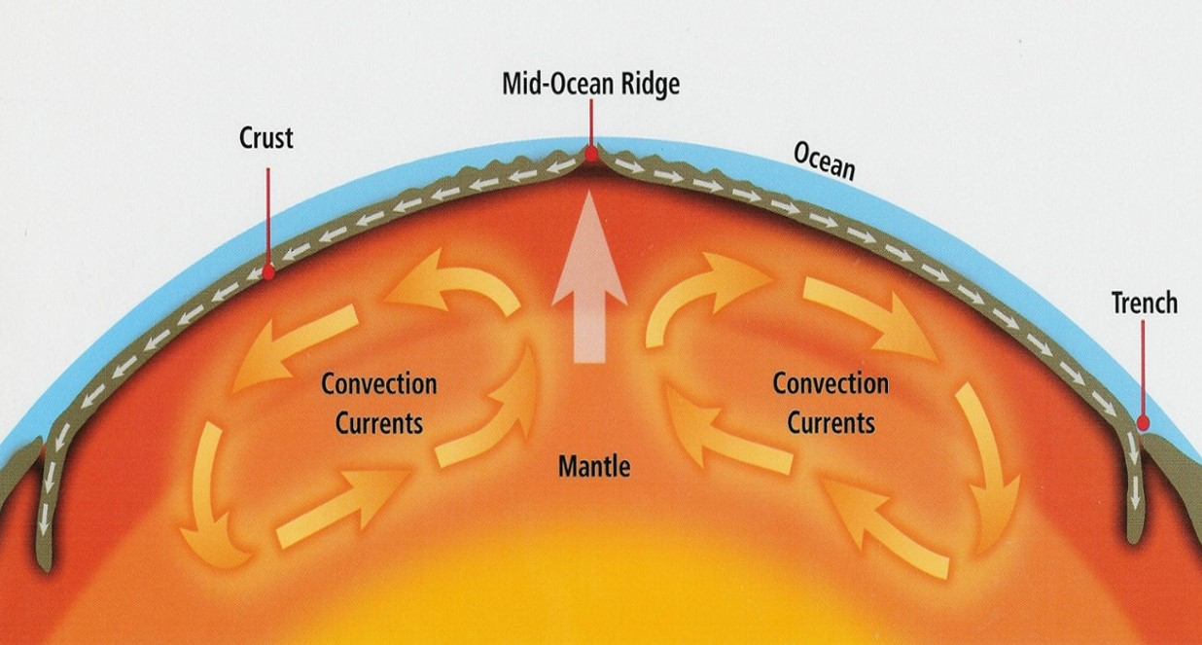
Movement of Tectonic Plates
Convection Currents
Convection currents refer to the movement of heat within the mantle. Material in the mantle is heated by the core. This causes convection currents in the molten mantle material, causing the mantle to expand and rise and spread out beneath the plates. Plates are dragged along and they move away from each other.
Subsequently, the hot molten mantle cools slightly and sinks, pulling the plates along and thus they move towards each other. The sinking mantle material heats up again and the cycle repeats.

Slide 16
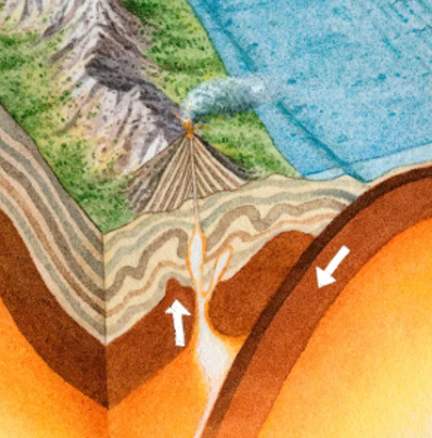
Movement of Tectonic Plates
Slab-Pull Force
Slab-pull occurs when a denser oceanic plate subducts a plate of lesser density and pulls the rest of the plate along. The subducting plate drives the downward-moving portion of the convection currents while mantle material away from the subduction zone drives the rising portion of the convection currents.
Subducting Plate | Mantle Material
Drives the downward-moving portion | Drives the rising portion
Subduction occurs when a denser oceanic plate subducts beneath a plate of lesser density (can be either continental or oceanic)

Slide 17
Gateway 1 – Why are some places more prone to tectonic hazards?
What is a natural hazard?
What is the internal structure of the Earth?
What is a tectonic plate?
Why do tectonic plates move?
What are the different types of plate boundaries?

Slide 18
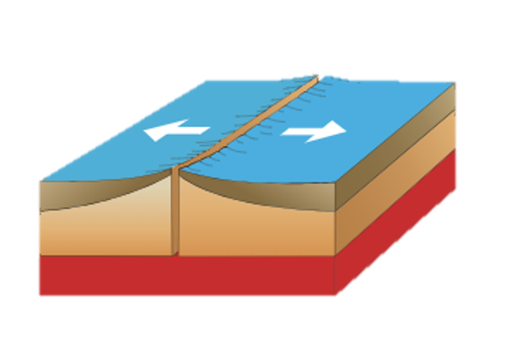
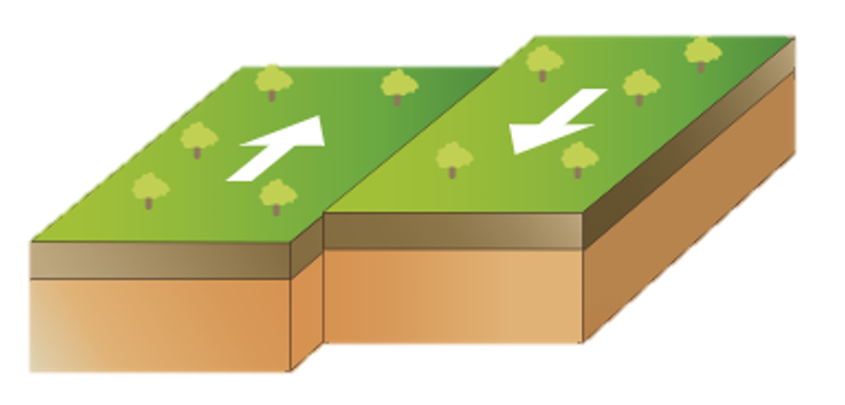
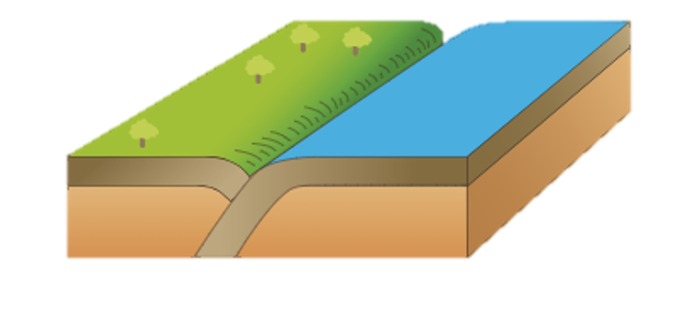
What are the different types of Plate Boundaries?
Earth’s crust is dynamic especially at plate boundaries. As such, tectonic plates move at different speeds and different directions.
Hence, there are 3 types of plate boundaries which are:
Divergent Plate Boundary (away from each other)
Convergent Plate Boundary (towards each other)
Transform Plate Boundary (slide past each other)
Divergent Plate Boundary
Convergent Plate Boundary
Transform Plate Boundary

Slide 19
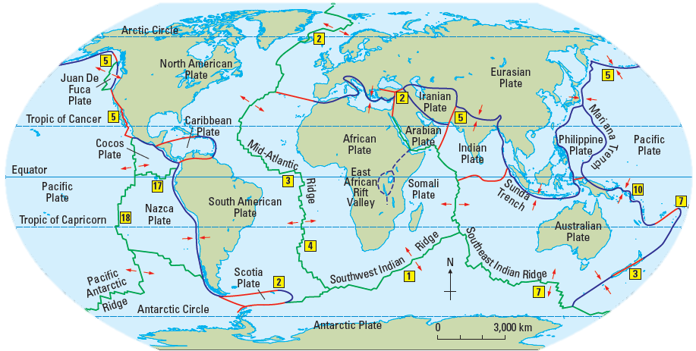

Locations of Plate Boundaries

Slide 20
Types of Plate Boundaries
Divergent Plate Boundaries | Convergent Plate Boundaries | Transform Plate Boundaries
Oceanic-Oceanic Plate Divergence Continental-Continental Plate Divergence | Oceanic-Oceanic Plate Convergence Continental-Continental Plate Convergence Oceanic-Continental Plate Convergence

Slide 21
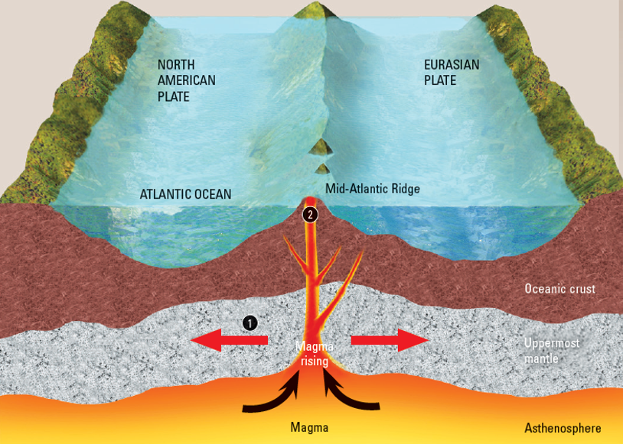
Divergent Plate Boundaries
Oceanic-Oceanic Plate Divergence
Oceanic-Oceanic Plate Divergence of the North American and Eurasian plates

Slide 22
Divergent Plate Boundaries
Oceanic-Oceanic Plate Divergence
Magma rises from the mantle to fill the gap between the plates as they diverge. New sea floor is formed when the magma cools and solidifies. This process is known as sea-floor spreading.
At the spreading zone, a ridge of new ocean floor known as the mid-oceanic ridge forms. Newly-formed rocks are closest to the plate boundaries and the older ones are further way.
At various points along the ridge, magma builds up above the ocean to form volcanic islands.
Oceanic-Oceanic Plate Divergence (Associated Landforms)
Mid-Oceanic Ridge Volcanic Islands

Slide 23
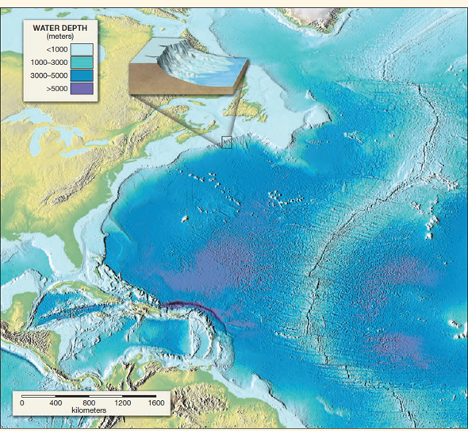
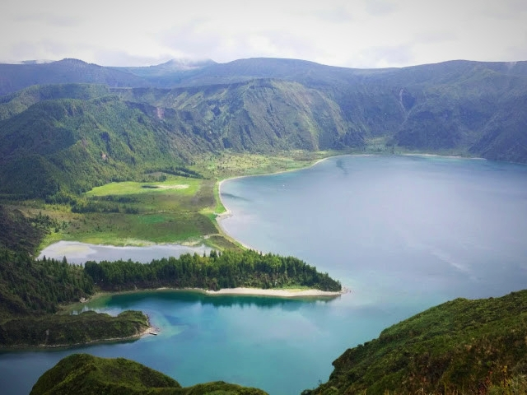
Divergent Plate Boundaries
Oceanic-Oceanic Plate Divergence
Mid-Atlantic Oceanic Ridge
The Azores Volcanic Islands, Portugal, formed due to magma build-up above the ocean.
The Mid-Atlantic Oceanic Ridge presented on the World Map. It mainly runs through the Atlantic Ocean.

Slide 24
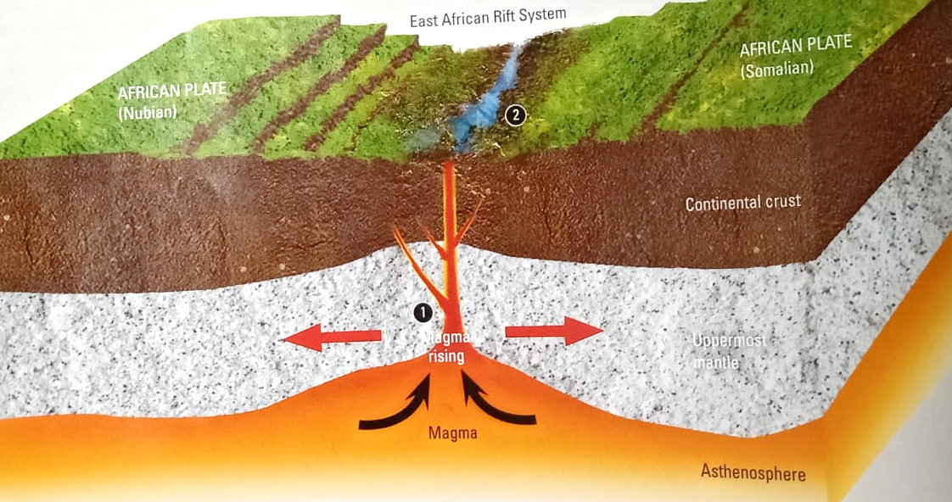
Divergent Plate Boundaries
Continental-Continental Plate Divergence
Continental-Continental Plate Divergence of the Nubian and Somalian boundaries of the African Plate

Slide 25
Divergent Plate Boundaries
Continental-Continental Plate Divergence
When two continental plates diverge, they are stretched, causing fractures to form on the continental crust. As the crust continues to be pulled apart, a rift valley is formed.
Continental-Continental Plate Divergence (Associated Landforms)
Rift Valley

Slide 26
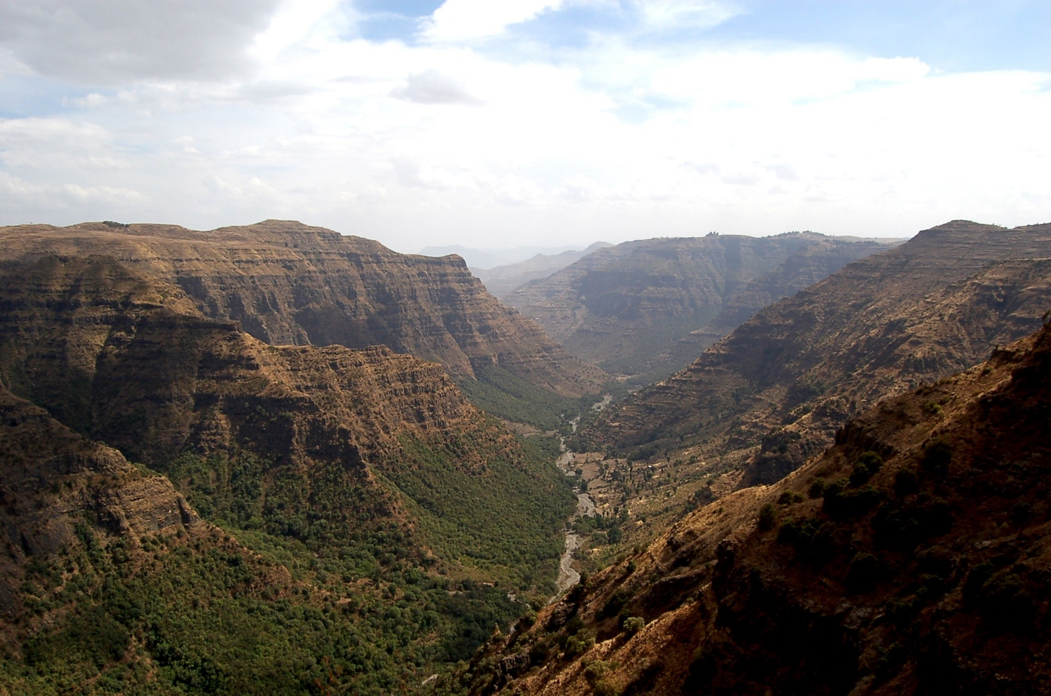
Divergent Plate Boundaries
Continental-Continental Plate Divergence
Flat-top plateau (a plateau is a highland with steep slopes and a flat summit)
Steep slopes with evidence of fractures
East African Rift Valley

Slide 27
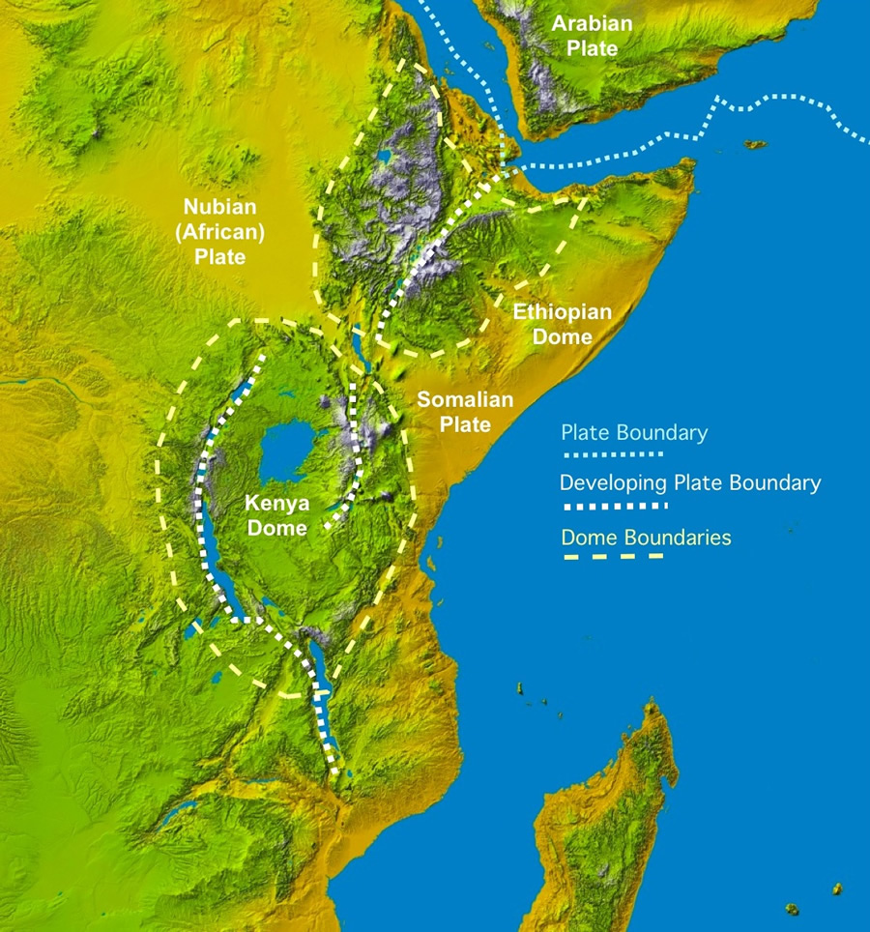
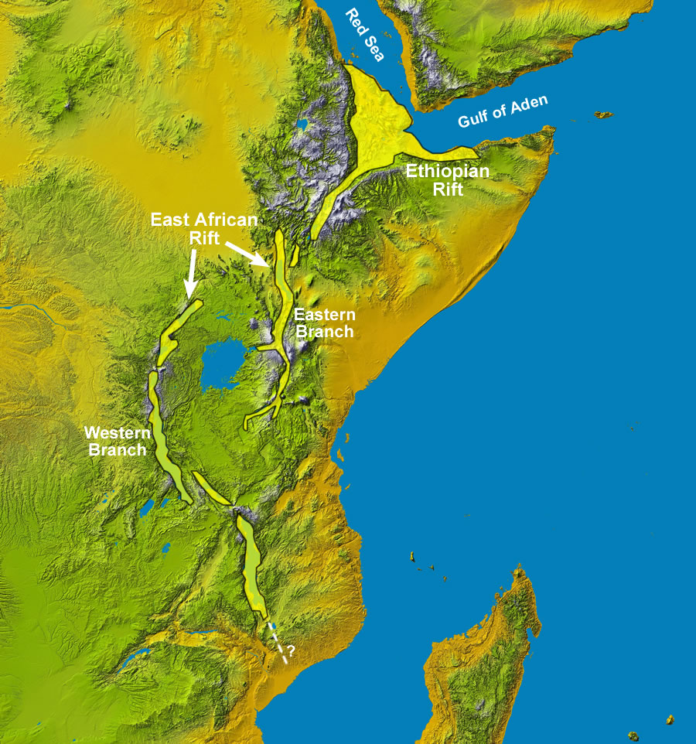
Divergent Plate Boundaries
Continental-Continental Plate Divergence
The East African Rift stretches over 3000 kilometres from the Gulf of Aden towards Zimbabwe

Slide 28
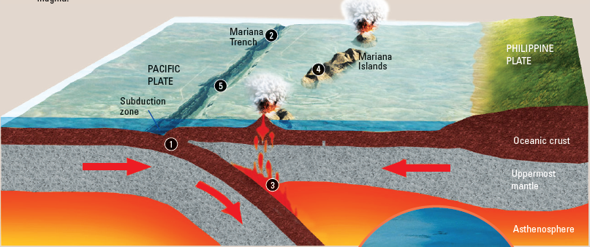
Convergent Plate Boundaries
Oceanic-Oceanic Plate Convergence
Oceanic-Oceanic Plate Convergence of the Pacific Plate and Philippine Plate

Slide 29
Convergent Plate Boundaries
Oceanic-Oceanic Plate Convergence
When two oceanic plates converge and collide, the denser oceanic plate will subduct beneath the less dense oceanic plate. A deep oceanic trench is formed at the subduction point. The subducted oceanic plate causes mantle material to melt, forming magma.
The magma rises through the crust and forms volcanoes. Eventually, a chain or arc of islands is formed.
Earthquakes may also occur at the boundary between two plates due to friction created between the moving rock masses when a plate subducts under another, hence it accounts for the reason that earthquakes generally occur at convergent plate boundaries.
Oceanic-Oceanic Plate Convergence (Associated Landforms)
Oceanic Trench Volcanic Islands

Slide 30
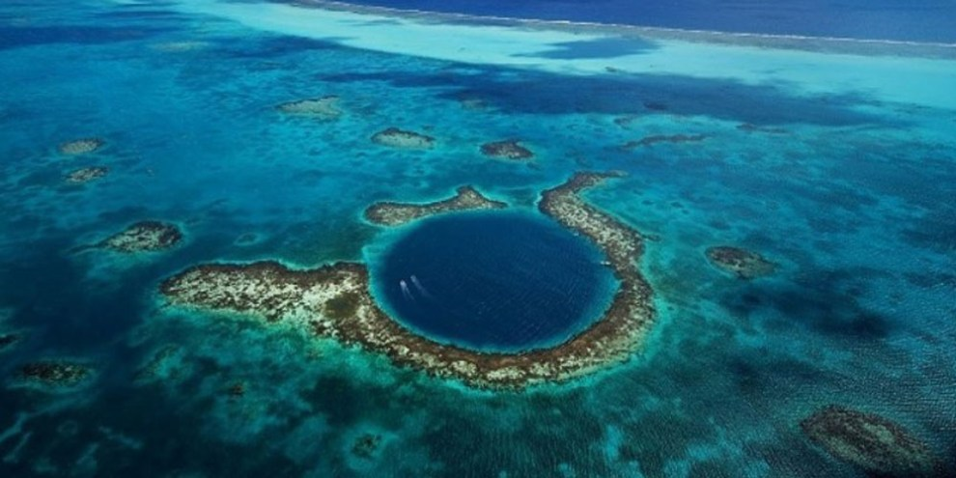
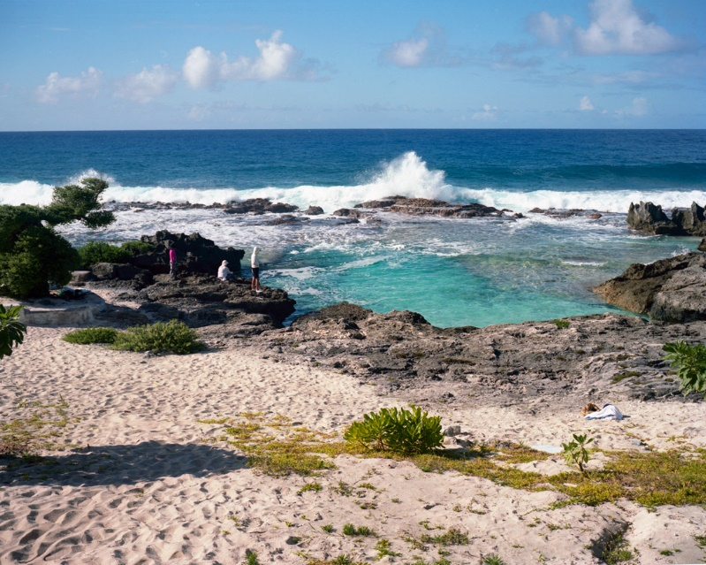
Convergent Plate Boundaries
Oceanic-Oceanic Plate Convergence
The Marianas Oceanic Trench, which has a depth of about 11 kilometres. This is known as the deepest trench in the world.
The Marianas Volcanic Islands, a landform created as a result of the convergence of the oceanic Philippine Plate and oceanic Pacific Plate

Slide 31
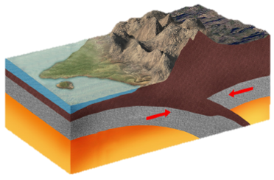
Convergent Plate Boundaries
Continental-Continental Plate Convergence
Himalayas Fold Mountains
Tibetan Plateau
Indian Plate
Continental Crust
Ancient Oceanic Crust
Uppermost Mantle
Asthenosphere
Continental-Continental Plate Convergence of the Indian Plate and Eurasian Plate

Slide 32
Convergent Plate Boundaries
Continental-Continental Plate Convergence
When two continental plates collide and converge, the crusts are compressed and this causes massive folding. The folding of the crusts forms a range of fold mountains.
During continental-continental plate convergence, either plate does not subduct as they are of similar densities.
Continental-Continental Plate Convergence (Associated Landforms)
Fold Mountains

Slide 33
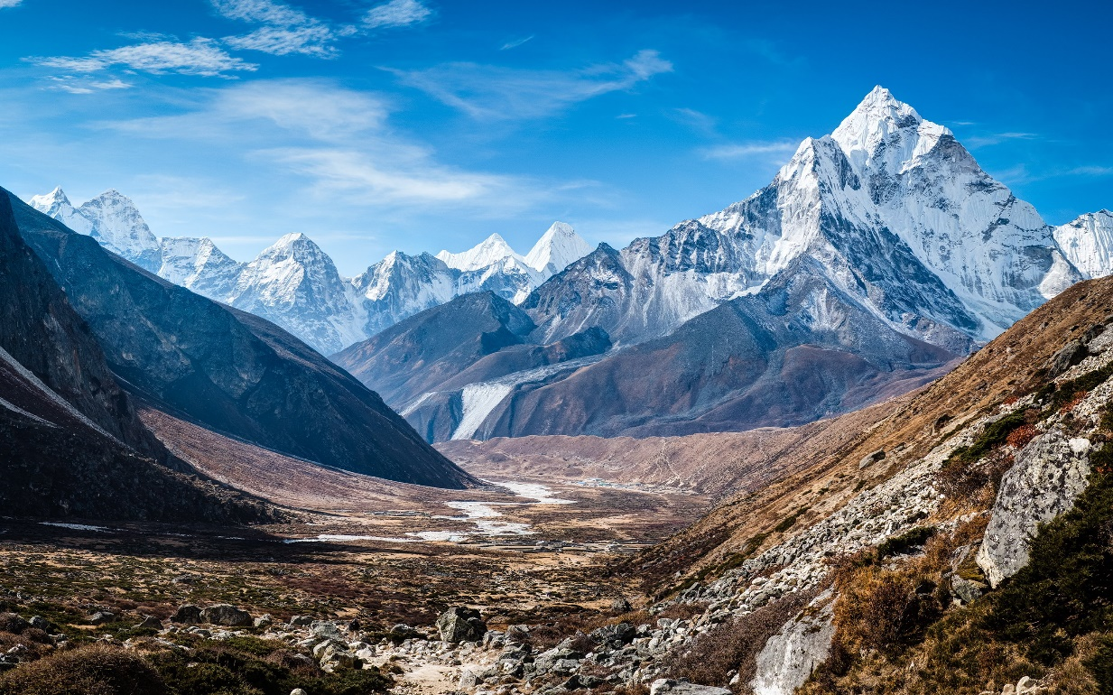
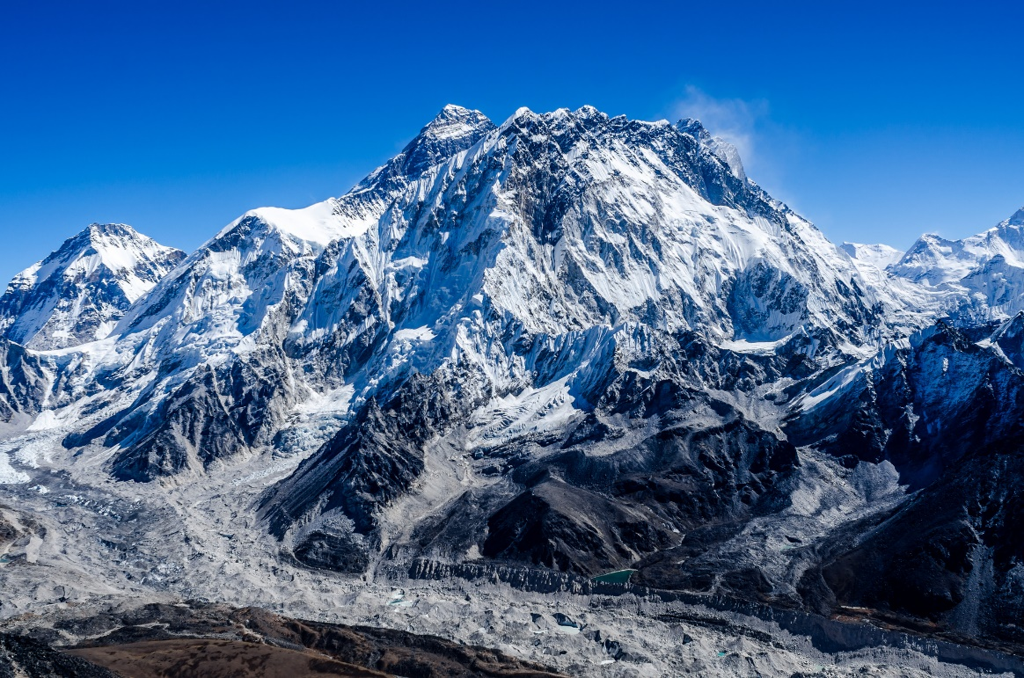
Convergent Plate Boundaries
Continental-Continental Plate Convergence
The Himalayas Fold Mountain range
Mount Everest, the tallest mountain in the world at 8848m, located along the fold mountain range of the Himalayas

Slide 34
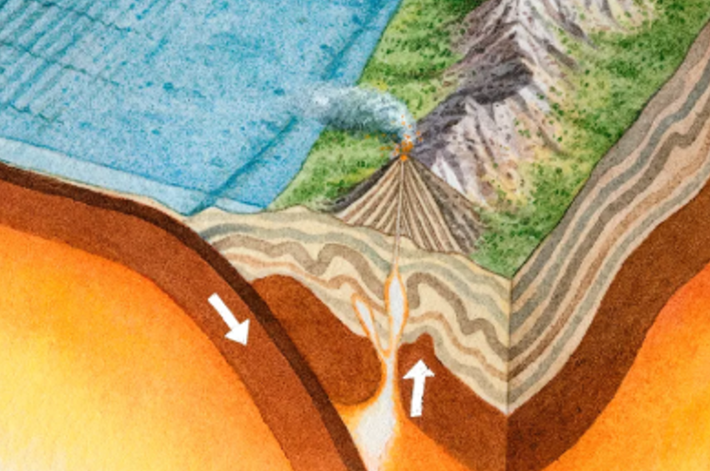
Convergent Plate Boundaries
Oceanic-Continental Plate Convergence
Nazca Plate
Andes Fold Mountains
Peru-Chile Trench
Oceanic Crust
Subduction Zone
Uppermost Mantle
South American Plate
Continental Crust
Asthenosphere
Oceanic-Continental Convergence of the Oceanic Nazca Plate and Continental South American Plate

Slide 35
Convergent Plate Boundaries
Oceanic-Continental Plate Convergence
When an oceanic plate converges with a continental plate, the denser oceanic plate subducts beneath the less dense continental plate. An oceanic trench is formed at the point of subduction.
The continental plate buckles and folds, forming fold mountains. The sinking oceanic plate causes mantle material to melt to form magma. The magma rises above the crust, giving rise to volcanoes and volcanic islands.
Oceanic-Continental Plate Convergence (Associated Landforms)
Oceanic Trench Fold Mountain Volcanic Islands

Slide 36
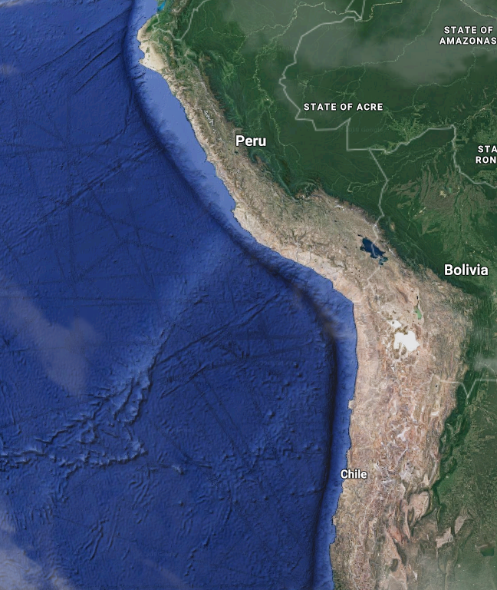
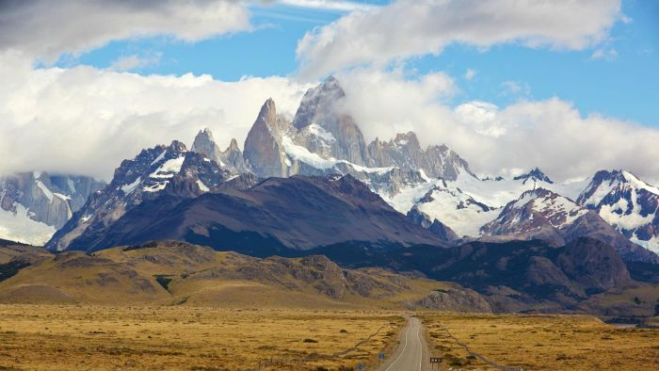
Convergent Plate Boundaries
Oceanic-Continental Plate Convergence
The Peru-Chile Oceanic Trench, which stretches 160 kilometres off the coast of Peru and Chile
The Andes Fold Mountain range

Slide 37
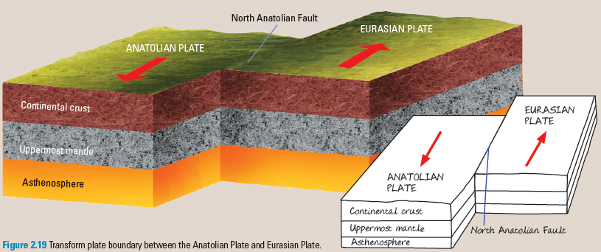
Transform Plate Boundaries
Transform plate boundary between the Anatolian Plate and Eurasian Plate

Slide 38
Transform Plate Boundaries
Plates slide past each other along transform plate boundaries. This movement results in the formation of a transform fault. In the process, tremendous stress builds up and is eventually released, often in the form of violent earthquakes.
Transform Plate Boundaries (Associated Landforms)
None

Slide 39
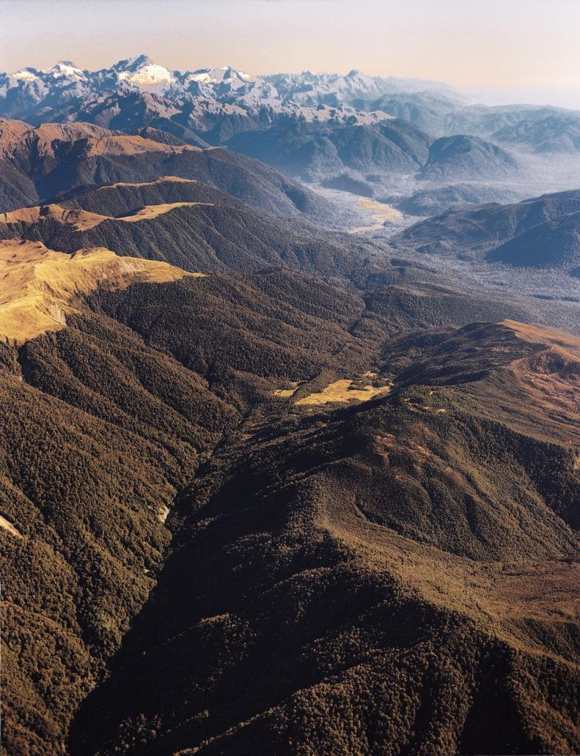
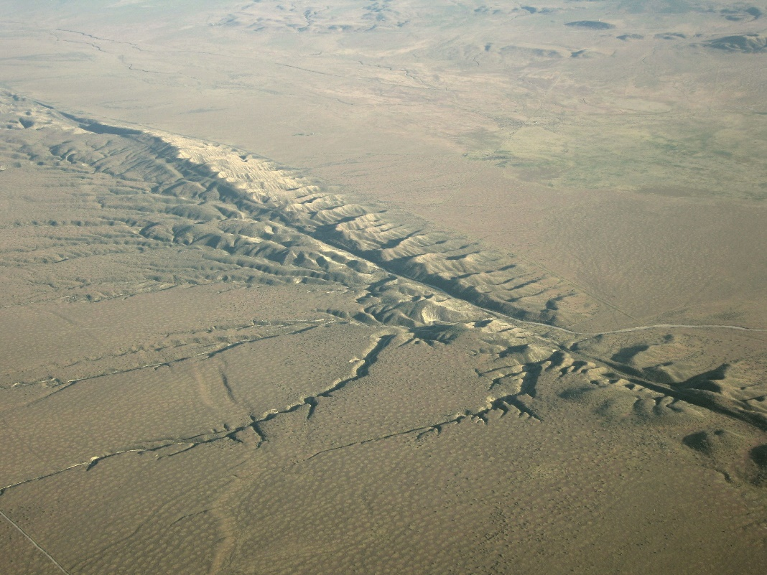
Transform Plate Boundaries
San Andreas Fault formed due to the transform plate boundaries of the Pacific Plate and North American Plate
Alpine Fault formed due to the transform plate boundaries of the Australian Plate and Pacific Plate

