Slide 1
Secondary 3 Pure Geography
Chapter 1 - Coasts
Gateway 3 – How can we manage coastal areas in a sustainable manner?

Slide 2
Gateway 3 – How can we manage coastal areas in a sustainable manner?
How can coastal areas be managed?

Slide 3
How can coastal areas be managed?
The management of a coastal area refers to the implementation of certain policies, building certain structures or doing restoration works to ease pressure on the coast according to agreed principles and criteria.
As coasts are vulnerable to erosion and destruction by natural processes as well as human activities, there is a need to manage coasts.

Slide 4
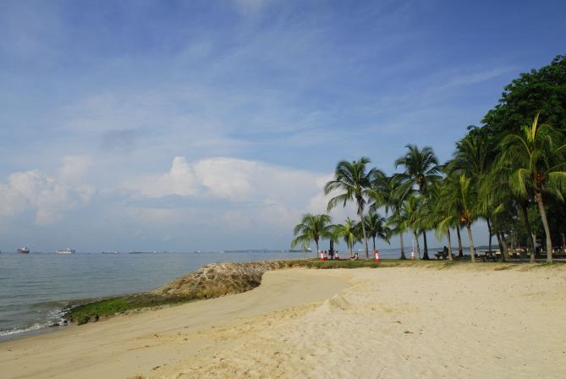
Managing Coastal Areas in a Sustainable Manner
Management of coasts can be carried out in several ways like
Limiting damaging activities
Protecting coastal resources
Restricting development in areas prone to natural hazards
A coastal area in East Coast Park, Singapore

Slide 5
Management of Coasts
Limiting Damaging Activities
Damaging activities are those that threaten to disrupt the balance of ecosystems like clearing mangroves for aquaculture farms.
Since such activities cannot be banned, they can be minimised to ensure a balance between needs, intactness of nature and economic profits.

Slide 6
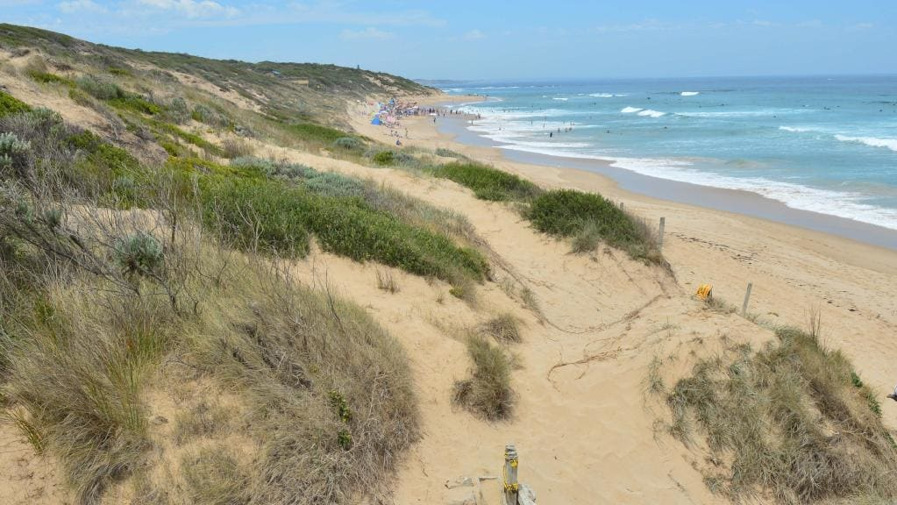
Management of Coasts
Limiting Damaging Activities
An example is limiting damage to grasses planted to stabilise sand dunes on Port Phillip in Melbourne, Australia to prevent sand from being blown and burying houses.
This is done by fencing off dunes, building access paths and building walkovers to the beach to avoid grasses being trampled on by beach-goers. However, this destroys the aesthetic appeal of the beach.
Management of sand dunes on Port Phillip, Melbourne in Australia

Slide 7
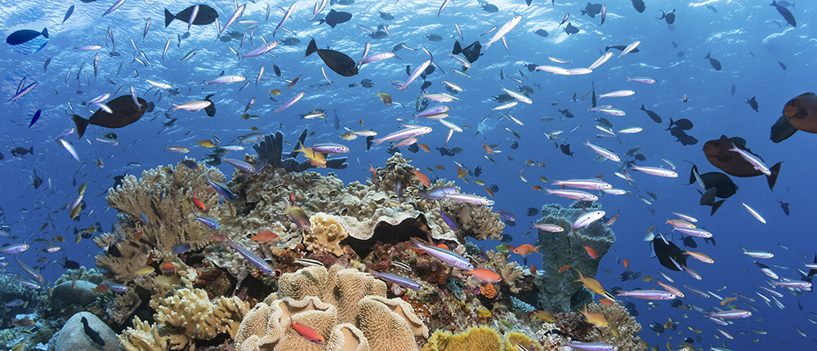
Management of Coasts
Protecting Coastal Resources
One of the measures is discouraging over-fishing and destructive fishing methods to protect marine ecosystems and sustain endangered species.
An example is the Wakatobi National Park in Indonesia where banning of fishing here has led to the recovery of fish population such as snappers.
The ban of fishing at the Wakatobi National Park proved its effectiveness since it resulted in the recovery of the fish population

Slide 8
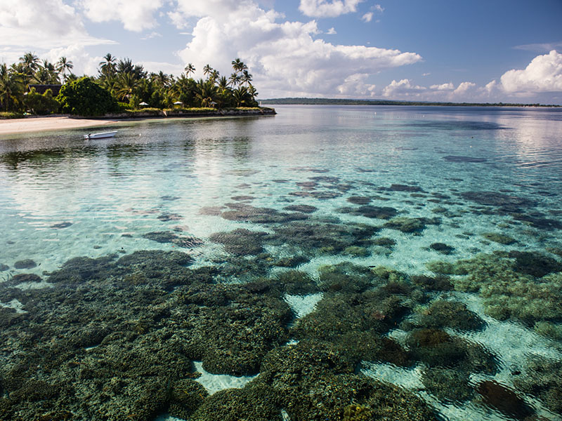
Management of Coasts
Protecting Coastal Resources
Establishment of marine reserves has met with opposition by local fishermen who suffer a loss of income as they have been denied their traditional fishing grounds.
Wakatobi National Park in Sulawesi, Indonesia

Slide 9
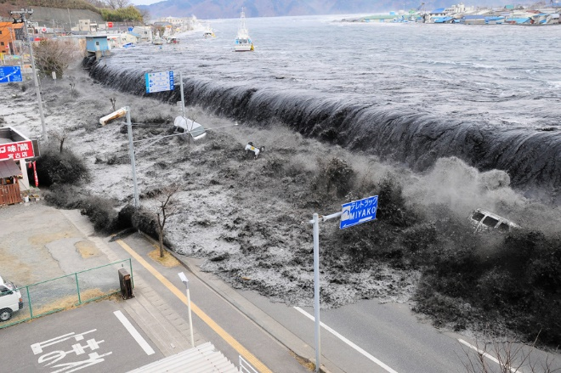
Management of Coasts
Restricting development in areas prone to natural hazards
Natural hazards such as tsunamis can be disastrous to natural environments and human activities. The powerful 2011 Tohoku earthquake resulted in a tsunami of powerful sea waves that swamped large areas of coastal Japan.
The powerful 2011 Tohoku earthquake resulted in over 20,000 deaths and rebuilding costs were estimated to be around US$300 billion.

Slide 10
Management of Coasts
Restricting development in areas prone to natural hazards
Despite the occurrence and unpredictability of natural hazards, people are still attracted to coasts due to the following reasons.
Advantages
Provision of natural resources (e.g. food and building materials) Provision of a substantial range of built services (e.g. docks, ports and housing)
Disadvantages
Residents and investors may have to spend more in construction and maintenance and also be prepared for emergencies.

Slide 11
Soft Engineering Measures
Soft engineering measures use natural processes without the construction of physical structures to protect coasts. Examples include
Beach nourishment
Planting vegetation and stabilising dunes
Encouraging coral reef growth

Slide 12
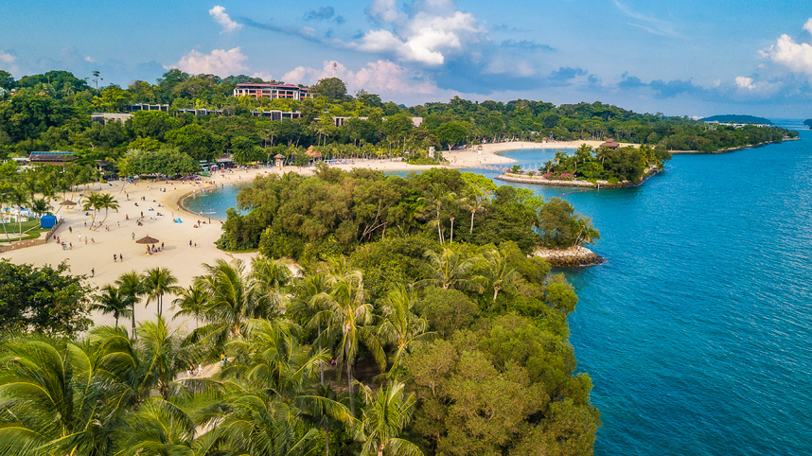
Soft Engineering Measures
Beach Nourishment
Beach nourishment refers to the replenishment of large quantities of sand from another source (i.e. using sand from an external source to replenish sand on a depleted beach).
EFFECTIVENESS: Changes a coast into a wide, sandy beach.
For example, this measure is implemented on Siloso Beach in Sentosa, creating an aesthetically appealing beach for recreational purposes.
LIMITATIONS: Expensive strategy as sand needs to be purchased and transported to the location of nourishment.
Siloso Beach, Sentosa in Singapore

Slide 13
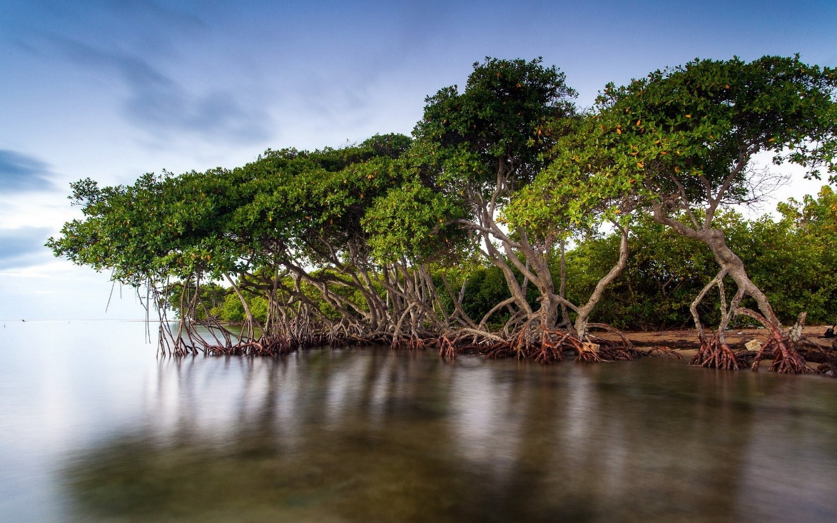
Soft Engineering Measures
Planting Vegetation and Stabilising Dunes
Mangrove-planting near coasts uses human power.
EFFECTIVENESS: Prop roots trap sediments and reduce coastal erosion and mangroves form a wall of protection against natural disasters.
Mangroves were planted to protect the entire 4800km Malaysian coastline against strong waves and winds, reducing erosion.
LIMITATIONS: Mangroves only grow in tropical regions. Requires calm conditions for survival (destructive waves).
Mangrove trees
Prop roots

Slide 14
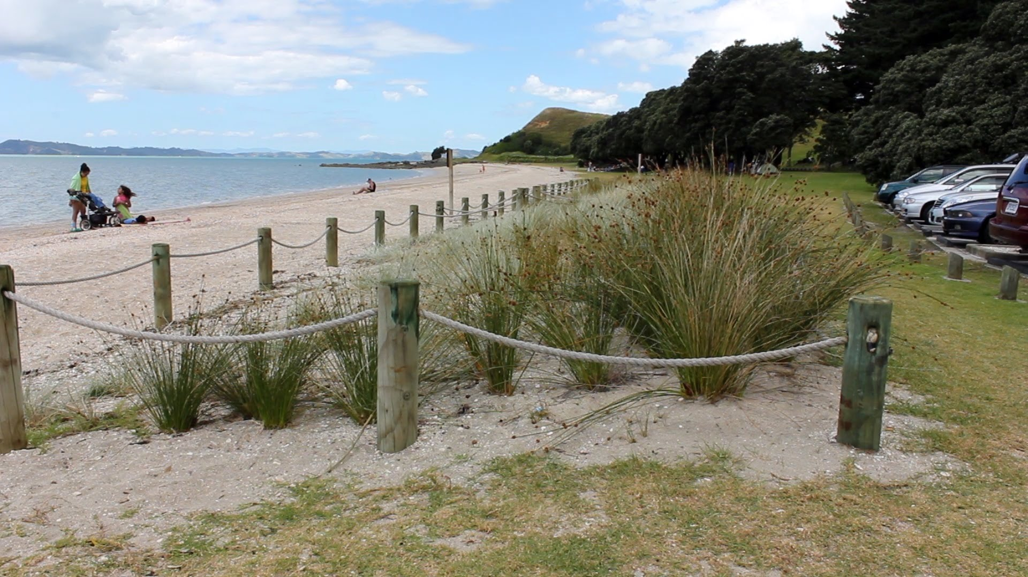
Soft Engineering Measures
Planting Vegetation and Stabilising Dunes
Involves the use of vegetation such as marram grass to bind existing sand dunes which exist along the coast.
Marram grass planted on sand dunes

Slide 15
Soft Engineering Measures
Planting Vegetation and Stabilising Dunes
EFFECTIVENESS: Prevents coasts from being disturbed by human activities, the dunes protect the coast from erosion. Inexpensive since it only involves the planting of vegetation.
Marram grass is planted at Omaha Beach, New Zealand to stabilise coastal dunes to reduce erosion.
LIMITATIONS: Can only be implemented on sandy beaches since coastal dunes are formed there naturally.

Slide 16
Soft Engineering Measures
Encouraging Coral Reef Growth
Coral reefs involves the cultivation of coral polyps in laboratories and subsequently transplanting them along the coast by human means.
EFFECTIVENESS: Effective as artificial reefs can act as a natural off-shore breakwater to absorb impact of waves and protect coast behind it. There is also no environmental damage since it is a fully natural process.
For example, coral reefs in Malaysia are protected to enhance growth in order to slow down oncoming waves to reduce erosion.

Slide 17
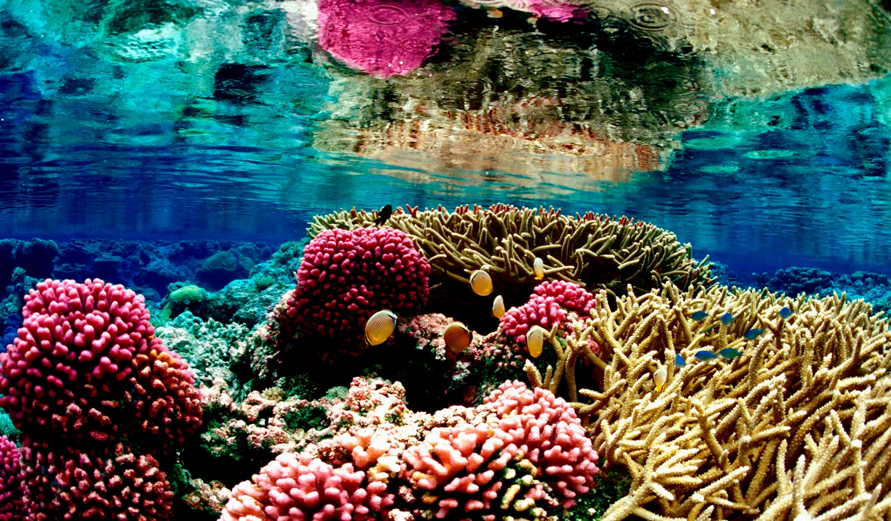
Soft Engineering Measures
Encouraging Coral Reef Growth
LIMITATIONS: Cannot be implemented in all coastal regions as coral reefs only grow in warm tropical areas and specific zones where water is not so deep and reefs can still absorb sunlight.
Coral reefs only grow in warm tropical areas where water is not so deep in order for them to absorb sufficient sunlight

Slide 18
Hard Engineering Measures
Hard engineering measures are strategies that involve the construction of physical structures to protect coasts against the erosive power of destructive waves. Examples include
Seawalls
Gabions
Breakwaters
Groynes
Tetrapods

Slide 19
Hard Engineering Measures
Seawalls
Seawalls are concrete structures built parallel to a coast.
EFFECTIVENESS: Seawalls are effective in protecting the coast from erosion as it reflects energy from the incoming waves.
For example, seawalls are built around the Esplanade in Singapore to absorb wave energy, and protect the coast from erosion.
LIMITATIONS: However, seawalls are costly as it requires much manpower, machinery and resources as well as expertise. Furthermore, LDCs may not be able to afford the high costs of building seawalls.

Slide 20
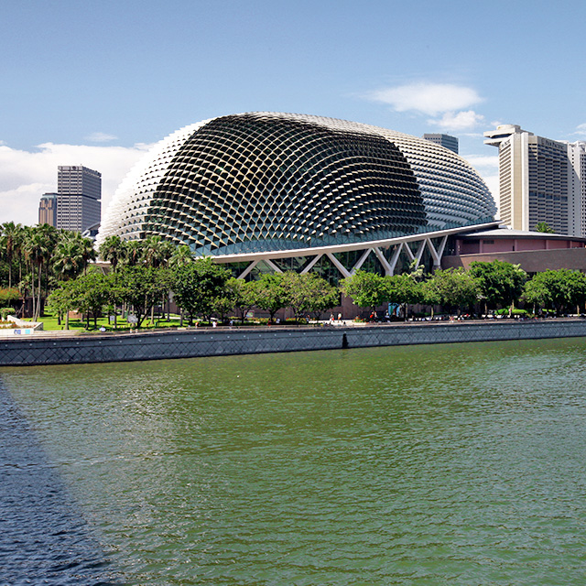
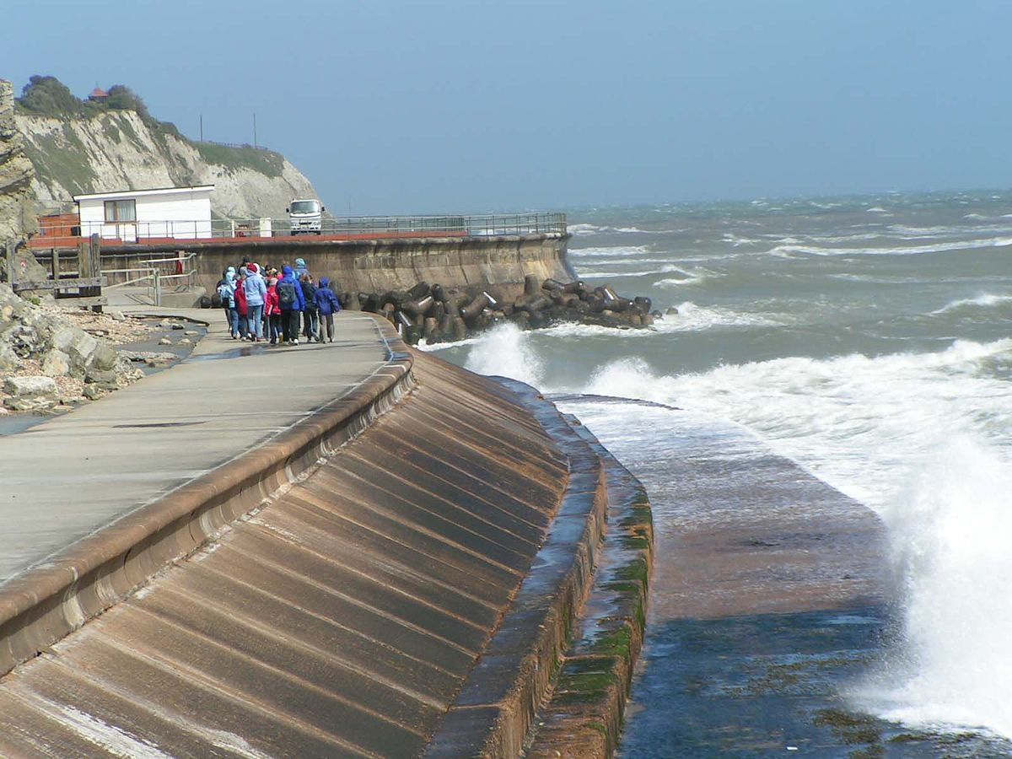
Hard Engineering Measures
Seawalls
Seawalls
Seawalls built in Ventnor in the Isle of Wight, United Kingdom
Seawalls located around the Esplanade, Singapore

Slide 21
Hard Engineering Measures
Gabions
Gabions refer to wire cages containing small rocks that are used to form a wall to protect the coast.
EFFECTIVENESS: Piling these cages along the shore is effective in reducing coastal erosion through dissipating wave energy.
For example, gabions in Norfolk, United Kingdom, weaken wave energy to help reduce the rate of erosion.
LIMITATIONS: It is a short term strategy as wired cages corrode easily by seawater. Building such large physical structure may disrupt or alter the natural coastal processes of erosion and deposition. The natural environment may be disturbed as a result.

Slide 22
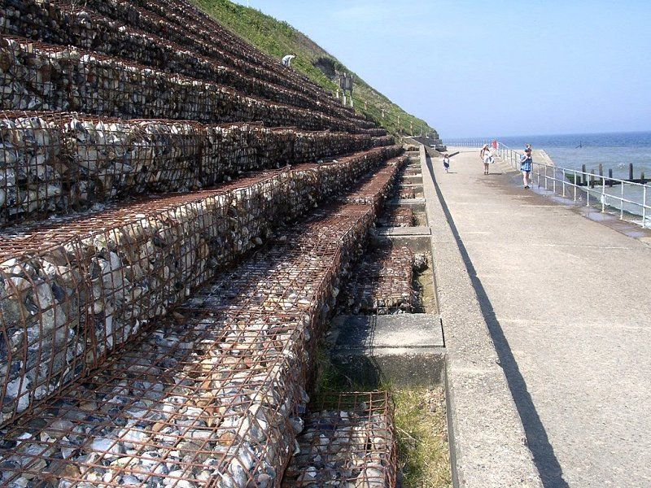
Hard Engineering Measures
Gabions
Gabions
Gabions constructed in North Norfolk, United Kingdom

Slide 23
Hard Engineering Measures
Breakwaters
Breakwaters are structures composed of concrete or boulders built parallel to the coast or with one end attached to the coast.
EFFECTIVENESS: Breakwaters protect the coast and harbour by breaking the force of oncoming waves before they reach the shore.
They are built at East Coast Park in Singapore and are used to accumulate sediments for the formation of beaches.
LIMITATIONS: Breakwaters can protect only a limited area of the coast. Areas located away from breakwaters will not sufficient sediments and will be eroded away over time.

Slide 24
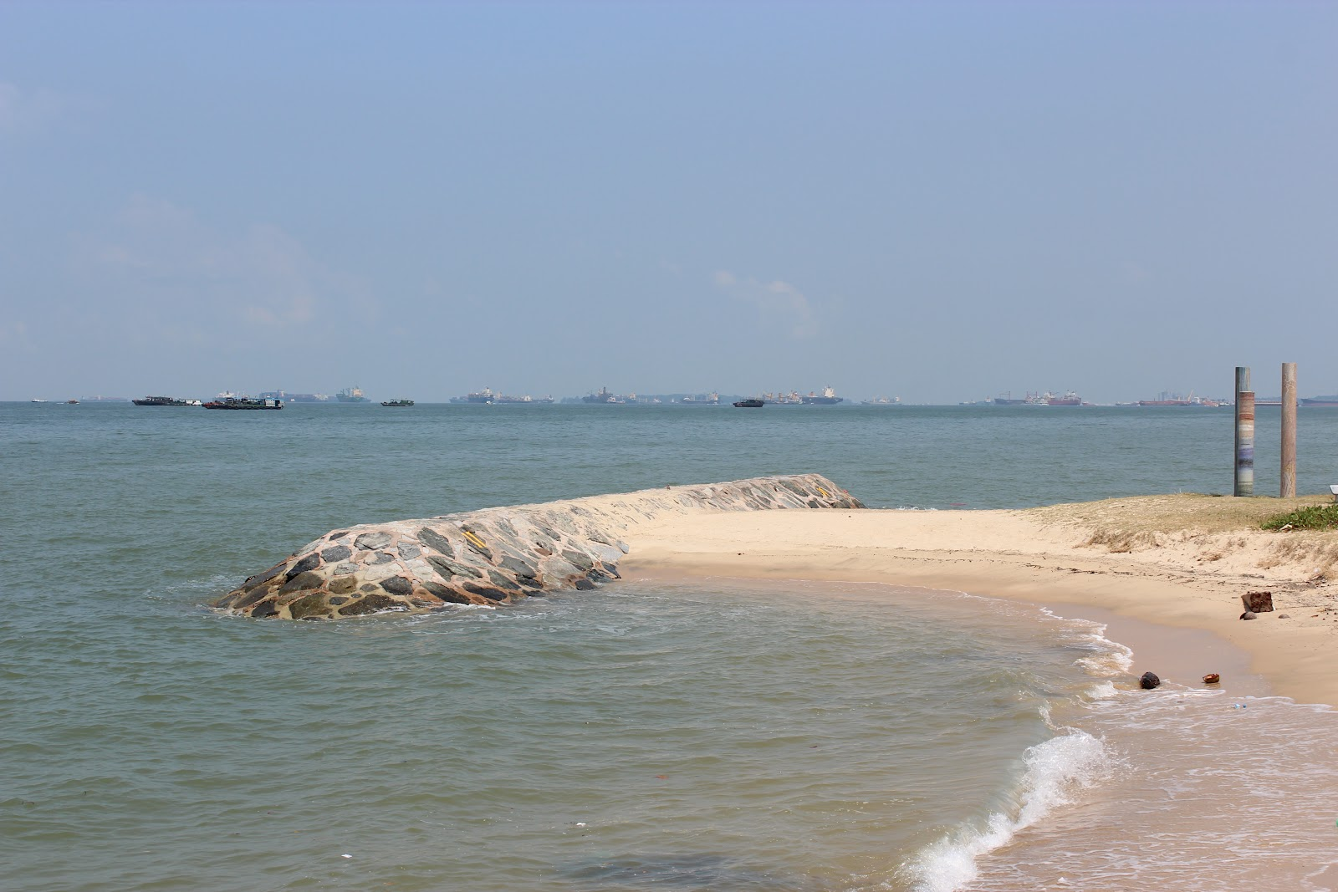
Hard Engineering Measures
Breakwaters
Formation of beach due to sediment accumulation
Breakwater
Breakwaters constructed in East Coast Park, Singapore

Slide 25
Hard Engineering Measures
Groynes
Groynes are low walls constructed at right angles to the coast to trap beach sediments.
EFFECTIVENESS: Groynes absorb energy waves and cause materials to be deposited on the side of the groyne facing the longshore drift.
They are built at East Coast Park in Singapore, effectively slowing down beach drifting and encouraging the development of a wide beach.
LIMITATIONS: However, it is a short term strategy as it requires constant maintenance since the structure is constantly impacted upon the waves. Furthermore, changing dynamic coastal processes such as erosion and deposition may impact natural habitats.

Slide 26
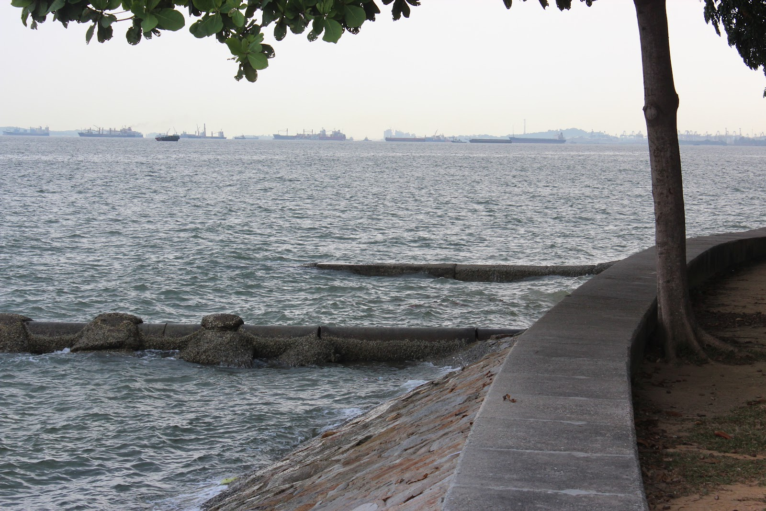
Hard Engineering Measures
Groynes
Groynes are rather costly and expensive to maintain
Groynes
Groynes constructed in East Coast Park, Singapore

Slide 27
Hard Engineering Measures
Tetrapods
Tetrapods are four-legged concrete structures which are stacked offshore in an interlocking position.
EFFECTIVENESS: Allow water to pass around them rather than hitting against them. It also has a longer life span compared to other hard engineering structures as gaps in interlocking tetrapods allow water to flow freely.
For example, tetrapods are successfully implemented off the coast of Hokkaido in Japan.
LIMITATIONS: Serves as a hazard to swimmers and surfers. They are also aesthetically unappealing and affect the natural beauty of coasts.

Slide 28
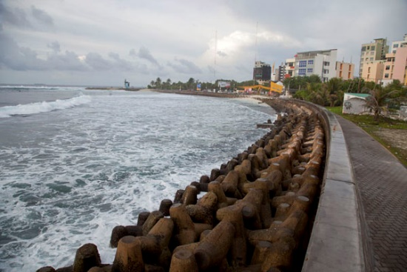
Hard Engineering Measures
Tetrapods
Tetrapods
Tetrapods constructed in Malé, Maldives

