Slide 1
Secondary 3 Pure Geography
Chapter 1 - Coasts
Gateway 2 – Why are coastal areas valuable?

Slide 2
Gateway 2 – Why are coastal areas valuable?
How do people use coastal areas?
Why are coral reef ecosystems distinctive and valuable?
Why are mangrove ecosystems distinctive and valuable?

Slide 3
How do people use coastal areas?
People use coasts in many ways. The use of the coast affects its appearance, function and ecosystems. Human activities in coastal areas include the following. However, we will examine 3 of these activities highlighted in yellow in more detail.
Human Activities in Coastal Areas
Fisheries and Aquaculture Housing and Transportation Tourism and Recreation Ports, Harbours and Piers Wind Farming Desalination Sand Mining and Salt Extraction Waste Disposal Operations Oil Refining

Slide 4
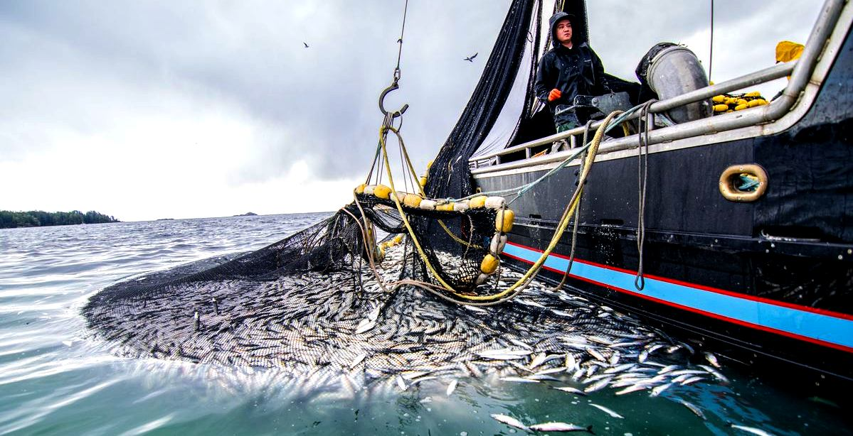
Fisheries and Aquaculture
Due to increasing demand for fish and declining global fish stock as a result from overfishing with advanced fishing methods in the deep seas, fish are now farmed.
Fish are bred and reared in fisheries such as caged enclosures in coastal waters and ponds.
An example of a fishery, which is a caged enclosure in coastal waters

Slide 5
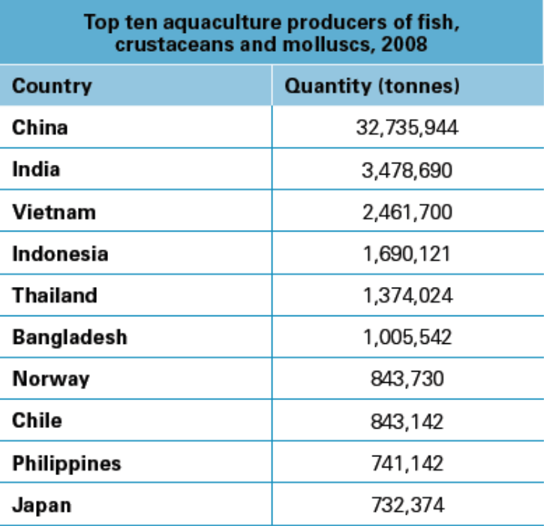
Fisheries and Aquaculture
Aquaculture contributes 33% of the world’s fish supply and is widely practised in Asian countries like China, India, Vietnam, Indonesia, Thailand and the Philippines.
From the table, it is observed that the top 6 aquaculture producers are mainly LDCs in Asia. They rely heavily on aquaculture for a living and have a large proportion of workforce in the primary industry.
Top ten aquaculture producers of fish, crustaceans and molluscs in 2008

Slide 6
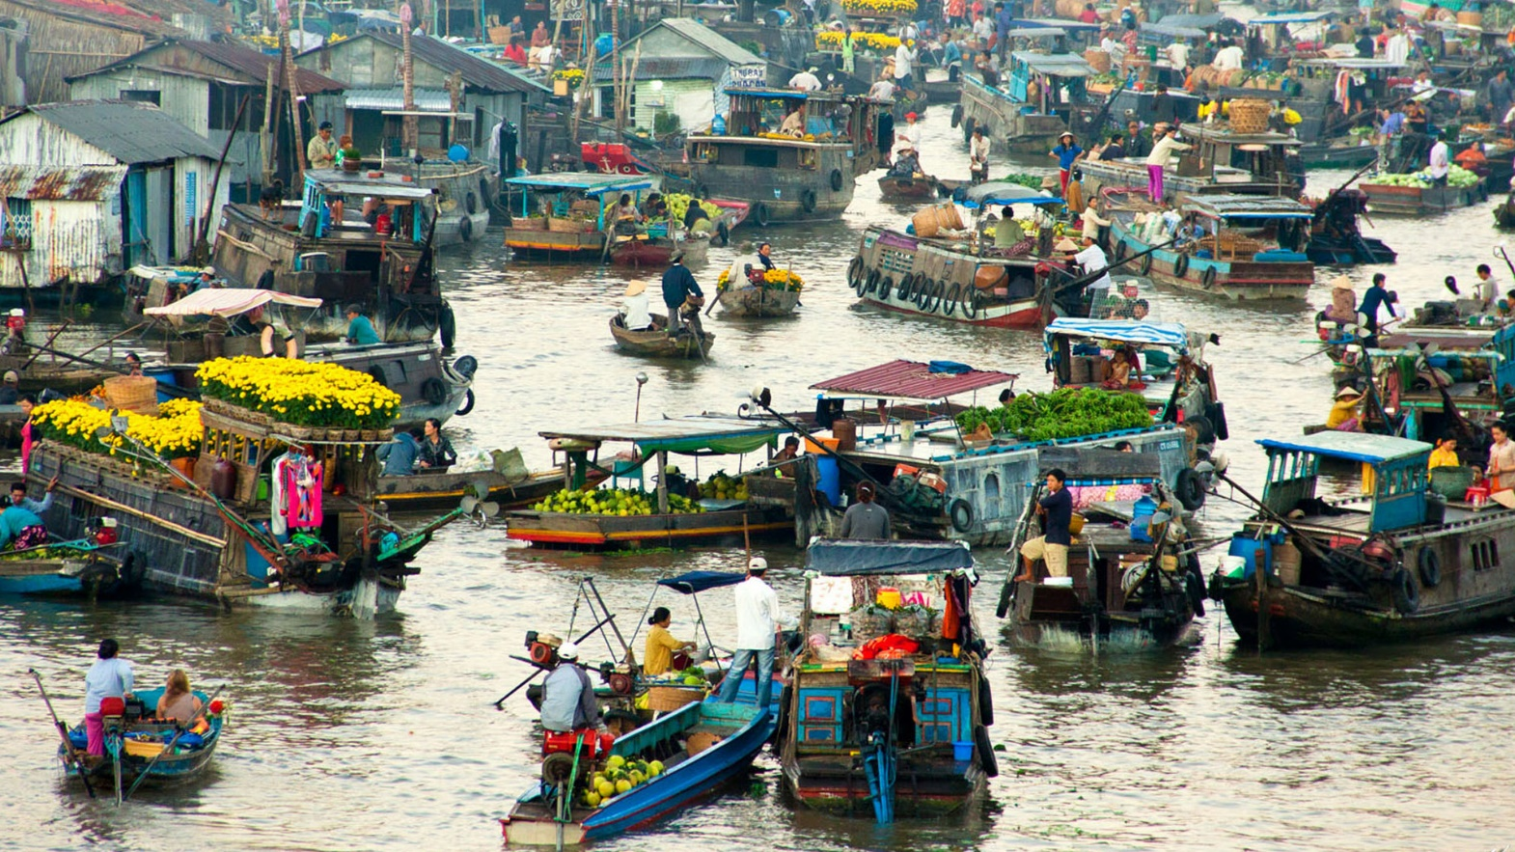
Fisheries and Aquaculture
Case Study of Cà Mau, Vietnam
Shrimp farms in Cà Mau province are carried out in ponds constructed of mud or concrete in waterlogged areas that have been cleared of 60,000 hectares of coastal mangroves for building materials, firewood, charcoal and medicinal herbs.
Cà Mau, Vietnam

Slide 7
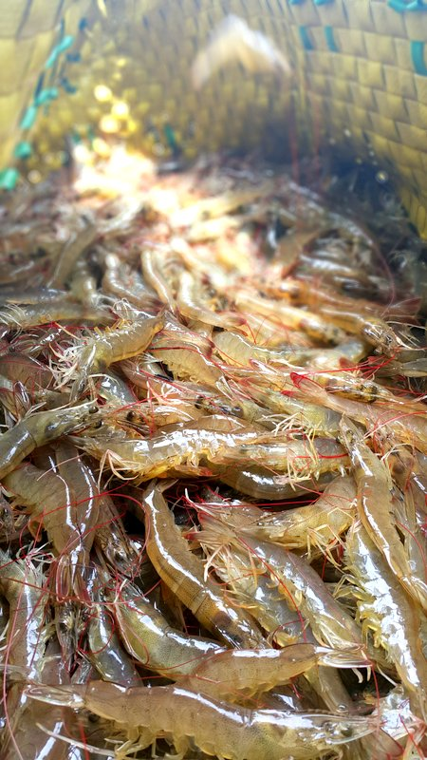
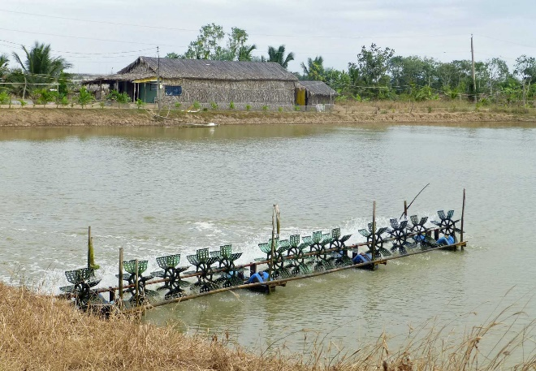
Fisheries and Aquaculture
Case Study of Cà Mau, Vietnam
Since 1990s, shrimp production has accelerated and valued at US$800 million in 2010. This was largely at the cost of mangrove forests and wetland rice fields.
A shrimp farm in Cà Mau

Slide 8
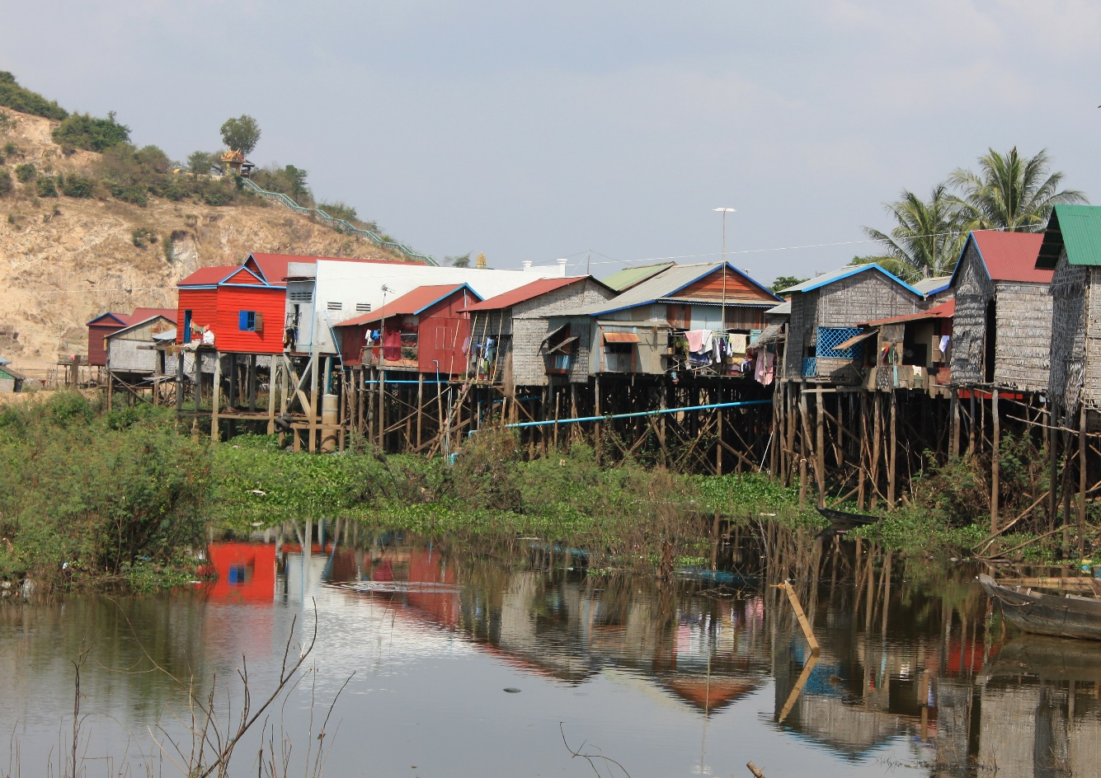
Housing and Transportation
Many people especially fishermen living in houses built on stilts in the water near the coasts. Living near the coast is a way of life for these people as they can rely on daily tides to remove household waste from the area.
Stilt houses in Cambodia

Slide 9
Housing and Transportation
Case Study of Kukup, Malaysia
Kukup is a town located on the southwest corner of Johor. It has 3 fishing villages, one of which is Air Masin. Air Masin has about 180 houses built on stilts in the water.
A diversity of marine products like crabs, fish and shellfish caught from the sea are the main sources of income for local fishermen. Fishermen use moderate size boats to fish in the sea.

Slide 10
Tourism and Recreation
People usually associate coasts with tourism and recreation. Tourism involves the temporary movement of people, primarily for leisure or recreational purposes. Recreation involves activities done for enjoyment when one is not working. Coasts are therefore popular for tourism and recreation.

Slide 11
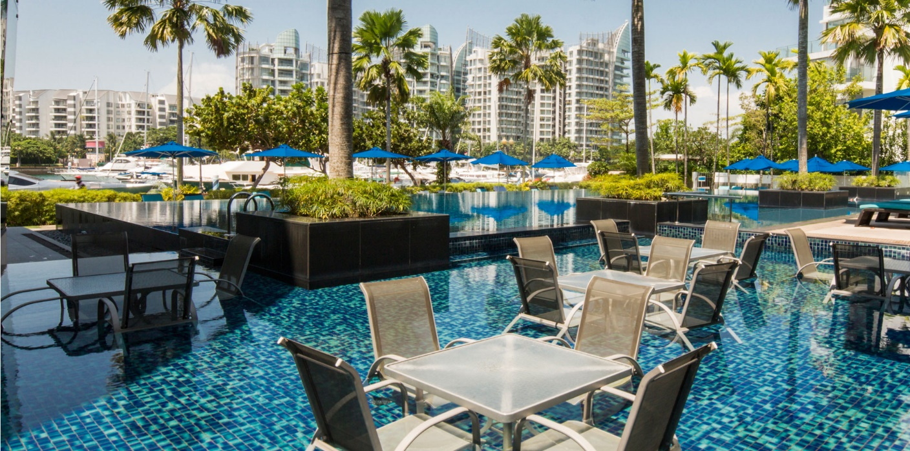
Tourism and Recreation
Case Study of Sentosa, Singapore
Sentosa Island is fringed by sheltered artificial beaches on its southern coast, with an integrated resort, an exclusive residential area, 2 golf courses and a marina. The use of the coast has been maximised. An excellent example of a heavily capitalized coastline is ONE° 15 Marina Club.
These coastal attractions have led to an influx of tourists to Singapore – 19 million in 2011, an increase of 600% from 2003
Pool Bar at ONE° 15 Marina Club

Slide 12
Gateway 2 – Why are coastal areas valuable?
How do people use coastal areas?
Why are coral reef ecosystems distinctive and valuable?
Why are mangrove ecosystems distinctive and valuable?

Slide 13
Why are coral reef ecosystems distinctive and valuable?
Besides being aesthetically pleasing and hence a resource for recreation, coral reefs are also a resource for the livelihood of millions of people. These reefs provide food, building materials, shelter and recreation for some people.

Slide 14
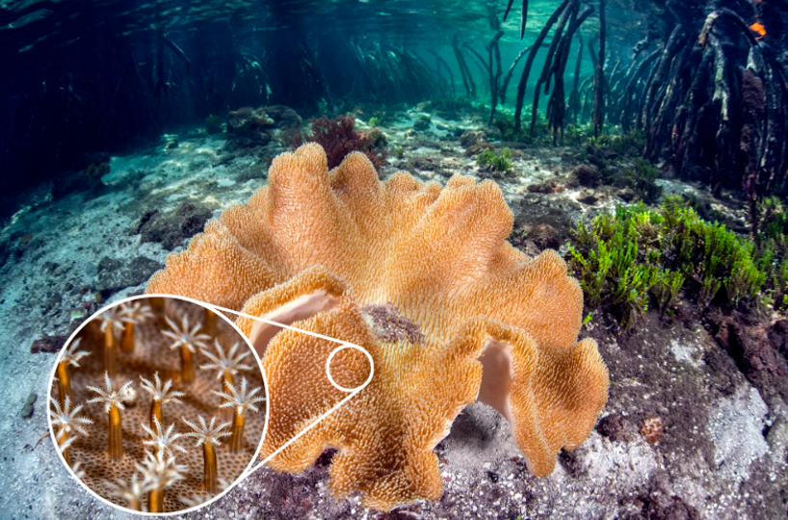
Coral Reef Ecosystems
Coral reefs are structures that develop at, or slightly below sea level on the seabed. They are built by and made up of thousands of tiny animals known as coral polyps which secrete rock-like deposits of calcium carbonate to protect the soft and delicate body of the polyp.
Coral
Coral Polyps

Slide 15
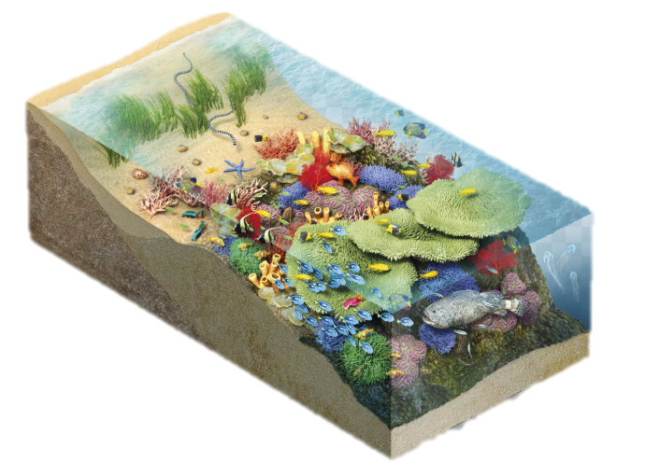
Coral Reef Ecosystems
As colonies of coral polyps die, new polyps continue living on the reef, while the calcium carbonate skeletons accumulate as limestone.

Slide 16
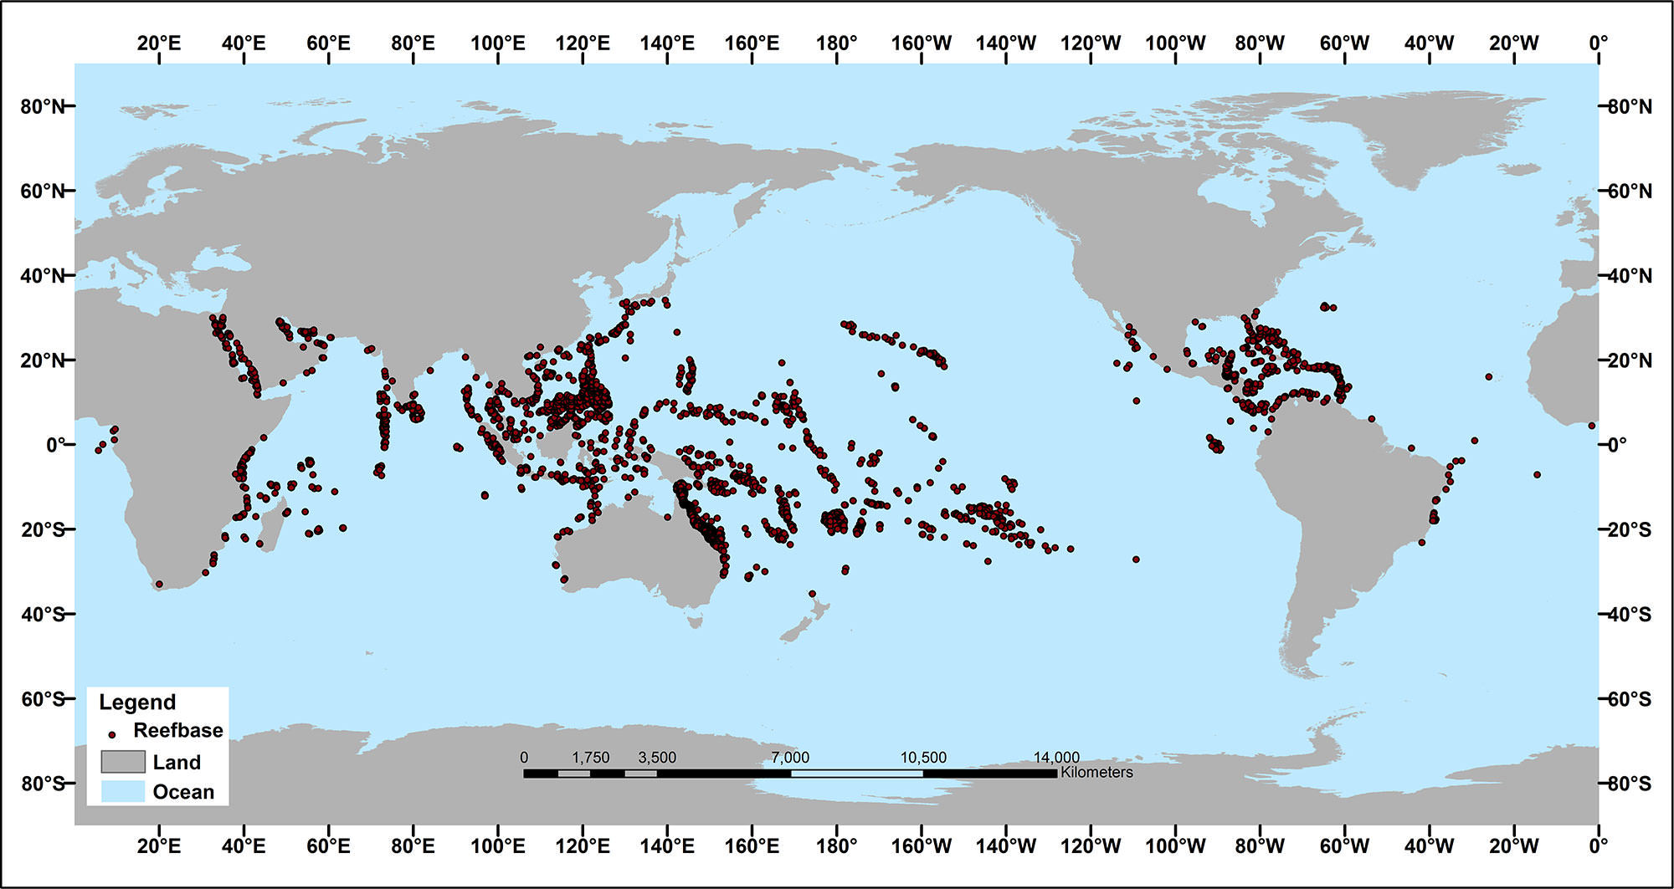
Distribution of Coral Reefs
Coral reefs are widely distributed but are mostly found between the Tropic of Cancer and the Tropic of Capricorn. With about 70,000km² of coral reefs, the region of Southeast Asia has the largest area and the highest biodiversity of coral reefs in the world.
Global distribution of Coral Reefs

Slide 17
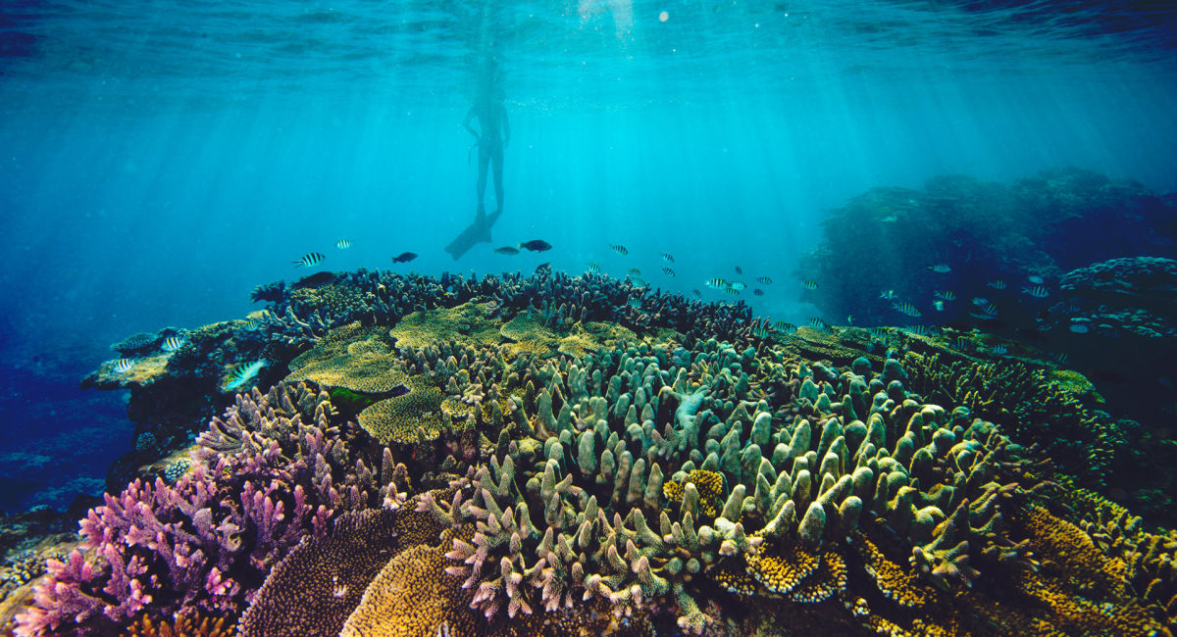
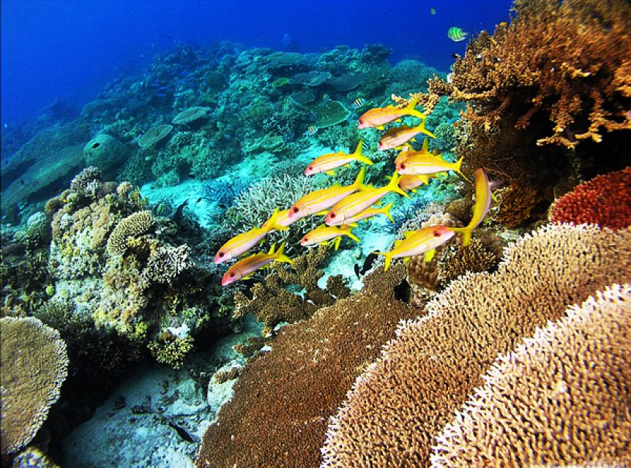
Distribution of Coral Reefs
Most Popular Coral Reefs around the World
Great Barrier Reef off the coast of Queensland in Northeastern Australia
Apo Reef in the Philippines

Slide 18
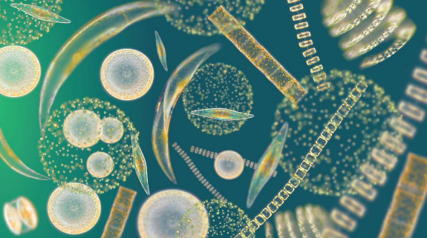
Environmental Conditions for Growth
Favourable Conditions
Corals are confined to certain environments because they are fragile and very sensitive to water temperature.
Favourable Conditions | Purpose
Warm and clear shallow tropical saline waters not lower than 17ºC and not deeper than 60m. | To allow photosynthesis of coral food such as phytoplankton and algae.
Phytoplankton, which is a microscopic marine algae

Slide 19
Environmental Conditions for Growth
Unfavourable Conditions
Corals are confined to certain environments because they are fragile and very sensitive to water temperature.
Unfavourable Conditions | Purpose
Low salinity, accompanied with high amounts of sedimentation. | Inhibits coral growth. Sediments result in the water turning murky, inhibiting sunlight penetration for photosynthesis.

Slide 20
Value of Coral Reefs
The value of coral reefs is their crucial role in supporting natural ecosystems, allowing a wide range of marine creatures to breed and grow.
Value of Coral Reefs
Habitat to many species of marine life
Protect land mass from coastal erosion from storms and typhoons
Nearby land areas developed as tourist attractions
Corals used as souvenirs

Slide 21
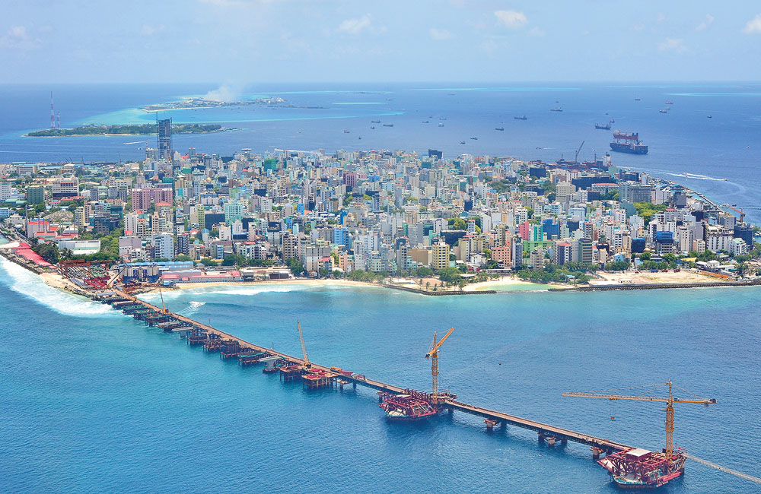
Pressures that threaten Coral Reefs
Across the world, coral reefs are under pressure either from natural processes or human activities. Pressures are events or conditions that cause changes. Natural processes such as floods may damage coral reefs.
Coastal development on the Maldives puts pressure on coral reef ecosystems

Slide 22
Pressures that threaten Coral Reefs
Across the world, coral reefs are under pressure either from natural processes or human activities. Pressures are events or conditions that cause changes. Natural processes such as floods may damage coral reefs.
Pressure | Activity | Impact
Fishing Methods | Dynamite blasting Use of cyanide to stun fish | Destroys coral reef habitat
Recreational Use of Coast | Tourism activities Expansion of coastal resorts Anchoring of boats | Sewage waste discharged into the water Oil spills from boats may pollute the water Anchors may damage corals
Coastal Development | Reclamation and extension of land areas by dumping rock and sand onto reefs | Introduction of sediments, resulting in suffocation and destruction of coral reefs
Climate Change | Rapid changes in sea temperatures and sea levels | Coral bleaching, which results in the corals to be more susceptible of diseases

Slide 23
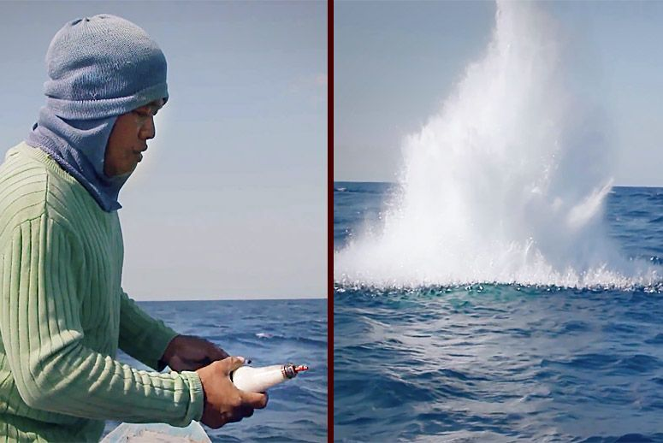
Pressures that threaten Coral Reefs
Fishing Methods
Humans adopt a process of blast fishing, where explosives are used to stun fish, inflicting terrible consequences on coral reefs. As such, the reefs are destroyed.
This is a common commercial fishing method in the Philippines where cyanide is dumped into the sea to stun the fish for easier harvesting. Not only does this kills the fish but the reefs are also damaged.
The effect of a fisherman dropping cyanide into the sea.

Slide 24
Pressures that threaten Coral Reefs
Recreational Use of Coast
This involves tourist activities to cater to recreational sailing, scuba diving etc.
Anchoring of boats at marinas may cause careless discharge of waste which harm corals. Moreover, the anchors may damage the corals.
Due to the increase in the number of tourists in areas like the Philippines and Indonesia, areas for snorkeling and scuba diving activities have shot up. An increase in these actions resulted in the coral reefs being harmed.

Slide 25
Pressures that threaten Coral Reefs
Climate Change
Human activities such as deforestation and industrialisation contribute to global warming. The changing global climate has an impact on the coral reef ecosystem. Sea temperatures and sea levels will rise greatly. Climate change results in coral bleaching.
For example, the impacts of climate change are very prevalent in low-lying areas like the Seychelles. The carbon dioxide emitted from human activities will dissolve in the water, lowering the pH value.

Slide 26
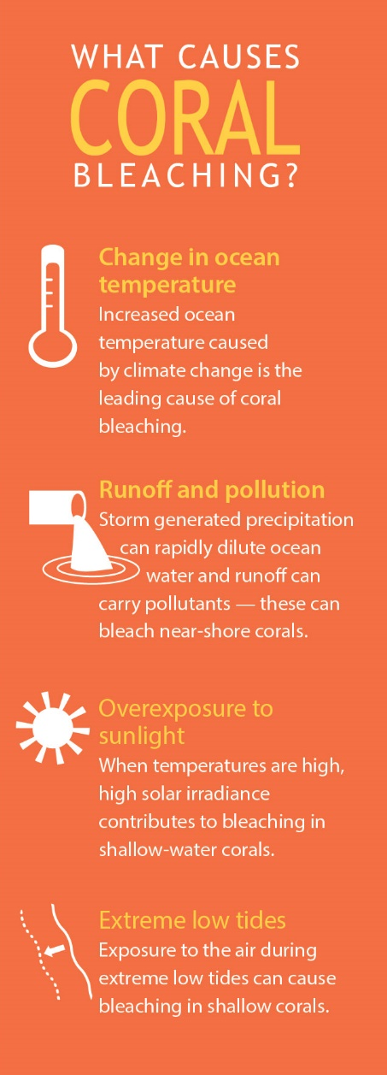

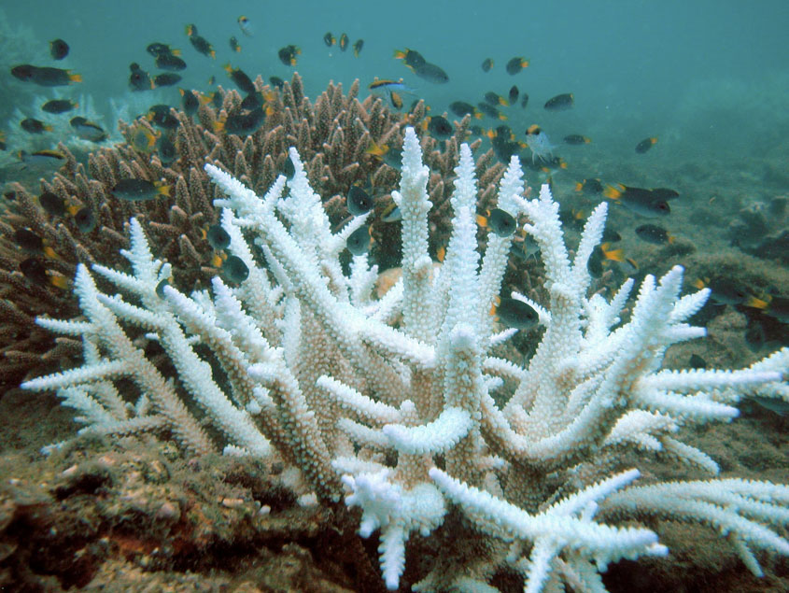
Pressures that threaten Coral Reefs
Coral Bleaching
Coral bleaching slows growth and reproduction of corals.
A bleached coral

Slide 27
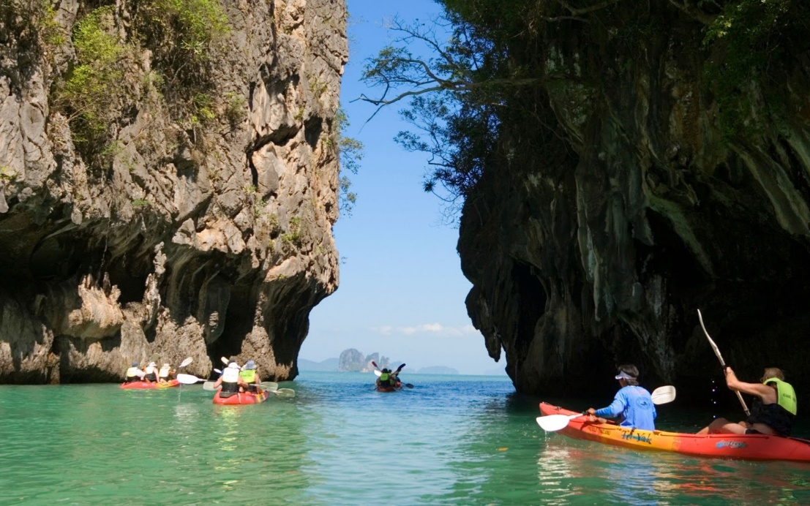
Human Activities that benefit Coral Reefs
Ecotourism
Ecotourism is refers to responsibly travelling to natural areas that conserves the environment. When carefully managed and monitored, ecotourism would actually preserve the valuable coral reef habitats.
In Phuket, the Phuket Alternative Tours (PAT), as part of its guidelines regarding sea-canoe ecotourism, limits tourist numbers to 64 daily in consideration of the carrying capacity of the ecologically sensitive region.
Sea-canoeing in Phuket, Thailand

Slide 28
Gateway 2 – Why are coastal areas valuable?
How do people use coastal areas?
Why are coral reef ecosystems distinctive and valuable?
Why are mangrove ecosystems distinctive and valuable?

Slide 29
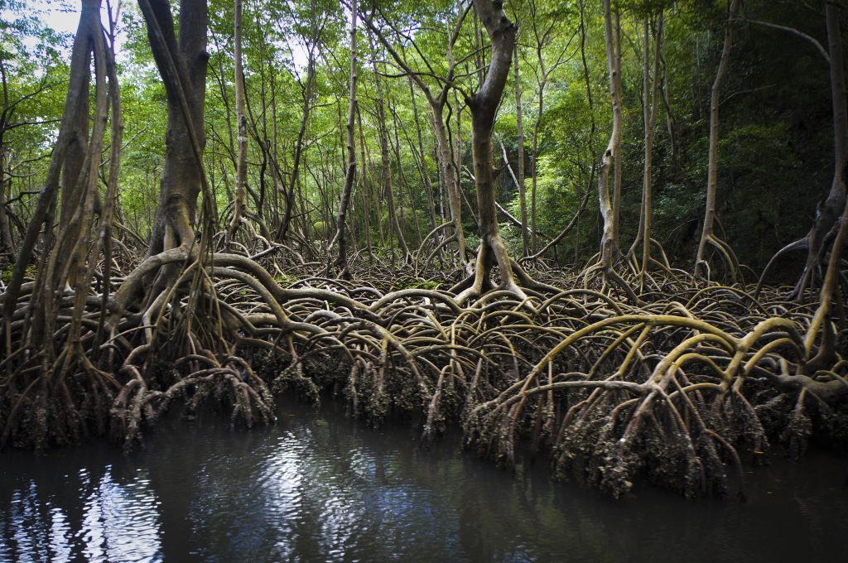
Why are mangrove ecosystems distinctive and valuable?
Mangrove species are salt-tolerant tropical or subtropical plants which grow in conditions that most plants are unable to. They grow in tidal mud on sheltered coasts. They are home to their unique communities of plants and animals, and are one of the most productive and biologically complex ecosystems.
Mangrove trees

Slide 30
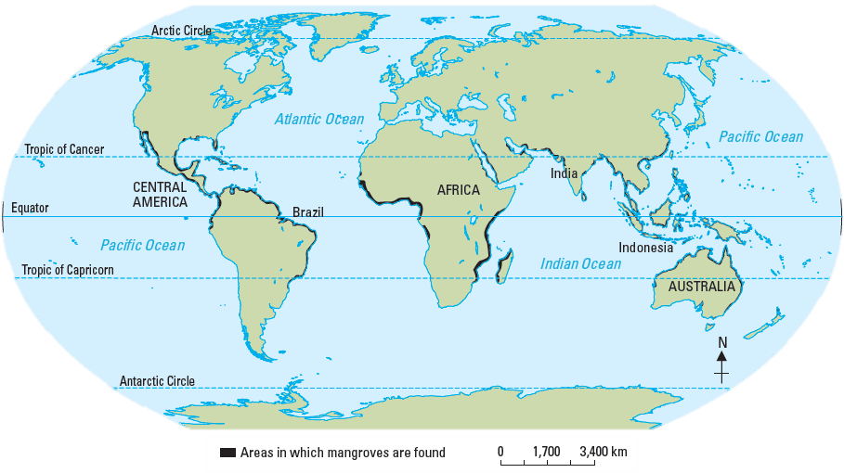
Distribution of Mangroves
Mangroves are found on the coasts of countries. These countries are mostly located between the Tropic of Cancer and the Tropic of Capricorn.
Mangroves are most abundant on tropical coastlines such as the Malay Peninsula, Borneo, Papa New Guinea and northern Australia.
Distribution of mangroves around the world

Slide 31
Environmental Conditions affecting Growth
Mangroves have various characteristics which allow them to adapt to the saline environment. Adaptation refers to the ability of life forms to adjust to changing conditions. Since many plants cannot adapt to the saline water and oxygen-deficient soil of a tidal environment, mangrove ecosystems have few species of plants.

Slide 32
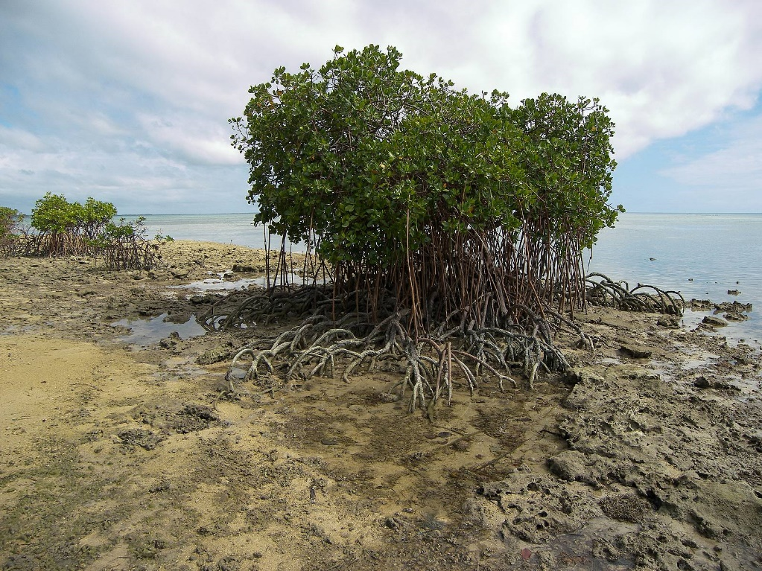
Zonation and the Mangrove Ecosystem
Coastal Zonation
These mangroves are the nearest to the coast and they grow in saltwater. The trees have breathing aerial/pencil roots. An example of a mangrove tree in the coastal zonation is the Avicennia.
However, such trees are subject to regular strong effects of tides and sediment changes.
Aerial roots
The Avicennia Marina

Slide 33
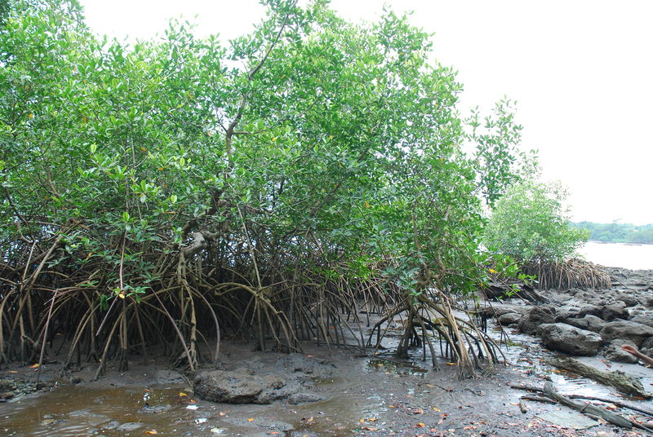
Zonation and the Mangrove Ecosystem
Middle Zonation
These mangroves have prop/stilt roots and they are most dense and consist of a wider variety of species. Sedimentation helps the mangroves to maintain greater height. Such mangroves include the Rhizophora.
Prop roots
The Rhizophora plant

Slide 34
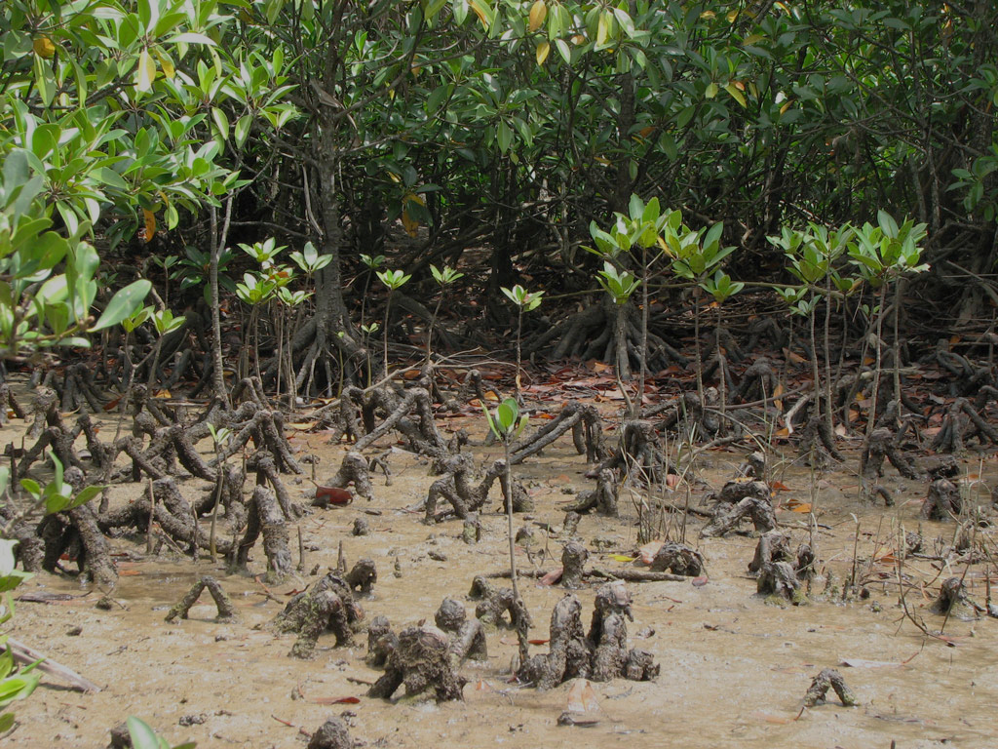
Zonation and the Mangrove Ecosystem
Inland Zonation
These mangroves are the least tolerant to saltwater. The trees have knee-like roots and such mangroves include the Bruguiera plant. The trees trap soil between their roots.
Furthermore, the knee-like roots allow oxygen intake in water-logged oxygen-deficient soil conditions as well as provide stability for the tree in the soft unstable ground.
Knee-like or kneed roots
The Bruguiera plant

Slide 35
Mangrove Adaptations
Leaves
Avicennia​ leaves have salt glands which secrete salt. It is then washed away by the sea during high tide.
Rhizophora​ and Bruguiera​ plants absorb the salt in old leaves which are then discarded when they fall.

Slide 36
Mangrove Adaptations
Roots
Aerial roots of the Avicennia​ help plants take in oxygen directly from atmosphere because of the low oxygen content under the muddy ground.
Prop roots of the Rhizophora​ help plants anchor themselves firmly to the ground so that they are not easily swept away by waves.
Kneed roots of the Bruguiera​ help to trap soil between their roots which is essential for plant growth.

Slide 37
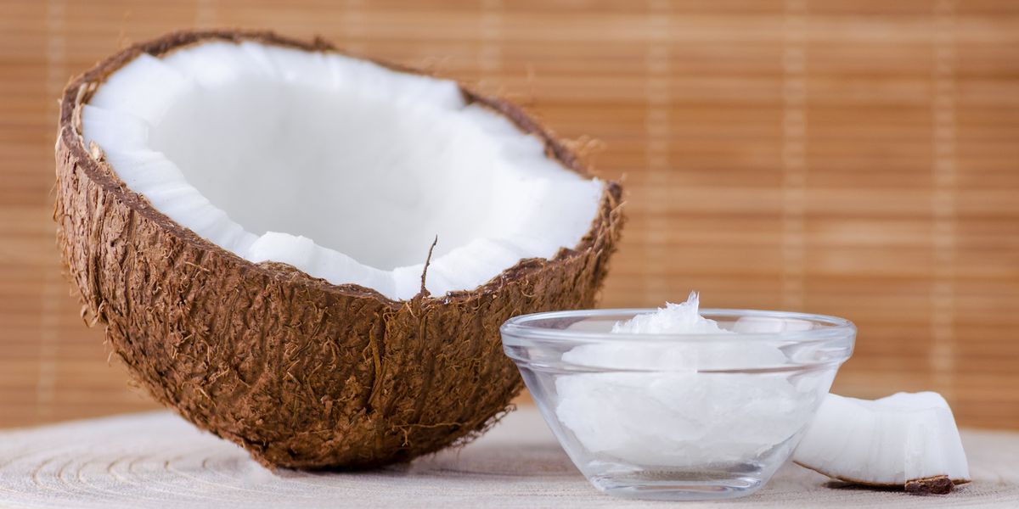
Mangrove Adaptations
Fruits and Flowers
Fruits can germinate while still attached to the plant so that they can drop and directly grow without being washed away.
Rhizophora species have fruits that are javelin-shaped, allowing them to pierce into soft mud and grow into a sapling immediately.
Avicennia species have fruits that are buoyant, allowing them to float on water so that they can be carried away by it to other coastal areas.
The coconut, an example of a buoyant fruit

Slide 38
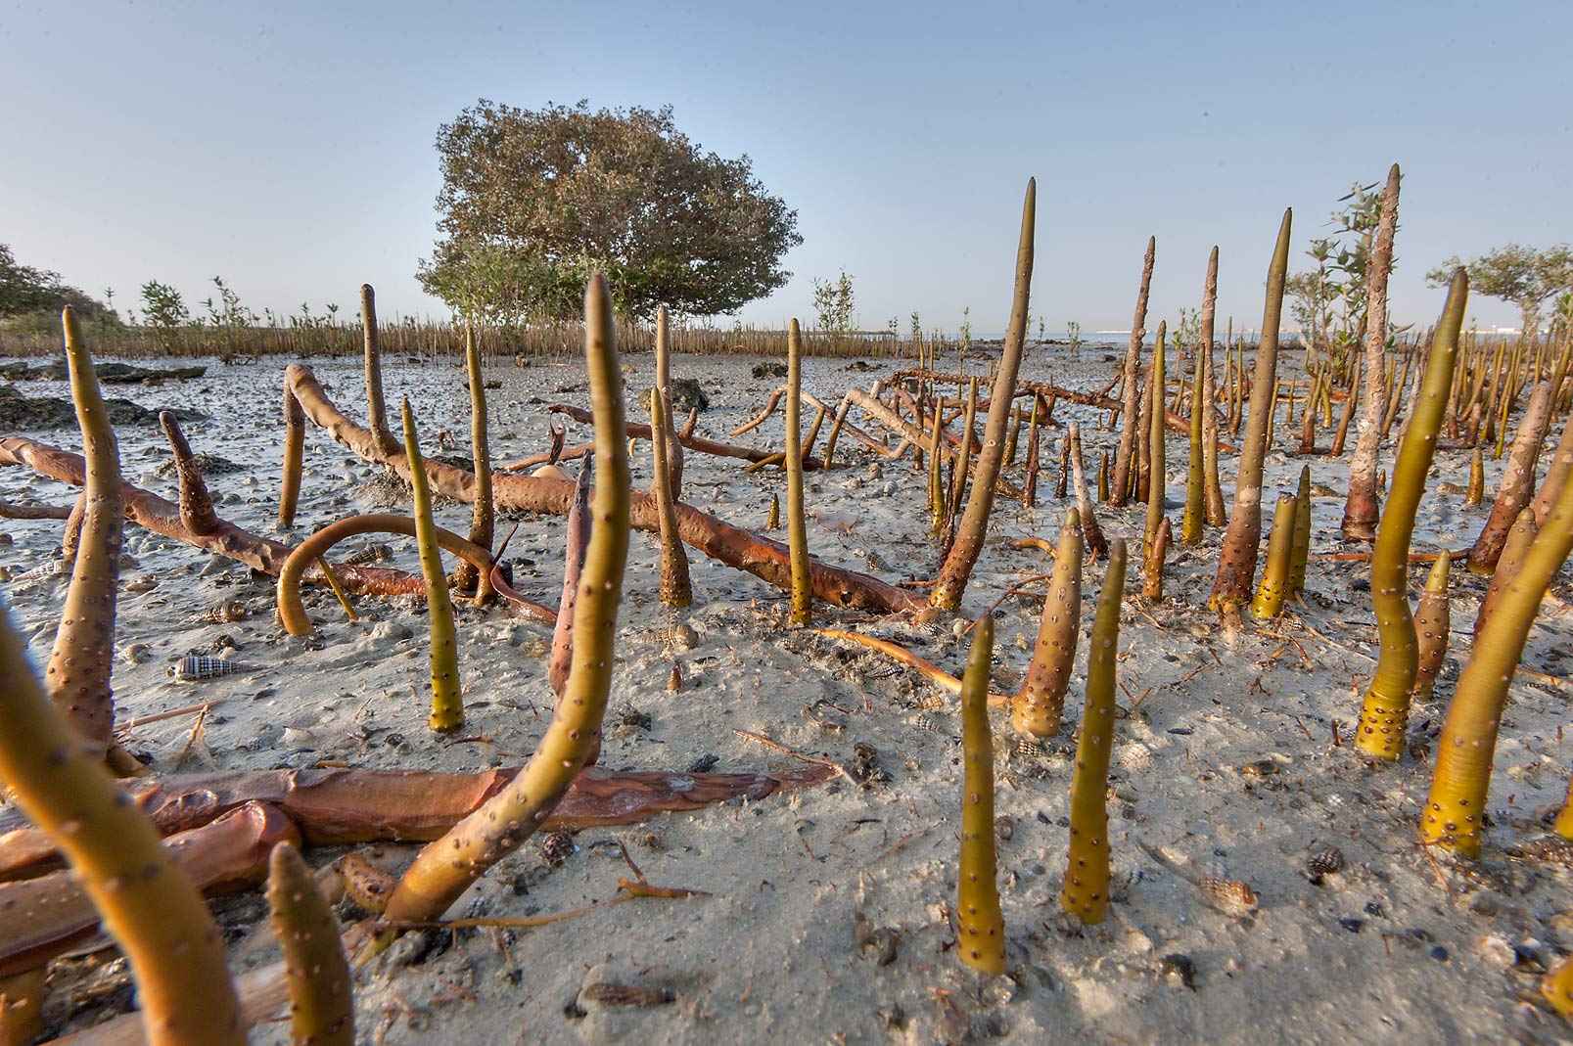
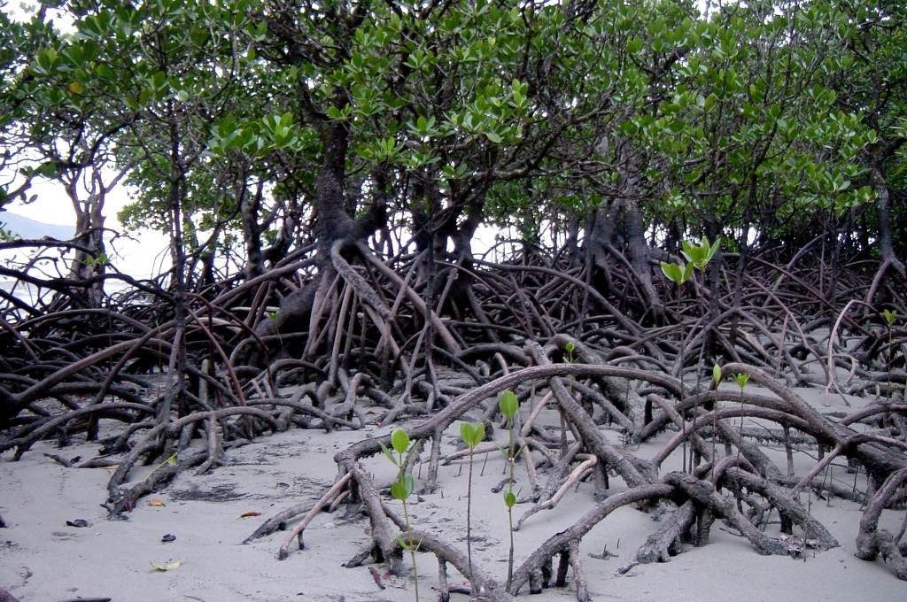
Environmental Conditions affecting Growth
Mangrove Roots
Aerial roots help trees breathe.
Prop roots help anchor trees firmly.

Slide 39
Value of Mangroves
Mangroves play a crucial role in a range of natural processes and also serve as a valuable resource for people.
Value of Mangroves
Filters sediments washed down by rivers onto coasts
Protect coastal areas from erosion by storm waves
Breeding ground and habitat for a range of marine creatures
Wood for fuel and construction

Slide 40
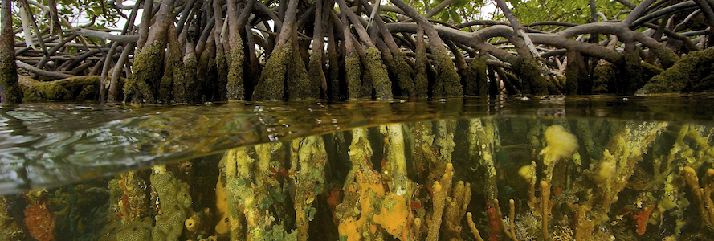
Value of Mangroves
Breeding Ground and Habitat for a Range of Marine Creatures
The mangrove environment is a breeding ground and habitat for a range of marine creatures. Barnacles, oysters and sponges anchor on the hard surfaces of the aerial roots. Shrimps, crabs and lobsters search for food in the muddy sediments between mangrove roots.
Barnacles live in shallow and tidal waters, and attach themselves permanently to hard surfaces such as the aerial roots of mangroves.

Slide 41
Pressure on Mangroves
Despite mangroves being valuable to natural environments and human activities, they are under pressure due to humans’ use of resources from these ecosystems.
Pressure | Activity | Impact
Clearing of mangroves for fuel wood and charcoal | Mangroves are cleared for fuel and charcoal (e.g. Malaysia) | Coasts become more open to storm waves
Conversion to other land uses | Thousands of hectares of lands are converted to paddy fields and shrimp farms (e.g. Ca Mau, Vietnam) | Mangroves are cleared and coasts become more vulnerable
Coastal development | Land is reclaimed for housing, industrial and recreational use | Coastal waters are polluted as a result of human activities
Rising sea level | Acceleration of climate change results in rising sea levels and extreme storm activity | Mangroves will have difficulty colonising areas further inland

Slide 42
Pressures that threaten Mangroves
Clearing of Mangroves for Wood and Charcoal
Mangrove branches and roots are harvested for fuel wood and trunks are used for cooking. This is prevalent in low income and low technology countries such as Malaysia.
This makes coastal areas vulnerable to potential destruction by storm waves and reduced breeding grounds for organisms.

Slide 43
Pressures that threaten Mangroves
Conversion to other Land Uses
Large areas of mangroves have been converted into rice fields and shrimp farms to meet the rising demand for seafood. This made coastal areas vulnerable to potential destruction by storm waves and deprived local fishermen of their livelihoods.
For example, over 60 000 hectares of mangroves have been cleared to build shrimp farms in Ca Mau, Vietnam to provide more income to the country via the seafood industry. However, this has left the southern coast of Vietnam prone to coastal erosion.

