Slide 1
Secondary 3 Pure Geography
Chapter 1 - Coasts
Gateway 1 – How and why are coastal environments different and dynamic?

Slide 2
Gateway 1 – How and why are coastal environments different and dynamic?
What is a coastal environment?
How are coastal environments different?
Why are coastal environments dynamic?
What are waves and how are they generated?
How do waves affect coastal areas?
Why do coastal landforms and features vary from place to place?
In what ways do coastal landforms and features vary from place to place?

Slide 3
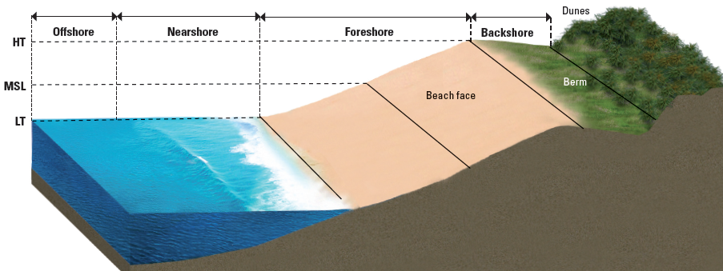
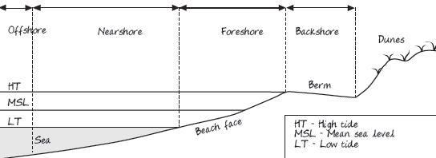
What is a coastal environment?
The coast is the area where the land meets and interacts with the sea. It is covered into 4 sections which are backshore, foreshore, nearshore and offshore.

Slide 4
Gateway 1 – How and why are coastal environments different and dynamic?
What is a coastal environment?
How are coastal environments different?
Why are coastal environments dynamic?
What are waves and how are they generated?
How do waves affect coastal areas?
Why do coastal landforms and features vary from place to place?
In what ways do coastal landforms and features vary from place to place?

Slide 5
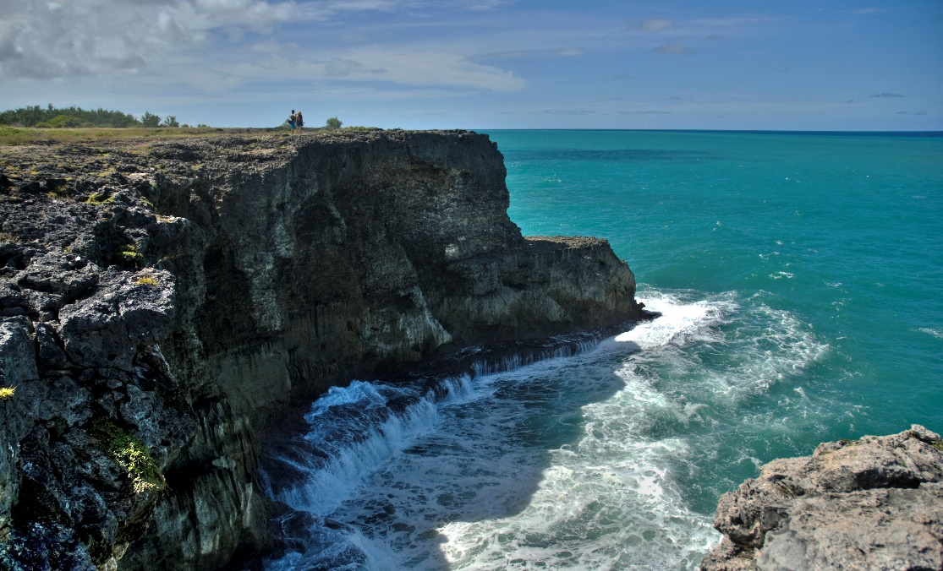
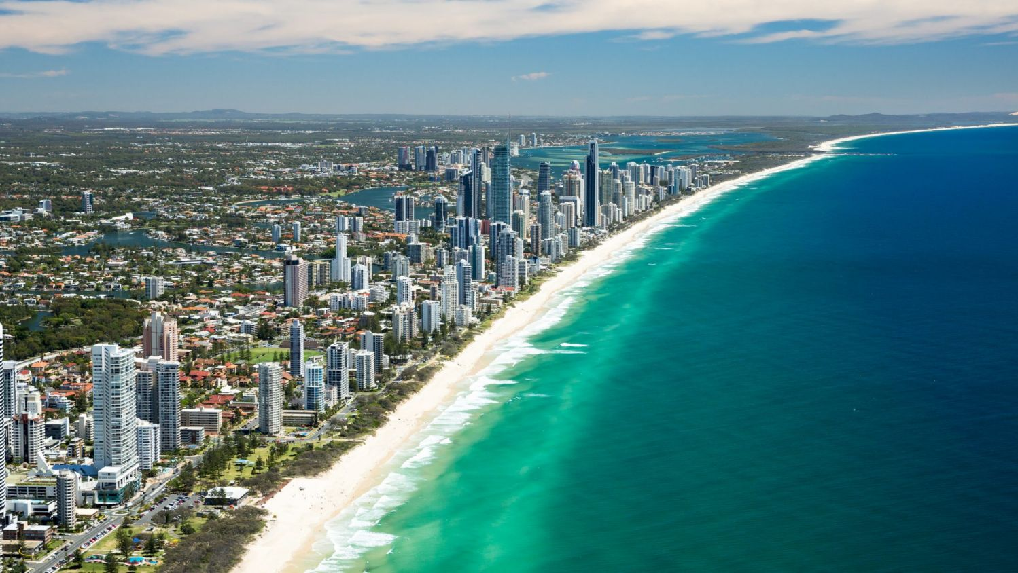
How are coastal environments different?
Coastal environments differ in their characteristic appearance which is dependent on their geological composition and the extent marine processes and human activities have shaped them.
Cliffed
Sandy

Slide 6
Gateway 1 – How and why are coastal environments different and dynamic?
What is a coastal environment?
How are coastal environments different?
Why are coastal environments dynamic?
What are waves and how are they generated?
How do waves affect coastal areas?
Why do coastal landforms and features vary from place to place?
In what ways do coastal landforms and features vary from place to place?

Slide 7
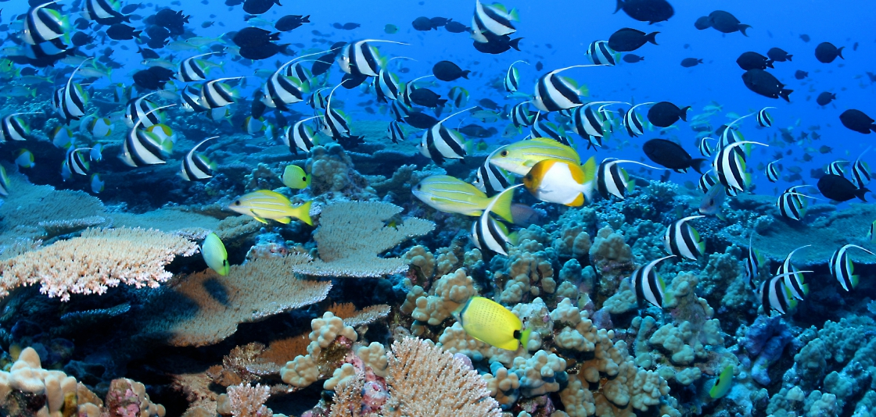
Why are coastal environments dynamic?
The dynamism of coastal environments are influenced by several factors.
Waves
Tides
Currents
Geology
Types of ecosystems
Human activities
Types of ecosystems: Coral reefs are underwater structures which develop on seabed comprising tiny polyps

Slide 8
Factors affecting Coastal Environments
Waves
Waves refer to swells in the water rising forward and falling backward. Wind energy is transferred to the water surface, blowing across the surface of seas and oceans.
AFFECTS: The power of waves to erode landforms.

Slide 9
Factors affecting Coastal Environments
Tides
Tides are daily sea level changes caused by the gravitational pull of the Moon and Sun on the Earth.
Coastal areas experience one high tide and one low tide every 12 hours or there is a 6-hour period between tides. During high tides, waves strike foreshore and have greater power to erode and transport sediments.
AFFECTS: The transportation of sediments and erosion.

Slide 10
Factors affecting Coastal Environments
Currents
Currents refer to the large-scale continuous water movements in seas and oceans. It is driven by the prevailing wind in one direction.
AFFECTS: Erosion and distribution of sediments.

Slide 11
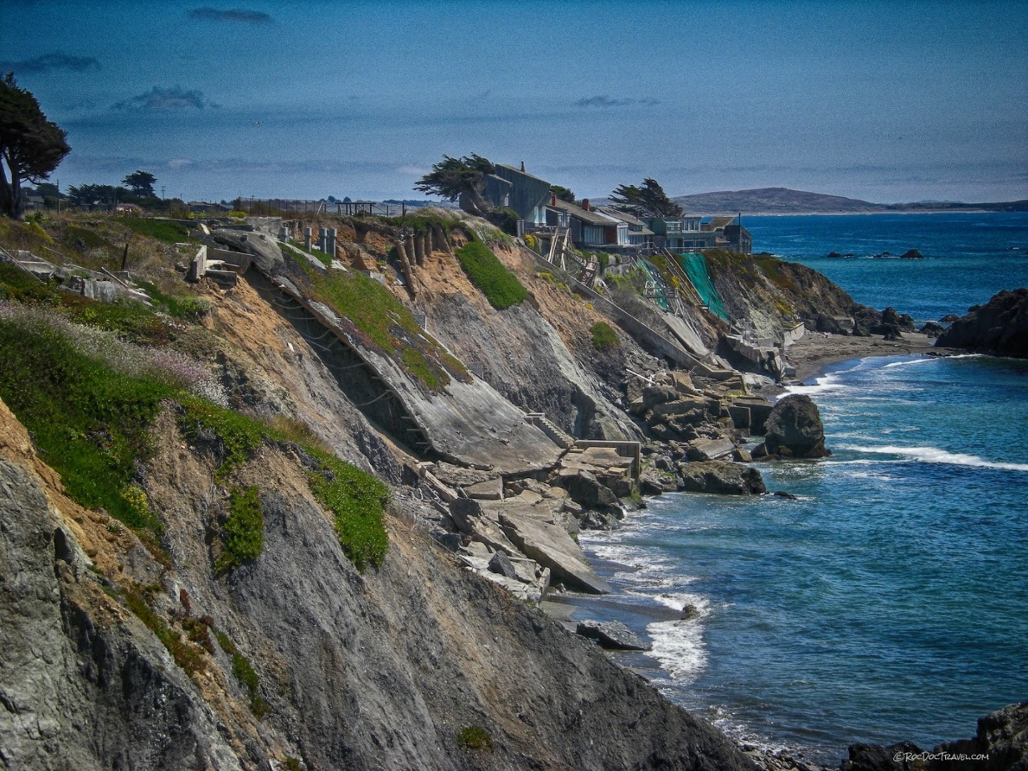
Factors affecting Coastal Environments
Geology
Geology refers to the arrangement and composition of rocks. It is determined by the rate of erosion. The composition determines the hardness, resistance and structure of the rocks.
AFFECTS: Rate of erosion.
Differing rock resistance to marine attack gives rise to differing rates of erosion, hence differing coastlines.

Slide 12
Factors affecting Coastal Environments
Types of Ecosystems
Marine ecosystem or plant and animal communities interacting with one another and with the coastal environment. They contribute to dynamic and changing nature of coastal environments.
Corals slow down the speed of waves whereas mangroves trap sediments and reduce the impact of soil erosion.
AFFECTS: Impact of waves on coasts.

Slide 13
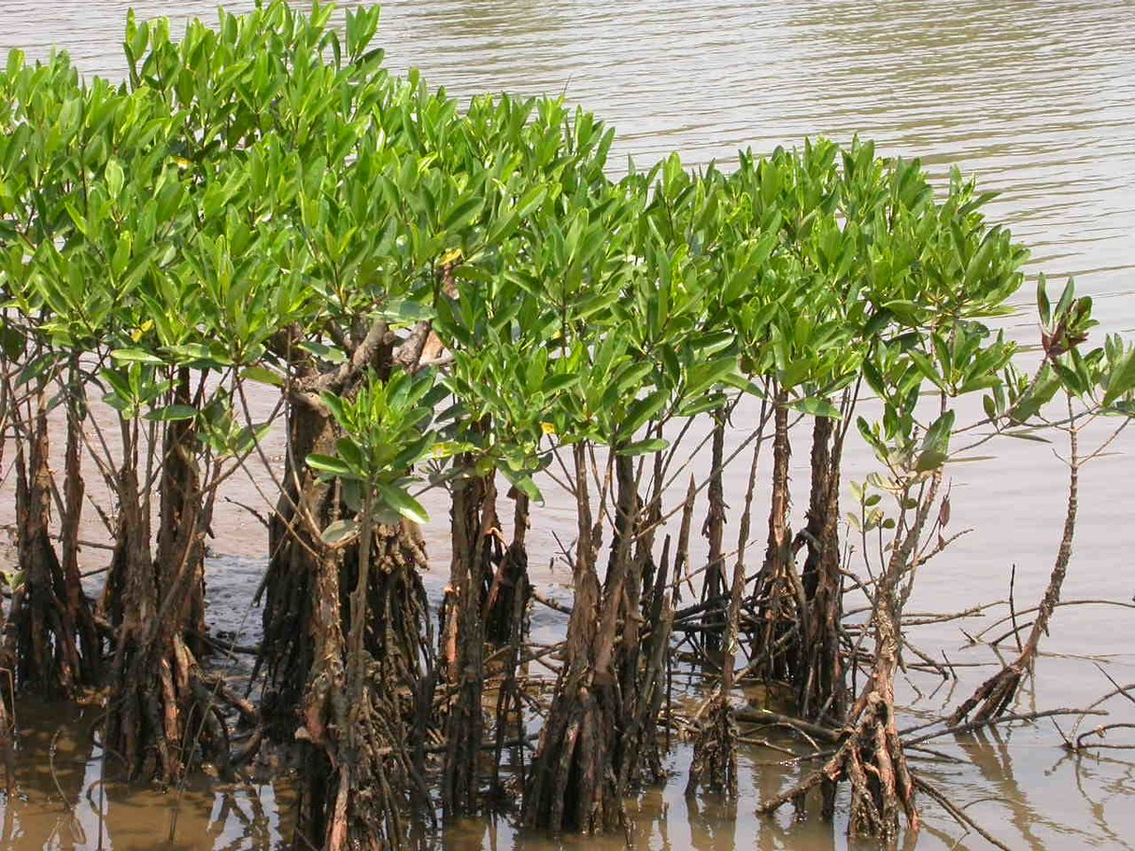
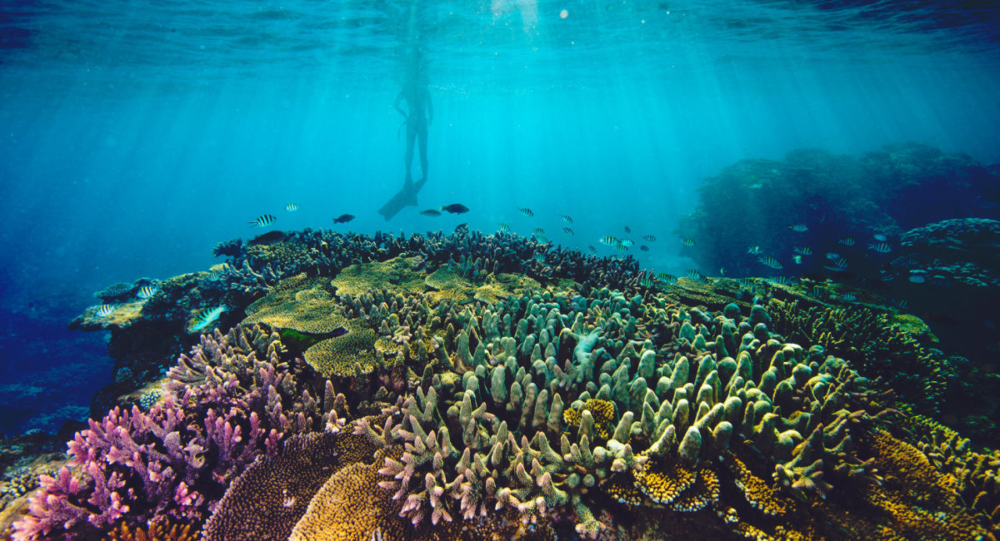
Factors affecting Coastal Environments
Types of Ecosystems
Coral Reefs: Coral reefs are excellent natural barriers that absorb and reduce wave energy, hence slowing down the rate of erosion.
Mangroves: Mangroves comprise aerial roots which trap sediments and reduce coastal erosion.

Slide 14
Factors affecting Coastal Environments
Human Activities
People change coastal environments by living, trading, fishing and engaging in recreational activities in these environments. For example, people cause pollution in these environments by dumping waste.
AFFECTS: Condition of coastal environment.

Slide 15
Gateway 1 – How and why are coastal environments different and dynamic?
What is a coastal environment?
How are coastal environments different?
Why are coastal environments dynamic?
What are waves and how are they generated?
How do waves affect coastal areas?
Why do coastal landforms and features vary from place to place?
In what ways do coastal landforms and features vary from place to place?

Slide 16
What are waves and how are they generated?
Waves develop when the energy from the wind blowing across seas and oceans is transferred to the water surface. The movement of waves is affected by wind direction.
Onshore winds push waves towards the coast, resulting in waves crashing onto the shore.

Slide 17
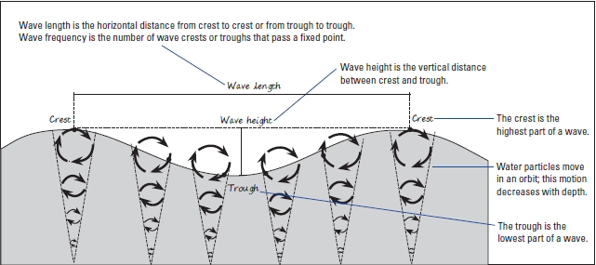
Waves
Wave Terminology
The following diagram shows the various parts of a wave.

Slide 18
Waves
Wave Terminology
Crest: Highest part(s) of the wave
Trough: Lowest part(s) of the wave
Wavelength: Distance from crest to crest or trough to trough
Wave height: Vertical distance from crest to trough
Wave frequency: The number of wave crests or troughs passing through a fixed point
Wave period: The time taken for waves to travel through one wavelength
Wave amplitude: Measurement of wave from centre to highest point/lowest point

Slide 19
Waves
Factors affecting Wave Energy
Wave energy depends on 3 factors – the wind speed, wind duration and length of fetch. Fetch is the distance the wind has travelled over seas and oceans to form waves.
Factor | Size and Energy of Waves
Wind Speed | The faster the wind blows, the greater the wave energy.
Wind Duration | The longer the wind blows, the larger the waves are, resulting in greater wave energy.
Speed | The greater the fetch, the more energy the waves have.

Slide 20
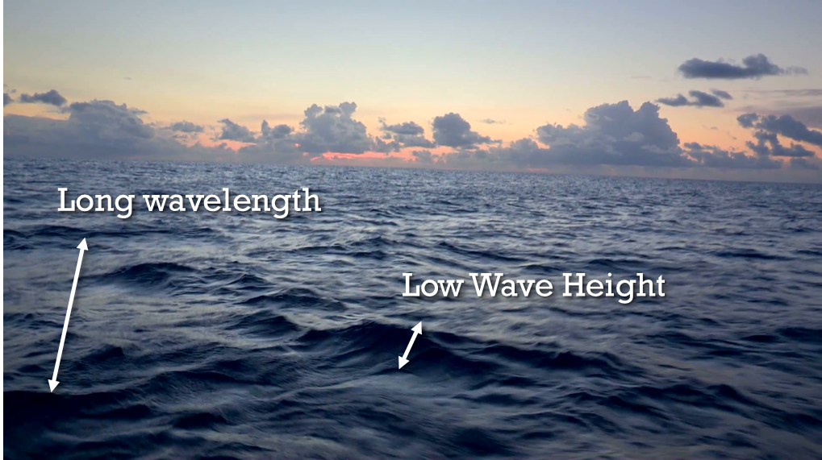
Waves
Waves in the Open Ocean
Waves in the open ocean have a long wavelength and low wave height. Water particles in the ocean move in an orbit, a motion that rapidly decreases with depth.
Waves in the open ocean

Slide 21
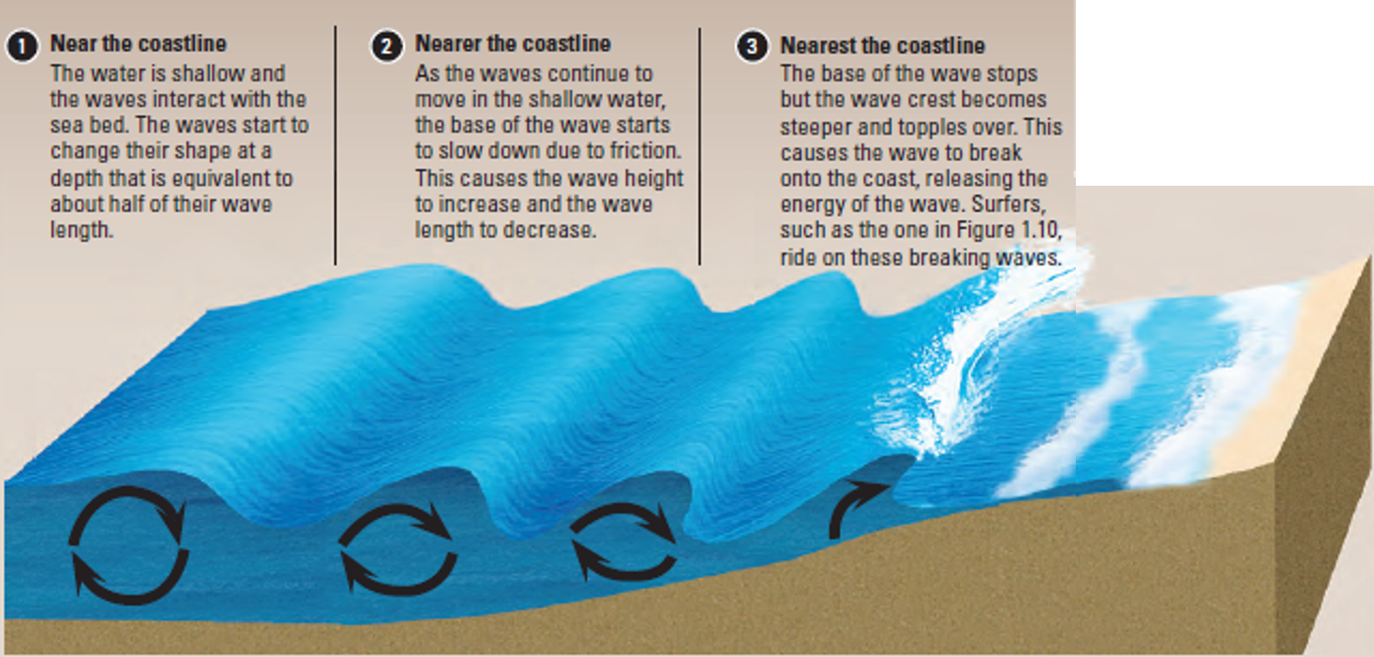
Waves
Waves Close to the Coastline

Slide 22
Gateway 1 – How and why are coastal environments different and dynamic?
What is a coastal environment?
How are coastal environments different?
Why are coastal environments dynamic?
What are waves and how are they generated?
How do waves affect coastal areas?
Why do coastal landforms and features vary from place to place?
In what ways do coastal landforms and features vary from place to place?

Slide 23
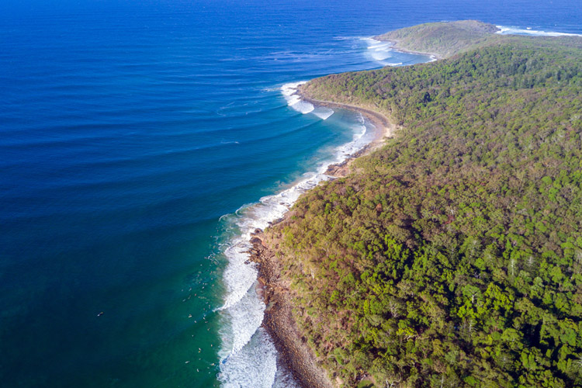
How do waves affect coastal areas?
Not all beaches look the same. The key reason is because the profile of a beach is partly determined by waves. Wave energy differs from place to place.
The convergence of waves on headlands. This process is part of wave refraction.

Slide 24
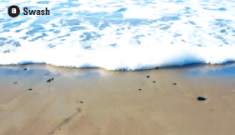
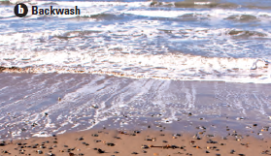
Waves on the Beach
Swash and Backwash
When waves break, water rushes up a beach. We call this swash. As swash moves up the beach, it carries sediments with it.
Swash loses energy due to gravity and friction with the land and returns to the sea as backwash. The backwash carries sediments from the shore into the sea.

Slide 25
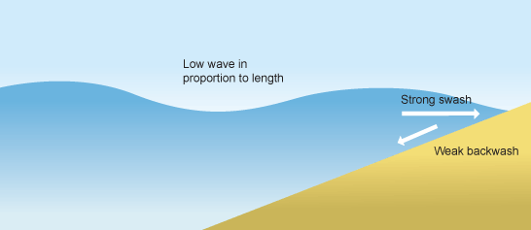
Types of Waves
Constructive Waves
Constructive waves break far from the shore and with little energy. In such low energy wave environments, finer material is deposited, which in turn forms gentle slopes. Constructive waves have a strong swash but a weak backwash.
They have a long wavelength, and are low in height. They are created in calm weather and are less powerful than destructive waves.
Illustration of a constructive wave

Slide 26
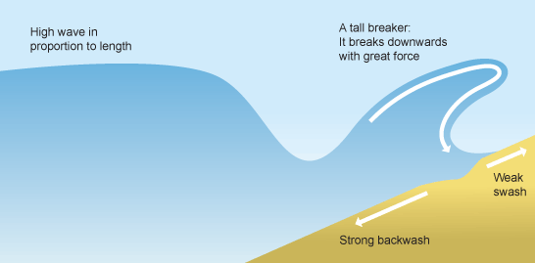
Types of Waves
Destructive Waves
Destructive waves break violently on the shore with high energy. In such high energy wave environments, finer materials like sand tend to be transported away by the turbulent water, leaving only coarser materials like pebbles which in turn form steeper slopes.
Destructive waves produce a weak swash but a strong backwash. Instead of depositing sediments on coasts, destructive waves erode coasts and transport rocks and beach material away.
Illustration of a destructive wave

Slide 27
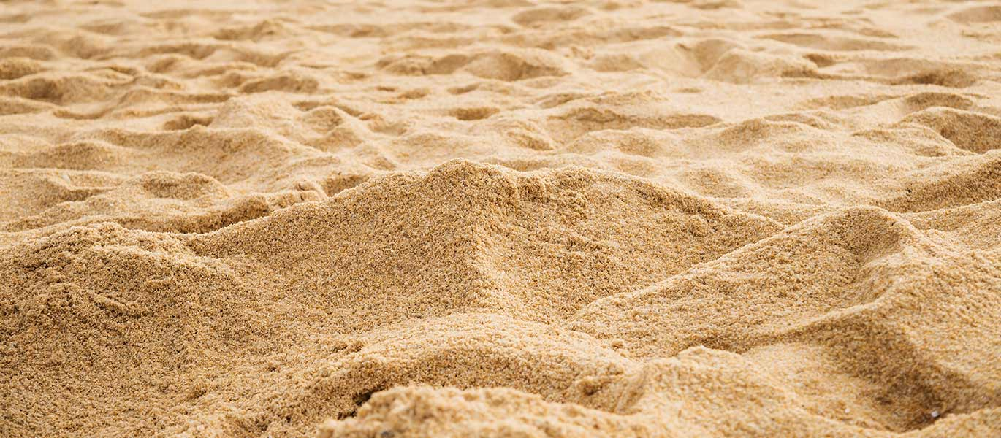
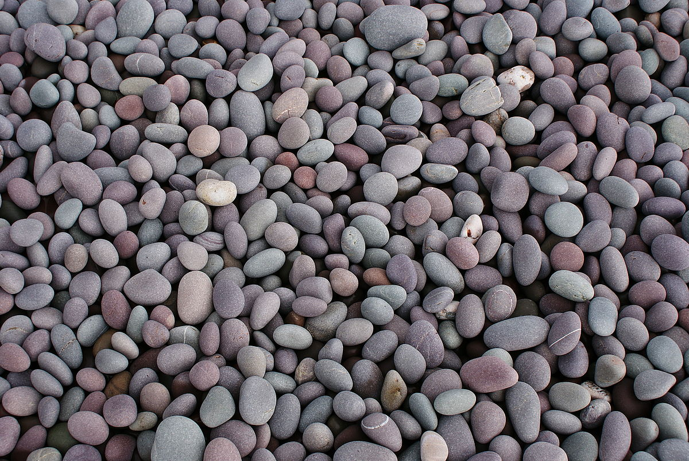
Types of Waves
Destructive Waves
Finer materials like sand tend to be transported away by the turbulent water
Coarser materials like pebbles are left behind, which form steeper slopes

Slide 28
Types of Waves
Comparison between Constructive Waves and Destructive Waves
 | Constructive waves | Destructive waves
Gradient | Low | High
Energy environment | Low | High
Wave height | Low | High
Wave length | Long | Short
Wave frequency | 6–8 per minute | 10–14 per minute
Swash and backwash | Swash more powerful than backwash | Backwash more powerful than swash
Prominent process | Deposition | Erosion

Slide 29
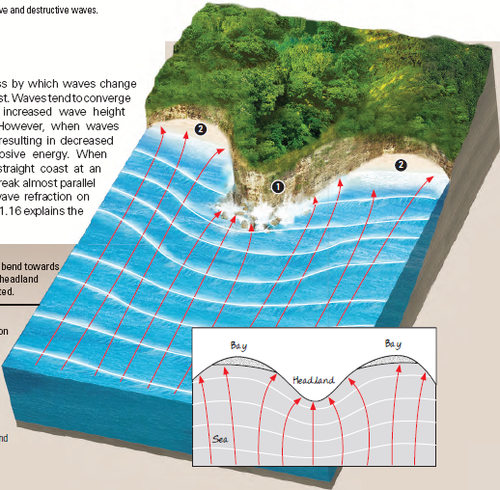
Wave Refraction
Wave refraction is the process by which waves change direction as they approach a coast, giving rise to increased wave height and greater erosive energy.
Waves approach a headland and bend towards it. More erosion will occur at the headland where wave energy is concentrated. Then, waves diverge when they reach the adjacent bays. More deposition will occur in bays where wave energy is spread out.
Waves approaching headland | Waves reaching adjacent bays
Convergence | Divergence

Slide 30
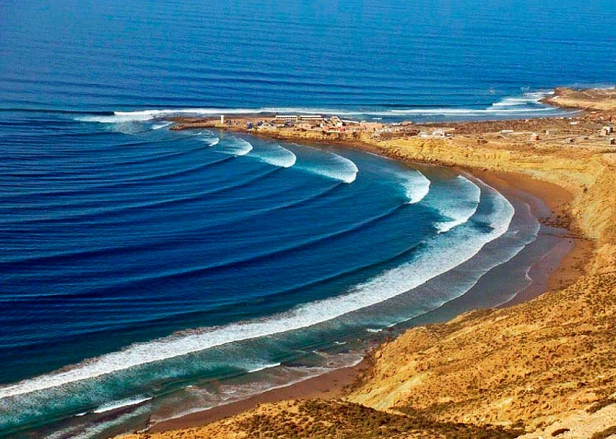
Wave Refraction
Waves approach a headland and bend towards it. More erosion will occur at the headland where wave energy is concentrated.
Headland
Divergence of waves
Waves diverge when they reach the adjacent bays. More deposition will occur in bays where wave energy is spread out.
Bay

Slide 31
Gateway 1 – How and why are coastal environments different and dynamic?
What is a coastal environment?
How are coastal environments different?
Why are coastal environments dynamic?
What are waves and how are they generated?
How do waves affect coastal areas?
Why do coastal landforms and features vary from place to place?
In what ways do coastal landforms and features vary from place to place?

Slide 32
Why do coastal landforms and features vary from place to place?
Waves, tides and currents erode coastal rocks and, transport and deposit sediments along coasts. The coastal processes of coastal erosion, transport and deposition operate at varying degrees to produce a variety of coastal landforms and features.

Slide 33
Coastal Processes
Coastal Erosion (Hydraulic Action)
Coastal erosion takes place in four main ways. One or more of these erosional processes may take place at the same time at any one coastal location.
Coastal Erosion
Hydraulic Action
Abrasion/Corrasion
Attrition
Corrosion/Solution

Slide 34
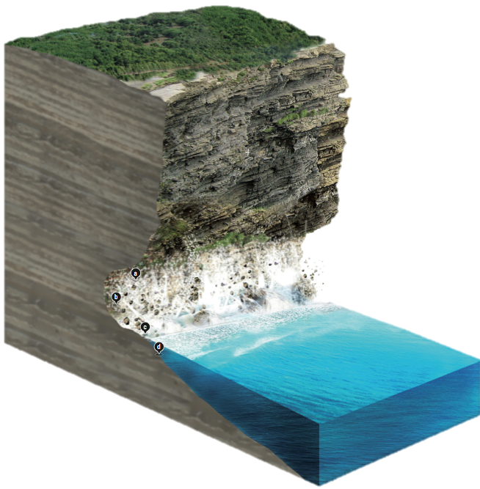
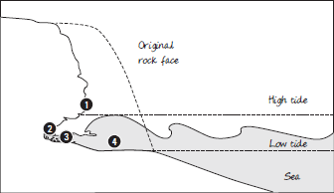
Coastal Processes
Coastal Erosion (Hydraulic Action)
Waves striking against a rock surface trap air in the rock joints. This air is compressed by the oncoming waves, exerting pressure on the joints. Over time, these joints weaken and the rocks shatter.

Slide 35
Coastal Processes
Coastal Erosion (Abrasion)
As waves break, sediments carried by waves such as sand and rocks are hurled against the coast. These loosened sediments knock and scrape against the coastal cliffs. This weakens the surface, resulting in the breaking down of the coast.
Over time, the impact from abrasion is powerful enough to undercut a cliff.

Slide 36
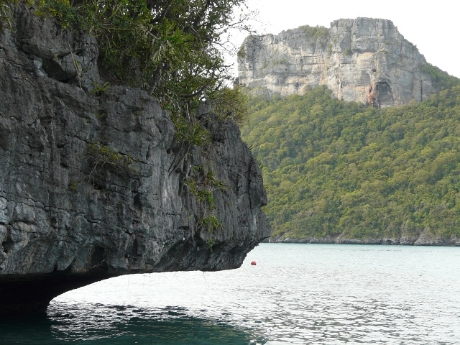
Coastal Processes
Coastal Erosion (Abrasion)
Cliff undercut due to coastal abrasion

Slide 37
Coastal Processes
Coastal Erosion (Attrition)
When rock particles carried by waves rub or hit against one another, they break down into smaller pieces and become smoother and more rounded over time.

Slide 38
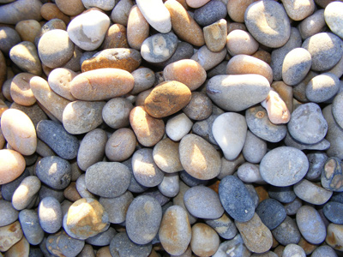
Coastal Processes
Coastal Erosion (Attrition)
Rocks become smoother and more rounded due to attrition

Slide 39
Coastal Processes
Coastal Erosion (Solution)
Sea water reacts chemically with water-soluble minerals in coastal rocks and dissolves them. For example, limestone rocks are easily eroded by carbonic acid in solution.
When solution of minerals occurs, rocks are weakened and will eventually disintegrate.

Slide 40
Coastal Processes
Sediment Transport
Sediments are transported along coasts which involves beach drift and longshore drift. When waves approach the coast at an oblique angle, they generate longshore currents in the nearshore which move parallel to the coast.

Slide 41
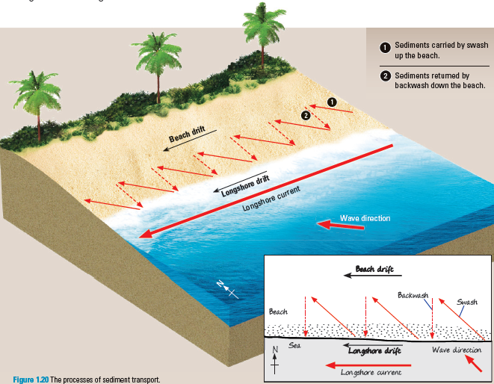
Coastal Processes
Sediment Transport
As waves approach the coast at an angle, sediments move up the beach at an angle as swash and pull of gravity drags them perpendicularly down the beach as backwash.
When waves approach the coast at angle, they generate longshore currents in the nearshore zone and move sediments along the shore. Longshore currents are ocean currents that flow parallel to a coast.

Slide 42
Coastal Processes
Sediment Deposition
Sediment deposition takes place when waves lose energy and lose ability to transport sediments, hence larger size sediments are deposited first followed by smaller ones.
Sediment texture | Sediment type | Sediment size
Very fine | Clay | less than 0.0039 mm
Fine | Silt | 0.0039 mm to 0.0625 mm
Medium | Fine sand | 0.125 mm to 0.25 mm
 | Medium sand | 0.25 mm to 0.5 mm
 | Coarse sand | 0.5 mm to 1 mm
 | Very coarse sand | 1 mm to 2 mm
Coarse | Pebble | 2 mm to 64 mm
 | Cobble | 64 mm to 256 mm
 | Boulder | more than 256 mm

Slide 43
Gateway 1 – How and why are coastal environments different and dynamic?
What is a coastal environment?
How are coastal environments different?
Why are coastal environments dynamic?
What are waves and how are they generated?
How do waves affect coastal areas?
Why do coastal landforms and features vary from place to place?
In what ways do coastal landforms and features vary from place to place?

Slide 44
In what ways do coastal landforms and features vary from place to place?
Cliffed coasts or depositional coasts may form depending on the geology of different locations and the actions of waves, tides and currents. The following table lists the landforms formed in these 2 coastal areas.
Cliffed Coasts | Depositional Coasts
Cliffs and Shore Platforms Headlands and Bays Caves, Arches and Stacks | Beaches Spits and Tombolos

Slide 45
Landforms of Cliffed Coasts
Cliffs and Shore Platforms
Hydraulic action and abrasion may erode a crack on the rock surface, gradually enlarging it to form a notch.
This notch may be further deepened to produce a bigger hollow space called a cave. Further erosion by the waves eventually causes the roof of the cave to collapse and form a steep cliff.
As the process of erosion continues, an overhanging cliff is formed. Eventually, this overhanging cliff will collapse and the materials will be deposited at the foot of the cliff. Some of these materials may be carried by the waves and thrown against the base of the cliff, causing further erosion. Over time, the cliff will retreat inland and a gently sloping platform appears at the base where the cliff used to be. This platform is called a shore platform, which is submerged during high tides.

Slide 46
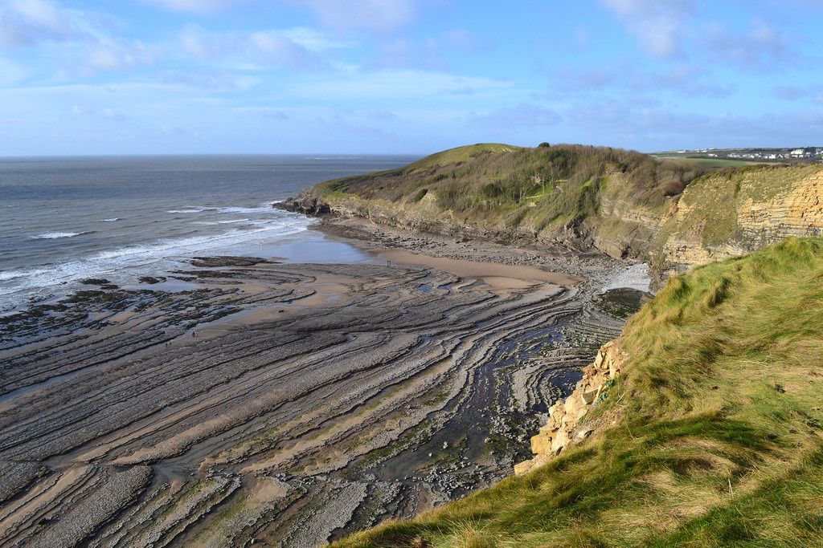
Landforms of Cliffed Coasts
Cliffs and Shore Platforms
Processes
Hydraulic action Erosion by waves
Cliff
Characteristics
Enlarged joints Notch Cliff collapse Cliff retreat Gently-sloping platform at cliff base
Shore Platform

Slide 47
Landforms of Cliffed Coasts
Headlands and Bays
Some coastlines have alternate bands of more resistant and less resistant rocks arranged at right angles to the coast. The less resistant rocks will be eroded faster than the more resistant rocks.
When the less resistant rocks are eroded away, bays are formed. These are wide indented coasts. The remaining more resistant rocks which extend into the sea are known as headlands.
Headlands and bays are formed by wave refraction. At the headland, the waves converge as the seabed is shallow. Wave erosion occurs here. At the bay, the waves diverge. Sediments are deposited here. Over time, wave erosion at the headland and sediment deposition at the bay results in the coastline to be straightened.

Slide 48
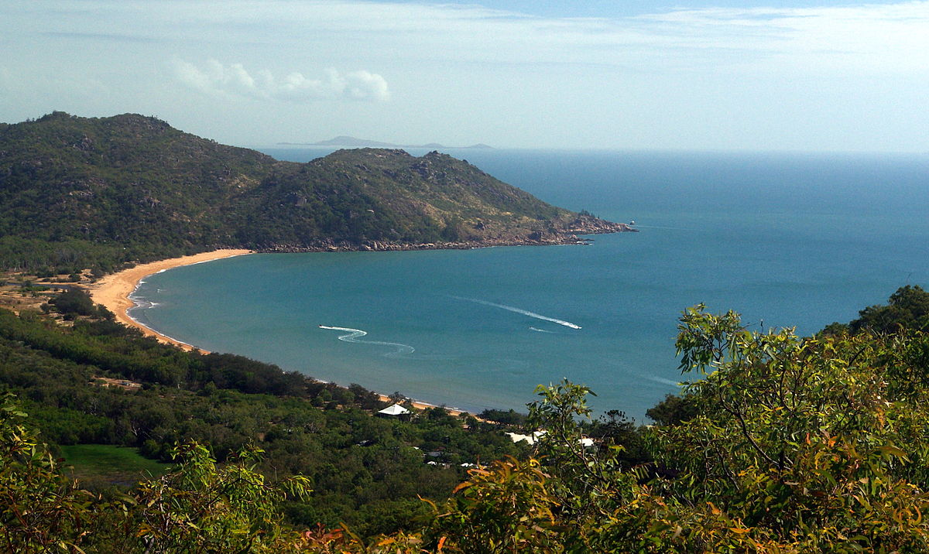
Landforms of Cliffed Coasts
Headlands and Bays
Processes
Different rates of erosion on rocks of different resistance
Headland
Characteristics
Bay (wide indented inlets in the coastline) Headlands (rocks which extend into the sea)
Bay

Slide 49
Landforms of Cliffed Coasts
Caves, Arches and Stacks
Waves attack lines of weakness at the base of the headland and undercut it. The continuous action of waves forms a cave at the area that is hollowed by wave action.
Caves may develop on each side of the headland. Erosion may eventually join caves together, leaving a bridge of rock known as an arch above the opening.
After a period of time, the roof of the arch may collapse to form a stack. A stack is a pillar of rock in the sea left behind after an arch collapses.

Slide 50
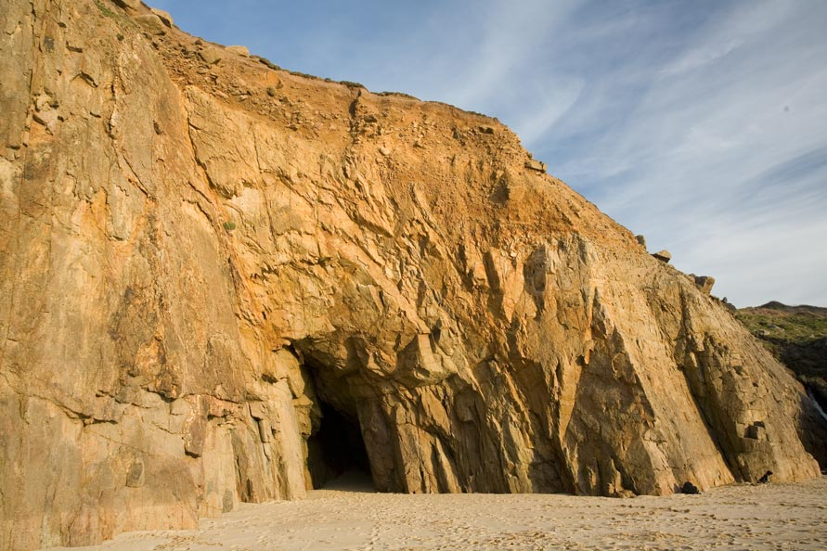
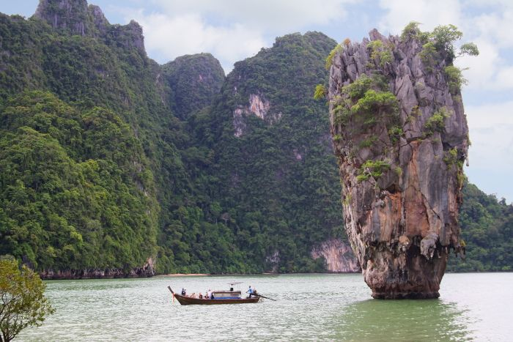
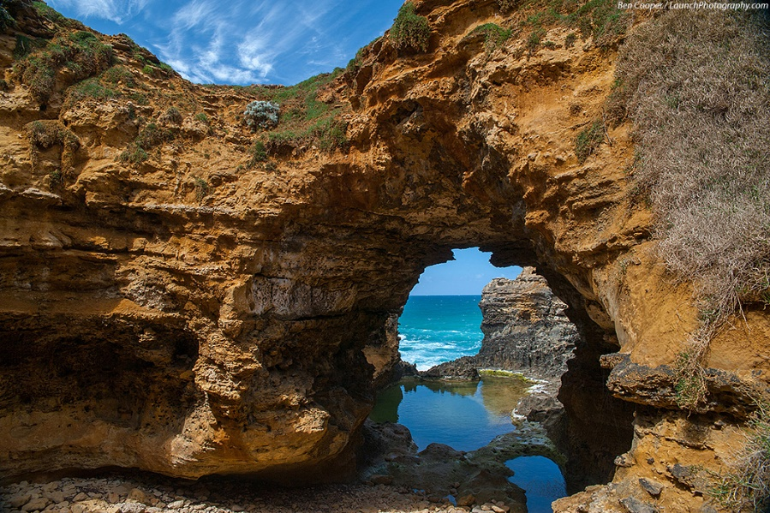
Landforms of Cliffed Coasts
Caves, Arches and Stacks
Processes
Further erosion of headlands (abrasion and hydraulic action) Roof of cave collapses
Cave
Stack
Characteristics
Lines of weaknesses Cave Stack (Pillar of rock)
Arch

Slide 51
Landforms of Depositional Coasts
Beaches
Beaches are areas of loose sediments made up of sand, gravel, pebbles, cobblestones, rocks and broken shells and corals.
Beaches are constantly changing because they are controlled by waves, tides and currents which move accumulated sediments either by dragging them along the foreshore, removing them or adding on to them.
For example, during calm weather, constructive waves deposit materials and bring about beach accretion whereas during stormy weather, destructive waves erode materials and cause beach loss. When there is a dominant wind boosting longshore current, sediment drift are dragged up and down along the foreshore according to the direction of longshore drift.

Slide 52
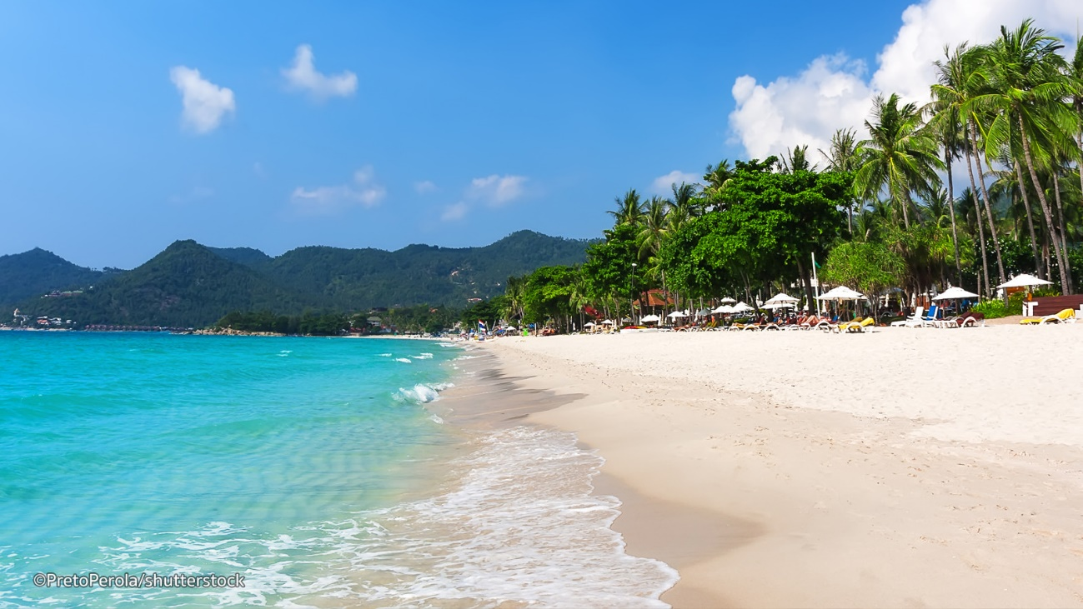
Landforms of Depositional Coasts
Beaches
Processes
Deposition of different sized particles Erosion by strong waves
Characteristics
Zone of deposition Made of loose sand, gravel and pebbles Gentle gradient (fine grains) Steep gradient (coarse grains)
Beach

Slide 53
Landforms of Depositional Coasts
Spits and Tombolos
Spits are formed by longshore drift which transports materials along the coast in the direction of the longshore current. Even if there is a sudden change in orientation of the coast, longshore drift continues to transport materials in the original direction into deep water where materials are deposited. Over time, materials accumulate, become thicker and appear above water. The spit often has a curve or hook due to wave refraction.
When a spit continues to grow with continuous deposition of materials, it eventually joins a nearby island to form a tombolo.

Slide 54
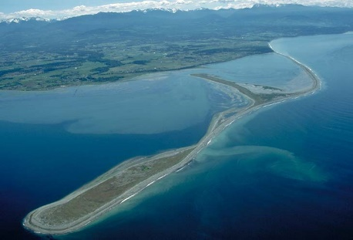
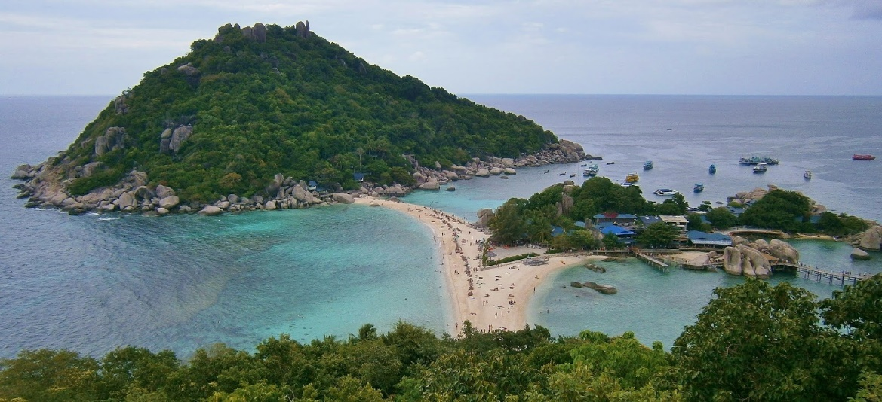
Landforms of Depositional Coasts
Spits and Tombolos
Processes
Longshore drift Deposition and transportation Continued longshore drift even though coastline changes abruptly
Spit
Characteristics
Accumulated materials
Tombolo

