Slide 1
Secondary 4 Pure Geography
Chapter 1 – Global Tourism
Gateway 2 – Why has tourism become a global phenomenon?

Slide 2
Gateway 2 – Why has tourism become a global phenomenon?
In what ways is tourism changing?
What influences tourism trends?
Why is tourism subject to fluctuations?

Slide 3
In what ways is tourism changing?
Tourism has become an increasingly varied and global industry. Tourists wish to travel to unexplored destinations. The nature and purpose of travel have changed.

Slide 4
Trends in the Global Tourism Industry
Trends of International Tourism
One way that tourism is changing is through trends in the global tourism industry, be it in terms of destinations, country of origin or tourist dollars. Both international and domestic tourism display these changing trends.
Since the 1980s, international tourism has become increasingly diverse in its origins and its destinations. One major trend is that the Asia-Pacific region has increased in popularity as a tourist destination.

Slide 5
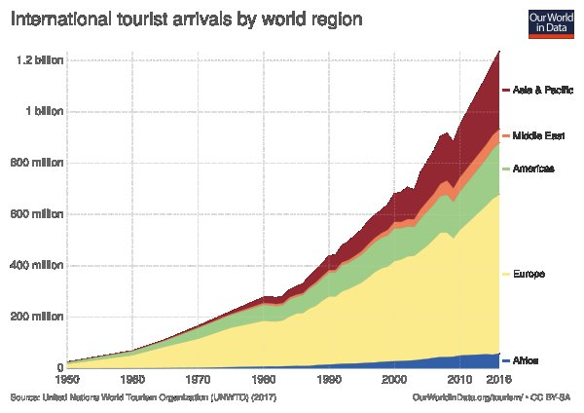
Trends in the Global Tourism Industry
International Tourist Arrivals from 1950-2016

Slide 6
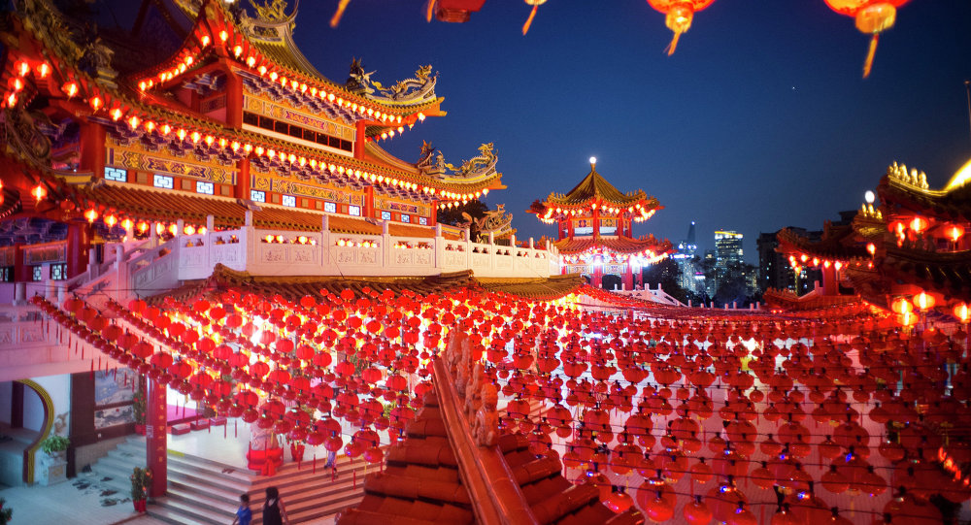
Trends in the Global Tourism Industry
Trends of Domestic Tourism
Domestic tourism has grown along with international tourism. Domestic tourism was and continues to be the most popular form of tourism.
For example, in China, domestic tourism peaks during the 2-week Lunar New Year break when employees go for sightseeing holidays or visit relatives and friends.

Slide 7
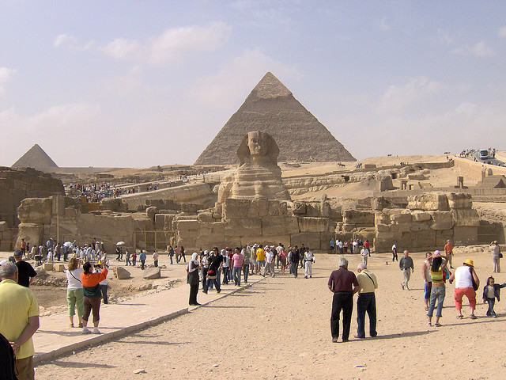
Evolution of Mass Tourism to Niche Tourism
Mass Tourism
Mass tourism refers to group travel in large numbers usually on package holidays for purposes of leisure.
A group of tourists at the Great Sphinx, Egypt

Slide 8
Evolution of Mass Tourism to Niche Tourism
Niche Tourism
Niche tourism refers to a special-interest tourism based on a particular area, interest or activity. Niche tourism appeals to travellers who seek ‘new’ destinations, activities and experiences.
Niche Tourism Types | Examples
Special interests | Whale-watching in Hawaii
Adventure holidays | Whitewater rafting in New Zealand

Slide 9
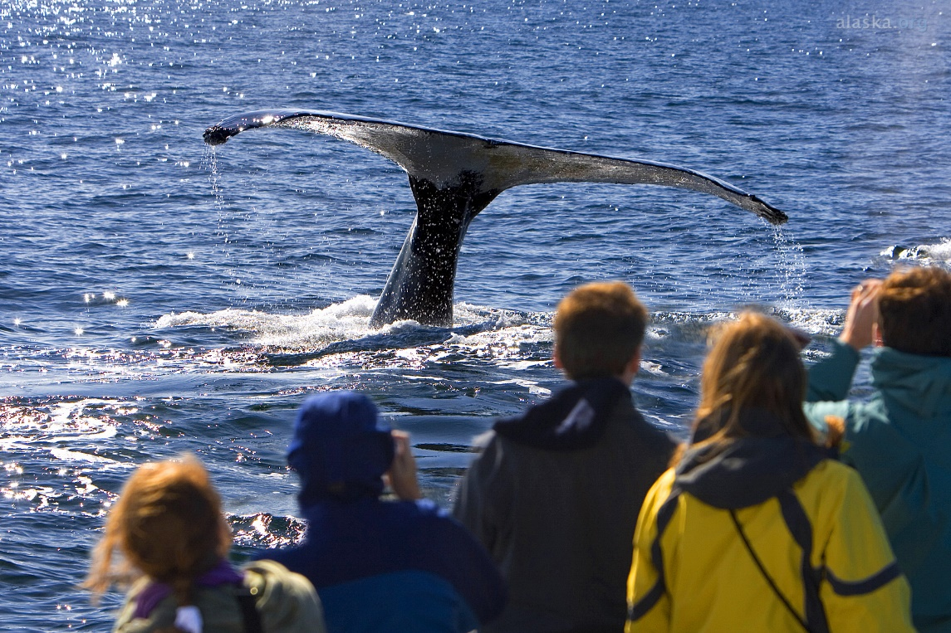

Evolution of Mass Tourism to Niche Tourism
Niche Tourism
Whale-watching in Hawaii
Whitewater rafting in New Zealand

Slide 10

Evolution of Mass Tourism to Niche Tourism
Ecotourism
Ecotourism is a form of niche tourism which refers to responsibly travelling to natural areas that conserves the environment and improves the well-being of the local people.
Example of ecotourism which is at the Waitomo Caves in New Zealand. The glowworms light the caves’ ceiling and the Waitomo Caves are regarded as an ideal example of responsible ecotourism.

Slide 11
Growth of Long-Haul Destinations
They refer to destinations generally only reachable by air with a flight time of 6 or more hours.
For example, European countries are long-haul destinations for Singaporeans with a flight time of about 12-15 hours.

Slide 12
Growth of Short-Haul Destinations
They refer to destinations reachable by car, bus or train with a short flight time of a couple of hours.
For example, Hong Kong is a short-haul destination for Singaporeans.

Slide 13
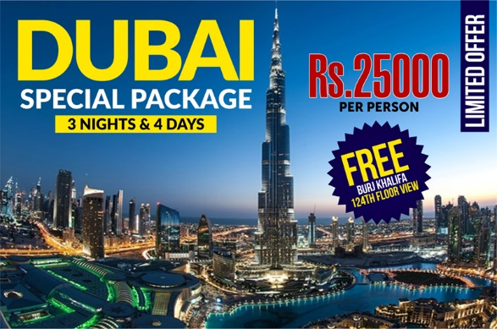
Development of Package Holidays
Package holidays are group tours arranged by a travel agent with transportation, food and lodging all provided with fixed itinerary of visits to places of interests at an inclusive price.
An example of a package holiday targeted at tourists who are interested in visiting Dubai

Slide 14
Gateway 2 – Why has tourism become a global phenomenon?
In what ways is tourism changing?
What influences tourism trends?
Why is tourism subject to fluctuations?

Slide 15
What influences tourism trends?
Tourism trends can be influenced by different factors. Millions of people travel annually. The reasons for the growth of global tourism include the following:
Developments in technology
Demand factors
Destination factors

Slide 16
Developments in Technology
Better and Affordable Transport
Developments in technology has led to improvements in various modes of transport. Commercial air travel has revolutionised global tourism due to ongoing technological developments in jet aircraft since the 1950s. It has improved in terms of:
Safety
Efficiency
Seating Capacity
Number of Air Routes

Slide 17
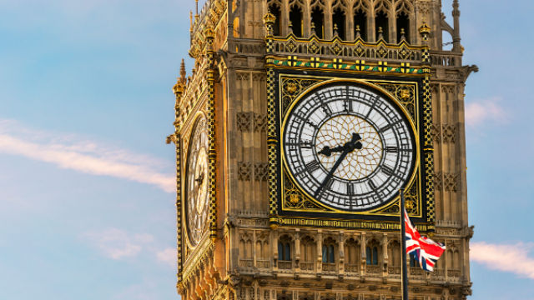
Developments in Technology
Better and Affordable Transport
 | Past | Present
Example | De Haviland Comet 1 | Airbus A380
First Flight | July 1949 | April 2005
Capacity | 36 passengers | 853 passengers
Maximum Cruise Speed | 810km/h | 1090km/h
Range | 2400km | 15700km
A commercial flight from Singapore to London now takes around 14 hours.

Slide 18
Developments in Technology
Ease of Access to Information
Developments in technology such as the Internet has made possible hassle-free e-service like accessing information about destinations, booking tickets and accommodation online.
Furthermore, surveillance, electronic checks and safety controls at entry points make tourists feel safe and confident when venturing abroad.

Slide 19
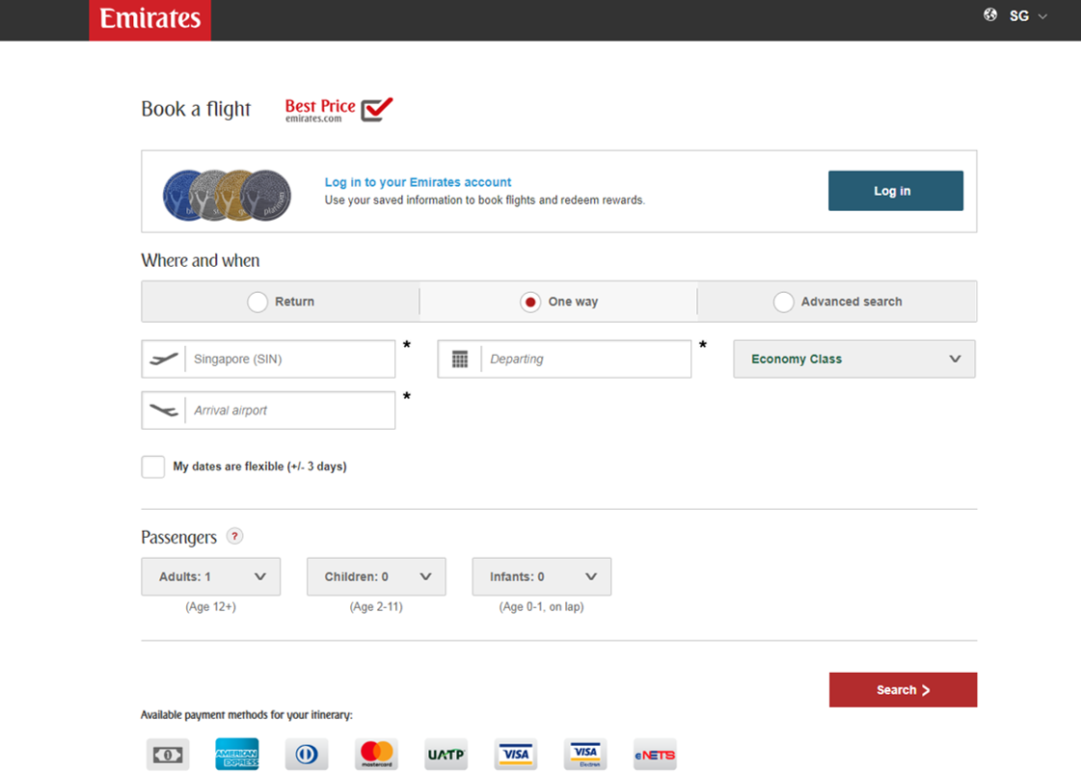

Developments in Technology
Ease of Access to Information
ONLINE BOOKING AND RESEARCH BENEFITS
Enables travellers to purchase their tickets without going through travel agents
Gives tourists more options and control
Gives tourists better access to information at their destination
Enables travellers to do research to find out more about their destinations

Slide 20
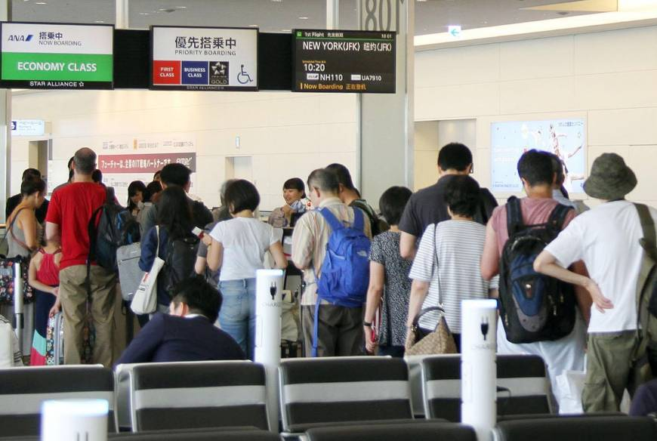
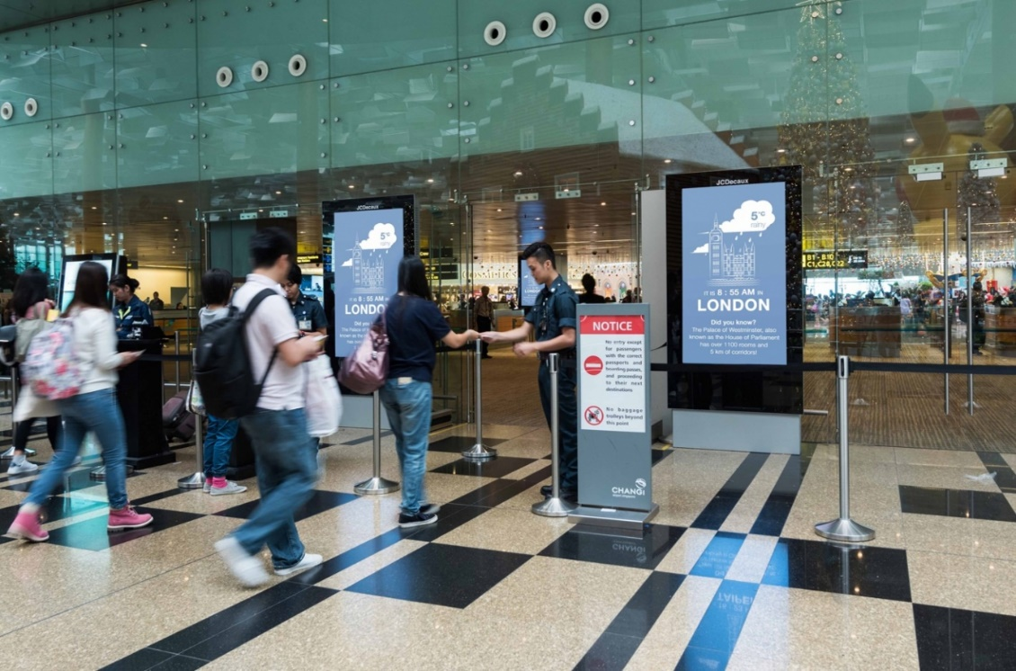
Developments in Technology
Ease of Access to Information
SURVEILLANCE, ELECTRONIC CHECKS AND OTHER SAFETY CONTROLS RESEARCH BENEFITS
Makes tourists feel safer and more confident about travelling
TOP-RIGHT: Electronic device checks at an airport in Japan; BOTTOM-RIGHT: Surveillance and checks at Changi Airport, Singapore

Slide 21
Demand Factors
Disposable Income
Disposable income is the remaining income that can be freely used after income tax has been paid after expenditure on basic necessities. Improvement in economic conditions means people earn higher incomes and hence, more disposable income and can afford to spend on leisure activities and travel.
It accounts for the growth in tourism as people can afford to travel more frequently and to more expensive destinations.
For example, countries such as China have experienced rapid economic growth. As such, individuals’ disposable incomes have been rising, resulting in more international tourists from China.

Slide 22
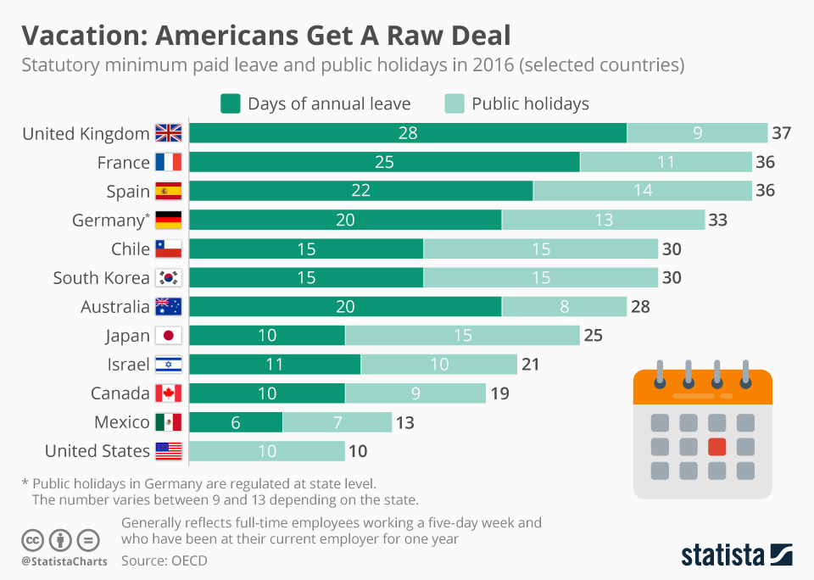
Demand Factors
Leisure Time
Leisure time refers to time available outside of the demands of work or duty. Increase in leisure time allows people to travel more.
It is interpreted that workers in the United Kingdom, France, Spain, Germany and Australia have 20 or more days of annual leave.

Slide 23
Demand Factors
Changing Lifestyle
Changing lifestyle refers to the way people choose to live like social relationship, work attitude, dressing, food consumption and entertainment.
People are now extravagant instead of frugal even among those in the East and hence more willing to spend on holidays to enjoy and be entertained.

Slide 24
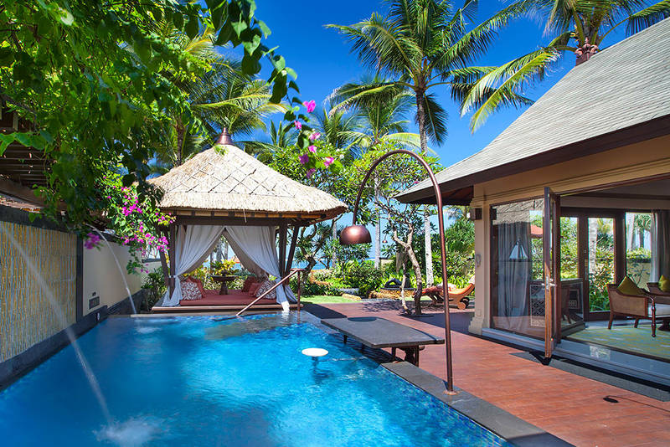
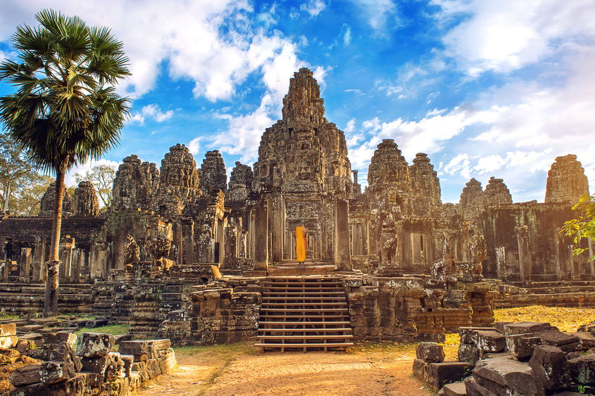
Demand Factors
Changing Lifestyle
Health-conscious ones opt for wellness holidays like spa resorts in Bali, Indonesia
History-conscious tourists prefer to visit archaeological and historical sites like Angkor Wat in Cambodia

Slide 25
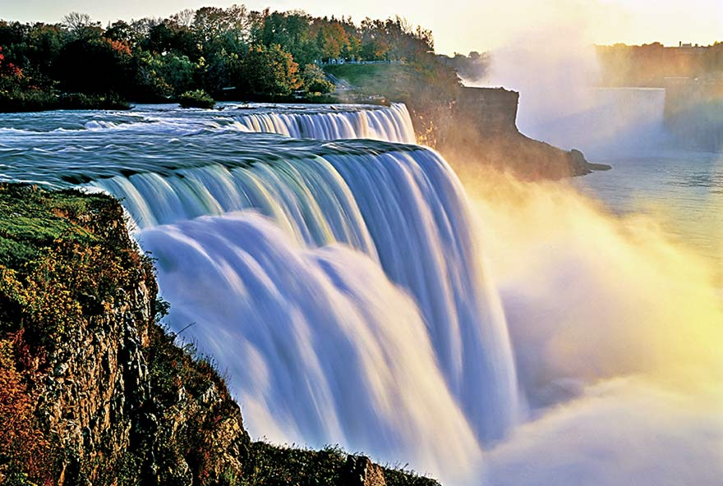
Destination Factors
Attractions
Attractions refer to natural features/man-made pleasurable features which draw tourists. An example of a natural attraction is the Niagara Falls with scenic beauty. It is located in North America.
The Niagara Falls

Slide 26
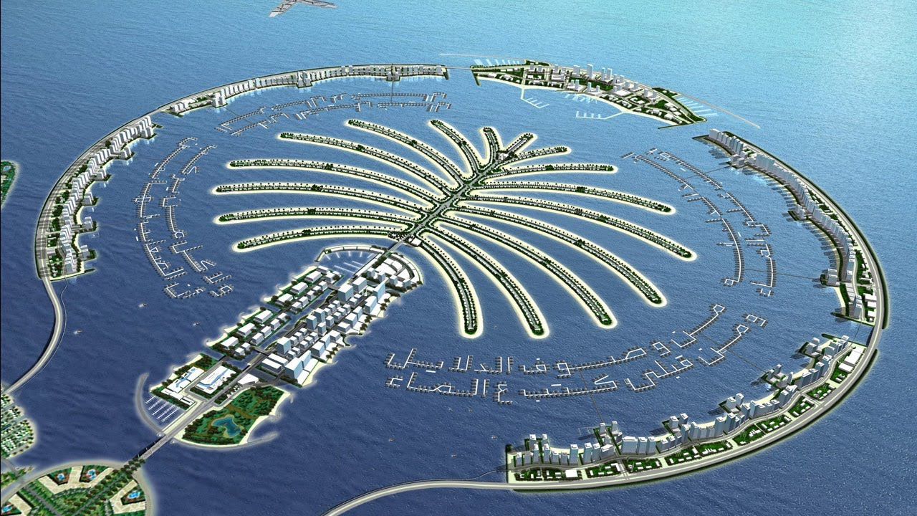
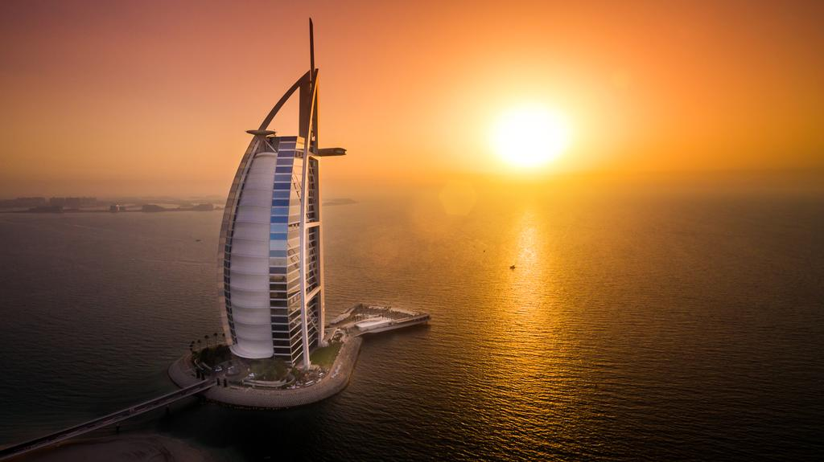
Destination Factors
Attractions
Examples of man-made attractions are those in Dubai, United Arab Emirates like the luxurious Burj Al Arab, a 7-star hotel. Another is the Palm Islands near the Jumeirah Beach which is a wonderful man-made invention of artificial islands, high-end residence, entertainment and leisure.
Burj Al Arab
Palm Islands

Slide 27
Destination Factors
Investment in Infrastructure and Services
This factor refers to the presence of a range of large-scale public systems, services, and facilities. It includes tourist accommodation, medical facilities, transport infrastructure, recreational and entertainment facilities.
Destinations with more investments in infrastructure and services are likely to attract more tourists.
Transportation | Accommodation
Airports Roads Rails | Hotels Homestays Hostels

Slide 28
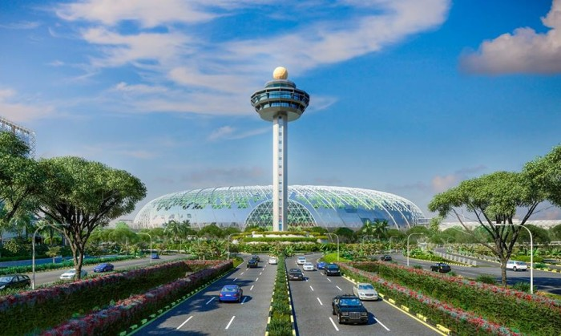
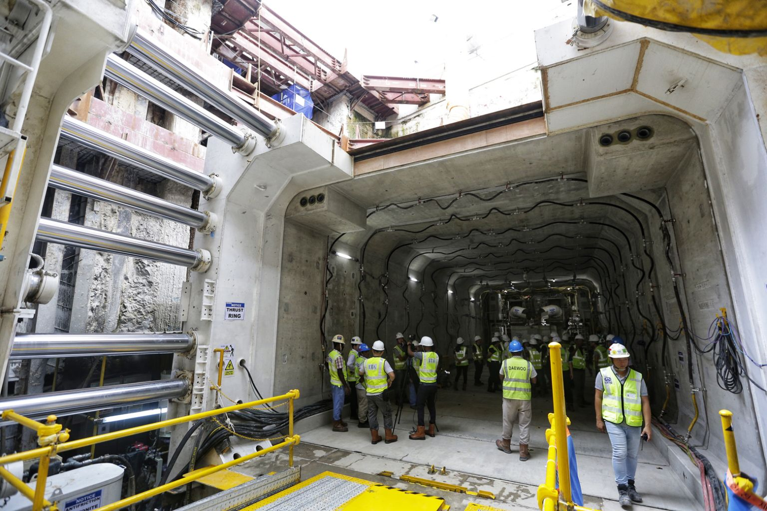
Destination Factors
Investment in Infrastructure and Services
An example of tourism-oriented infrastructure is the expansion of airport such as Changi Airport in Singapore
Workers constructing one of the stations of the first stage of the Thomson East-Coast MRT Line which is expected to open in 2019

Slide 29
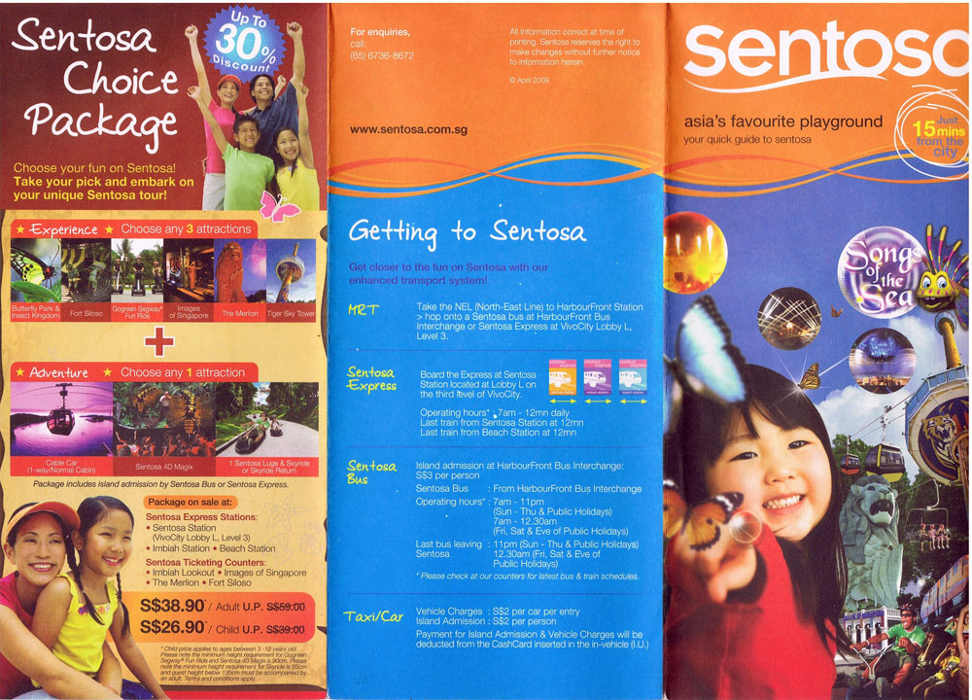
Destination Factors
Access to Information
This refers to the ease with which travel-related information can be obtained. In Singapore, information-infused brochures in different languages and maps are easily available at various places of attractions.

Slide 30
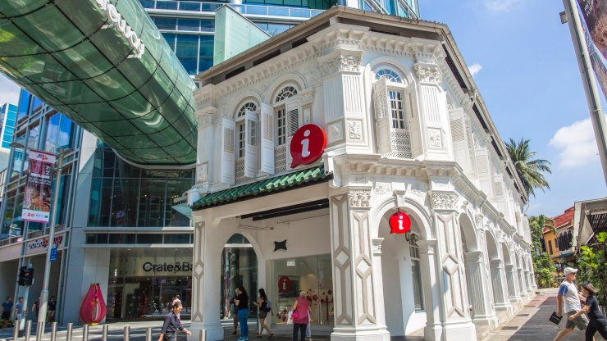
Destination Factors
Access to Information
For example, there are signs and maps at MRT stations which help give tourists a sense of security and an assurance that help is available when needed.
The Singapore Visitor Centre at Orchard Gateway, which provides tourists with advice on sightseeing, eating and shopping.

Slide 31
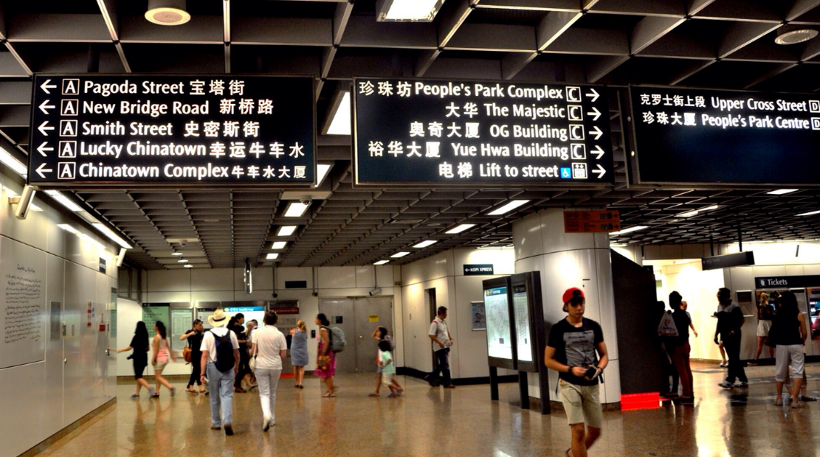
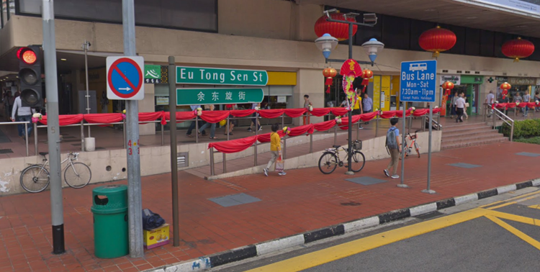
Destination Factors
Access to Information
MRT signs and street signs in Chinatown, Singapore are written in both English and Chinese to cater to the large number of tourists who come from China. This provides a sense of assurance and security that they are able to access to information easily.
LEFT: MRT signs at Chinatown MRT station; RIGHT: Eu Tong Sen Street Sign

Slide 32
Gateway 2 – Why has tourism become a global phenomenon?
In what ways is tourism changing?
What influences tourism trends?
Why is tourism subject to fluctuations?

Slide 33
Why is tourism subject to fluctuations?
Tourism is a volatile industry, meaning that the changes in tourist numbers and receipts can occur suddenly and greatly. Tourism numbers and receipts may be subjected to fluctuations due to events which include:
Disasters
Recessions
Political Situations
Diseases

Slide 34
Impact of Disasters on Tourism Fluctuations
Disasters are usually destructive and they cause damage to properties and injure or take away lives. Hence, they tend to deter tourists from visiting affected destinations.
For example, in March 2011, after the Tohoku Earthquake and tsunami took place, many foreign tourists avoided trips to disaster hit prefectures of Fukushima etc. even though April is cherry blossom season due to lingering concerns about radioactive contamination and fears that another major earthquake or tsunami could strike Tohoku again.

Slide 35

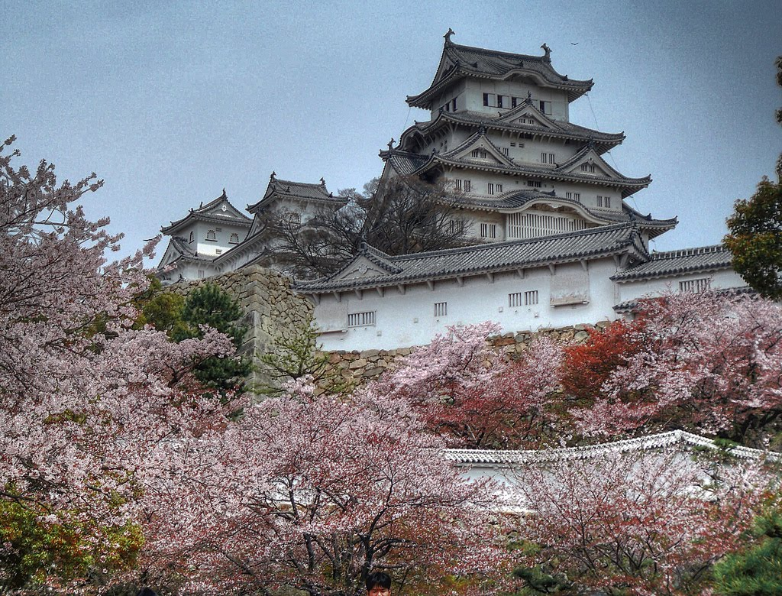
Impact of Disasters on Tourism Fluctuations
‘The Tsunami and Chery Blossom’ was a film published in 2011 following the disastrous impact which the Tohoku Earthquake and tsunami had on Japan

Slide 36
Impact of Recessions on Tourism Fluctuations
Recessions are economic slowdowns due to inflation and decline in exports, resulting in a loss of jobs, lower incomes and lower demands for goods and services.
For example, the Global Financial Crisis of 2007-2008 was caused by the bubble burst in the U.S. property market. As such, banks and financial institutions declared bankrupt due to massive debts.
Effects of Recession on Tourism
Increased unemployment Likely increase in domestic travel Decreased international tourists Reduced spending by tourists

Slide 37
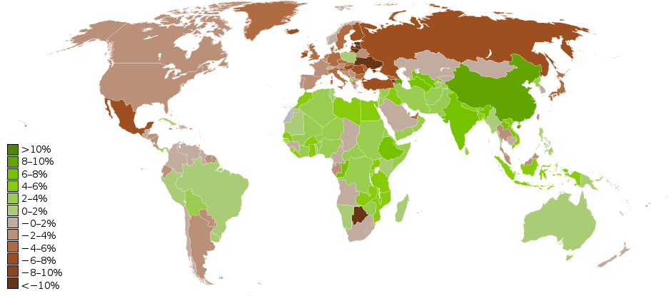
Impact of Recessions on Tourism Fluctuations
Assets have lowered due to the collapse of the stock and property markets. Hence, there is less disposable income that can be used to finance holidays.
World map showing real GDP growth rates for 2009 (countries in brown were in recession)

Slide 38

Impact of Political Situations on Tourism Fluctuations
Undesirable political situations may pose threats to tourists due to dangers caused by armed conflicts between rebel groups and governments.
The Libyan Civil War in 2011 involving armed conflict have stifled tourism even from neighbouring countries like Tunisia and Egypt.
Demonstrations in Libya, 2011

Slide 39
Impact of Diseases on Tourism Fluctuations
Disease outbreaks refer to sudden and widespread occurrences of disease in an area and beyond its geographic boundaries. As such, disease outbreaks deter tourists from travelling to affected areas for fear of getting infected as well.
For example, the SARS (Severe Acute Respiratory Syndrome) outbreak in Singapore, March 2003, led to a decline in visitor arrivals by 67% in April from the corresponding period in the previous year.

