Slide 1
Secondary 4 Pure Geography
Chapter 1 – Global Tourism
Gateway 1 – How does the nature of tourism vary from place to place?

Slide 2
Gateway 1 – How does the nature of tourism vary from place to place?
Who are the tourists?
How do tourist destinations differ from one another?
What factors affect the nature of tourism?

Slide 3
Who are the tourists?
Tourists are people travelling to and staying in places away from their normal place of residence for usually less than a continuous year, but more than 24 hours.
Their purposes can be for leisure, business, cultural exchanges, education, etc.
Tourism can be categorized into either international or domestic.
International Tourism
Tourism outside of a tourist’s own country (e.g. a Singaporean businessman working in Dubai for two years)
Domestic Tourism
Tourism within a tourist’s own country (e.g. a family who lives in Shanghai and visited Beijing for four days)

Slide 4
Gateway 1 – How does the nature of tourism vary from place to place?
Who are the tourists?
How do tourist destinations differ from one another?
What factors affect the nature of tourism?

Slide 5
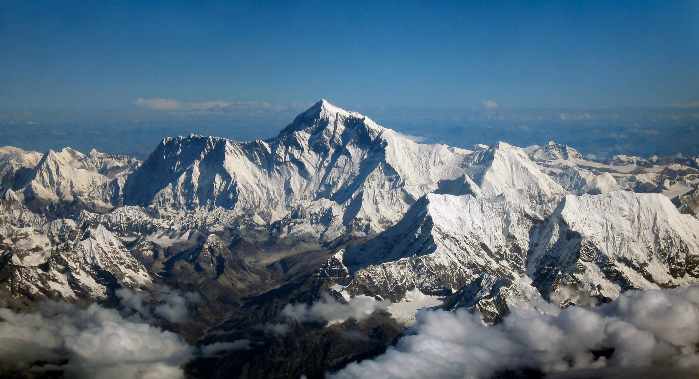
How do tourist destinations differ from one another?
Tourist destinations differ due to different physical and human environments which present varied opportunities for tourists and tourism. These places and tourist activities include:
Places of scenic beauty
Places with good facilities
Places with rich culture
Places of conflict
The Himalayas Mountains, an example of a place with scenic beauty

Slide 6
Difference in Tourist Destinations
Places of Scenic Beauty
Many of the Earth’s natural environments have become major tourist destinations. These include mountains, rivers, deserts, waterfalls and rainforests. These places attract tourists with their awe-inspiring sceneries. Some examples include:
The Himalayas, South Asia
The Grand Canyon, United States of America
Ha Long Bay, Vietnam

Slide 7
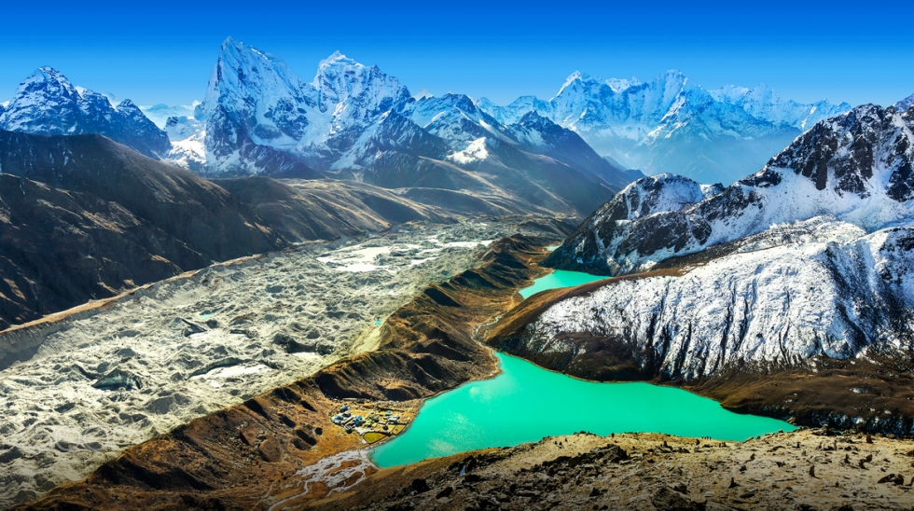
Difference in Tourist Destinations
Places of Scenic Beauty (The Himalayas, South Asia)
The Himalayas is a remarkable expanse of natural beauty with pristine snow-capped mountain peaks and crisp mountain air that leave visitors breathless and filled with awe and wonderment.
One of the lakes in the Himalayas mountain range

Slide 8
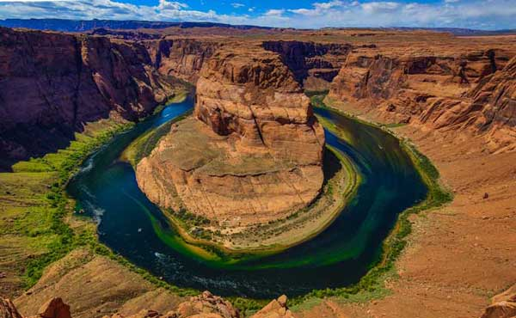
Difference in Tourist Destinations
Places of Scenic Beauty (The Grand Canyon, United States of America)
The Grand Canyon National Park is a UNESCO World Heritage Site and a honeypot site. This implies that The Grand Canyon attracts large numbers of people due to its scenic beauty.
Visitors are attracted to its awesome views of its immense depth, width and length showing rocks of reddish-orange coloured streaks as the Colorado River winds through it.
The Grand Canyon

Slide 9
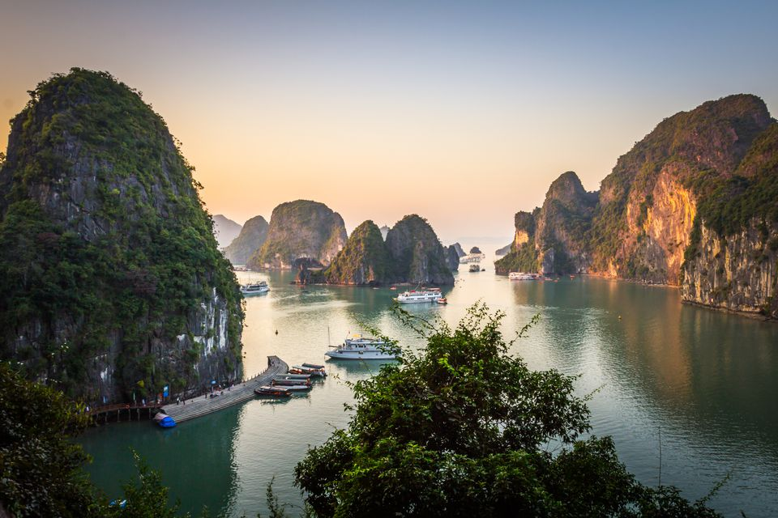
Difference in Tourist Destinations
Places of Scenic Beauty (Ha Long Bay, Vietnam)
Visitors are attracted to the beauty of the Ha Long Bay in Vietnam with stunning rock formations that rise like jewels from the gorgeous emerald sea.
Evening in Ha Long Bay from Sung Sot Cave

Slide 10
Difference in Tourist Destinations
Places with Good Facilities
Places with good facilities offer a wide variety of activities. One of the outstanding characteristics of such places is having facilities that will attract and serve tourists. Examples include:
Meetings, Incentives, Conventions and Events (MICE) Facilities
Medical Facilities
Theme Parks

Slide 11
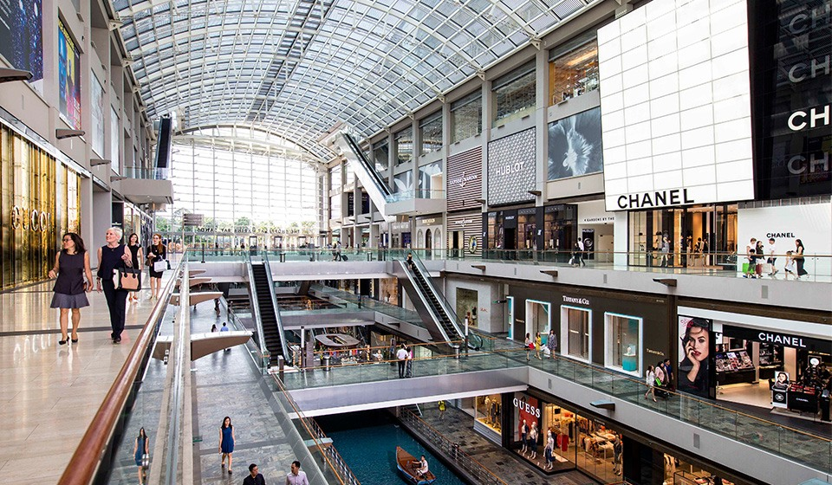
Difference in Tourist Destinations
Places with Good Facilities (MICE facilities)
MICE is an acronym for Meetings, Incentives, Conventions and Exhibitions and it refers to travelling for business or commercial purposes.
Retail shops at The Shoppes at Marina Bay Sands

Slide 12
Difference in Tourist Destinations
Places with Good Facilities (Medical facilities)
Medical tourism refers to travelling for medical care by bypassing services offered in their own communities.

Slide 13
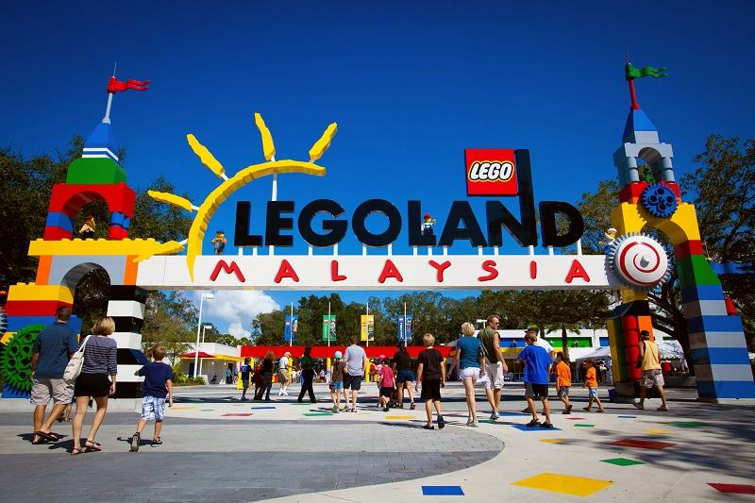
Difference in Tourist Destinations
Places with Good Facilities (Theme Parks)
Theme parks are places with amusement park settings or are attractions that have a central subject or theme, such as movies.
One example is a Lego-themed theme park in Malaysia known as LEGOLAND Malaysia Resort. It is packed with fun-filled activities for the entire family, along with great interactive attractions, shows and exciting rides.
LEGOLAND Malaysia Resort In Nusajaya, Malaysia

Slide 14
Difference in Tourist Destinations
Places with Rich Culture
Culture refers to the distinct ways in which people around the world embrace such as language, religion, cuisine, music and arts. Millions of tourists travel to experience the rich cultures of the past and present. Types of tourism which have a cultural flavour are:
Heritage Tourism
Film-Induced Tourism
Pilgrimage Tourism

Slide 15
Difference in Tourist Destinations
Places with Rich Culture (Heritage Tourism)
Heritage tourism is a type of tourism that is oriented towards cultural heritage of a place. It involves tourists travelling to that culturally heritage-rich country to experience the distinctive culture which is the pride and national identity of the locals.
Examples of heritage sites are museums and national and historical monuments. Places with involve heritage tourism include:
London, United Kingdom
Beijing, China

Slide 16
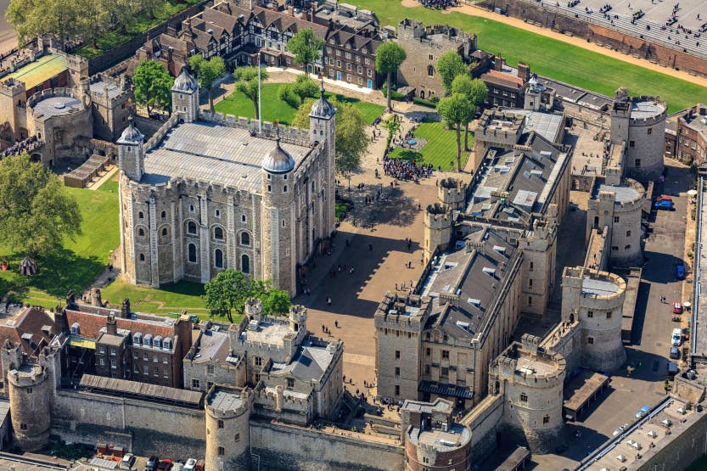
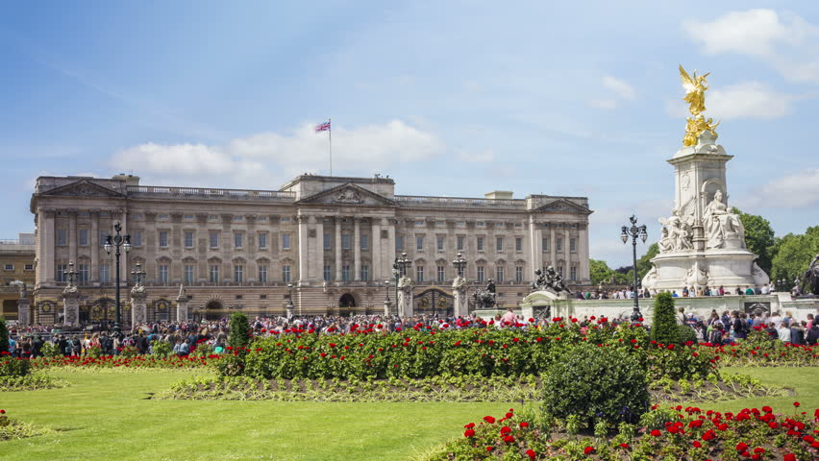
Difference in Tourist Destinations
Places with Rich Culture (Heritage Tourism in London, United Kingdom)
The Tower of London and Buckingham Palace in London attract over 15 million international tourists annually. Visitors are intrigued by the history of the Tower of London as a royal residence, prison and an execution site.
Buckingham Palace
Aerial view of the Tower of London

Slide 17
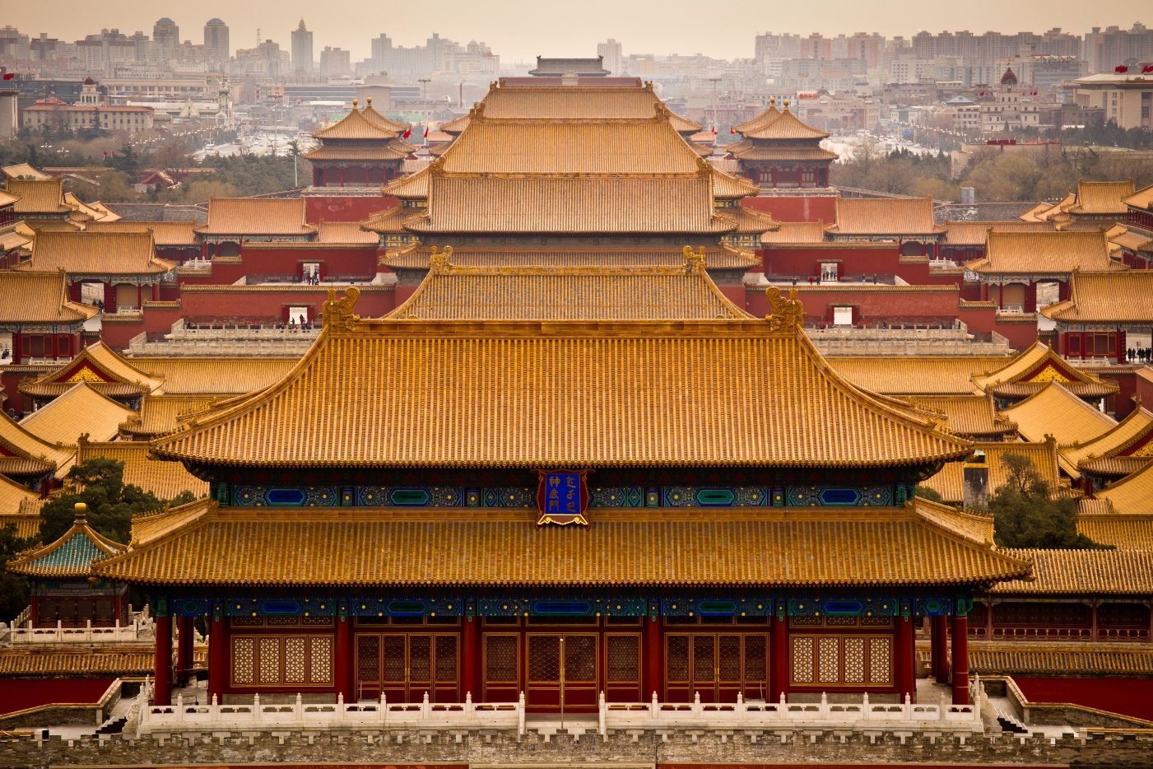
Difference in Tourist Destinations
Places with Rich Culture (Heritage Tourism in Beijing, China)
The ancient Forbidden City in Beijing is famous for its Chinese palatial architecture and preserved ancient wooden structures, as well as the Tiananmen Square.
Pagodas in the Forbidden City, Beijing

Slide 18
Difference in Tourist Destinations
Places with Rich Culture (Film-Induced Tourism)
Film-induced tourism is associated with film viewers’ interest in travelling to see the actual locations featured in films and to satisfy their curiosity why such places are chosen for shooting and how they are inspirational to the films shot. An example includes:
Slumdog Millionaire

Slide 19
Difference in Tourist Destinations
Places with Rich Culture (Film-Induced Tourism, Slumdog Millionaire)
A British drama film called ‘Slumdog Millionaire’ was filmed in the slums of Mumbai, India and this prompted curious visits to such slums which miraculously produced a millionaire.

Slide 20
Difference in Tourist Destinations
Places with Rich Culture (Pilgrimage Tourism)
Pilgrimage tourism refers to travelling to religiously holy and sacred places in search of spiritual and mental happiness. An example includes:
Christians visiting Jerusalem

Slide 21
Difference in Tourist Destinations
Places of Conflict
Places of conflict refer to areas where wars, battles, man-made tragedies and unfavourable political situations have occurred. Tourists often visit such places to participate in dark tourism. Dark tourism refers to travelling to sites associated with death and tragedy. Such locations include:
Ruins of Pompeii, Italy
Auschwitz Concentration Camp, Poland

Slide 22
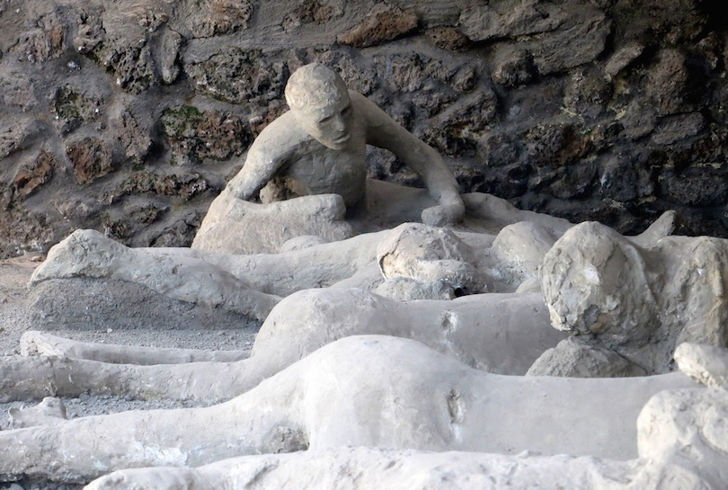
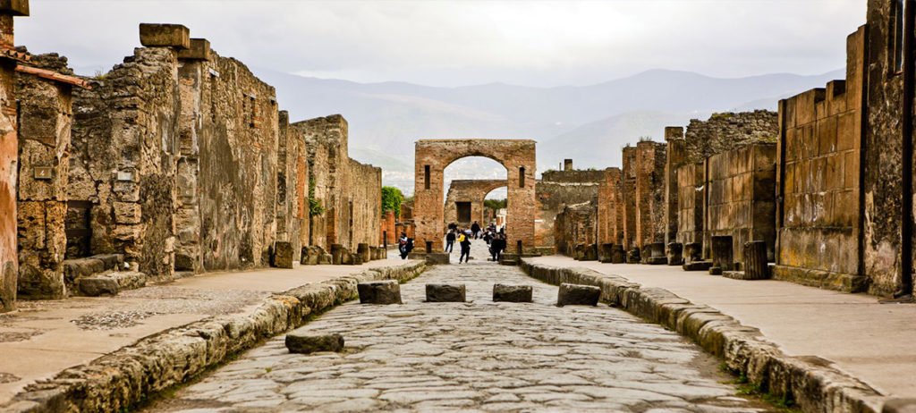
Difference in Tourist Destinations
Places of Conflict (Ruins of Pompeii, Italy)
In Italy, the Ruins of Pompeii buried in ashes by the explosive eruption of Mount Vesuvius in 79 AD are a popular tourist destination today.
The town of Pompeii, Italy was buried by layers of ash from the nearby Mount Vesuvius in 79 CE. The unearthed archaeological site has revealed buildings, pottery and mosaic left intact.

Slide 23
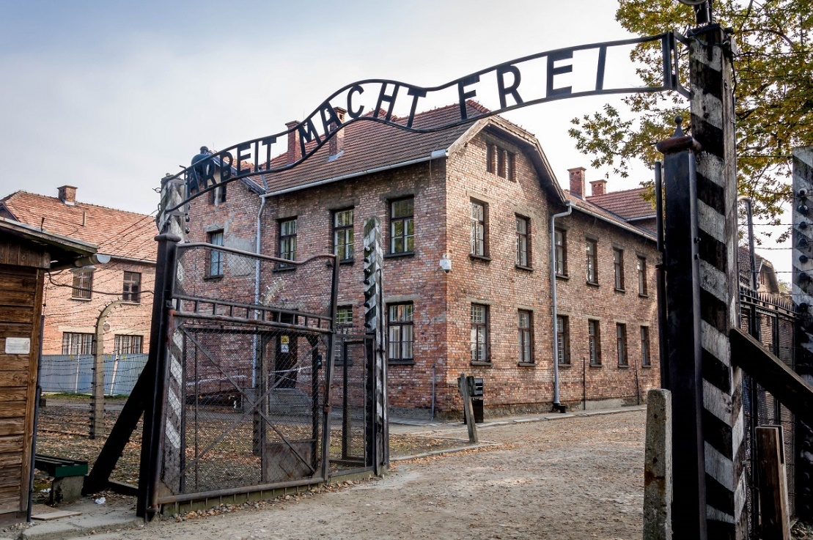
Difference in Tourist Destinations
Places of Conflict (Auschwitz Concentration Camp, Poland)
At Auschwitz Concentration Camp in Poland, tourists feel for and pay their respects to the dead. It is a death camp where millions of people especially the Jews were murdered in gas chambers during the Holocaust, a deadly time period of mass murder of the Jews under Nazi regime during WWII.
Auschwitz Concentration Camp, Poland

Slide 24
Gateway 1 – How does the nature of tourism vary from place to place?
Who are the tourists?
How do tourist destinations differ from one another?
What factors affect the nature of tourism?

Slide 25
What factors affect the nature of tourism?
Tourism can be affected by natural and human factors.
Human Factors
Cost of travelling Effectiveness of marketing Quality of infrastructure
Natural Factors
Type of landscapes Weather and climate
Tourism is also affected by different groups of people that help promote it as an industry. The different groups are:
Government
Media
International Organisations

Slide 26
Role of the Government in affecting Tourism
The role of the government is crucial because it has the authority to grant visitors’ visas, dictate duration of stay, and make decisions in development of hotels or casinos.
It is the responsibility of the government to plan, fund and build tourism-related infrastructure such as airports, roads and railways.

Slide 27
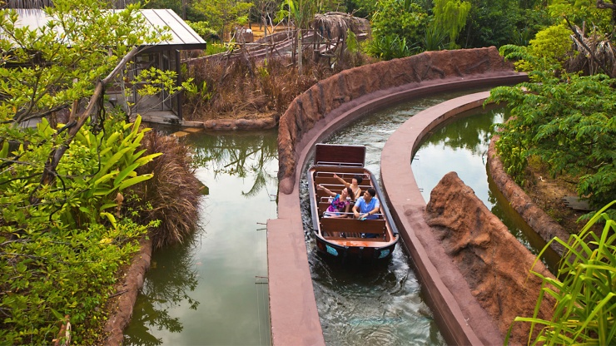
Role of the Government in affecting Tourism
Case Study of Singapore
At Mandai Zoo, the River Safari is in addition to the Night Safari. Such attractions cater to the diverse likes of tourists. More creative attractions are to give tourists more choices and to sustain repeated visits.
The River Safari at the Mandai Zoo

Slide 28
Role of the Media in affecting Tourism
Media refers to channels such as television, radio, newspapers, magazines and the Internet through which information is disseminated to the public.

Slide 29
Role of the Media in affecting Tourism
Positive reports such as the friendliness of the local population, an interesting culture, good shopping opportunities and attractive scenery can encourage tourists to visit.
On the other hand, negative reports such as those incidents of violence, disease outbreaks and natural disasters can deter visitors both immediately and for many years to come.
Example of a Positive Report
TripAdvisor Votes Sicilian Beach The Best In The World
Example of a Negative Report
Attack in Nice: 84 dead including many foreigners, 50 people 'between life and death'

Slide 30


Role of the Media in affecting Tourism
Case Study of a Travel Vlogger, Drew Binsky
Drew Binsky, a renowned YouTuber from Arizona, the United States, makes daily travel videos with purposes to inspire young adults to travel and shatter stereotypes that some regions in the world are unsafe. He has visited more than 150 countries since 2012 and is planning to visit every single country by 2021.
Drew Binsky makes compelling videos such as his ‘$100 in 24 hours’ series which gained much popularity from the public.

Slide 31


Role of International Organisations in affecting Tourism
An international organisation is a group of different countries that work together for a common purpose. Reports produce by international organisations can encourage or discourage tourists in visiting a place.
Logos of some international organisations which include LEFT: Organisation for Economic Co-operation and Development (OECD) and RIGHT: World Health Organisation (WHO)

Slide 32
Role of International Organisations in affecting Tourism
Case Study of the World Health Organisation (WHO)
The role of the World Health Organisation (WHO) in giving health advisories on outbreak of viruses in certain regions may temporarily influence tourists’ travel plans and deter them from visiting currently affected places.

