Slide 1
Secondary 4 Pure Geography
Chapter 3 – Health and Diseases
Gateway 2 – What influences the spread and impact of infectious diseases?

Slide 2
Gateway 2 – What influences the spread and impact of infectious diseases?
What were the major disease outbreaks in the past?
What is the scale at which diseases occur?
What is malaria and how is it transmitted?
What is the extent and spread of malaria in the world and in Asia?
What are the impacts of malaria?
What is HIV/AIDS and how is it transmitted?
What is the extent of spread of HIV/AIDS in the world and Sub-Saharan Africa?
Groups vulnerable to HIV/AIDS
What are the impacts of HIV/AIDS?

Slide 3
What were the major disease outbreaks in the past?
Examples include Measles (700BC-1963), Black Death (165-190), Spanish Flu (1918-1919), SARS (2003) etc.

Slide 4
Gateway 2 – What influences the spread and impact of infectious diseases?
What were the major disease outbreaks in the past?
What is the scale at which diseases occur?
What is malaria and how is it transmitted?
What is the extent and spread of malaria in the world and in Asia?
What are the impacts of malaria?
What is HIV/AIDS and how is it transmitted?
What is the extent of spread of HIV/AIDS in the world and Sub-Saharan Africa?
Groups vulnerable to HIV/AIDS
What are the impacts of HIV/AIDS?

Slide 5
What is the scale at which diseases occur?
Diseases occur on different geographic scales. Some affect a community within a city; others affect people in many continents at the same time.

Slide 6
Types of Diseases
Endemic
Endemic diseases are diseases that consistently occur in an area or community.
An example is malaria.

Slide 7
Types of Diseases
Epidemic
Epidemic is the rapid spread of an infectious disease following an outbreak on a regional scale and may occur every 2 or 3 years, usually affecting a small percentage of the population.
An example of an epidemic is cholera.

Slide 8
Types of Diseases
Pandemic
Pandemic is the spread of an infectious disease over a large region, an entire country, entire continent or on a global scale, claiming millions of lives over an extensive geographical area.
An example is the 1918-1919 Spanish Flu, which is one of the deadliest pandemics. It killed 50 to 100 million people.

Slide 9
Gateway 2 – What influences the spread and impact of infectious diseases?
What were the major disease outbreaks in the past?
What is the scale at which diseases occur?
What is malaria and how is it transmitted?
What is the extent and spread of malaria in the world and in Asia?
What are the impacts of malaria?
What is HIV/AIDS and how is it transmitted?
What is the extent of spread of HIV/AIDS in the world and Sub-Saharan Africa?
Groups vulnerable to HIV/AIDS
What are the impacts of HIV/AIDS?

Slide 10
What is malaria and how is it transmitted?
Malaria is a life-threatening disease caused by a parasite. It is transmitted from person to person via living organisms, commonly insects such as mosquitoes.
Female mosquitoes of the Anopheles species transmit malaria.

Slide 11
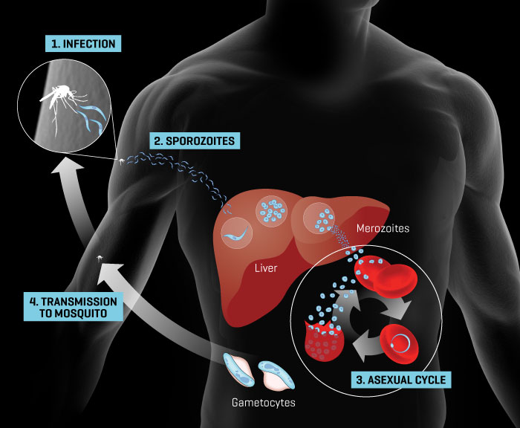
What is malaria and how is it transmitted?
The transmission of malaria is as follows.
A mosquito takes blood from a human infected with malaria parasites.
Malaria parasites enter and infect the mosquito.
The infected mosquito bites another human. Malaria parasites are then injected into that person. The parasites migrate to the liver where they can reproduce and spread into the bloodstream.
A diagram depicting the transmission of malaria.

Slide 12
Gateway 2 – What influences the spread and impact of infectious diseases?
What were the major disease outbreaks in the past?
What is the scale at which diseases occur?
What is malaria and how is it transmitted?
What is the extent and spread of malaria in the world and in Asia?
What are the impacts of malaria?
What is HIV/AIDS and how is it transmitted?
What is the extent of spread of HIV/AIDS in the world and Sub-Saharan Africa?
Groups vulnerable to HIV/AIDS
What are the impacts of HIV/AIDS?

Slide 13
What is the extent and spread of malaria in the world and in Asia?
Malaria is mainly spread through expansion diffusion. Expansion diffusion occurs when an infectious disease is spread outwards from its source. Aforementioned, malaria is an endemic disease. Babies and females are vulnerable to malaria.

Slide 14
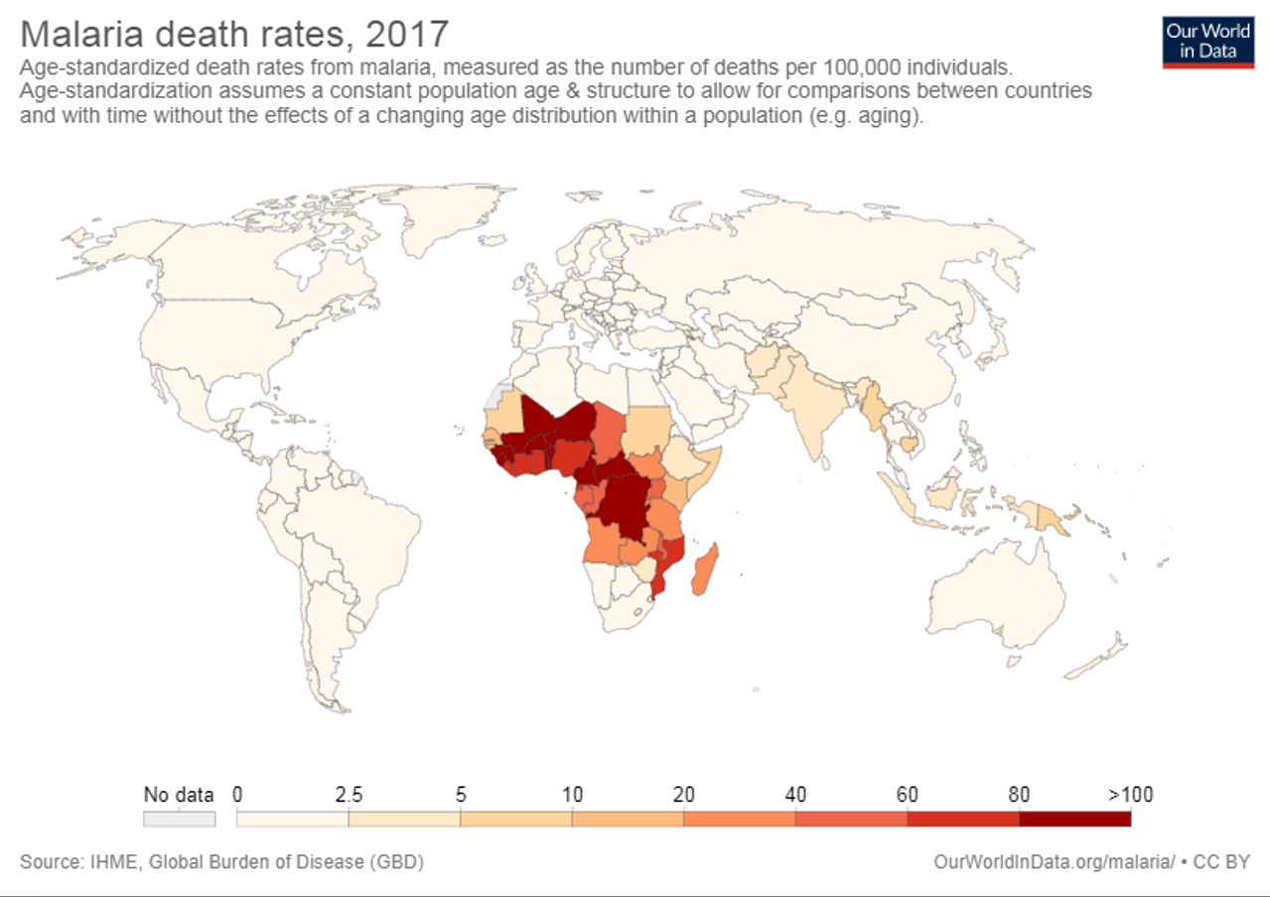
What is the extent and spread of malaria in the world and in Asia?
Malaria is found throughout most of the tropics such as Southeast Asia.
Mosquitoes thrive in areas with constant high temperatures, high relative humidity and rainfall and stagnant waters which provide breeding grounds for mosquito larvae.

Slide 15
Factors contributing to the Spread of Malaria
Despite some success at eliminating malaria, the disease continues to spread. Different economic and environmental factors contribute to this spread.
Economic Factor
Limited provision and access to healthcare
Social Factor
Lack of proper sanitation
Environmental Factors
Overcrowded living conditions Poor drainage and stagnant water Effect of climate

Slide 16
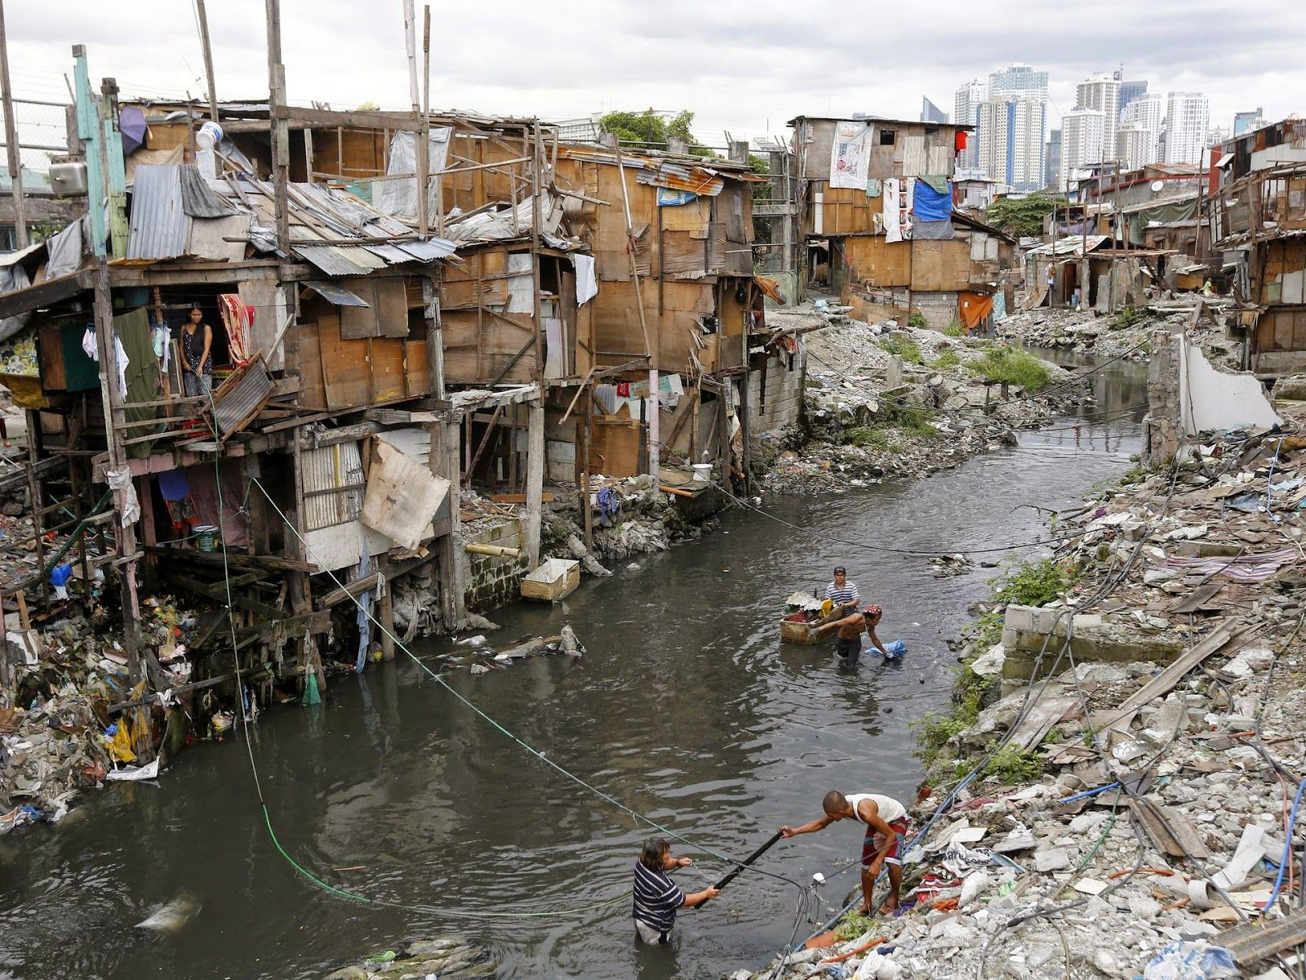
Social Factor
Lack of Proper Sanitation
Waste water and uncollected household garbage due to lack of garbage disposal trucks may accumulate in the streets forming stagnant water puddles, often replenished when it rains. These puddles provide grounds for mosquito larvae to thrive.
Slums along a dirty canal in Manila, the Philippines

Slide 17
Economic Factor
Limited Provision and Access to Healthcare
In areas where malaria is prevalent, there has been little spending on healthcare. Few and badly maintained roads in rural areas make medical centres and clinics difficult to access to those who need treatment.
Delays in treatment of the numerous malaria-infected people create greater opportunities for healthy mosquitoes to get infected, spreading the disease.
For example, most of India’s spending on healthcare is concentrated in urban areas while little spending goes to rural areas. Although medication is often available at medical centres, these may be far from people’s homes.
People usually delay receiving treatment. The longer an infected person waits, the greater the chances are of the person spreading the disease.

Slide 18
Environmental Factors
Overcrowded Living Conditions
Residents living in such conditions tend to leave doors and windows open for better ventilation and this may invite Anopheles mosquitoes.
Many people clustered together within a limited space gives mosquitoes opportunities to increase in human-biting frequency thus increasing the spread of the disease.

Slide 19
Environmental Factors
Poor Drainage and Stagnant Water
Excess water in large fields with clayey soils cannot be drained away, creating stagnant water puddles providing ideal conditions for Anopheles breeding.
For example, in Rajasthan, India, water from canals in the Great Indian Thar Desert leaks into many places, creating stagnant water puddles where Anopheles larvae thrive. Outbreaks of malaria have occurred since 1980.

Slide 20
Environmental Factors
Effect of Climate
Temperature, rainfall and relative humidity have a direct impact on mosquitoes. Monsoons create favourable conditions for mosquitoes to breed by bringing large amounts of rainfall.
Temperature
Higher temperatures shorten the development time of the parasites. As a result, mosquitoes become active and infectious sooner. The life cycle of mosquitoes will reduce as temperature rises.
Precipitation
Habitats for mosquitoes to breed may include pools of stagnant water which may result from rainfall that does not drain or evaporate. Habitats may be removed when rainfall is too high since the stagnant water will be washed away by the rain.

Slide 21
Environmental Factors
Effect of Climate
Temperature, rainfall and relative humidity have a direct impact on mosquitoes. Monsoons create favourable conditions for mosquitoes to breed by bringing large amounts of rainfall.
Relative Humidity
Relative humidity that ranges from 50% to 60% is needed for the survival and activity of mosquitoes. Higher humidity level leads to more mosquitoes having a longer lifespan, and are able to infect more people.

Slide 22
Gateway 2 – What influences the spread and impact of infectious diseases?
What were the major disease outbreaks in the past?
What is the scale at which diseases occur?
What is malaria and how is it transmitted?
What is the extent and spread of malaria in the world and in Asia?
What are the impacts of malaria?
What is HIV/AIDS and how is it transmitted?
What is the extent of spread of HIV/AIDS in the world and Sub-Saharan Africa?
Groups vulnerable to HIV/AIDS
What are the impacts of HIV/AIDS?

Slide 23
What are the impacts of malaria?
Malaria has social and economic impacts because it causes death and exerts an economic burden on individuals, households and countries.
Social Impacts
Death rate Infant mortality rate
Economic Impacts
Burden of malaria on households Cost of healthcare Loss of productivity

Slide 24
Social Impacts
Death Rate
About 3.3 billion people are at risk of malaria. People living in the poorest countries are the most vulnerable to malaria.
For example, in 2010, 90% of all malaria deaths occurred in the African region. Nigeria and DR Congo accounted for 40% of global malaria deaths.

Slide 25
Social Impacts
Infant Mortality Rate
Infants are most at risk especially those born to women infected during pregnancy.
For example, in Nigeria, 150 infants die from malaria within the first year of birth out of every 1000 babies born. This implies a high IMR.

Slide 26
Economic Impacts
Burden of Malaria on Households
Malaria-infected people require money to pay for medical treatment services, travel expenses for treatment etc.
This expenditure puts a heavy burden on households as there is additional expenditure and no additional income, but instead lower income due to absenteeism from work.

Slide 27
Economic Impacts
Cost of Healthcare
Healthcare costs of malaria include personal and public expenditures on prevention and treatment. Malaria can cause governments billions of dollars to administer treatment.

Slide 28
Economic Impacts
Loss of Productivity
Malaria-infected people tend to have poor health, lethargic and are unproductive in their work performance. This can cause a loss in productivity in an industry.
For example, in Africa, lost productivity arising from malaria illness and death costs Africa approximately US$12 billion annually, negatively affecting the GDP which could otherwise be channelled to economic growth and development.

Slide 29
Gateway 2 – What influences the spread and impact of infectious diseases?
What were the major disease outbreaks in the past?
What is the scale at which diseases occur?
What is malaria and how is it transmitted?
What is the extent and spread of malaria in the world and in Asia?
What are the impacts of malaria?
What is HIV/AIDS and how is it transmitted?
What is the extent of spread of HIV/AIDS in the world and Sub-Saharan Africa?
Groups vulnerable to HIV/AIDS
What are the impacts of HIV/AIDS?

Slide 30
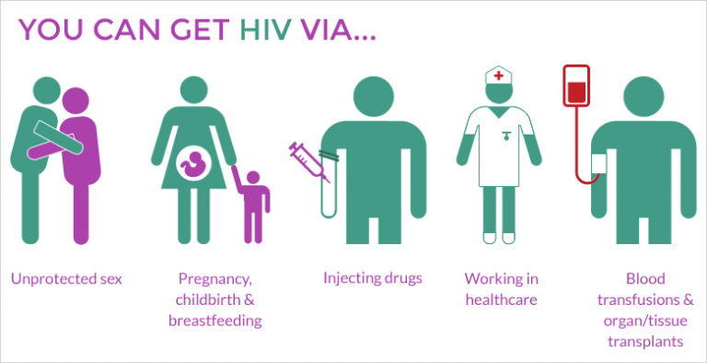
What is HIV/AIDS and how is it transmitted?
Human Immunodeficiency Virus (HIV) attacks the cells of the immune system by destroying white blood cells that are critical to fighting infections. Over time, the body loses its ability to fight infections, leading to Acquired Immune Deficiency Syndrome (AIDS).
AIDS is the final stage of HIV infection that occurs when the immune system is severely damaged, causing the body to become vulnerable to infections.
A diagram depicting how HIV/AIDS can be transmitted.

Slide 31
Gateway 2 – What influences the spread and impact of infectious diseases?
What were the major disease outbreaks in the past?
What is the scale at which diseases occur?
What is malaria and how is it transmitted?
What is the extent and spread of malaria in the world and in Asia?
What are the impacts of malaria?
What is HIV/AIDS and how is it transmitted?
What is the extent of spread of HIV/AIDS in the world and Sub-Saharan Africa?
Groups vulnerable to HIV/AIDS
What are the impacts of HIV/AIDS?

Slide 32
What is the extent of spread of HIV/AIDS in the world and Sub-Saharan Africa?
HIV/AIDS can be spread through both expansion and relocation diffusion. Relocation diffusion occurs when a disease spreads to new areas outside its current geographic range, whilst still being present in the location of origin.
Botswana, a country in Africa, has the highest concentration of HIV/AIDS.

Slide 33
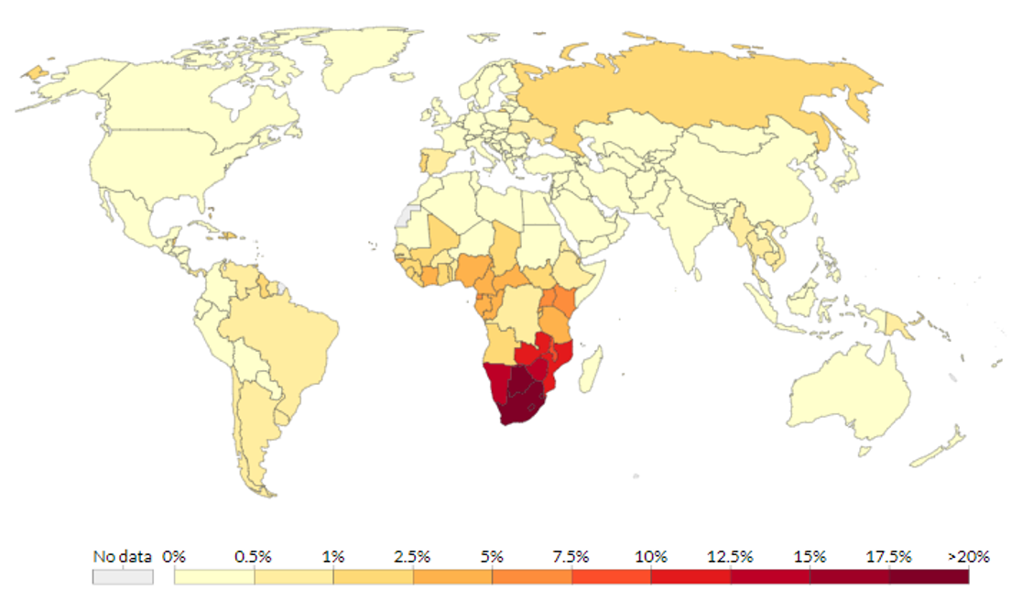
What is the extent of spread of HIV/AIDS in the world and Sub-Saharan Africa?
The spread of HIV/AIDS in Sub-Saharan Africa was mainly through expansion diffusion. By 2003, Africa was home to 67% of the world’s people living with HIV/AIDS.
A chloropleth map depicting the population aged between 15 and 49 years old infected with HIV/AIDS.

Slide 34
Gateway 2 – What influences the spread and impact of infectious diseases?
What were the major disease outbreaks in the past?
What is the scale at which diseases occur?
What is malaria and how is it transmitted?
What is the extent and spread of malaria in the world and in Asia?
What are the impacts of malaria?
What is HIV/AIDS and how is it transmitted?
What is the extent of spread of HIV/AIDS in the world and Sub-Saharan Africa?
Groups vulnerable to HIV/AIDS
What are the impacts of HIV/AIDS?

Slide 35
Groups vulnerable to HIV/AIDS
The groups of people vulnerable to HIV infection are as follows:
People who participate in risk-taking behaviours
Women
Babies born to HIV-positive mothers
People who lack sexuality education awareness

Slide 36
Factors contributing to the Spread of HIV/AIDS
There are social and economic factors that contribute to the spread of HIV/AIDS.
Social Factors
Social stigma related to the disease Education Lifestyle choices Lapses in medical practices
Economic Factors
Vice trades Mobility

Slide 37
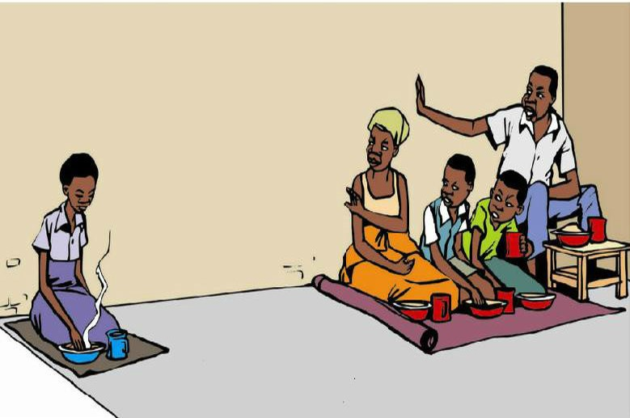
Social Factors
Social Stigma related to the Disease
Social stigma is society’s extreme disapproval of a person due to the presence of different characteristics from the norm leading to the person being ostracised from society.
Social stigma may cause a HIV-infected person to be discriminated against, lose his job, rejected by family and community etc.
A cartoon published in Uganda about how a family member suffering from HIV/AIDS may be ostracised as the others fear of the spreading of HIV/AIDS.

Slide 38
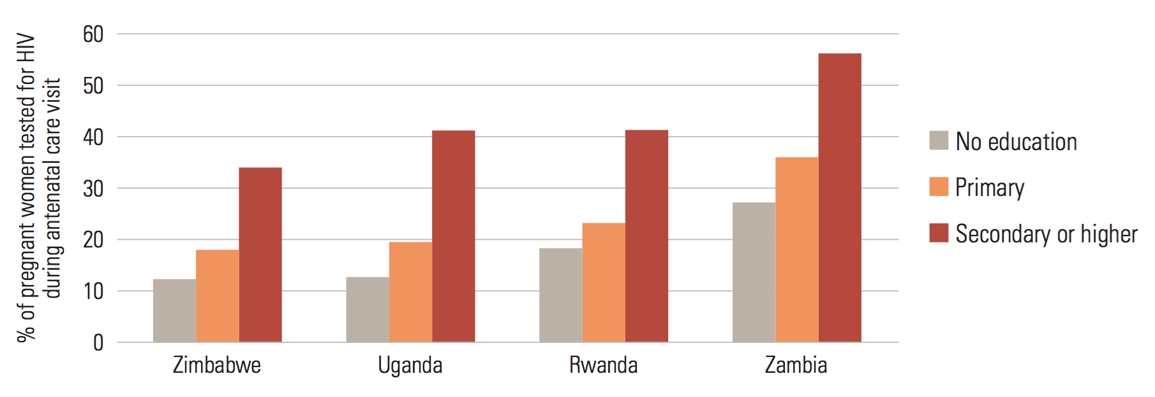
Social Factors
Education
Lack of education especially among females makes them unaware of the transmission of HIV and its prevention.
Percentage of pregnant women who, when it was offered during an antenatal care visit, sought HIV testing and received their results, by education, 2004-2007

Slide 39
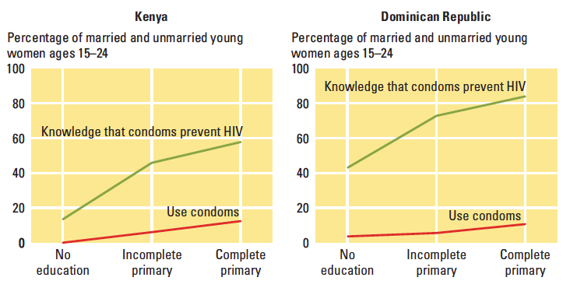
Social Factors
Lifestyle Choices
Some people choose not to practise safe sex and avoid using condoms while drug injection users may choose to share needles partly to save cost. Increases in education lead to safer behaviors.
In both Kenya and the Dominican Republic, higher education level is correlated with higher condom usage. Even having partial primary education leads to a massive increase in the percentage of people who know that condoms prevent the spread of HIV.

Slide 40
Social Factors
Lapses in Medical Practices
Carelessness and negligence associated with medical practice may promote the spread of HIV/AIDS.
This occurs when strict blood transfusion and blood screening procedures are not enforced before blood is collected from donors. For example, between 2001 and 2011, 130,000 patients in the USA were potentially exposed to HIV due to using HIV-tainted containers and syringes during blood transfusion.

Slide 41
Economic Factors
Vice Trade
This refers to illegal business activities (e.g. drug trafficking and prostitution). Such trades are recursive because people have no other job options or are prepared to take risks for making quick money.
For example, many females from rural China turn to sex trade in cities to supplement their low incomes. This makes them vulnerable to HIV/AIDS.

Slide 42
Economic Factors
Mobility
Many men from rural areas move to cities to work as truckers or miners, leaving their families behind. While away from home, they may get involved in unprotected sex, resulting in them getting infected. When they return home, wives may get infected by these migrant husbands.
Tourism also contributes to the spread of HIV/AIDS. Tourists may engage in unprotected sex.
For example, in 2010, Queensland, Australia, recorded its highest incidence of HIV/AIDS with 206 people diagnosed with it. This was due to a vacation in Papua New Guinea that has a high incidence of HIV/AIDS cases.

Slide 43
Gateway 2 – What influences the spread and impact of infectious diseases?
What were the major disease outbreaks in the past?
What is the scale at which diseases occur?
What is malaria and how is it transmitted?
What is the extent and spread of malaria in the world and in Asia?
What are the impacts of malaria?
What is HIV/AIDS and how is it transmitted?
What is the extent of spread of HIV/AIDS in the world and Sub-Saharan Africa?
Groups vulnerable to HIV/AIDS
What are the impacts of HIV/AIDS?

Slide 44
What are the impacts of HIV/AIDS?
HIV/AIDS affects not only the individual, but communities, countries and even large geographical reasons. Hence, HIV/AIDS has crippling social and economic implications.
Social Impacts
Life expectancy and infant mortality rate Orphan crisis
Economic Impacts
Cost of healthcare Loss of productivity resulting in slower economic growth

Slide 45
Social Impacts
Life Expectancy and Infant Mortality Rate
HIV/AIDS increases the number of deaths and reduces life expectancy, population size and population growth. The large numbers of death occur mostly in LDCs where HIV/AIDS is prevalent.
HIV/AIDS also cause an increase in IMR in countries like Uganda.

Slide 46
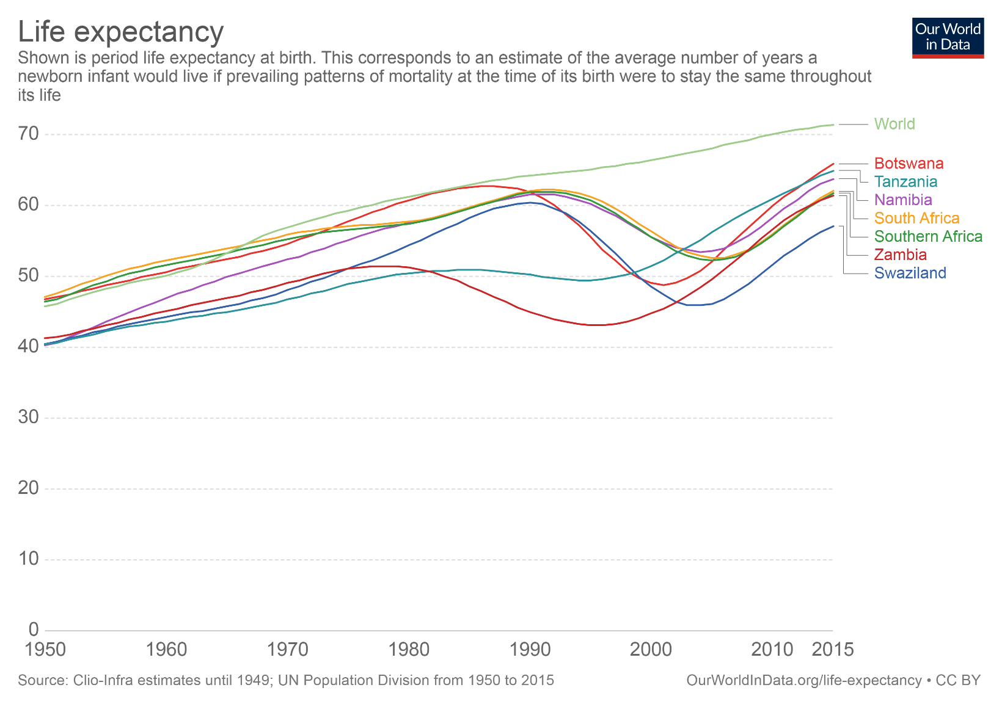
Social Impacts
Life Expectancy and Infant Mortality Rate
While globally life expectancy has been increasing since the 1950s, several countries in Sub-Saharan Africa saw a major decrease in life expectancy with the onset of the AIDS crisis around 1990. Life expectancy has started to increase again since the early 2000s.

Slide 47
Social Impacts
Orphan Crisis
Numerous children become orphans when their parents die from AIDS. Most of these children live in Sub-Saharan countries.
These uncared-for orphans have little access to basic necessities and tend to be undernourished and malnourished, making them vulnerable to illnesses.
These orphans suffer from the emotional trauma of losing their parents. They are also often stigmatised by society through association with HIV/AIDS.

Slide 48
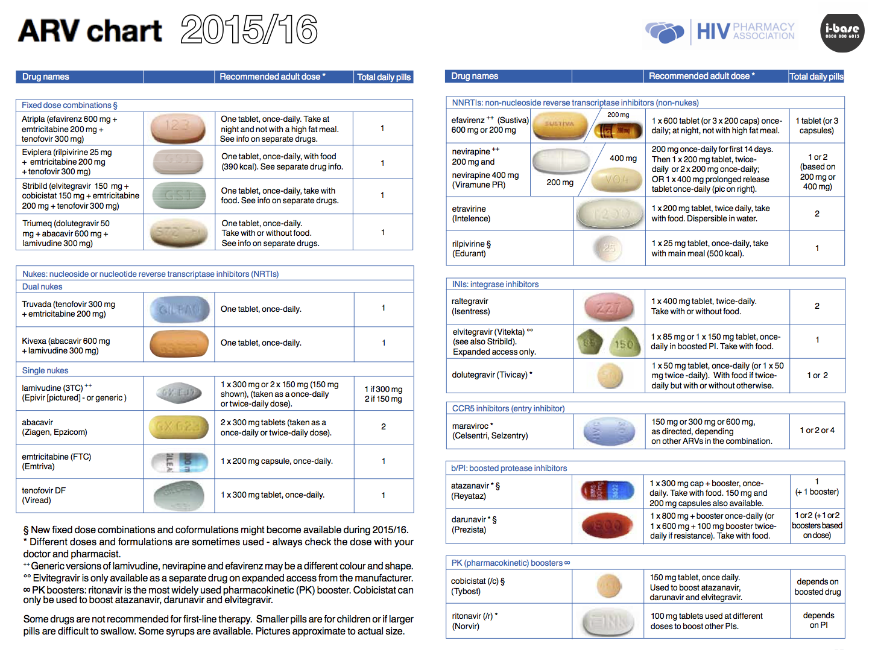
Economic Impacts
Cost of Healthcare
Prevalence of HIV/AIDS puts pressure on individuals and the government to divert financial resources to healthcare expenditure.
The medications used to treat HIV/AIDS are called antiretroviral drugs. They do not cure HIV/AIDS but keep it from progressing in the body. It can also stop patients from suffering from complications for many years and even decades.
Examples of antiretroviral drugs

Slide 49
Economic Impacts
Cost of Healthcare
The healthcare expenditure could have been spent on more nutritious food, leisure activities and further education to lift individuals’ standard of living and quality of life.
For example, in South Africa, the government’s HIV/AIDS-related healthcare expenditure in 2010 was a hefty US$1.2 billion. If HIV/AIDS had not been rampant, funds could have been channelled to infrastructural development to generate economic growth.

Slide 50
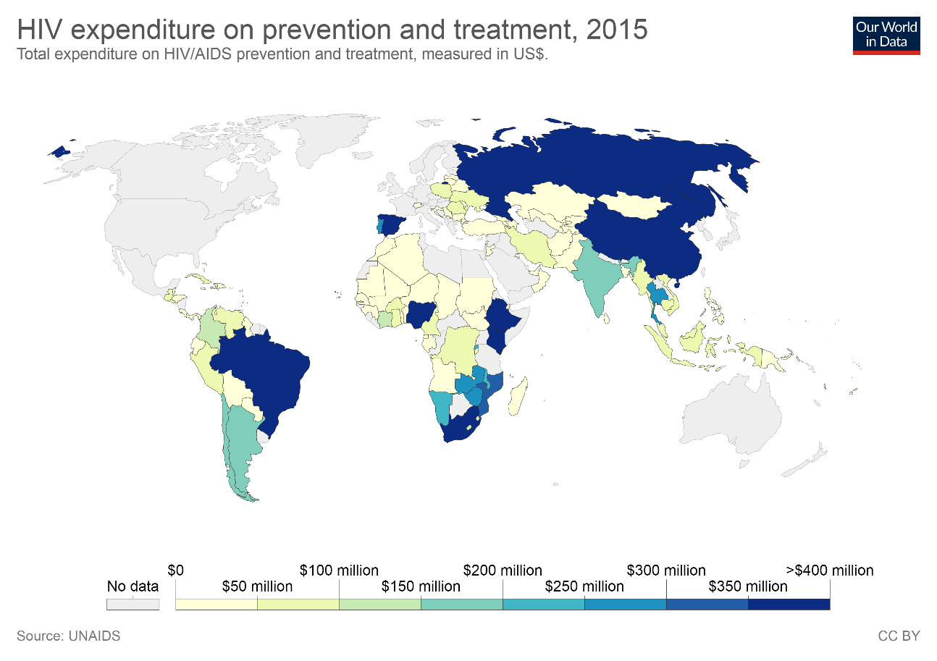
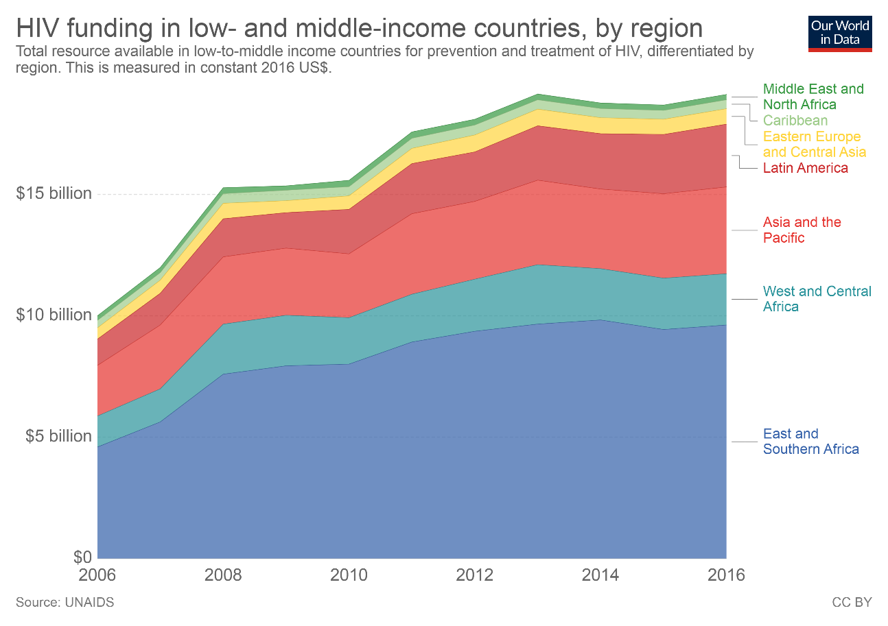
Economic Impacts
Cost of Healthcare
LEFT: The following chart shows international and domestic spending on HIV, broken down by donor, and region in low- and middle-income countries.; RIGHT: Total resource available in low-to-middle income countries for prevention and treatment of HIV.

Slide 51
Economic Impacts
Loss of Productivity resulting in Slower Economic Growth
HIV/AIDS epidemic hinders economic growth. Deaths caused by HIV/AIDS shrink the workforce while AIDS-related illnesses increases absenteeism from work resulting in low productivity in the production of goods and services, negatively affecting the country’s GDP per capita.
Limited available financial resources may negatively affect building of schools and training of educational staff. Low literacy rate means a less-skilled and less productive workforce to drive the economy.
As a result, a slower economic growth means fewer employment opportunities and lower incomes which may lead to region-wide poverty.

