Slide 1
Secondary 4 Pure Geography
Chapter 2 – Food Resources
Gateway 3 – How can the problem of food shortage be addressed?

Slide 2
Gateway 3 – How can the problem of food shortage be addressed?
What are the strategies to overcome food shortage?
How effective is technology in solving the problem of food shortage?

Slide 3
What are the strategies to overcome food shortage?
Strategies to overcome food shortage may be technological, agricultural, social, political or economic.
Technological
Storage Farming technology Biotechnology
Agricultural
Multiple cropping and crop rotation Water and soil conservation Leasing farmland to other countries
Social
Support local farmers Population control
Political and Economic
National strategies (agricultural policies) International strategies (food programmes and aid assistance)

Slide 4
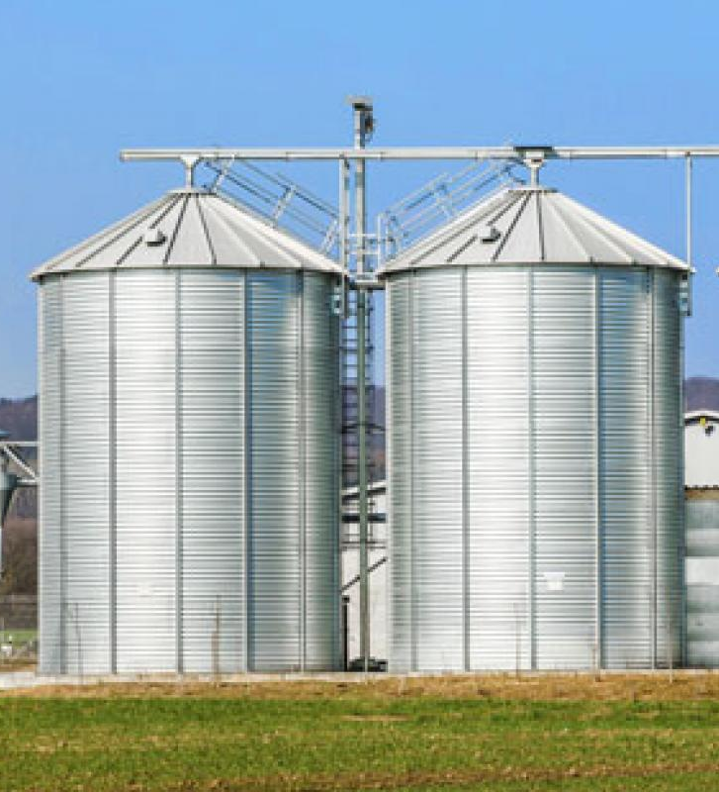
Technological Strategies
Storage
This refers to the use of refrigerated warehouse storage or delivery trucks to keep food fresh for a longer period of time.
EFFECTIVENESS: With the use of refrigerated storage, crops can be distributed to places further away from its area of production. This has led to a larger variety of food being made available and accessible for more people.
For example, in Timor-Leste, silos are built and the FAO has helped reduce the loss of crops to pests by 20%.
LIMITATIONS: Expensive strategy which adds on to the cost of food production. Moreover, farmers in LDCs might be unable to afford silos.
Silos

Slide 5
Technological Strategies
Farming Technology
The use of HYVs, irrigation technology and chemical fertilisers in order to increase crop yields.
EFFECTIVENESS: Enabled food to be grown in places previously considered unsuitable for agriculture.
For example, irrigation has allowed farming to be carried out in areas that were previously too dry for growing crops.
LIMITATIONS: Expensive strategy which adds on to the cost of food production, especially in LDCs.

Slide 6
Technological Strategies
Farming Technology
These dramatic improvements in technology since the 1960s are known as the Green Revolution.
EFFECTIVENESS: These technologies have increased crop yield for farmers, and also enabling farmers to farm more efficiently, reducing their dependence on labour. For example, the use of computers in Singapore’s high-tech farms has resulted in fewer workers being needed to grow crops on these farms.
LIMITATIONS: If not properly managed, these technologies may result in environmental problems such as waterlogging.

Slide 7

Technological Strategies
Biotechnology
Genetically-modified (GM) food refers to food derived from crops that have had their genetic make-up modified.
EFFECTIVENESS: GM crops have a higher yield. This helps farmers to earn a higher income and helps countries to be more self-sufficient in food production. For example, GM tomatoes were commercially grown and especially popular in the late 1990s in the USA due to their firmness for a longer period.
LIMITATIONS: GM crops are mostly grown in large-scale commercial farms in DCs due to the high capital investment involved to purchase inputs such as seeds. For many small farmers in LDCs, these seeds are unaffordable.
However, GM food are said to pose certain health risks as well.

Slide 8
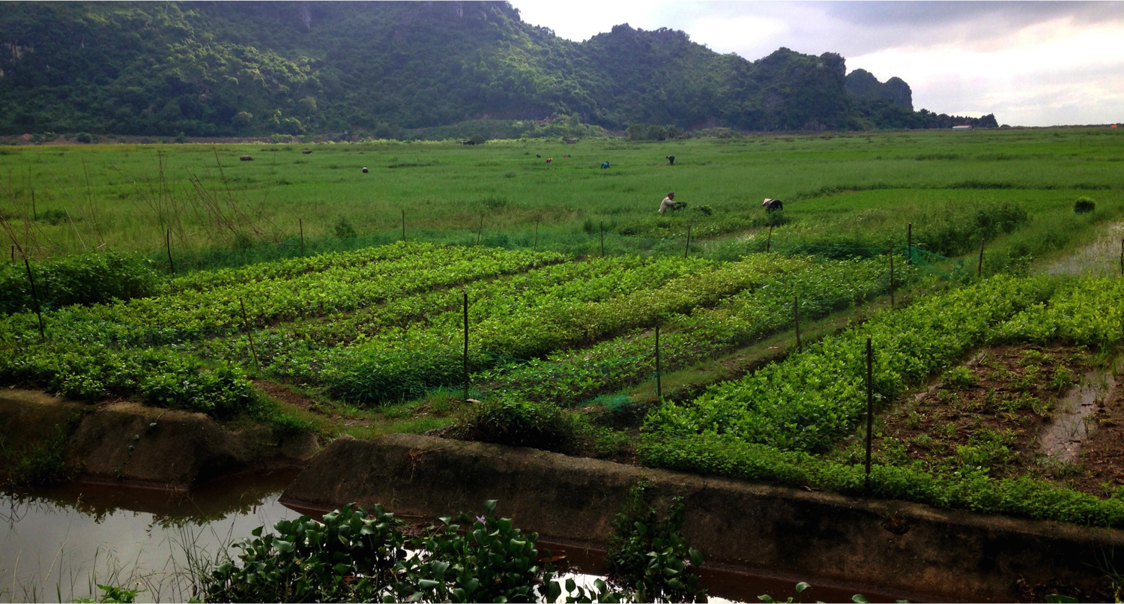
Agricultural Strategies
Multiple Cropping
Multiple cropping is growing 2 or more crops of the same type or different crops on the same field resulting in multiple harvests annually.
EFFECTIVENESS: There is less crop damage because different crops are vulnerable to different pests. This is evident in Garhwal, Himalayas where the risk of crop damage by pests is reduced.
LIMITATIONS: Multiple cropping requires greater inputs like chemical fertilisers which can be expensive and may be a financial burden to poor farmers.
Multiple cropping of different crops on a small-scale farm in Indonesia

Slide 9
Agricultural Strategies
Crop Rotation
Crop rotation refers to growing of 2 or 3 crops one after another at different times of the year on the same plot of land with the crops moved around in sequence to maximise the use of soil nutrients.
EFFECTIVENESS: For example, in Nigeria, leguminous soya bean is grown first and after harvest, maize is cultivated to make use of the nitrogen-enriched soil.

Slide 10
Agricultural Strategies
Water and Soil Conservation
No-till farming is not removing weeds or creating rows in the soil for planting. This helps to reduce compacting by machines which makes the soil too compacted for infiltration of water.
EFFECTIVENESS: For example, no-till wheat farming is practised in the grasslands of northern Kazakhstan. No-till farming leaves the stubble of the previous year’s crop standing in the fields to trap snow so that when weather warms, it melts and seeps into the soil, making the soil fertile.
LIMITATIONS: Crop residue left on the soil hinders soil warming and drying, making planting more difficult and germination conditions less ideal.

Slide 11
Agricultural Strategies
Leasing Farmland to other Countries
Land may be leased out to countries with limited land for food production. This may generate income for farmers to improve their farming methods and increase food production.
EFFECTIVENESS: For example, Angola leases land to China to raise fish and DR Congo leases land to China to produce cabbage, increasing food production and generating income for Chinese farmers.
LIMITATIONS: Leasing out land to generate income has been argued to be an unsustainable practice since less land is made available to local farmers.

Slide 12
Social Strategies
Support Local Farmers
Socially-responsible consumers are those who purchase locally-produced food in support of local farmers.
EFFECTIVENESS: For example, in Sub-Saharan Africa, agriculture is their economic backbone, essential for poverty reduction and food security.
LIMITATIONS: Some people especially the rich have a preference for better quality imported food.

Slide 13

Social Strategies
Population Control
The world population is predicted to reach 10 billion in 2050. In order to mitigate food shortage, the solution is to reduce population by educating the public on importance of family planning.
EFFECTIVENESS: For example, China’s aggressive ‘One Child Policy’ has drastically cut down population growth and hunger.
LIMITATIONS: The success of family planning policies in India and Sub-Saharan Africa is hindered by traditional beliefs in having large families.
A Chinese propaganda poster promoting the ‘One Child Policy’

Slide 14
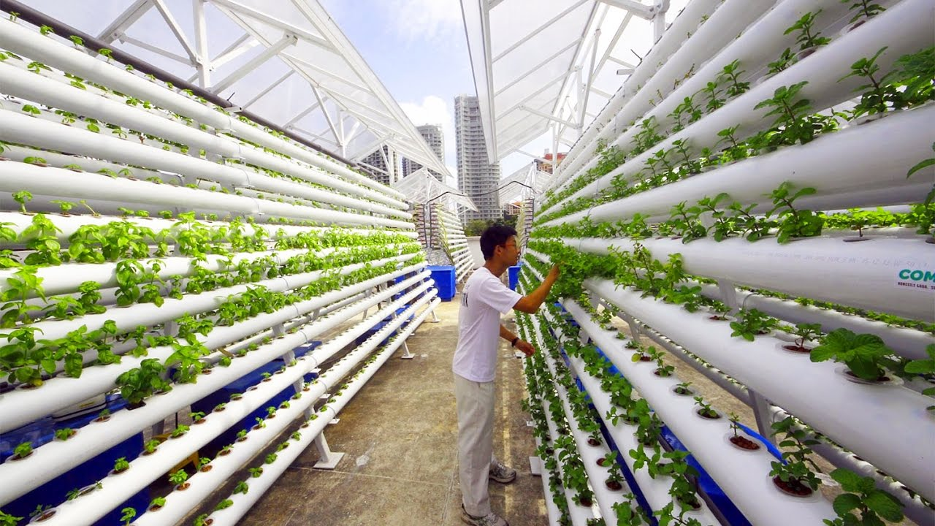
Political and Economic Strategies
National Strategies (Agricultural Policies)
For example, Singapore has been practising high-tech farming since the 1970s. It involves agrotechnology parks that contain house high-tech farms. These parks are equipped with the necessary infrastructure that modern farms require such as computers.
High-tech farming in Orchard, Singapore

Slide 15
Political and Economic Strategies
National Strategies (Agricultural Policies)
EFFECTIVENESS: Local farms produce up to 8% of vegetables, 8% of fish and 26% of eggs consumed in Singapore. Hence, Singapore can reduce its reliance on food imports.
LIMITATIONS: It is very costly to set up high-tech farms which translate into higher prices of food produce for consumers. Moreover, this industry is very small as there is a shortage of trained workers for high-tech farming.

Slide 16
Political and Economic Strategies
International Strategies (Food Programmes)
The World Food Programme (WFP) was established by the UN in 1961. It aims to address food needs of victims of natural disasters and civil wars, to reduce global chronic hunger and undernourishment.
EFFECTIVENESS: In 2011, WFP pledged humanitarian aid to South Sudan to support 3 million people affected by hunger and conflict due to crop failure brought about by a severe drought.
LIMITATIONS: WFP was unable to reach those living in villages where violence was widespread.

Slide 17
Political and Economic Strategies
International Strategies (Food Programmes)
Food programmes refers to food donations or assistance in agricultural techniques given by one country or an international organisation to another country.
EFFECTIVENESS: The School Meals Programme initiated by WFP in 2011 was targeted at 300,000 Cambodian primary school children where they were given nutritious breakfast of rice, fish and vegetables to fight malnutrition. As such, extreme cases of malnutrition reduced and children’s health improved significantly.
LIMITATIONS: The coverage of such programmes is uneven across countries.

Slide 18
Gateway 3 – How can the problem of food shortage be addressed?
What are the strategies to overcome food shortage?
How effective is technology in solving the problem of food shortage?

Slide 19
How effective is technology in solving the problem of food shortage?
Challenges include misuse and overuse of technology leading to problems such as:
Increased costs of storage
High price of GM seeds in biotechnology
High costs of fertilisers, pesticides and irrigation facilities in Green Revolution
Increase maintenance costs of farming technology

Slide 20
How effective is technology in solving the problem of food shortage?
Moreover, the advent of technology would lead to environmental problems like:
Reduction of biodiversity
Habitat loss
Land degradation
Soil erosion
Chemical pollution of land and water courses

