Slide 1
Secondary 4 Pure Geography
Chapter 2 – Food Resources
Gateway 1 – How and why have food consumption patterns changed since the 1960s

Slide 2
Gateway 1 – How and why have food consumption patterns changed since the 1960s
How do food consumption patterns vary between DCs and LDCs over time?
Developed countries (DCs) and less developed countries (LDCs)
Why do food consumption patterns vary between DCs and LDCs?
What are the consequences of variations in food consumption patterns?

Slide 3
How do food consumption patterns vary between DCs and LDCs over time?
People in developed and developing countries have different levels and types of food consumption patterns.
Food consumption patterns are influenced by economic, socio-cultural and political factors.

Slide 4
Gateway 1 – How and why have food consumption patterns changed since the 1960s
How do food consumption patterns vary between DCs and LDCs over time?
Developed countries (DCs) and less developed countries (LDCs)
Why do food consumption patterns vary between DCs and LDCs?
What are the consequences of variations in food consumption patterns?

Slide 5
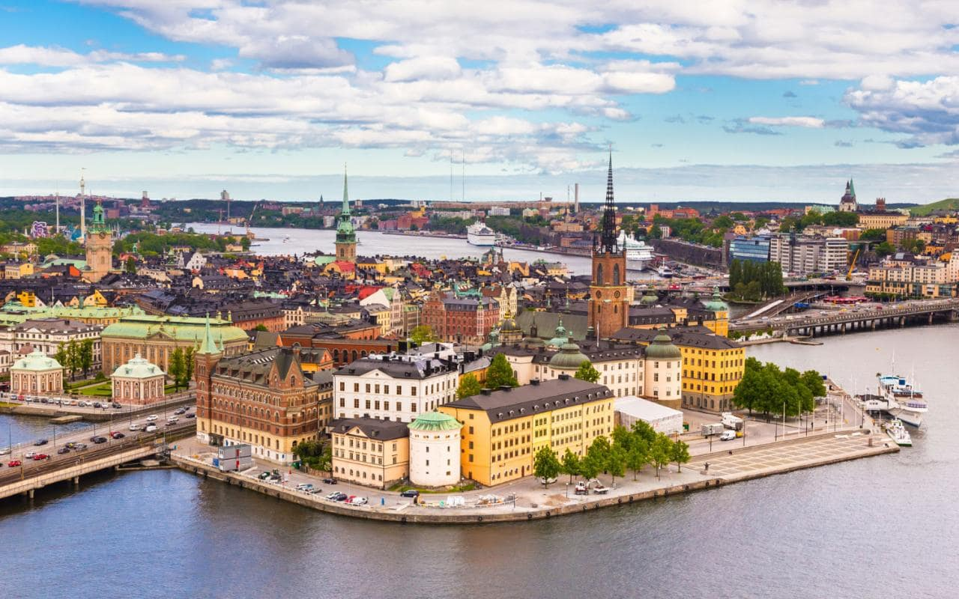
Developed countries (DCs) and less developed countries (LDCs)
Examples of DCs include Japan, Australia, New Zealand, United States of America (USA), Canada, France, Germany and Sweden.
Sweden, an example of a developed country with a GDP of 540 billion USD.

Slide 6

Developed countries (DCs) and less developed countries (LDCs)
On the other hand, examples of LDCs include Mongolia, Laos, Cambodia, Indonesia, Kenya and Bangladesh.
Cambodia, an example of a less developed country with a GDP of 22 billion USD.

Slide 7
Differentiating DCs and LDCs
DCs and LDCs are identified by comparing their Gross Domestic Product (GDP) per capita, income per capita, employment opportunity, employment structure, adult literacy rate, life expectancy and infant mortality rate.
Differentiating DCs and LDCs
Gross Domestic Product (GDP) per Capita
Employment Opportunity
Adult Literacy Rate
Life Expectancy
Infant Mortality Rate

Slide 8
Differentiating DCs and LDCs
GDP per Capita
GDP per capita refers to the total value of goods and services generated by a country in a particular year divided by the total population. Generally, the higher the GDP, the higher the development level and vice versa.

Slide 9
Differentiating DCs and LDCs
Employment Opportunity
Employment opportunity refers to the availability of jobs in a country. More employment opportunities mean more people get employed and have incomes hence improving their standard of living and quality of life.

Slide 10
Differentiating DCs and LDCs
Adult Literacy Rate
Measures the percentage of those aged 15 and above who can read and write a short statement about their everyday life. Countries with a high literacy rate tend to have more professionals who can contribute their skills and expertise to society and drive the country’s economy.

Slide 11
Differentiating DCs and LDCs
Life Expectancy
Refers to the average number of years a person born in a country is expected to live. It is influenced by the level and quality of healthcare, water, sanitation, food supply and living conditions in a country.
Generally, the longer the life expectancy, the more developed a country is.

Slide 12
Indicators of Food Consumption
Variations in the food consumption patterns between DCs and LDCs can be measured in terms of the following factors:
Food consumption per capita
Daily calorie intake
Starchy staples as a percentage of all calories

Slide 13
Indicators of Food Consumption
Food Consumption per Capita
Food consumption per capita refers to the amount of energy obtained from food consumed each day by each person. It is measured in kilograms per capita per year.

Slide 14
Indicators of Food Consumption
Daily Calorie Intake
The minimum daily calorie requirement for healthy growth is 2500 calories.
Generally, people in DCs have a higher daily calorie intake than people in LDCs as food consumption kilogram per capita per year in DCs is greater than that in LDCs.

Slide 15
Indicators of Food Consumption
Starchy Staples as a Percentage of all Calories
Staple food is food that forms the main part of the diet of a given population. Examples include carbohydrates, proteins and minerals.
If staple food forms a large percentage of all calories, it means that diet of the individual is not well-balanced. A well-balanced diet should include both staple and non-staple food items.

Slide 16
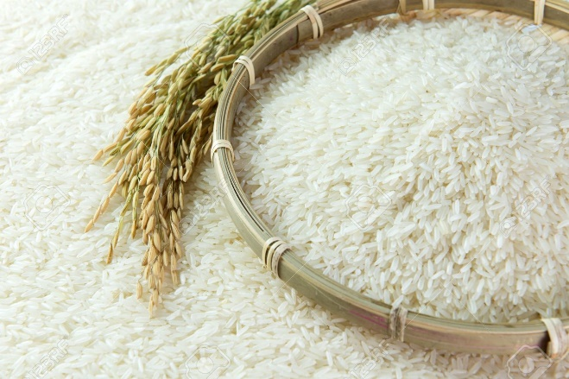

Indicators of Food Consumption
Starchy Staples as a Percentage of all Calories
The difference between staple and non-staple food is as follows.
 | Staple Food | Non-Staple Food
Characteristics | Constitute the main part of most people’s diet | Do not form the bulk of people’s diet
Examples | Rice, wheat | Meat, eggs
LEFT: Rice, a staple food; RIGHT: Salmon, a non-staple food

Slide 17
Indicators of Food Consumption
Starchy Staples as a Percentage of all Calories
Staple food is food that forms the main part of the diet of a given population. Examples include carbohydrates, proteins and minerals.
If staple food forms a large percentage of all calories, it means that diet of the individual is not well-balanced. A well-balanced diet should include both staple and non-staple food items.

Slide 18
Changing Food Preferences
Food preference refers to the choice of one food type over another due to increase in income, hence preference for more expensive and nutrient-rich food.
Changing preference is partly due to health-conscious attitude, thus preference for fruits and vegetables and also due to availability of a wide variety of food to choose from and easy access to such food.

Slide 19
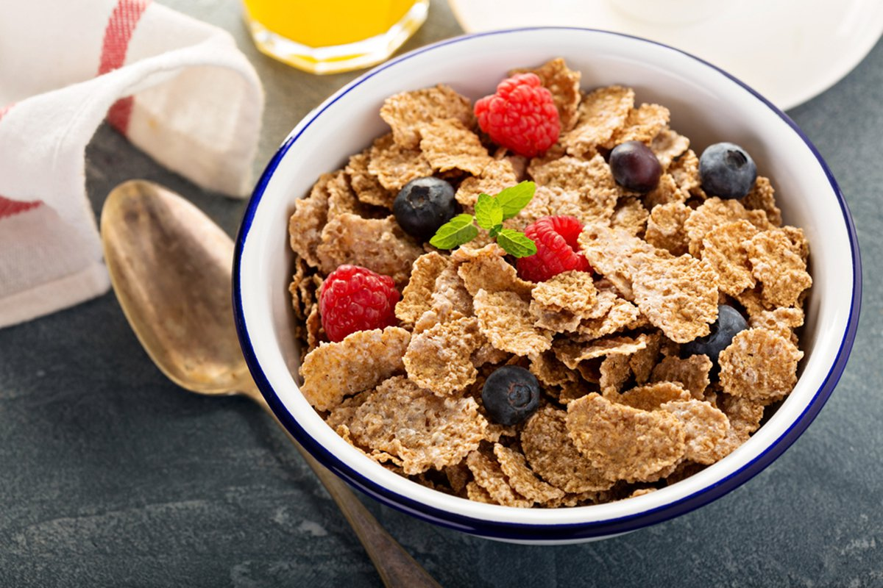
Changing Food Preferences
Cereals
Cereals are the most important food source in the world. They contribute up to 50% of the global calorie intake.
In LDCs such as Africa and parts of Asia, cereal consumption is high. Cereals make up as much as 70% of the calorie intake.
On the other hand, in DCs, cereal consumption is lower compared to LDCs as more of other foods are consumed.
Cereals are the most important food source in the world

Slide 20

Changing Food Preferences
Meat
Livestock refers to domesticated animals such as cattle, pigs and sheep. They provide us with meat, dairy products and other livestock by-products which are high in protein and essential nutrients.
As income per capita increases, so does meat consumption. Generally, meat consumption is increasing in both DCs and LDCs.
While meat consumption remains high, DCs are beginning to consume less red meat as this has been linked to health problems such as obesity.

Slide 21
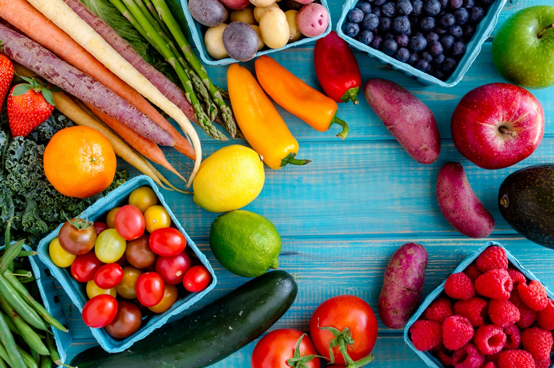
Changing Food Preferences
Fruits and Vegetables
Consumption of fruits and vegetables has increased in both DCs and LDCs. Fruits and vegetables contain much-needed vitamins, minerals and dietary fibre and they can also reduce the risk of diseases such as health disease, cancer and diabetes.
There is a positive correlation between fruits and vegetables consumption and income.

Slide 22
Gateway 1 – How and why have food consumption patterns changed since the 1960s
How do food consumption patterns vary between DCs and LDCs over time?
Developed countries (DCs) and less developed countries (LDCs)
Why do food consumption patterns vary between DCs and LDCs?
What are the consequences of variations in food consumption patterns?

Slide 23
Why do food consumption patterns vary between DCs and LDCs?
The following factors account for the growth and variations in food consumption.
Economic Factors
Disposable Income
Prices of Food
Political Factors
Stability of Food Supply
Food Safety
Socio-Cultural Factors
Religious Beliefs
Food Preferences
Migration
Population Growth

Slide 24
Economic Factors
Disposable Income
Disposable income refers to the amount of income an individual has left after taxes have been deducted. It determines how much money people have to buy food and it has been rising in both DCs and LDCs.

Slide 25
Economic Factors
Prices of Food
People in LDCs are generally more affected by food prices than those in DCs because they have less disposable income.
A sharp increase in prices could lead to large changes in consumption patterns of people in LDCs as they are unable to afford food.

Slide 26
Socio-Cultural Factors
Religious Beliefs
Different faiths influence people’s food choices and preparation.
Religion | Food Practices
Islam | Muslims can only consume food that is halal.
Buddhism | Buddhists consume very little meat or adopt a vegetarian diet because they do not believe in harming animals. Strict Buddhists do not eat beef.
Hinduism | Hindus do not eat beef as the cow is considered a holy animal.
Judaism | Jews can only consume kosher foods such as fruits and vegetables.

Slide 27

Socio-Cultural Factors
Food Preferences
Certain kinds of food have become popular and are widely consumed because of cultural beliefs or social influences.
For instance, fast foods popularised because of their convenience and affordability. They are also made popular by advertisements which packaged the meal as something cool and trendy.
An advertisement about McDonalds ‘Classic Angus Cheese’ and ‘Buttermilk Crispy Chicken’ burgers

Slide 28
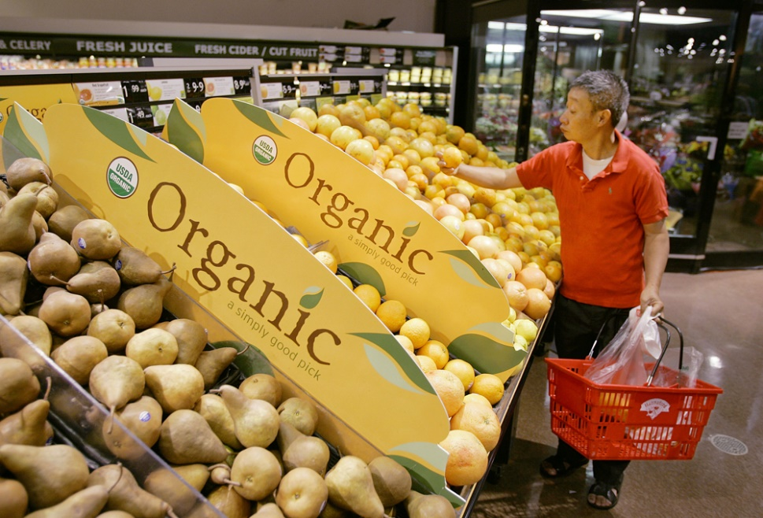
Socio-Cultural Factors
Food Preferences
Organic food is becoming popular due to people becoming increasingly concerned about chemicals used in producing food. Many people have chosen to eat organic products due to the perceived health benefits it brings.
Organic food is generally more expensive than non-organic food and sometimes even costing twice as much.
A man shopping for organic produce in a supermarket

Slide 29
Socio-Cultural Factors
Migration
Cuisines typical of countries of origin have extended their geographic boundaries due to globalisation, inter-connectedness and migration; and this has brought about the availability of a vast variety of food all over the world.

Slide 30
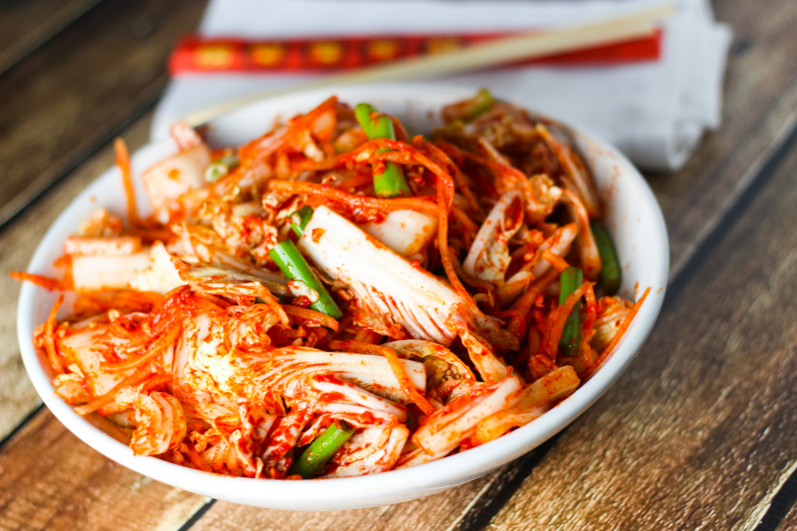

Socio-Cultural Factors
Migration (Japan and Korea)
For example, South Koreans emigrating to the United States of America have popularised their famous vegetable salad ‘kimchi’ while the Japanese introduced their ever popular and healthy ‘sushi’.
LEFT: Kimchi; RIGHT: Sushi

Slide 31
Socio-Cultural Factors
Population Growth
Population growth is one of the key drivers in the increasing demand for food worldwide. The Food and Agricultural Organisation (FAO) estimates that the world population is expected to increase to 10 billion in 2050.

Slide 32
Political Factors
Stability of Food Supply
Governments of countries play important roles in bringing about stability of food supply and food safety, thus influencing growth and variation in food consumption.
Generally, there is a greater food consumption in DCs than LDCs where many people in Sub-Saharan African countries do not have sufficient food to eat.
The stability of food supply can be affected by:
Civil War
Natural Diseases

Slide 33

Political Factors
Stability of Food Supply (Civil War, Libya)
For example, the 2011 Libyan Civil War has caused a loss of rural manpower, abandonment of farms and depletion of food stocks causing food security crisis.
Protests during the 2011 Libyan Civil War

Slide 34
Political Factors
Stability of Food Supply (Natural Disaster, Haiti)
For example, the 2010 Haiti Earthquake crippled the agriculture sector and left the economy in shambles, making it unable to import food.
The Haitian government was unable to raise enough funds to put the country on the road to recovery to ensure political stability.

Slide 35
Political Factors
Food Safety
The role of the government on food safety influences growth and variation in food consumption. It is responsible for ensuring that meat, poultry and eggs are safe and properly labelled and packaged for consumption.
For example, the tsunami triggered by the 2011 earthquake damaged the nuclear plants in Fukushima, Japan. Radiation released from the radioactive materials contaminated farmland and water resources. Seafood imports from Japan to Singapore were restricted for many months following the disaster to ensure the safety of the consumers in Singapore.

Slide 36


Political Factors
Food Safety
Here are two of the many ways to keep food safe from bacteria.
LEFT: Wash hands and surfaces often; RIGHT: Do not cross-contaminate

Slide 37
Gateway 1 – How and why have food consumption patterns changed since the 1960s
How do food consumption patterns vary between DCs and LDCs over time?
Developed countries (DCs) and less developed countries (LDCs)
Why do food consumption patterns vary between DCs and LDCs?
What are the consequences of variations in food consumption patterns?

Slide 38
What are the consequences of variations in food consumption patterns?
The variations in food consumption patterns can be classified into ‘inadequate food consumption on individuals and countries’ and ‘excess food consumption on individuals and countries’.

Slide 39
Impact of Inadequate Food Consumption on Individuals and Countries
The impacts of inadequate food consumption on individuals and countries are as follows:
Economic
Lower Productivity
Diversion of Financial Resources to Healthcare
Long-term Debt due to Food and Financial Aid
Health
Malnutrition
Starvation
Political
Social Unrest
Social
Scavenging

Slide 40
Health Impact
Malnutrition
Imbalanced consumption of nutrients, inadequate in some and excess in others results in malnutrition. Two co-existing forms of severe malnutrition are marasmus and kwashiorkor.
Malnutrition hinders healthy tissue growth and proper organ functions. For example, lack of Vitamin A derived from eggs and cheese can cause impairment and blindness.

Slide 41
Health Impact
Starvation
Starvation is the state of extreme hunger from a severe lack of food. It is an extreme form of malnutrition. When going through starvation, the body becomes skeletally thin and the organs become permanently damaged.
Starvation is much more common in LDCs because of the:
Greater number of people living in poverty
Lack or absence of resources to recover from natural disasters
Unstable political situation such as rebellions and wars

Slide 42
Economic Impact
Lower Productivity
Undernourished and malnourished people are generally weak, lethargic and vulnerable to illnesses. This has led to a fall in work productivity as weak and sickly people are usually not mentally alerted and unmotivated to perform tasks be it at school or at work.
For example, in Sierra Leone, low work productivity is linked to under-nutrition and malnutrition as reported by the International Food Policy Research Institute (IFPRI). This has caused affected people to have low incomes and the nation to have lower revenue.

Slide 43
Economic Impact
Diversion of Financial Resources to Healthcare
Public health expenditures will increase when the demand for health services increase. This is because of more people falling sick. This is turn increases the overall cost of providing healthcare.

Slide 44
Economic Impact
Long-term Debt due to Food and Financial Aid
Food aid and financial aid can be given to help people and countries cope with insufficient supply of food. However, financial aid may lead to long-term debt problems for the receiving country.
For example, the United States of America contributes about half of all global aid.

Slide 45
Political Impact
Social Unrest
Hungry people are often angry people who spark social unrest against the authorities due to their unhappiness in the prices of food.
For example, violent riots caused some deaths and hundreds injured in Mozambique in 2010 when wheat prices increased by 30% due to shortage caused by the drought in Russia, its wheat supplier.

Slide 46
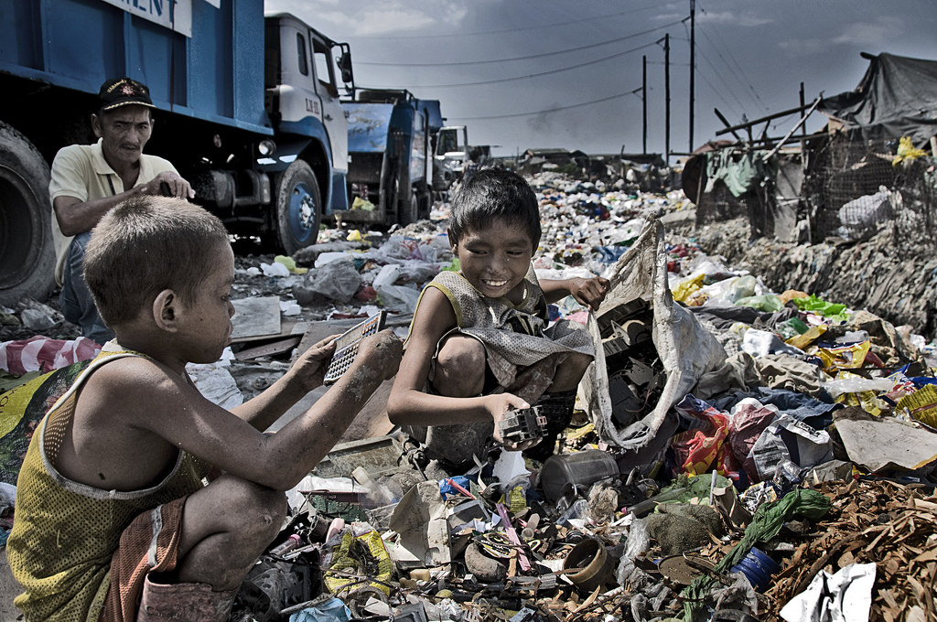
Social Impact
Scavenging
Hunger drives people to survival responses such as scavenging or rummaging through rubbish dumps to look for food or recyclable waste that can be sold to buy food.
However, discarded food may be contaminated with bacteria and chemicals (e.g. mercury and lead).
Scavengers at Smokey Mountain, a landfill in Manila, Philippines

Slide 47
Impact of Excess Food Consumption on Individuals and Countries
The impacts of excess food consumption on individuals and countries are as follows:
Economic
Lower Productivity
Diversion of Financial Resources to Healthcare
Health
Obesity and Related Illnesses
Social
Food Wastage
Dieting

Slide 48
Health Impact
Obesity and Related Illnesses
Excessive consumption of food results in overweight problem of obesity whereby excess nutrients are stored as body fat. Obesity increases vulnerability to illnesses such as coronary heart disease and high blood pressure.
Obesity is more common in DCs than in LDCs. For example, USA has about 45% obese adult population compared with India’s 5%, partly due to higher disposable income.

Slide 49
Economic Impact
Lower Productivity
Obese adults are generally slow in their movement and not mentally alert. This has led to a fall in work productivity, incomes and job promotion prospects.

Slide 50
Economic Impact
Diversion of Financial Resources to Healthcare
Obese-related poor health also prompts governments to increase public health expenditure at the expense of improving infrastructure to generate economic growth.
On an individual level, higher medical bills mean less disposable income for other uses to upgrade one’s economic well-being.

Slide 51
Social Impact
Food Wastage
DCs which have abundant and a great variety of food for consumption tend to have a lot of wastage because people are picky about food and spoilt for choice.
For example, the amount of food wasted in DCs is almost equivalent to the amount of food available for consumption in Sub-Saharan Africa.

Slide 52

Social Impact
Dieting
Dieting arises when obese people become increasingly aware of the health benefits of maintaining the right weight.
Proper dieting such as consumption of food low in fat like salads boost people’s self-esteem making them happy and confident whereas inappropriate dieting may lead to depression and malnutrition.
Foods low in fats such as salads are often consumed by people on a diet.

